Slide 1
Supporting Our Continuing Education Community Webinar
Continuing Professional Development November 19, 2020

Slide 2
Today’s Goal
Thank you for joining us today
Today we will review:
Interprofessional education
Updating SMS code for grand rounds, etc.
COVID-19 education & MOC IV
Next meeting: An invite will be sent out
We will leave approximately 10 minutes for Q & A’s at the end of this presentation
Please send CME questions to PartnersCPD@partners.org
This webinar is being recorded and slides will be available on our website

Slide 3
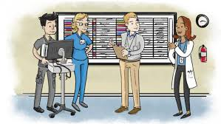
Interprofessional Education
What is the definition of an interprofessional activity?
An interprofessional activity is a continuing educational activity that incorporates the educational needs that underlie the practice gaps of the healthcare team and their members.
Interprofessional activities must be designed to change the skills/strategy, or performance, of the healthcare team or patient outcomes as described in an organization's mission statement.
Interprofessional activities also reflect the healthcare team's current or potential scope of practice.
For an official definition, please view our website: http://www.jointaccreditation.org/ce-planning-implementation.

Slide 4
Planning process for Interprofessional Education
The planning process for education activities classified as "interprofessional" must demonstrate:
• An integrated planning process that includes health care professionals from two or more professions.
• An integrated planning process that includes care professionals who are reflective of the target audience members the activity is designed to address.
• The intent to achieve outcome(s) that reflect a change in skills, strategy, or performance of the health care team and/or patient outcomes.
• Reflection of one or more of the interprofessional competencies to include: values/ethics, roles/responsibilities, interprofessional communication, and/or teams/teamwork.

Slide 5
Application for Joint Accreditation
Mass General Brigham’s Continuing Professional Development and the Norman Knight Center have been working in collaboration for Joint Accreditation
We submitted the Intent to Apply form on October 1, 2020
We received notice on November 16, 2020 that we can proceed with our Joint Accreditation application
Next Steps over the next year
Submit list of our educational activities to the Joint Accreditation
Joint Accreditation will inform us which activity files will be reviewed
We will set up an interview date
We will submit a self-study and activity files requested
Interview
Receive decision by December 31, 2021

Slide 6
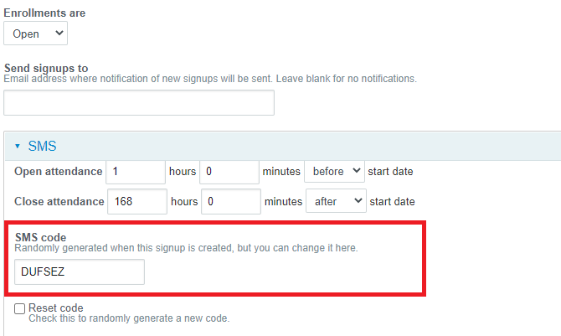
Updating a Session’s SMS Code for Attendance
Steps for changing automatically generated SMS code:
Navigate to the session that has just been approved
Click ‘Enrollments’ on bar at top of page
Then click ‘Settings’ in green area at top of page
Edit the text currently in the SMS code box and click ‘save configuration’ at the bottom of the page

Slide 7
Covid-19 Rapid CME Approval: Ending 12/31/20
In April, we rolled out a special rapid CME approval process for Covid-19 activities
We were able to do so because the ACCME loosened some requirements, especially around speaker disclosure.
At the time, there were no likely commercial interest conflicts because the topic was so new.
Now, we have 2 vaccines as well as medicines used to treat patients Covid-19.
Therefore, the ACCME has set 12/31/20 as the last day that the rapid CME approval process can be used.

Slide 8
Covid-19 CME: Important Changes
 | Rapid CME: Retiring Dec. 31, 2020 | Standard Process: Phasing in as of November 19, 2020
Course proposal | Special Covid-19 Rapid CME online form | Standard CME proposal for new courses: on cpd.partners.org
Speaker disclosure | Confirm that speaker is not owner or employee of pharmaceutical or device company | Have speaker fill out disclosure and attestation form
Disclosure summary | Not required | Required – see next slide
Evaluation | Course director fills out short evaluation form at end of activity | Standard evaluation process of evaluation at end of activity for all participants
In-hospital series session approval | Put in comments box that activity is Covid, confirm speaker is not owner or employee of pharmaceutical or device company | Upload disclosure, attestation and (if relevant) COI.
Fee | During the surge in March & April, we did not charge any fees for Covid education. In May and June we started charging fees again. | Standard accreditation fees apply.

Slide 9
SMS Code, Disclosure Summary, & Accreditation Statement
SMS Code for Attendance: XX
FACULTY DISCLOSURE STATEMENTS In accord with the disclosure policy of Mass General Brigham as well as guidelines of the Accreditation Council for Continuing Medical Education (ACCME), planners, speakers and anyone who may have an influence on the content of the activity have been asked to disclose any relationship they or their spouse/partner have to companies producing pharmaceuticals, medical equipment, devices, etc. that may be germane to the content of their presentation. Such disclosure is not intended to suggest or condone bias, but provides participants with information that might be of potential importance to their evaluation of a given presentation.
RESOLUTION OF CONFLICTS OF INTEREST (COI) Mass General Brigham has implemented a process to resolve potential COIs for this CME activity to help ensure content objectivity, independence, fair balance and ensure that the content is aligned with the interest of the public. The following planners and/or their spouse/partner have reported no relevant financial relationship with a commercial interest: XX
The following planners and/or their spouse/partner have reported a relevant financial relationship with a commercial interest: XX The following speaker and/or their spouse/partner have reported no relevant financial relationship with a commercial interest: XX
The following speaker and/or their spouse/partner have reported a relevant financial relationship with a commercial interest: XX
ACCREDITATION Mass General Brigham is accredited by the Accreditation Council for Continuing Medical Education to provide continuing medical education for physicians. Mass General Brigham designates this live activity for a maximum of XX AMA PRA Category 1 Credit TM. Physicians should claim only the credit commensurate with the extent of their participation in the activity.

Slide 10
Covid-19 CME: Next Steps
Please continue to submit your Covid-19 education programs to us!
We will review all activities according to the standard CME process.
Thank you for submitting Covid-19 CME in 2020!
With your help we provided:
Total # of attendees: 15,430
Total # of credits granted/claimed: 15,541

Slide 11
Mass General Brigham Continuing Professional Development is the system-wide sponsor for the American Board of Medical Specialties (ABMS) Portfolio Program. Our goal is to help Mass General Brigham-affiliated physicians and physician assistants fulfill ABMS Maintenance of Certification (ABMS MOC®) Improvement in Medical Practice (Part IV) requirements.

Slide 12
Quality Improvement MOC (MOC IV) Credits for Covid-19
As an ABMS Portfolio Program Sponsor, we can help physicians and physician assistants receive continuing certification credit from an ABMS Member Board for the incredibly important work they have done related to the pandemic. The ABMS has simplified the process for MOC performance-in-practice for work related to the pandemic. All they need to do is fill out a brief attestation and reflection about their work with the appropriate information.

Slide 13
Instructions for 2020 Covid-19 MOC IV
These instructions in this email are for physicians or physician assistants who need MOC IV credit for 2020.
To receive MOC IV credit for 2020, physicians should follow the steps on the next slide for both themselves and their supervisor.
We will follow up with instructions for how to submit for your work related to the pandemic for 2021 credit in early January.

Slide 14
Instructions for Covid-19 MOC IV
Physician or physician assistant:
Determine if you need MOC IV credit for 2020.
Confirm that your specialty board participates in the ABMS Portfolio program. View a list of participating boards here.
Fill out the attestation form. Click here to download.
Give the form to your supervisor for signature & ask them to return it to you. You will upload the form to your online reflection in the next step.
Fill out the online reflection form by 12/1/2020. Click here to go to the online reflection form for 2020.
Supervisor:
Sign the attestation form confirming your participation.
Provide the form to you by 12/1/2020.

Slide 15
Thank you & Covid-19 MOC IV Contact Information
On behalf of the Mass General Brigham Continuing Professional Development, thank you to all health care providers, for your continued dedication to the care of our patients.
The goal for the Covid MOC is to provide the opportunity to receive credit for the work providers did, recognizing that they were focused on providing care and not planning out projects with baseline data, PDSA cycles, and formal outcomes data during the Covid surges.
If you have any questions, please contact us at phsmoc@partners.org.

Slide 16
Covid-19 MOC IV Important links
American Board of Medical Specialties (ABMS) Portfolio Program:
https://mocportfolioprogram.org/
View a list of participating boards here:
https://mocportfolioprogram.org/about-us/abms-member-board-participation/
Click here to download attestation form:
https://www.dropbox.com/s/e03bsvxinhoie0t/ABMS-Physician-Attestation-%20COVID-19%20_Updated_2020_FINAL.docx?dl=0
Click here to go to the online reflection form for 2020:
https://cpd.partners.org/content/covid-19-project-reflection-2020#group-tabs-node-course-default1

Slide 17
Questions & Answers

Slide 18
In closing
Thank you for attending today’s meeting!
We wish all of you a very Happy Holiday Season. We will see you next year in 2021
Next meeting: An invite will be sent out
We welcome suggestions on topics for our webinars
These slides will be available on our website
Reminder to please send all CME questions to PartnersCPD@partners.org
Important links:
Course Coordinator Virtual Community:
https://cpd.partners.org/series-coordinators

