Slide 1


Supporting Our Continuing Education Community Webinar
Continuing Professional Department (CPD)
April 9, 2020 – COVID-19

Slide 2
Today’s goal:
We are glad you could join us for our second Zoom meeting.
Today we will address questions we have been receiving regarding the Rapid CME Proposal for COVID-19.
We will also address some questions from last week.
If time permits, we will answer some chat questions at the end of the presentation.
  Please send questions to PartnersCPD@partners.org, Subject line: CPD Webinar, and will address questions at each meeting

Slide 3
Rapid CME Proposal for COVID-19 related content
As we reviewed last week, per our accreditor, ACCME, COVID-19 learning and training activities can receive CME credit under different guidelines. We have a proposal form, Rapid COVID-19 CME Proposal, that can be used for coronavirus educational activities.
  Link to form: https://av192.infusionsoft.com/app/form/web-form-submitted1
Examples of activities include: bedside learning, phone interview with a faculty member who will be having a COVID-19 discussion later that day, Emergency Department morning brief, etc.
Currently, we do not need to collect COVID-19 planner or speaker disclosure forms, resolve or disclose information. Please note, as always, employees or owners of pharmaceutical companies or device manufacturers should not facilitate any activity.

Slide 4
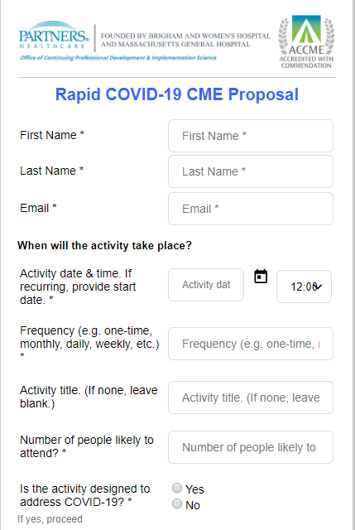
Example of COVID-19 rapid proposal form. The form is mobile friendly and can also be filled out on the computer.
We will step you through the process and make it as simple as possible.

Slide 5
Two Types of Requests for the Rapid CME Proposal for COVID-19
As we review the submissions for the Rapid CME Proposal for COVID-19, we realize that we were receiving two types of requests
Type 1: In-Hospital Series Process for COVID -19 Sessions
Type 2: Requests for new COVID-19 activities
We have a different process for each type of request

Slide 6
Type 1: In-Hospital Series Process for COVID -19 Sessions
Sessions related to COVID-19 within an established in-hospital series should follow the same steps as a regular in-hospital series session (please do not submit the rapid CME proposal form for these sessions)
An email will be sent to Emily Welch to review the information you have provided. Once the session has been approved, you will receive an email stating the SMS code for attendance is available. The SMS code will be posted on the session website. (The SMS code is only visible to those wo are “administrative members” on the site.)

Slide 7
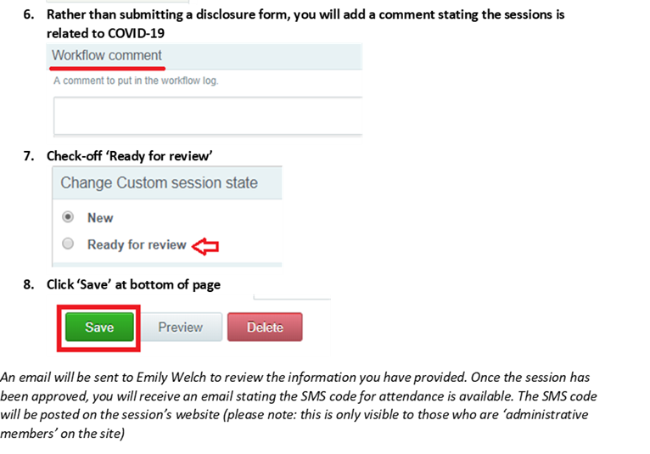
Type 1: In-Hospital Series Process for COVID -19 Sessions
The process for submitting a session related to COVID-19 for approval is relatively the same as submitting a regular session for approval except rather than submitting a speaker disclosure form, you will add a note in the ‘workflow comment’ section stating the session is related to COVID-19

Slide 8
Type 2: Requests for new COVID-19 activities
Course director sends Rapid CME COVID-19 proposal form.
CPD will review the form and send an email for clarification if needed.
CPD will send an approval email for the Rapid CME COVID-19 proposal within two business days of receiving.
  The approval email will include the CME accreditation statement, attendance spreadsheet, and evaluation form.
  We will build the course on our LMS, EthosCE. We will send you a link to the course.
  Accreditation statement needs to be disclosed to learners. The statement will also be online.
Once course is completed, Course Director/Coordinator will send the attendance sheet and evaluation form back to CPD within two weeks of activity date.
The credits will be on the learners transcript.

Slide 9
Follow-up to last weeks (4.2.20)questions during our Zoom meeting
Can we use texting for attendance?
Yes, you can use texting for attendance. We will work with you on a case by case basis.
Can we receive credit for activities that have happened in the past?
Please only submit activities that are happening in the future. If you are submitting a series of calls, for example, we can start accrediting future calls within 1-2 days in the future.
Can participants receive credit for activities that are not done in real time?
Yes, we will accredit it as an internet enduring activity. We will work with you to make sure that the activity meets all requirements for CME and the participants have a method to claim credit.

Slide 10
Series Coordinator Learning Group
Be sure to check out the series coordinator virtual learning space!
Examples of discussions going on:
  Managing attendance for virtual meetings
  Best practices for virtual meetings
Examples of questions that have been posted:
  Does anyone have any guidance on who they assigned as the designated meeting leader/moderator for your virtual sessions?
Log on to connect with other coordinators to share ideas!
  Link: https://cpd.partners.org/series-coordinators

Slide 11
Conclusion
We have established the steps for the Rapid COVID-19 CME
Please provide feedback on the Rapid COVID-19 CME process and how it is working for you
These slides will be available on our website
Please send all CME questions to PartnersCPD@partners.org, Subject line: CPD Webinar, and will address questions at each meeting
Important links:
  Rapid COVID-19 CME Proposal:
    https://av192.infusionsoft.com/app/form/web-form-submitted1
  CPD COVID-19 Resource Page:
    https://cpd.partners.org/content/covid-19-resource-page
  Course Coordinator Virtual Community:
    https://cpd.partners.org/series-coordinators

