Slide 1
Supporting Our Continuing Education Community Webinar
Continuing Professional Department (CPD)
September 10, 2020 – COVID-19

Slide 2
Today’s goal:
Thank you for joining us today.
Today we welcome a special guest speaker, Janice C. Palaganas, PhD, APRN, ANEF, FNAP, FAAN, FSSH. Dr. Palaganas will present on Virtual Education Best Practices & Innovative Approaches.
If time permits, we will answer some chat questions at the end of the presentation.
Please send questions to PartnersCPD@partners.org, Subject line: CPD Webinar, and we will address questions at each meeting.
This webinar is being recorded.

Slide 3
Virtual Education Best Practices & Innovative Approaches
Dr. Robert J. Birnbaum, MD, PhD: Course Director & Planner
Vice President, Professional Development & Implementation Science Director, Healthcare Knowledge Translation & Engineering Laboratory Assistant Professor of Psychiatry, Harvard Medical School
Rose Desilets, MBA: Speaker & Planner
Senior Business Manager, Mass General Brigham Continuing Professional Development
Mary Gelardi, MBA: Speaker & Planner
Administrative Director, Mass General Brigham Continuing Professional Development
Janice C. Palaganas, PhD, RN, NP, ANEF, FNAP, FAAN, FSSH: Speaker & Planner
Associate Director of Health Professions Education at Massachusetts General Hospital Institute of Health Professions Assistant Professor, Department of Anesthesia & Adjunct Professor of Interprofessional Studies, Harvard Medical School

Slide 4
Virtual Education Best Practices & Innovative Approaches
Target Audience:
Medical educators throughout Mass General Brigham
Learning Objectives:
Upon completion of this activity, participants will be able to:
Discuss findings from recent research on effective methods for virtual education.
List innovative formats and technologies for virtual education.
Apply best practices to upcoming virtual educational activities.
Apply innovative formats to upcoming virtual educational activities.

Slide 5
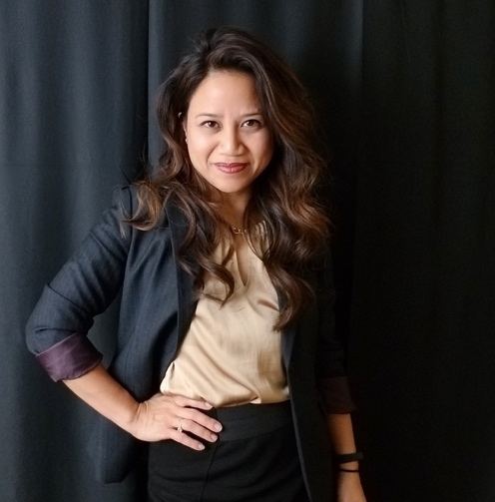
Today’s Speaker: Janice C. Palaganas, PhD, RN, NP, ANEF, FNAP, FAAN, FSSH
Dr. Janice Palaganas is the Associate Director of Health Professions Education at Massachusetts General Hospital Institute of Health Professions (MGH IHP) and Assistant Professor at Harvard Medical School, Department of Anesthesia, as well as Adjunct Professor of Interprofessional Studies.
Read Dr. Palaganas’ full bio on the activity web site:
https://cpd.partners.org/content/supporting-our-continuing-education-community-webinar-virtual-education-best-practices#group-tabs-node-course-default1

Slide 6
Conclusion
Dr. Janice C. Palaganas presented on Virtual Education Best Practices & Innovative Approaches.
Upcoming meeting reminders:
October 15: Next meeting
November 5: Guest speaker Dr. Jim Gordon, MD, Chief Learning Officer, Mass General
We welcome suggestions on topics for our webinars.
These slides will be available on our website.
Time to answer some chat questions.
Please send all CME questions to PartnersCPD@partners.org,
Subject line: CPD Webinar
Important links:
Rapid COVID-19 CME Proposal:
https://av192.infusionsoft.com/app/form/web-form-submitted1
CPD COVID-19 Resource Page:
https://cpd.partners.org/content/covid-19-resource-page
Course Coordinator Virtual Community:
https://cpd.partners.org/series-coordinators

Slide 7
See you on October 15th! Stay safe, happy and healthy!!!

