Slide 1
Aortic Aneurysm
Samir K Shah, MD

Slide 2
Aneurysm
Definition
Epidemiology
Treatment
Electively
Ruptures
NO coverage of
Pathogenesis/structural modeling research
Non-aortic aneurysms
Controversies of EVAR vs open aneurysm
Complex endovascular repair

Slide 3
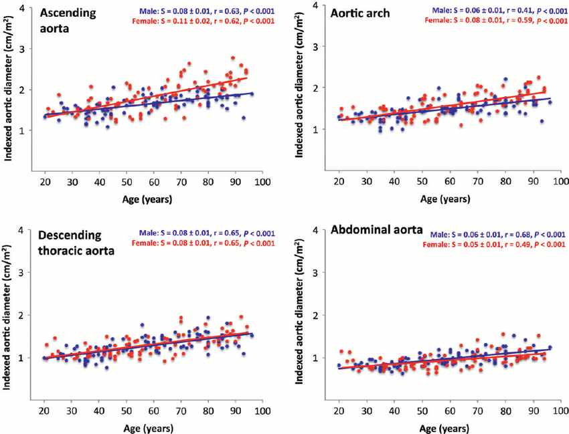
Aneurysm Definition
50% increase above nominal diameter
Practical definition of an AAA: 3 cm
Notes:
Will not discuss other critical management decisions: conduit type, tunneling and conduit orientation etc.

Slide 4
Epidemiology
>1 m in the US
Risks factors?
Notes:
Will not discuss other critical management decisions: conduit type, tunneling and conduit orientation etc.

Slide 5
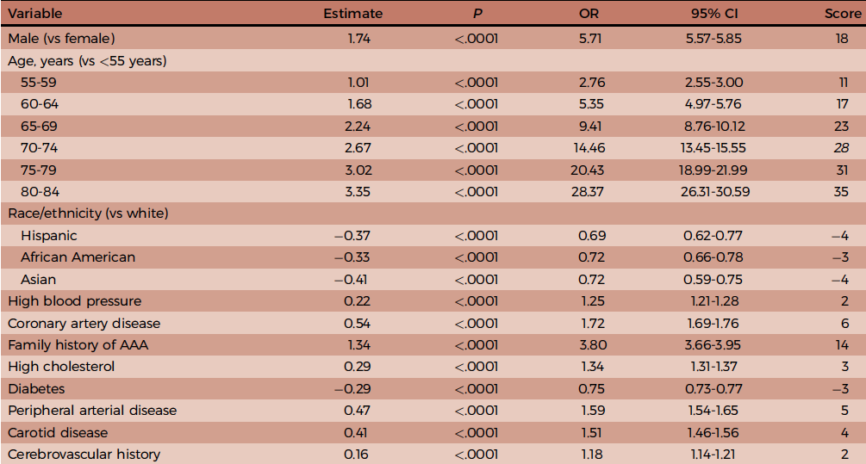
Risk Factors
Notes:
Will not discuss other critical management decisions: conduit type, tunneling and conduit orientation etc.

Slide 6
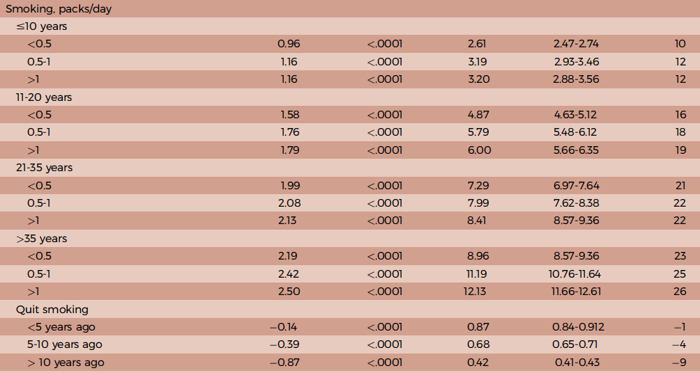
Risk Factors
Notes:
AAA has strongest epidemiologic association with smoking after lung cancer

Slide 7
Smoking
Dose effect
Quitting is beneficial
Reduces risk of development
Retards aneurysm growth
AAA-mortality has been decreasing in the US
Remains unchanged in countries where smoking rates have not declined

Slide 8
Risk Factors for Rupture
Related but distinct from risk factors for aneurysm development
Female gender
Current smoking
Larger AAA diameter
Elevated MAP

Slide 9
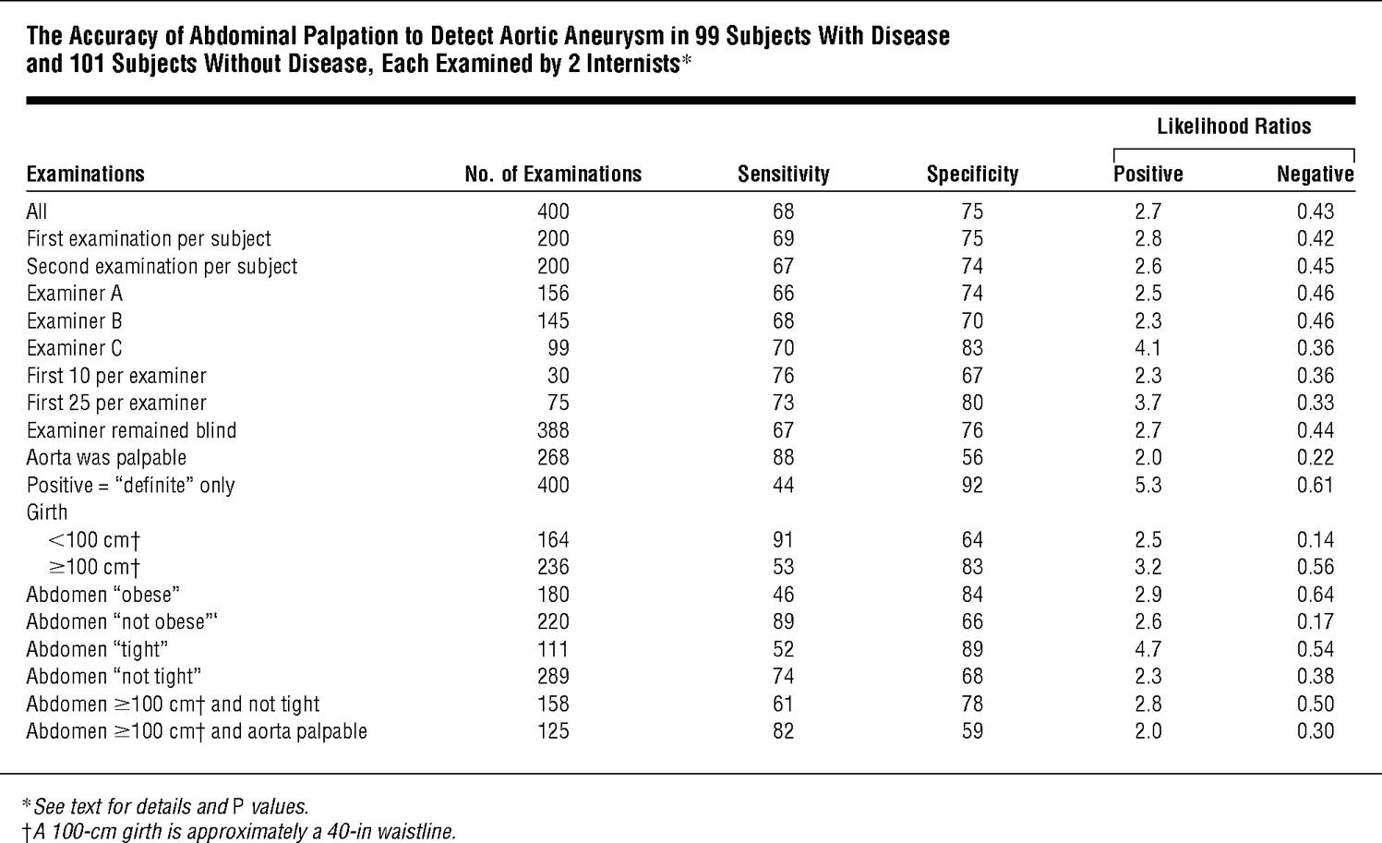
Diagnosis By Physical Examination
Notes:
Positive LR is the increase in odds with presence of the finding

Slide 10
Vertebral Levels
Diaphragmatic hiatus
T12
Renal arteries
L1-2
Aortic bifurcation
L4 (umbilicus)

Slide 11
Diagnosis – Imaging
Ultrasound
Nearly 100% sensitivity/specificity
Operator dependent; effect on diameter?
CT/MR
AAA 2 mm larger on CT than on US
Axial imaging imperfect
Overcome with awareness (and reprocessing software)

Slide 12
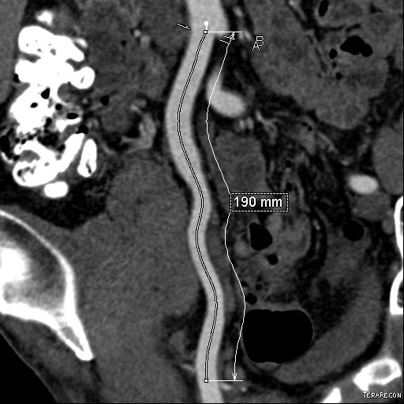
Centerline Measurements

Slide 13
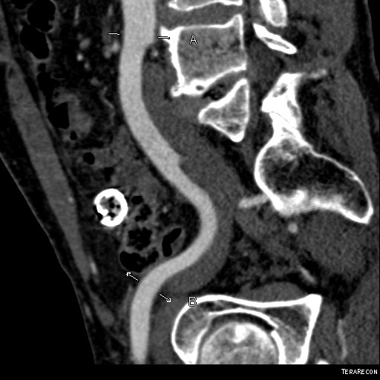
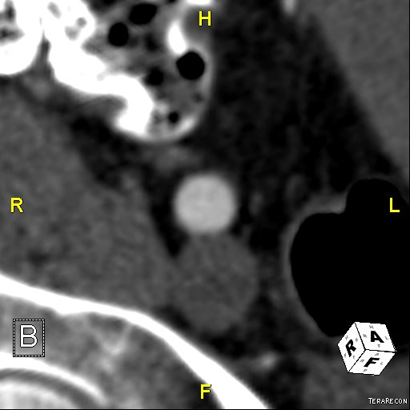
Orthogonal Diameter Measurements

Slide 14
Centerline vs Straight Distance

Slide 15
Management of Small Aneurysms
4 cm aneurysm?
Notes:
Will not discuss other critical management decisions: conduit type, tunneling and conduit orientation etc.

Slide 16
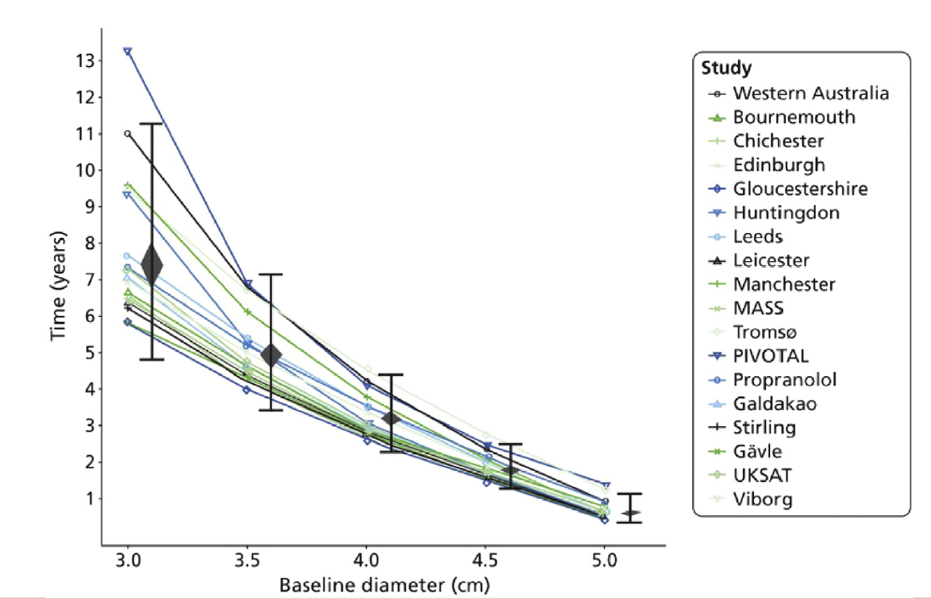
Time to 10% Probability of Achieving 5.5 cm

Slide 17
Management of Small Aneurysms
ADAM and UKSAT: 30-d increased mortality for treatment of 4.0-5.4 cm AAA
No difference in long-term survival
Surveillance strategy
3-3.9 cm: q3y
4-4.9 cm: q1y
5-5.4 cm: q6m
Average AAA growth/y: 2.2 mm
Notes:
Will not discuss other critical management decisions: conduit type, tunneling and conduit orientation etc.

Slide 18
Management of Small Aneurysms
What about endovascular aneurysm repair (EVAR)?
Comparison of Surveillance versus Aortic Endografting for Small Aneurysm Repair (CAESAR) and Positive Impact of Endovascular Options for Treating Aneurysms Early (PIVOTAL)
EVAR vs surveillance for 4 (or 4.1) cm to 5.4 cm
No survival benefit to EVAR
Notes:
Will not discuss other critical management decisions: conduit type, tunneling and conduit orientation etc.

Slide 19
Indications for Repair
5.5 cm
5.0 cm (women)
Growth of at least 5 mm/6 months
Symptomatic
Complicated (e.g. distal embolization)
Saccular (?)
Notes:
Will not discuss other critical management decisions: conduit type, tunneling and conduit orientation etc.

Slide 20
Endovascular vs Open Repair
Anatomy
Neck length, angulation, diameter, calcification, thrombus, morphology
Operative risk
EVAR is not trivial
EVAR 2 trial with 8.4% 30-d mortality for EVAR in patients unfit for open surgery (controversial)
Willingness to comply with lifelong surveillance
Tradeoff in type of reinterventions, complications (e.g. hypogastric artery) and recovery
Notes:
Will not discuss other critical management decisions: conduit type, tunneling and conduit orientation etc.

Slide 21
Late Follow-up of the DREAM Trial

Slide 22
Late Follow-up of the DREAM Trial

Slide 23
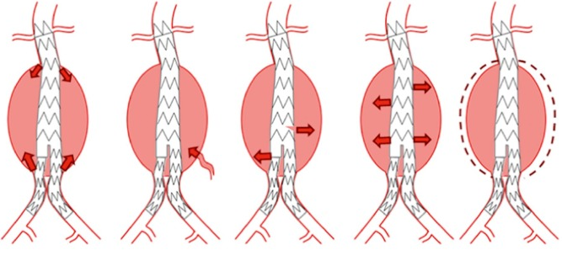
Endoleaks
Notes:
90% power to detect a difference of 5%
Each center had to do at least 50 cases yearly

Slide 24
Immediate Management of Patients with Rupture: Open Versus Endovascular repair (IMPROVE)
30 centers (UK, Canada), 2009-2013
Clinical diagnosis of rupture, randomized to open or endovascular repair
316 endovascular vs 261 open
Primary endpoint: survival at 30 d
Well-designed
Audit of centers for volume and results
CTA capability within 20 min of arrival
Included ill patients (>50% of patients had SBP<90 mm Hg)
Powell JT, et al. BMJ. 13(348): f7661
Notes:
90% power to detect a difference of 5%
Each center had to do at least 50 cases yearly

Slide 25
IMPROVE Trial
True rupture: endovascular 87%, open 88%
Endovascular arm
64% EVAR eligible
Unadjusted OR for 30-d mortality in endo vs open: 0.92 (0.66-1.28, p=0.62)
Adjusted OR (age, sex, Hardman index): 0.94 (0.67-1.33, p=0.73)
30-d mortality for confirmed rupture were nondifferent
36.4 (endovascular) vs 40.6%, p=0.31
Notes:
Most common reason for lack of EVAR eligibility was neck anatomy
Hardman index is a validated scoring system for ruptured aneurysms – uses 5 dichotomized variables: hemoglobin (9), creatinine, age (76), MI or ECG, pre-hospital LOC

Slide 26
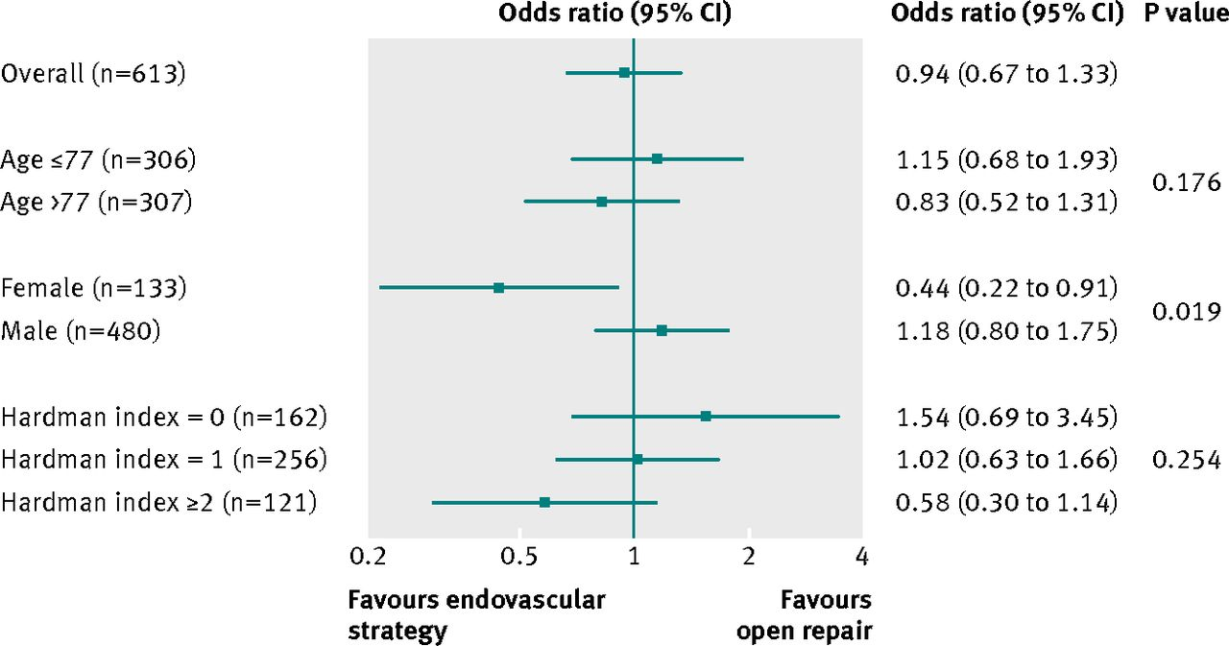
IMPROVE Trial
Notes:
Women seem to have better outcomes than men; otherwise no subgroup differences

Slide 27
IMPROVE Trial Outcomes
24-hour mortality: 22% (E) vs 19% (O) – nondifferent
30-d reinterventions – nondifferent
Shorter LOS for endovascular
ICU 4.2 vs 6.3 d
Total hospital 9.4 vs 12 d
Superior discharge to home for endovascular: 94 vs 77% (p<0.001)

Slide 28
ECAR and AJAX
Smaller trials
Randomized only after determining eligibility for EVAR
Excludes worst off patients
No difference in 30-day mortality
Pooled analysis from all 3 trials for 30-d mortality: endovascular vs open OR 0.88 (0.66-1.18)
Reimerink JJ, et al. Ann Surg. 258(2): 248-56

Slide 29
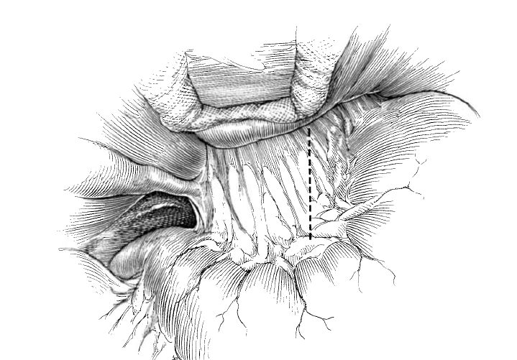
Supraceliac Control

Slide 30
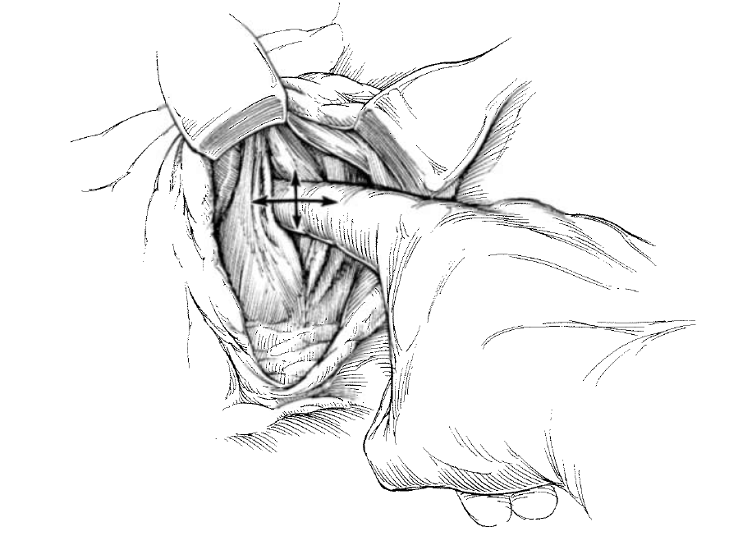
Supraceliac Control

Slide 31
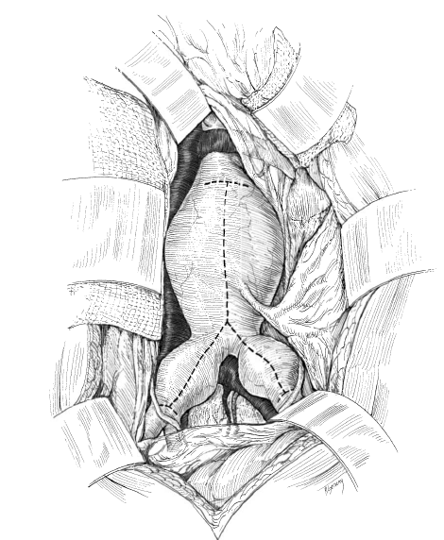
Aortotomy

Slide 32
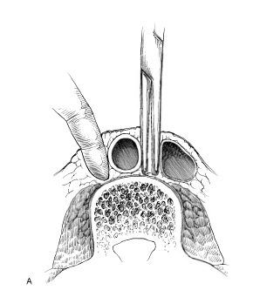
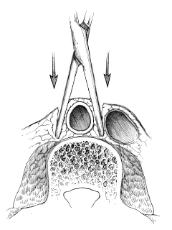
Aortic Dissection

Slide 33
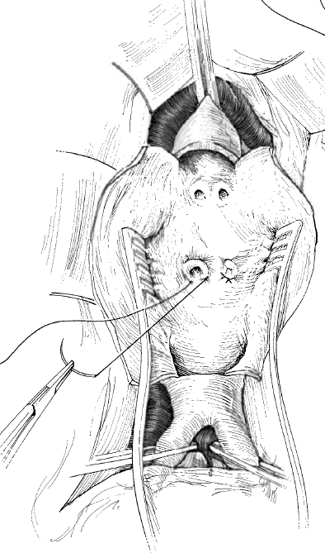
Control of Lumbar Vessels

Slide 34
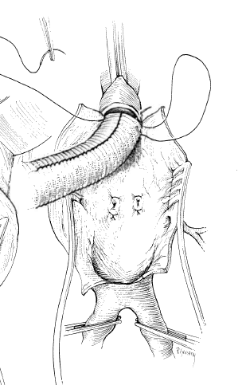
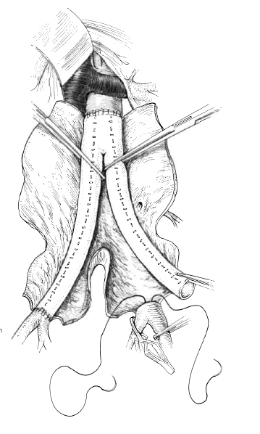
Aortic Reconstruction

Slide 35
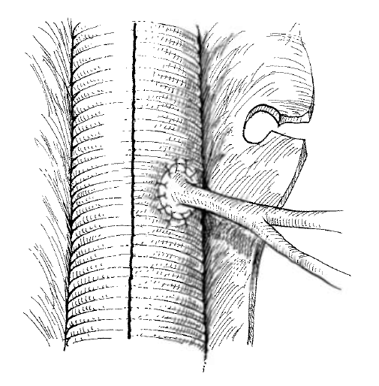
IMA Management

Slide 36
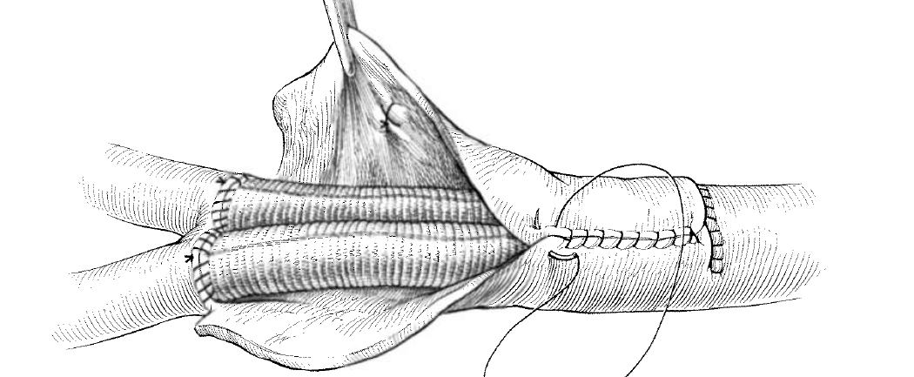
Aneurysm Sac Closure

Slide 37
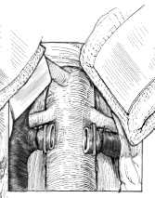
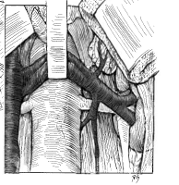
Infrarenal Exposure

