Slide 2
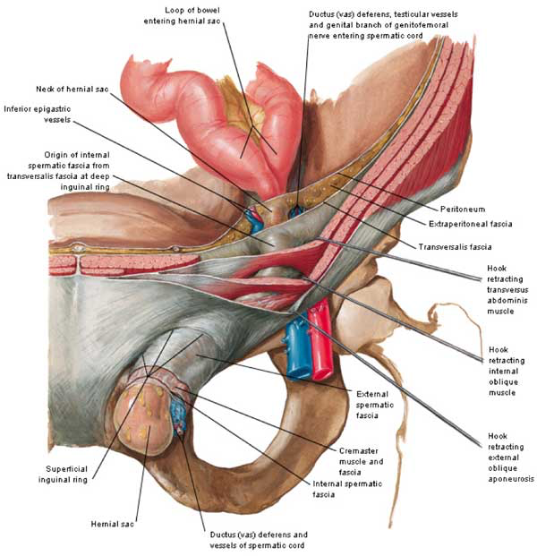
Inguinal Anatomy
Notes:
Deep ring – at level of transversalis fascia
Superficial ring – at level of external oblique
Spermatic cord, ilioinguinal nerve, and genital femoral nerve travel through canal

Slide 3
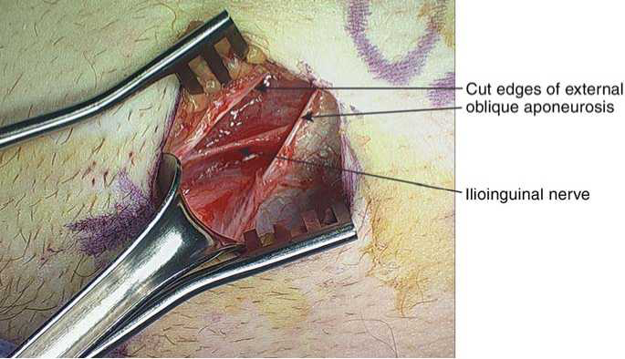
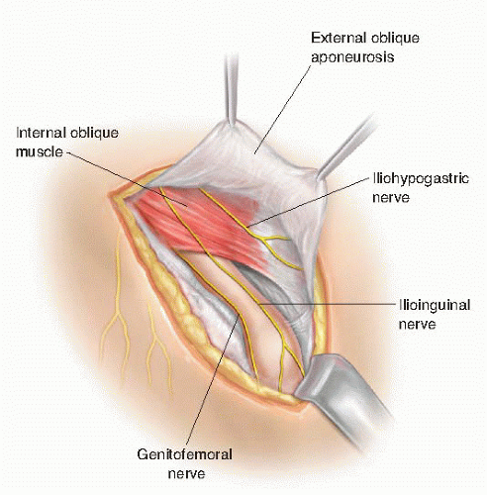
Important
Nerves
-Ilioinguinal: upper & medial thigh, scrotum, penis, labia, mons pubis
-Genitofemoral: upper anterior thigh, scrotum, mons pubis, cremasteric reflex
-Iliohypogastric: above the pubis, lateral gluteal region

Slide 4
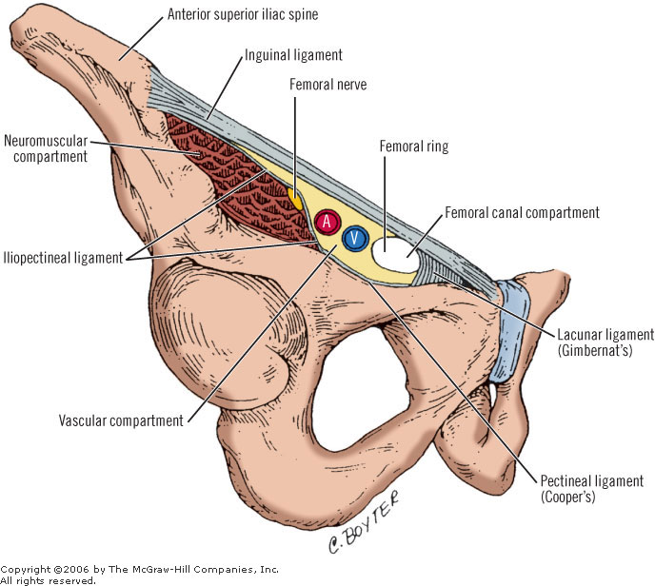
Confusing Ligaments/Tendons
Inguinal ligament (Poupart): inferior edge of external oblique
Extends from ASIS to pubic tubercle
Lacunar ligament (Gimbernat): triangular extension of inguinal ligament before insertion on pubic tubercle
Cooper’s ligament (Pectineal): formed by periosteum and fascia along superior ramus of pubis
Conjoined tendon: fusion of internal oblique and transversus abdominis aponeurosis

Slide 5
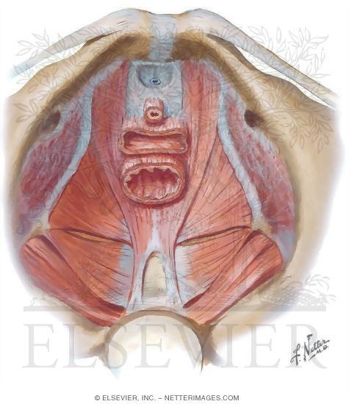
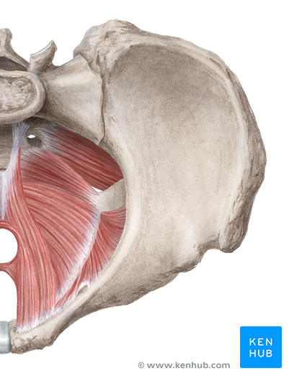
Inguinal ligament (Poupart)
Cooper’s ligament
Inguinal ligament
Cooper’s ligament

Slide 6
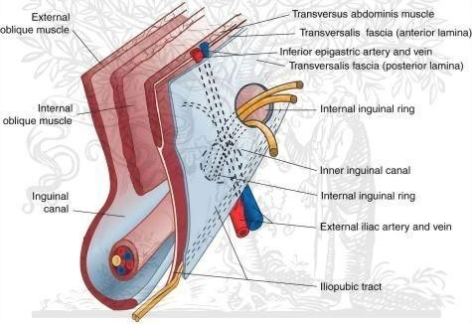
Borders of the Inguinal Canal
Notes:
Anterior wall: ext oblique
Superior wall: internal oblique and trannsversus abdominis
Posterior wall: Transversus abdominus, transversalis
Inferior wall: Inuginal ligament, iliopubic tract – (thickening of transversalis fascia as it approaches inguinal ligament

Slide 7
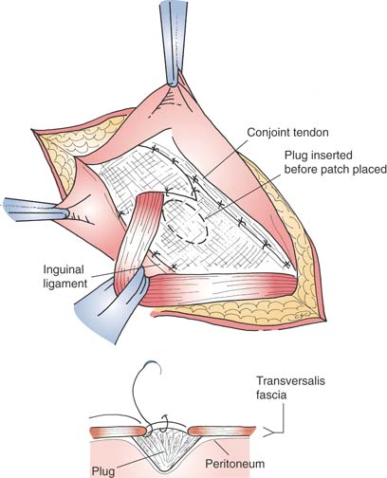
Lichtenstein
Medial edge to fascial attachments of pubic tubercle
Inferior edge of mesh sutured to shelving edge of inguinal ligament
Superior portion sutured to conjoined tendon
Slit made in mesh in lateral edge to accommodate spermatic cord
PLUG AND PATCH modification: plug placed in defect, lichtenstein repair performed on top of the plug
Notes:
Tension Free

Slide 8
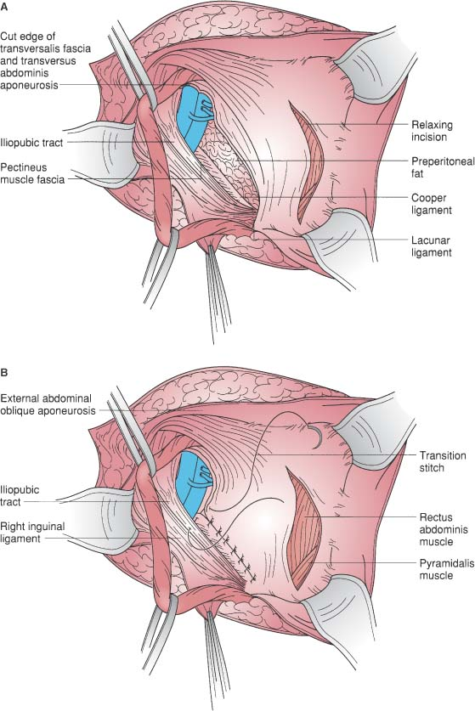
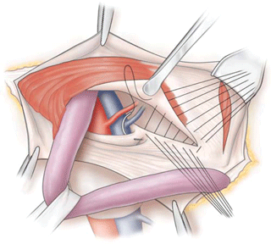
McVay
Expose Cooper’s ligament
Make relaxing incision in anterior rectus sheath
Inguinal floor repaired by sewing the conjoined tendon to Cooper’s ligament beginning at pubic tubercle
As femoral vein is approached, transition stich placed that progresses repair from deep plane of Cooper’s ligament to more superficial plane of inguinal ligament - brings the repair above the femoral vessels
Notes:
-Tension repair closing deeper layers
-Can also be used in femoral hernias

Slide 9
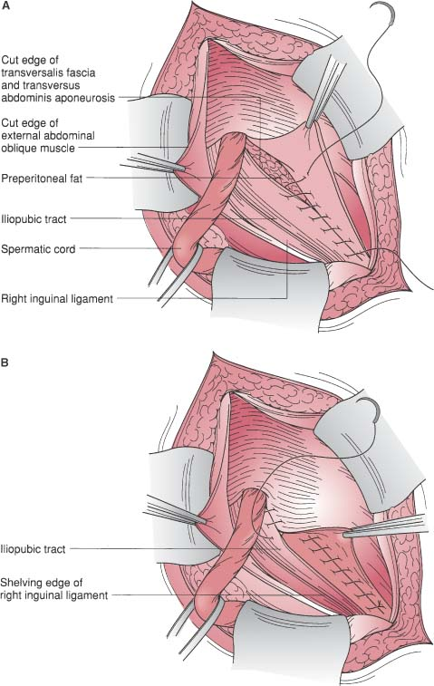
Shouldice
Transversalis fascia divided from the internal ring to the pubic tubercle creating upper and lower flaps
Four layered closure:
Start at pubic tubercle to internal ring – overlap upper and lower flaps of transversalis and sew together in two layers
Start at internal ring: Conjoined tendon (transversus abdomins and internal oblique) to inguinal ligament, at the pubic tubercle turn the suture line around
Notes:
-More layers and uses deeper layers, more secure than the superficial layers of the Bassini
-High tension repair – swelling, poor healing, pain

Slide 10
Bassini (late 19th century)
Conjoined tendon & transversalis fascia sutured to shelving edge of the inguinal ligament
Notes:
-Only 1 layer, lower tension but higher recurrence rates

Slide 11
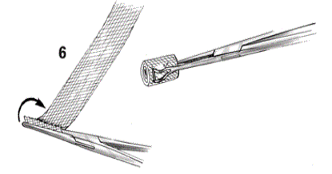
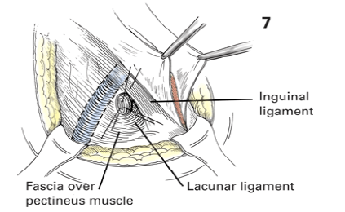
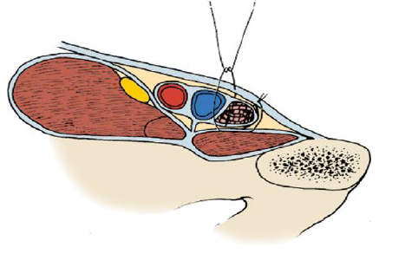
Femoral Hernia Repair from Below – Cigarette Mesh Plug

