Slide 1
Supporting Our Continuing Education Community Webinar
Continuing Professional Department (CPD)
April 29, 2020 – COVID-19

Slide 3
Today’s goal:
Thank you for joining us today.
Today we are going to revisit last week’s polling and lessons learned.
We will review CPD’s Course Coordinator Virtual Community, and also give you an update on the in-hospital series for academic year 2020-2021.
We will also review the updated accreditation slide that must be disclosed to learners prior to any activity.
If time permits, we will answer some chat questions at the end of the presentation.
Please send questions to PartnersCPD@partners.org, Subject line: CPD Webinar, and will address questions at each meeting

Slide 4
Polling – Lesson learned
Last week we attempted polling but encountered a problem.
We learned that our “glitch” was two members of our team were logged in as Partners CPD which prevented us from conducting the poll.
Once we fixed the logon issue, the polling worked for us.
Zoom polling instructions:
https://support.zoom.us/hc/en-us/articles/213756303-Polling-for-Meetings

Slide 5
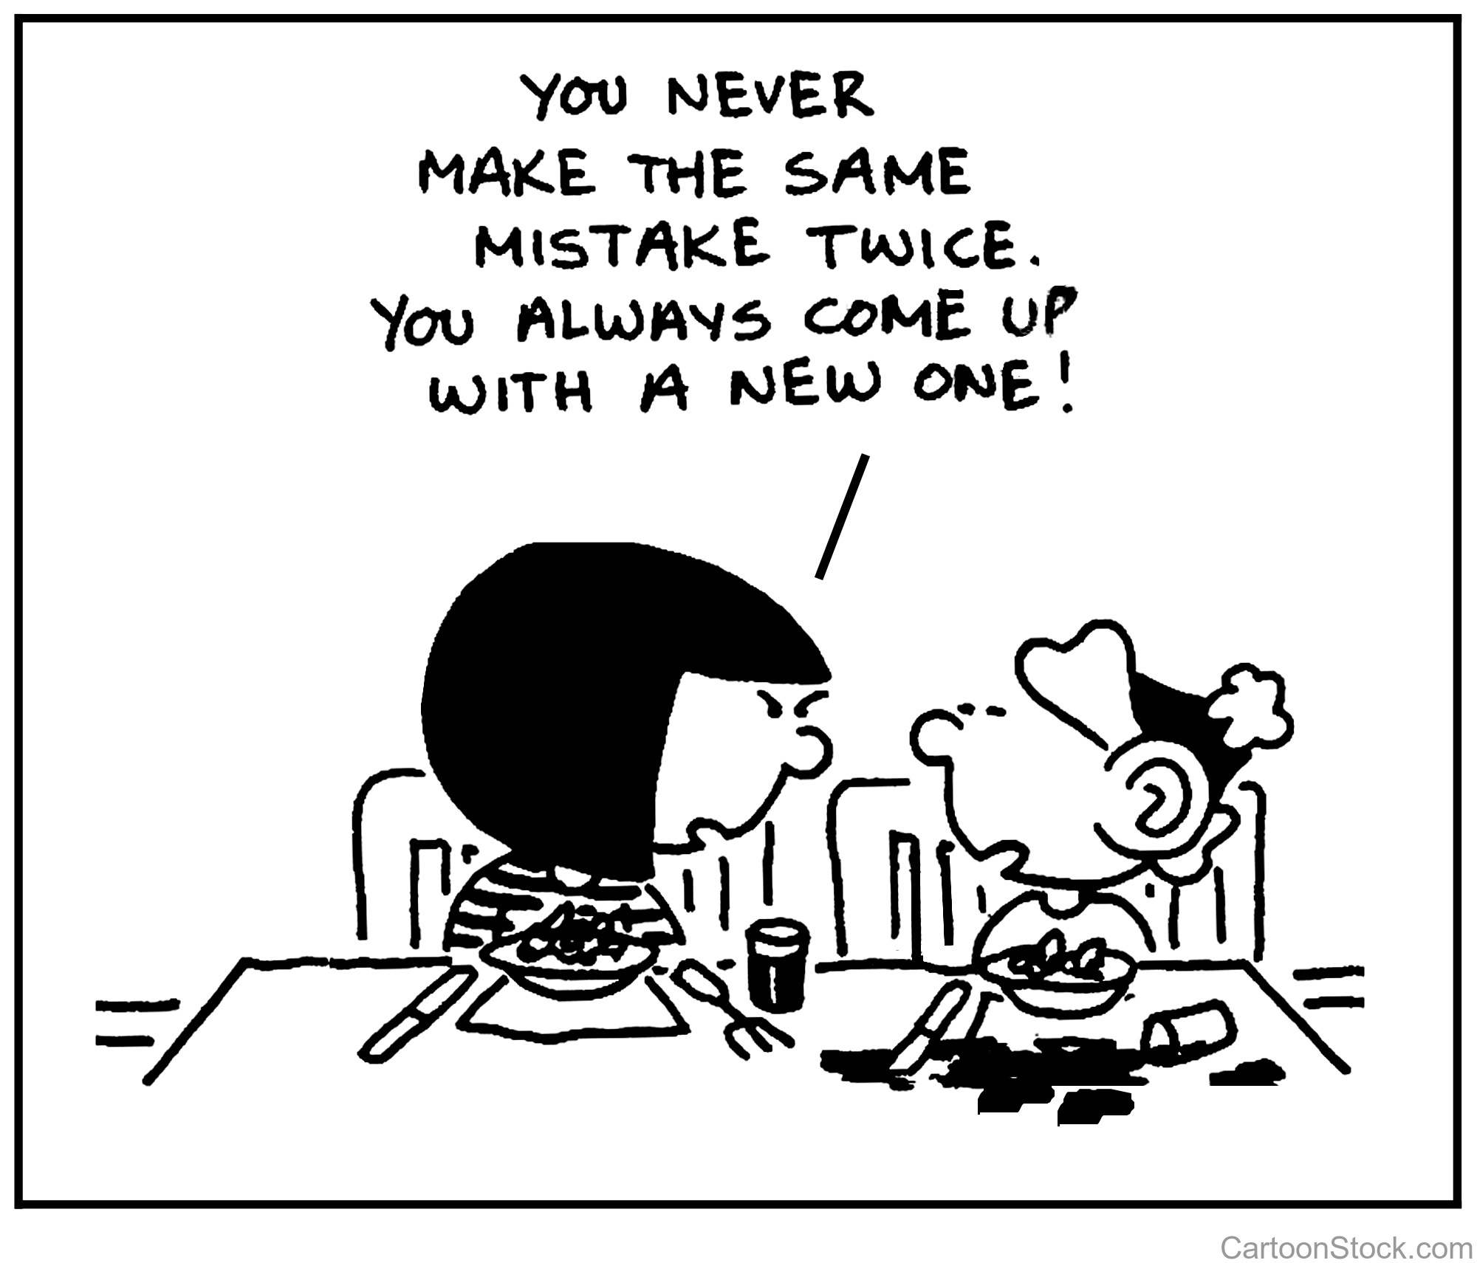
Polling – Lesson learned
Practice what you will do if your original plan doesn’t work.
Assign a backup co-presenter with access to meeting controls.
Make practice sessions as similar to the real presentation situation as you can.
The only way to learn how to do something is to try it!

Slide 6
Polling
Why use polling in your virtual meeting?
Promote audience engagement
Receive real-time feedback from participants
Generate higher response rate than if you ask the questions outside of the meeting
Ways to use polling
Create an icebreaker and get the interaction started
Let your audience pick the content
Get input on the meeting
Polling & CME
Generate a quick needs assessment
Obtain pre- or post-test data
More info on polling from Zoom:
https://blog.zoom.us/wordpress/2016/09/20/3-ways-to-use-polls-in-meetings/

Slide 7
In-Hospital Series Update Academic year 2020-2021
We have sent the emails for the academic year 2020-2021 in-hospital series renewals and have already received responses.
We have heard from Brigham Women’s Hospital and Newton Wellesley Hospital.
ACCME defines in-hospital series as a live activity planned as a series with multiple, ongoing sessions, e.g., offered weekly, monthly, or quarterly.
An in-hospital series is primarily planned by and presented to the accredited organization’s professional staff and generally targets the same audience over the whole series. Examples include grand rounds, tumor boards, and morbidity and mortality conferences.
We are working with departments to switch their in-hospital series and live courses to virtual.
Please contact us with questions.

Slide 8
Course Coordinator Virtual Community
Please utilize our Course Coordinator Virtual Community which is a private discussion/help forum for in-hospital series coordinators.
Link to Course Coordinator Virtual Community: https://cpd.partners.org/series-coordinators
As a member of this group, you will have access to a number of video tutorials, as well as PDFs that outline step-by-step instructions.
We encourage you to post comments/concerns/questions and correspond with other members of the group.
Our hope is that it will provide feedback and suggestions to help facilitate an easier and more efficient way of conducting your series.
We will also bring your questions to this Thursday webinar group.

Slide 9
Accreditation Slide
In response to last weeks questions about the accreditation slide and COVID- 19, we have created two slides instead of having just one.
One slide is for COVID-19 related activities that will have the SMS code if used and the accreditation statement. Disclosures are not required for COVID-19 activities at this time.
The other slide is for unrelated COVID-19 activities that require commercial financial disclosures to learners, accreditation statement and SMS code if used.
Please be sure to put slides at the beginning of your virtual session.
Activities using the text code for attendance should put the code at the top of the slide.

Slide 10
SMS Code & Accreditation Statement – COVID-19 Activities Only
SMS Code for Attendance: XX
ACCREDITATION Partners HealthCare System is accredited by the Accreditation Council for Continuing Medical Education to provide continuing medical education for physicians. Partners HealthCare System designates this live activity for a maximum of XX AMA PRA Category 1 Credit TM. Physicians should claim only the credit commensurate with the extent of their participation in the activity.

Slide 11
SMS Code, Disclosure Summary, & Accreditation Statement
SMS Code for Attendance: XX
FACULTY DISCLOSURE STATEMENTS In accord with the disclosure policy of Partners HealthCare System as well as guidelines of the Accreditation Council for Continuing Medical Education (ACCME), planners, speakers and anyone who may have an influence on the content of the activity have been asked to disclose any relationship they or their spouse/partner have to companies producing pharmaceuticals, medical equipment, devices, etc. that may be germane to the content of their presentation. Such disclosure is not intended to suggest or condone bias, but provides participants with information that might be of potential importance to their evaluation of a given presentation.
RESOLUTION OF CONFLICTS OF INTEREST (COI) Partners HealthCare System has implemented a process to resolve potential COIs for this CME activity to help ensure content objectivity, independence, fair balance and ensure that the content is aligned with the interest of the public. The following planners and/or their spouse/partner have reported no relevant financial relationship with a commercial interest: XX
The following planners and/or their spouse/partner have reported a relevant financial relationship with a commercial interest: XX The following speaker and/or their spouse/partner have reported no relevant financial relationship with a commercial interest: XX
The following speaker and/or their spouse/partner have reported a relevant financial relationship with a commercial interest: XX
ACCREDITATION Partners HealthCare System is accredited by the Accreditation Council for Continuing Medical Education to provide continuing medical education for physicians. Partners HealthCare System designates this live activity for a maximum of XX AMA PRA Category 1 Credit TM. Physicians should claim only the credit commensurate with the extent of their participation in the activity.

Slide 12
Conclusion
Today we reviewed polling, in-hospital series for academic year 2020-2021, Course Coordinator Virtual Community, and the accreditation slides that must be disclosed to learners prior to any activity.
We welcome suggestions on topics for our webinars.
These slides will be available on our website.
Time to answer some chat questions.
Please send all CME questions to PartnersCPD@partners.org, Subject line: CPD Webinar, and will address questions at each meeting
Important links:
Rapid COVID-19 CME Proposal:
https://av192.infusionsoft.com/app/form/web-form-submitted1
CPD COVID-19 Resource Page:
https://cpd.partners.org/content/covid-19-resource-page
Course Coordinator Virtual Community:
https://cpd.partners.org/series-coordinators

Slide 13
See you next week! Stay safe and healthy!!!!

