Slide 1
In-Hospital Series Annual Training Webinar
Continuing Professional Development March 21, 2024

Slide 2
Agenda
Important Dates & Upcoming Trainings
Joint Accreditation Professions
Systemwide Access Initiative
Approval and Access to the Series
EthosCE Refresh
RSS coordinator site & forms download
Changes to Session builds
Check-In Process
Evaluation Process
Owners, Employees and (Sometimes) Founders
CME That Counts for MOC
Skills for Professional Development
Q&A
Please send questions to PartnersCPD@partners.org
This webinar is being recorded and slides will be available on our website
Notes:
Michelle

Slide 3
Thank You!
2023 Highlights:
160 series • 6,000 sessions • 85,750 learners
Learner Feedback:
“Very clear presentation of process including scientific, financial, ethical and practical components”
“This is a really excellent series”
Reported improvements related to education:
Collaboration, communication and documentation improved
There was faster access to oncologists and rad oncologists for patients
Interactions between team members improved
Junior faculty members became more confident
A1C rates, LDL rates, and PHQ rates improved
Surgical site infection rates decreased
Ventilation times decreased
New guidelines developed
CPT coding and billing improved

Slide 4
Important Dates
Proposal Deadlines:
Series beginning in July or August 2024: March 29, 2024
Series beginning September 1, 2024, or later: May 31, 2024
Late Fees:
Proposals received more than 1 week after the deadline will incur a non-refundable late fee of $500.
Tuesday/Thursday Open Hours Meeting:
Tuesdays 10:30 to 11:30
Thursday 2:00 to 3:00 Support Meeting Zoom link: https://partners.zoom.us/j/85164198890
You’re Invited!
Save the Date: May 31, 2024: In-person and virtual presentation from Dr. Graham McMahon, President and CEO of the Accreditation Council of Continuing Medical Education (ACCME)
Notes:
Need to update with new dates

Slide 5
2024 Training
Training type | Required/Recommended Audience | Training Date
Annual Training | Recommended for all course directors and series admins Required for admin access to the series | March 21, 2024 (today)
Coordinator Refresher Trainings | Recommended for all new series admins and returning admins who would like a refresher on the process | April 18, 2024
MOC | Recommended for series offering MOC credit (especially ABIM, ABP, ABOHNS) | May 2024
Owner/Employee and Mitigation Refresher | Recommended for series that have owner or employee speakers, and for reviewers | June 2024
All trainings will be recorded and archived on https://cpd.partners.org/series-coordinators
Notes:
Need to update with new dates

Slide 6
Joint Accreditation
Mass General Brigham was awarded Joint Accreditation from December 6, 2021, through November 2025.
Joint Accreditation for Interprofessional Continuing Education™ offers organizations the opportunity to be simultaneously accredited to provide continuing education activities for multiple professions through a single, unified application process, fee structure, and set of accreditation standards.
Jointly accredited providers may choose to award single profession or interprofessional continuing education credit (IPCE) to:
Athletic Trainers
Dentists
Dietitians
Nurses
Optometrists
Physician Assistants
Pharmacists
Physicians
Psychologists
Social Workers

Slide 7
Systemwide Access to In-Hospital Series
Goal: Any MGB clinician will have all the information they need to easily participate in any MGB in-hospital series. Confidential series such as departmental M&Ms & Tumor Boards are excluded.
We will provide information about MGB series via:
A web page on Vitals that all MGB clinicians can easily access
Regular communications to MGB clinicians throughout the system, so that they know what educational opportunities are available to them
We are doing this at the request of Dr. David Roberts, President of the Community Hospitals, Dr. Kevin Tucker, VP of Education, Mass General Brigham, and the Chief Academic Office Leadership
Communications from leadership to department chiefs is also taking place

Slide 8
Process Map
Existing process. Modify.
Department coordinator gathers session information
ETHOS
Department coordinator enters session information
Existing process.
No change.
Does not exist yet. Building now.
CPD sends out message/ promotion
PROMOTION
Learner at community hospital sees message/ promotion
VITALS PAGE
Learner views RSS opportunities and sees how to participate
SESSION
Learner attends session on Zoom or other virtual meeting platform
TEXT CODE
Learner texts code for attendance and credit
CME CREDIT
Learner receives CME credit and is now on the series participant list in Ethos

Slide 9
Current vs. Future State
Current State:
Marketing is done by department conducting the series.
Department maintains a distribution list of series participants
Department sends invitations, reminders, and links to sessions
CPD is currently not involved in marketing at all
Future State (AY24-25):
Mass General Brigham will help market series system-wide
We will actively recruit participants from community hospitals on a multitude of levels
We will include series advertising in our monthly internal newsletter to Mass General Brigham learners
We will have a page that lists series titles, learning objectives, directions to participate, and contact information for each series
We will maintain a list of session titles and topics so that learners may view, search and choose which sessions to attend
We will provide directions on how to view the archived videos of sessions, when available

Slide 10
Information Needed for Site
All MGB clinicians will easily be able to access information for all our in-hospital series, so they can choose what to attend
Absolutely must have:
Name of Series
Series Director
Series Coordinator with email address
Virtual meeting link
Session list with dates
Dates and session topics
Target audience (specialty, professions)
Nice to have:
Speaker name
Link to recordings (when available)
Link to accredited enduring activity (when available)
Calendar function
Search function
Filter function
Out of scope:
Accreditation for archived sessions
Accreditation for select archived sessions

Slide 11
What We Need from Series Directors and Coordinators
Required for all sessions:
Meeting link to participate (we recommend using one link for the series)
Session topic and speakers
Please put the session topic in the title of the session. Many of you are already doing this
Providing this information up-front will make things easier for you at check-in time
For sessions with “surprise cases” – put something generic in the title
Required for recorded sessions:
Speaker copyright and consent form
Archived video link (if applicable)
Note about distribution lists:
We do not expect you to add newcomers to your distribution lists, although you are welcome to do so!

Slide 12
Confidential/Private Education Meetings
M&Ms and Tumor boards are considered confidential to the department and are excluded from this initiative
All other series should make some or all sessions available to anyone in the system
HIPAA Concerns: All MGB clinicians are bound by MGB standards of protecting PHI
We recognize your series may have sessions that are meant only for your department. For these sessions, we ask that you put “DEPARTMENT ONLY” in the session title. Also, don’t list the Zoom link or use a distinct Zoom link. Examples include:
Department meetings
Sessions designed for department only (for example, session that involve discussions about professional challenges and career issues)
Department-specific challenges: Please reach out!
Everyone is doing their series a little bit differently, it’s not possible to cover all the nuances today. Please email us at partnerscpd@partners.org if you have specific concerns.

Slide 13
What’s Next?
Your next steps:
Start putting the topic (if you aren’t already) and virtual meeting link in each session
Contact us with any issues or questions specific to your series
Provide feedback!
Now: Potential pitfalls, issues, benefits
July 1: Real-time feedback, problems as they arise, questions. We gladly accept success stories too!
Further down the road:
Phase 2 of this project will likely be to offer archived versions of the live sessions for anyone to access.

Slide 14
Approval and Access to the Series
To receive access to your series, you need to:
Submit disclosure and mitigation forms for all planners.
Attend one of the live trainings or view the archived version.
Material required to build the series
Any Evaluation question updates
Date for the 1st session
Recommend to provide the series link if known so the session can be built with the link.
We plan to build all series a minimum of
2 weeks prior to the 1st session!!
Notes:
Need to update with new dates

Slide 15
EthosCE Refresher
Create New Session
Use “Repeat This Session” to generate new sessions
Upload Documents to a session
Use edit -> Custom to upload all your disclosures and Mitigation and Disclosure summary slide documents
Always select “Ready for Review” to sent a notification to the CPD team
Submit documentation a few days in advance to allow time for review
The code will be available to series admins once the disclosures and disclosure summary are uploaded, and the session is approved
Add new or additional administrator to a series
Send an email to partnerscpd@partners.org
Reminder all series admins must have training prior to gaining access to the system
Please attend the refresher course in April for additional training

Slide 16
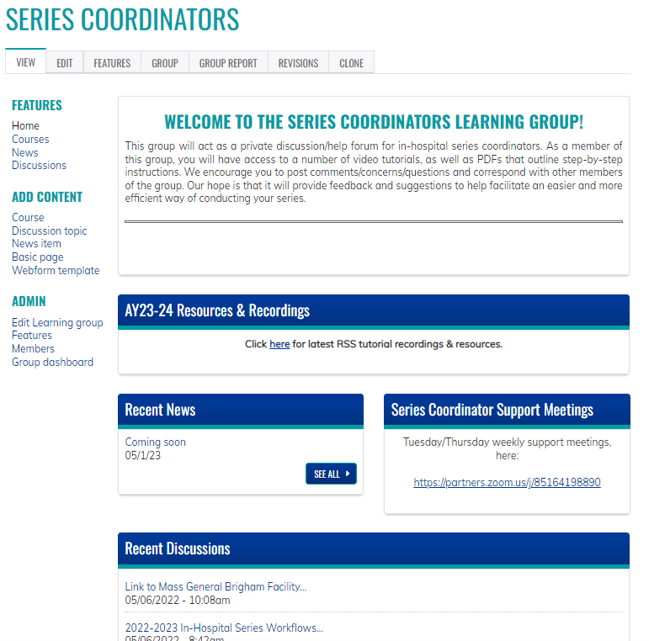
Series Coordinators Site
Resources/workflows can be found here: https://cpd.partners.org/series-coordinators/

Slide 17
Series Coordinators Site cont.
Links to the following documents are available on the Series Coordinators Site
Disclosure Form
Mitigation Form
Speaker Attestation Form
Copyright & Consent Form
Employee - Owner Content Review Form
Presentation Review Checklist
Risk Management Request Form
List of Verbs for Formulating Objectives
Announcement
CME for MOC Program Guide
Patient Safety MOC Credit Request Form
Session Information Form
Manual Enroll Attendees in a Session Workflow
https://cpd.partners.org/series-coordinators/

Slide 18
EthosCE Refresher: How participants claim credit
Only attendees who are enrolled in a session can claim credit
Ways to Enroll
Texting attendance (most common)
Text window is 1 hour prior to 1 week after the start date/time of the session
Texting phone number is: 857-214-2277
Manually enroll attendees (series admins have access)

Slide 19
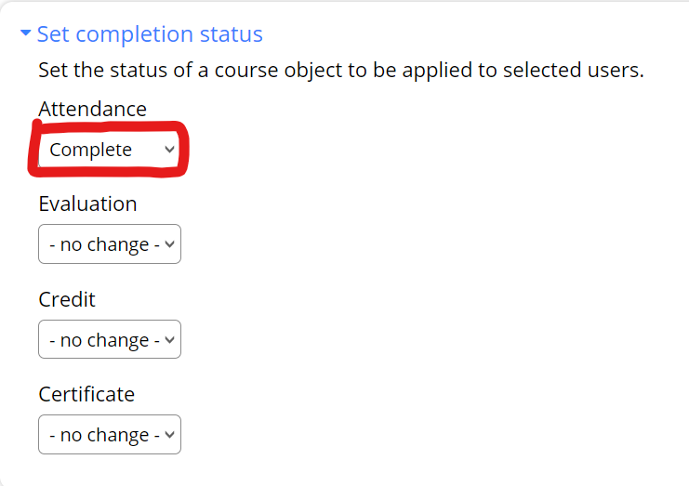
How to Manually Enroll Attendees in a Session
Process Change
All Series admins have access to manually enroll attendees
Here are the steps:
Open the session
Search for the attendee
Enroll the attendee in the session
Select the attendee
Edit the enrollment
Set the Attendance section status to
Completion
(all other objects should remain unchanged)

Slide 20
Required Information for Session Approval
Disclosure and Mitigation Forms
A disclosure is needed for anyone speaking at the session should be uploaded
Disclosure Summary Slide
A Template will be provided for your series and includes a 2024-2025 date (please note this template should be used unless other arrangement are made)
A sentence was added to state no reviewers have disclosures
All virtual session will require the zoom link be include for the session
Recommend to have 1 link for the series that all sessions use
Topic for Session in the Session Title
More than one topic: Use your judgement
Surprise cases: Can put something general in the title
Case topic in approval notes if you don’t want people to see beforehand
When a session discusses cases – a brief description will be required for credit to be awarded for the series

Slide 21
Additional Forms that may be Required for Session Approval
Risk Management Form
A completed form signed by a planner
Attestation Form
Signed by the speaker when a planner selects attestation as a mitigation strategy
The speaker should complete the form after the planner completes a mitigation form and selects attestation as a mitigation strategy
This mitigation strategy should be used only when the speaker has no slides
Owner/Employee Content Review form and Presentation
Only when requested should the presentation be uploaded to the session
The Owner/Employee Content Review should be completed by a planner with no disclosures
Recording Consent Form
A speaker should complete this form when a session is being recorded

Slide 22
Check-In Process
Check the Ready for Review button in the Final Check-in Session and
hit Save!
The process can be this easy if…

Slide 23
Check-In Session Requirements
All sessions includes a title/topic
Speaker Disclosures for all sessions are uploaded
Disclosure Summary Slide for all sessions include:
Session title
Session objectives
Planner and Speaker Disclosures
Accreditation statement for all professions
All cancelled sessions are labeled cancelled and unpublished

Slide 24
Check-In Process cont.
But if there are questions or information is missing the CPD team will use the check-in session at the end of the series to let you know

Slide 25
Evaluation Process
Evaluation Options:
After Every Session
Optional for any series
Required for ABIM, ABP and ABOHNS MOC activities
2x Year (Recommended) & Quarterly
A note will be included in the workflow to let you know the session includes the evaluation
The session will include Evaluation required for credit in the title
The attendees should be reminded an evaluation needs to be completed to receive credit
The recommended timeframe to complete the evaluation is 2 weeks
2x/year: The CPD team will update a December and June session to include the evaluation
Quarterly: The CPD team will update a September, December, March and June session to include the evaluation

Slide 26
Follow Up Surveys
All series
~3-6 months after series closes: Follow-up Survey will be sent to all participants by CPD. Questions ask about changes to individual and team performance.
The survey is built as an additional session in the series. You can view the results for the survey.
Series that measure higher-level outcomes
~6 months after series closes: Survey to course directors for any series stating they plan to measure performance, quality, safety and/or patient outcomes
We share a program-level report with all series that participate. We will also post the report on the series coordinator site.

Slide 27
Owners, Employees and (Sometimes) Founders
The following individuals are considered to have unresolvable financial relationships:
Owners of ineligible companies (includes private stock owners)
Employees of ineligible companies
Founders of ineligible companies who are compensated with private stock, salary or stipend. They are the equivalent of an owner or employee.
These individuals may not:
Control content of accredited education
Participate as planners
Participate as faculty
Source: https://www.accme.org/accreditation-rules/standards-for-integrity-independence-accredited-ce/standard-3-identify-mitigate-and-disclose-relevant-financial-relationships
Notes:
Add stock/equity in a private company

Slide 28
Exceptions
Owners, employees and founders* of ineligible companies can participate as planners or faculty in these specific situations:
Not Related to Business
When the content of the activity is not related to the business lines or products of their employer/company.
Basic Science Research
When the content of the accredited activity is limited to basic science research, such as pre-clinical research and drug discovery, or the methodologies of research, and they do not make care recommendations.
Technicians
When they are participating as technicians to teach the safe and proper use of medical devices, and do not recommend whether or when a device is used.
*When founder receives private stock, salary or stipend
Source: https://www.accme.org/accreditation-rules/standards-for-integrity-independence-accredited-ce/standard-3-identify-mitigate-and-disclose-relevant-financial-relationships

Slide 29
Employees, Owners & Founders – Most Important Takeaway
Contact us as soon as you know you are inviting an owner, founder or employee speaker!
Review of owners, founders, employees and stock owners of private companies takes time.
We cannot provide credit until all the steps are complete.
If we get it wrong, we risk losing accreditation.

Slide 30
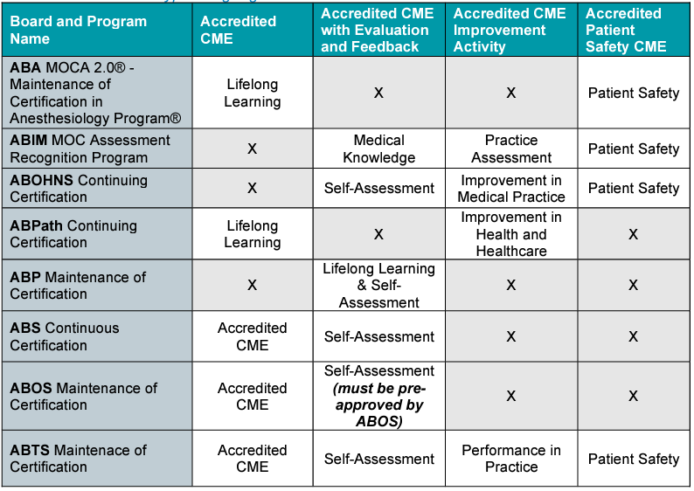
CME That Counts for Maintenance Of Certification (MOC)

Slide 31
MOC Reporting Update
Last year we implemented an update on EthosCE to make MOC credit claim and reporting easier.
Learners no longer have to enter their birthday and board information after every session.
Instead, learners will put their birthday and board information in their profile.
Reporting of learner participation in activities designated for MOC will be done immediately after the learner claims the MOC credit.
The LMS now has automatic reporting capabilities with the boards through our Joint Accreditation reporting system.
Automatic reporting for ABTS and ABOS, and ABA Patient Safety are being added by the LMS developers now. In the unlikely event the credits are not done by the start of the new academic year, we will manually report these credits.
Please remind your learners to update their profiles!
Notes:
Add screen shot

Slide 32
Skills for Professional Development
Compliance with Mass General Brigham CPD’s requirements for Joint Accreditation standards:
Collect disclosures and attestations from speakers. Escalate as needed to ensure compliance with deadlines.
Submit timely documentation of series accreditation materials for CPD review
Documentation for each session includes:
Speaker and planner disclosure and attestation forms
Mitigation forms for speakers with financial relationships to disclose
Session announcements
Disclosure summary for session as displayed to learners
Attendance SMS code
Documentation for series check-ins includes:
Series session list with each session title, speaker and date
Evaluation summary
Answers to any CPD questions
Build each new session on EthosCE, the Mass General Brigham CPD’s learning management system. In 2021, coordinators were required to attend a training on how to use EthosCE. Coordinators create new sessions by copying a sample session built by CPD. Coordinators must ensure that the dates, times and titles for each session they build are accurate. Coordinators upload disclosures before each session. CPD reviews for approval. When CPD approves the session, the coordinator obtains the attendance SMS code and shares with the audience.
Download evaluation reports for series.
Provide customer service to series attendees. Escalate issues that coordinator can’t resolve on own to CPD

Slide 33
Follow Us On Social Media!
We are growing our followers and standing on social media to:
Showcase all the great education projects being done around the system
Market courses to external participants
Follow us and share your news, to help grow the community!
X (formally known as Twitter):
@MassGenBrighCPD
LinkedIn:
Mass General Brigham Continuing Professional Development
https://www.linkedin.com/showcase/mass-general-brigham-office-of-continuing-professional-development

Slide 34
Thank you for attending today’s meeting!
We will email you with our next webinar date
Reminder to please send all questions to PartnersCPD@partners.org
These slides will be available on the Course Coordinator Virtual Community: https://cpd.partners.org/series-coordinators

