Slide 1
“CME that Counts for MOC” for MGB Series
Continuing Professional Development May 23, 2024

Slide 2
Agenda
Welcome & Introductions
Reminders: Important Dates and Upcoming Meetings
What MOC is & why physicians need it
MGB Process for reporting credit
Evaluation and Feedback Requirement: ABIM, ABP, ABOHNS
Review requirements & current process
Review other ways to meet requirements
Discussion
Discuss barriers
Brainstorm ways to meet requirements
Please send questions to PartnersCPD@partners.org
This webinar is being recorded and slides will be available on our website
Notes:
Michelle

Slide 3
Welcome and Introductions
Purpose of the Meeting
All Boards:
Discuss barriers and potential solutions to including MOC in series
Describe how we are reporting participants
ABIM, ABP and ABOHNS:
Brainstorm ways that series can meet the evaluation and feedback requirement
Goal: To have several alternatives to the current default requirement for everyone to do the evaluation after every session for MOC
Introductions
In chat: Please put:
Your hospital & department
Whether you are currently offering MOC
If you are currently offering MOC, to what boards
Why you are attending this meeting today

Slide 4
Important Dates
Proposal Deadlines:
Series beginning in July or August 2024: March 29, 2024
Series beginning September 1, 2024, or later: May 31, 2024
Late Fees:
Proposals received more than 1 week after the deadline will incur a non-refundable late fee of $500.
Tuesday/Thursday Open Hours Meeting:
Tuesdays 10:30 to 11:30
Thursday 2:00 to 3:00 Support Meeting Zoom link: https://partners.zoom.us/j/85164198890
Notes:
Need to update with new dates

Slide 5
Upcoming Trainings and Meetings
Topic | Audience | Date | Registration Link
CME that Counts for MOC | Recommended for directors and coordinators of series offering MOC credit (especially ABIM, ABP, ABOHNS) | May 23, 10-11 am | N/A - today
Owner/Employee and Mitigation Refresher | Recommended for series that have owner or employee speakers, and for reviewers | June 20, 10-11 am | https://partners.zoom.us/meeting/register/tZYvdu2trDkqHtzuNlLWS0oJYNx1MerXAIh4
Systemwide Access Check-in | Recommended for series that are non-confidential and are allowing people from around the system to attend their sessions | August 8, 10-11 am | TBD

Slide 6
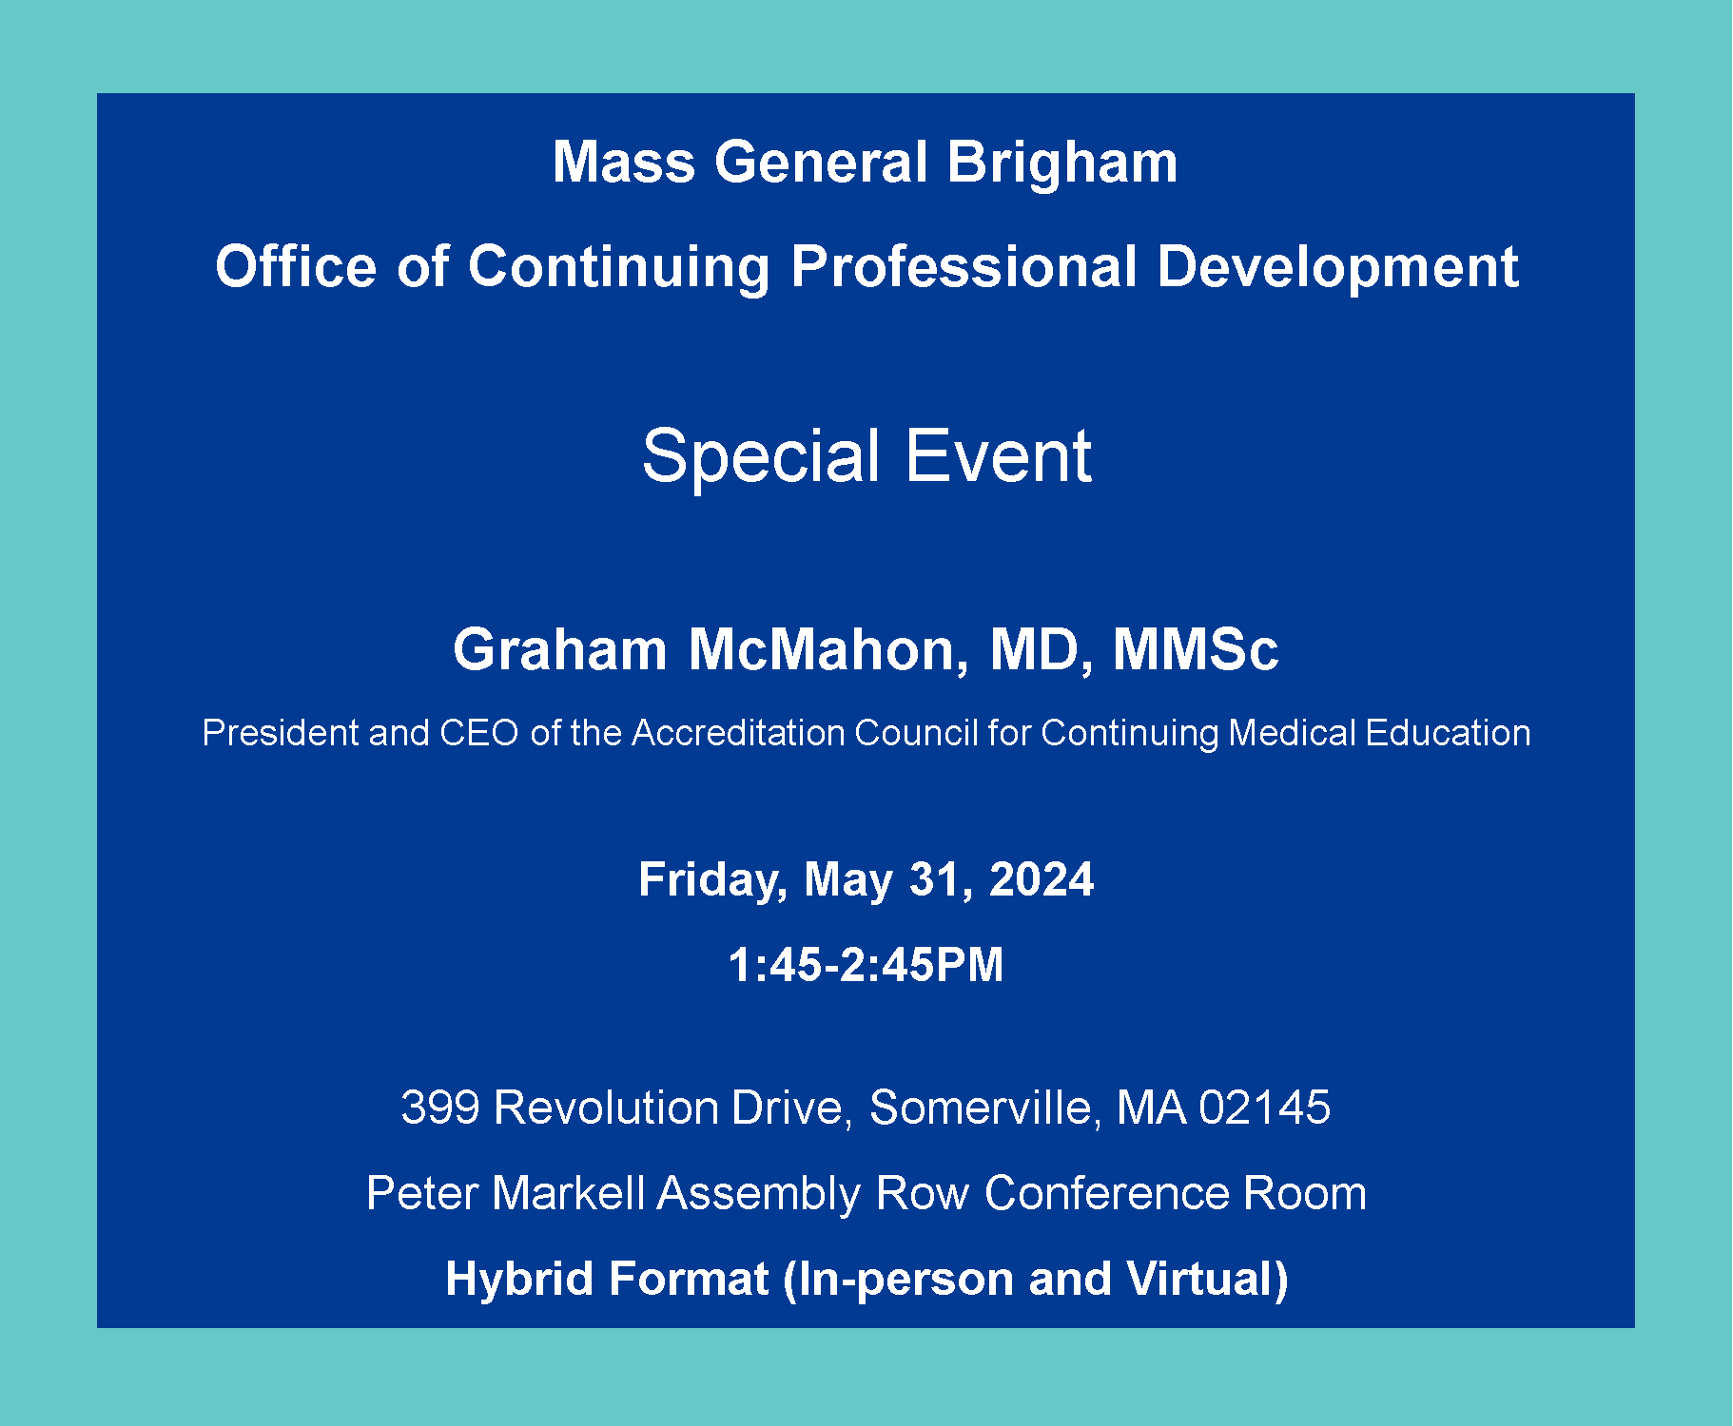
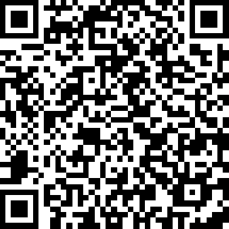
You Are Invited! Fri, May 31, 1:45-2:45 @ Assembly Row
Join us for an inspiring and frank discussion on the future of CME! This meeting is a rare opportunity to hear directly from ACCME leadership. There will be plenty of time for discussion, so bring your questions about whatever keeps you up at night. Topics may include:
Latest trends in CME
Challenges with audience generation
In-person vs. virtual education
Measuring the value of CME
How the Standards for Integrity and Independence have impacted your activities
The event will take place as a hybrid format (in-person and virtually). For in-person attendees, snacks and refreshments will be provided. Check-in begins at 1:30 pm. The talk begins at 1:45 pm.
https://www.surveymonkey.com/r/J57HV63

Slide 7
What is “CME that Counts for MOC?”
ACCME collaboration with the American Board of Medical Specialties (ABMS) certifying boards to simplify and align the Maintenance of Certification (MOC) process to better meet the needs of physicians and educators. We can register activities for MOC and report credit to the boards.
Participating Boards:
American Board of Anesthesiology (ABA)
American Board of Internal Medicine (ABIM)
American Board of Orthopaedic Surgery (ABOS)
American Board of Otolaryngology–Head and Neck Surgery (ABOHNS)
American Board of Pathology (ABPath)
American Board of Pediatrics (ABP)
American Board of Surgery (ABS)
American Board of Thoracic Surgery (ABTS)

Slide 8
Why Physician Learners Need MOC
What is MOC?
MOC = Maintenance of Certification
To remain certified in their specialty, physicians must meet continuing education requirements that are set by the certifying boards.
Physicians can earn credit toward meeting these requirements by participating in accredited CME activities that count for MOC.
Examples of MOC Requirements:
ABIM: 100 MOC points every 2 years Must be reported by Accredited Provider
ABS: 150 credits of Category-1 CME over five years Must be reported by Accredited Provider
ABP: 50 points for lifelong learning activities every 5 years
https://www.abim.org/maintenance-of-certification/moc-requirements/ https://www.absurgery.org/stay-certified/ongoing-certification-requirements/cme/
https://www.abp.org/content/lifelong-learning-and-self-assessment-part-2

Slide 9
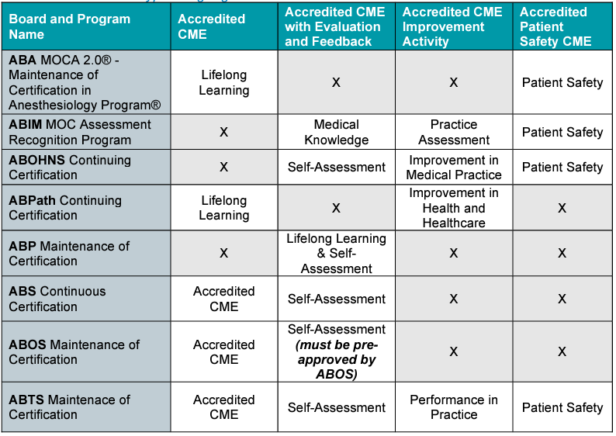
MOC MGB CPD Currently Offers

Slide 10
MOC with Same Requirements as CME
Post-Activity Evaluation Frequency Options:
After every session
Quarterly
Semi-annually

Slide 11
MOC with Additional Evaluation & Feedback Requirements
Post- Activity Evaluation Frequency Options:
Current: After every session
Goal: Up to department

Slide 12
MOC Reporting — What Learners Need to Know
Physicians need to update their profiles to ensure MOC credit is reported to their board.
The CPD office updated the way we report MOC.
We reported MOC credit automatically through our LMS for all series that included MOC starting 5/1/24.
Physicians no longer need to provide their permission, board certification number, board and birthdate after every session.
By updating their profile on cpd.partners.org, physicians give us permission to report their MOC to their board.
Physicians should leave the board section blank if they don’t want us to report.
This year, ABTS and ABOS joined the collaboration. As boards join the collaboration, we ask our LMS vendor to add the boards to automatic reporting. Until then, we report manually directly to the ACCME.
Activities that count for MOC include an MOC Recognition Statement in addition to the accreditation statement. This is how physicians can confirm if their activity includes MOC.

Slide 13
Learners — What to Expect for Activities that Include MOC
Learners receive email confirmation when MOC credit is awarded for each session.
Unless there is an error with the information provided, they can expect to see the credit within a few days of texting attendance and completing any required evaluation.
If there is an error in reporting, they will receive an email stating there was an error.
They will need to update their profile to fix the error.
If they don’t fix the error, their transcript on cpd.partners.org will still show the MOC credit. However, they won’t receive credit until the board awards it.
The true source to view MOC credit is the physician’s board profile.
Leaners should be sure to check their board profile periodically to ensure credit is being awarded.
The CPD account will also show the status of MOC in the “Reported Credit” tab under “My Activities.” If there was an error in reporting, the error will be listed here.
Known Issue
Physicians who have “M.D.” as part of their name in the MGB system will need to be manually updated by Digital. We pull a report and send to Digital on a regular basis.

Slide 14
Evaluation & Feedback Requirement: ABIM, ABP, ABOHNS
Component | Requirement | Expectation
Evaluation Mechanism | All activities, including live activities, must include a comprehensive evaluation component that assesses individual learner competence, knowledge and/or skill. | The evaluation measures the competence or performance of the individual learner and not of the activity. Evaluation methods employed should identify individual learning (not anonymous).
Participation Threshold | The provider determines and communicates the participation threshold, also known as a passing standard, for the learner to earn MOC credit. | The participation threshold must be clearly communicated to the learner prior to engagement in the activity. The learner must meet the participation threshold set by the provider before credit is reported.
Feedback | All activities must include feedback to participants, identifying learner results with rationales for correct answers or attainment of applicable skill(s), and/or relevant citations where appropriate. | Evaluation of the learner and feedback to the learner must be completed before completion credit may be awarded.
Source: 2020 Accreditation Council for Continuing Medical Education (ACCME®) CME for MOC – Evaluation Guide 839_20201215

Slide 15
Evaluation & Feedback Requirement: MGB Current Process
Mechanism | Evaluation Method | Participation Threshold | Feedback Method | Implementation
Written responses | Learners write down what they have learned and indicate commitment to change or maintain an element of practice. | Learner writes a reflective statement and makes a commitment to change or maintain an element of practice. | Leader/facilitator summarizes what was discussed and best next steps for learners. | CPD requires written responses through required evaluations after each session.
Limitations of Current Process:
Confusing: Many docs think they are getting MOC when they aren’t
Attending sessions with MOC but not doing do the evaluations
Attending some series with MOC and some without, then thinking they are getting MOC for series that don’t include MOC
Ineffective: Not meaningful/not meeting requirement
Quality of evaluation responses varies greatly, all are getting MOC credit
Feedback method missing/unclear
Inefficient:
Learners must go back online to do evaluation after every session to get credit

Slide 16
ACCME Evaluation Tips
The ACCME provides the following guidance:
The accredited provider may choose to evaluate the activity at the session level or at the activity level.
The provider does not need to be limited to a single method of evaluation per activity. Combinations of approaches to evaluation may produce rich information about learner change.
The accredited provider determines the passing standard/participation threshold of the evaluation and should give clear instructions to their learners on what they need to do in order to earn MOC credit.
The accredited provider must be able to demonstrate that the learner participated in/completed the evaluation for the educational activity for the learner to earn MOC credit.
If the activity is selected for review, the accredited provider will be asked to submit the evaluation mechanism, a description of how the evaluation was implemented, how feedback was provided to learners (if applicable), and a list of the physician learners who met the requirements to earn MOC credit. This does not need to include the answers submitted by learners.
Source: 2020 Accreditation Council for Continuing Medical Education (ACCME®) CME for MOC – Evaluation Guide 839_20201215

Slide 17
Evaluation & Feedback Requirement: Applicable to Series
Mechanism | Evaluation Method | Participation Threshold | Feedback Method | Implementation - Ideas/Options
Written responses | Learners write down what they have learned and indicate commitment to change or maintain an element of practice. | Learner writes a reflective statement and makes a commitment to change or maintain an element of practice. | Leader/facilitator summarizes what was discussed and best next steps for learners. | Eval after ever session (current) Meeting chat Learner journals
Case discussion | Learners asked to share with each other and group how they would approach the case at various stages. | Learner actively participates in the conversation as judged by a group leader or observer. | The outcome of the case is shared. | Course director attestation that outcome was shared Course facilitator sends summary of the discussion after the activity to learners
Audience response system | Learners select answers to provocative questions or using the ARS. Must be traceable to the individual. | Learners engage adequately with an acceptable number of attempts. Threshold set by provider. | Answer to each question is shared in dialogue or writing, including rationale for correct answers with relevant citations. | You must be able to track individual responses. Our office need copies of the questions with the correct answers, rationales and citations. Compliant options: Online quiz tool Kahoot Meeting chat
Quiz | Learners complete answers to a quiz during or after an activity. Must be traceable to the individual. | Percent of correct answers set by provider. | Best answer to each question is discussed or shared, including rationale for correct answers with relevant citations. | You must be able to track individual responses. Our office need copies of the questions with the correct answers, rationales and citations. Compliant options: Online quiz tool Kahoot Meeting chat

Slide 18
ACCME Examples of Reflective Statements
Example 1:
The provider plans a multi-day, large live activity that includes a wide variety of sessions (e.g., case discussion, didactic, skills-training). In the case discussion and skills-training sessions, facilitators manage the discussion/training and record those learners who demonstrate meaningful participation.
To assess learning overall for the activity, learners are asked to keep a learning journal and are given time at the start of each session to record their intended learning goals, learning points achieved, and an intent to change as a result of the activity.
The learning journals are reviewed for completeness and suggested resources are provided back to the learners

Slide 19
ACCME Examples of Reflective Statements
Example 2:
A provider convenes a live meeting to optimize communication with patients, with peers, and with students.
Each learner self-identifies the theme that they seek to pursue (such as optimal communication with patients) from the meeting agenda and completes a digital diary as they learn through the activity.
Those statements are reviewed for appropriateness and inadequate reflective statements are remediated.

Slide 20
ACCME Examples of Reflective Statements
Example 3:
A provider plans a large annual meeting with a range of content related to a specific specialty field. The meeting has tracks that help learners select the sessions that meet their own learning needs.
Learners are asked to write one or more reflective statements linking their own needs with the content in the track.
Key faculty from each track review the reflective statements for appropriateness and provide feedback to individual learners.

Slide 21
ACCME Examples of Reflective Statements
Example 4:
A provider plans a large annual meeting with a range of content related to a specific specialty field. Learners are asked to choose 10 sessions reflective of their top learning priorities and to keep track of at least one key learning point from each of the sessions.
Toward the end of the meeting, a special homeroom-style session is held where learners share their top patient problems, their key learning points, and discuss with their colleagues.
Faculty members review learning points and attest to engagement.

Slide 22
ACCME Examples of Reflective Statements
Example 5:
The provider develops a 3-day workshop focused on improving quality of care for children with chronic musculoskeletal disability.
The program includes a didactic focus on management of acute rheumatologic presentations, a series of case presentations, and a skill development program about effective application of orthopedic casts.
The participation of the learners in the program is verified, and learners are asked to complete a series of reflective statements about what they learned and what they will change.
Those statements are reviewed for appropriateness and inadequate reflective statements are remediated.

Slide 23
ACCME Examples of Reflective Statements
Example 6:
A provider convenes a half-day live program focused on optimizing palliative care that includes a variety of case presentations, discussions, and interviews with patients.
At the conclusion of the activity, learners are provided with the learning objectives for the activity and asked to document their own reflective statements and intent to change.
The group reconvenes to discuss and share what they wrote for these statements and give feedback to each other.
A facilitator confirms that each learner engaged and participated in this discussion and peer-feedback.

Slide 24
Discussion
All Boards
What would be most useful for your physician learners?
What do you need our help with?
What are barriers to including MOC in your series?

Slide 25
Discussion
ABIM, ABP and ABOHNS – Evaluation and Feedback Requirement
Do other options for meeting evaluation and feedback requirements apply to your sessions?
What are you already doing in your sessions that could meet requirements?
Are there small tweaks you can make so that sessions met the requirements?
What are barriers for evaluation and feedback?

Slide 27
Thank you for attending today’s meeting!
We will email you with 3-4 options for eval and feedback
We will email you with our next webinar date
Reminder to please send all questions to PartnersCPD@partners.org
These slides will be available on the Course Coordinator Virtual Community: https://cpd.partners.org/series-coordinators

Slide 29
Appendix and References
The following pages are for your reference.

Slide 30
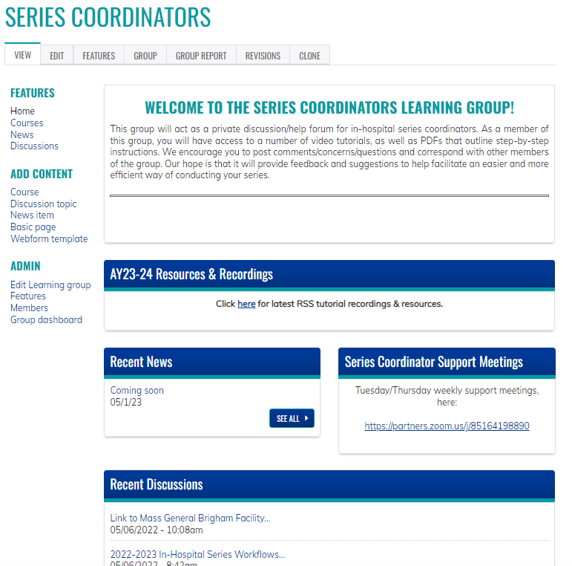
Series Coordinators Site
Resources/workflows can be found here: https://cpd.partners.org/series-coordinators/

Slide 31
Series Coordinators Site cont.
Links to the following documents are available on the Series Coordinators Site
Disclosure Form
Mitigation Form
Speaker Attestation Form
Copyright & Consent Form
Employee - Owner Content Review Form
Presentation Review Checklist
Risk Management Request Form
List of Verbs for Formulating Objectives
Announcement
CME for MOC Program Guide
Patient Safety MOC Credit Request Form
Session Information Form
Manual Enroll Attendees in a Session Workflow
https://cpd.partners.org/series-coordinators/

Slide 32
Evaluation and Surveys
Post-Activity Evaluation Options:
After Every Session
Quarterly
2x Year (Recommended)
Follow-Up Surveys: All series
~3-6 months after series closes: Follow-up Survey will be sent to all participants by CPD. Questions ask about changes to individual and team performance.
The survey is built as an additional session in the series. You can view the results for the survey.
Series that measure higher-level outcomes
~6 months after series closes: Survey to course directors for any series stating they plan to measure performance, quality, safety and/or patient outcomes
We share a program-level report with all series that participate. We will also post the report on the series coordinator site.

