Slide 1
Systemwide Grand Rounds Forum
Continuing Professional Development August 8, 2024

Slide 2
Agenda
Important Dates & Upcoming Trainings
Joint Accreditation Professions
Overview: Systemwide Grand Rounds Project
Vitals site
Process Review
Confidential Sessions
Engagement Stats
What’s next: Archived Recordings
Your Feedback
Q&A/Discussion
Please send questions to mgbcpd@mgb.org
This webinar is not being recorded so that participants can speak freely.
Slides will be available on our website.
Notes:
Michelle

Slide 3
Important Dates
Deadlines:
All proposal deadlines have passed.
If you haven’t submitted a proposal for 2024-2025, please contact us now!
Proposals received more than 1 week after the deadline incur a late fee of $500.
Michelle has reviewed most proposals at this point.
Please contact Michelle with any questions about your approval status.
We plan to send you your series site a minimum of 2 weeks before your first session.
Check ins for 2023-2024 are due by August 15, 2024.
Plan Ahead:
Proposals for next year will be due in:
February for series with a summer start date.
May for series with a fall start date.
Tuesday/Thursday Open Hours Meeting:
Tuesdays 10:30 to 11:30
Thursday 2:00 to 3:00 Support Meeting Zoom link: https://partners.zoom.us/j/85164198890
Notes:
Need to update with new dates

Slide 4
2024 Training
Training type | Required/Recommended Audience | Training Date
Systemwide Grand Rounds Forum | Recommended for series that are not confidential | August 8, 2024 (today)
Nuts and Bolts of Building and Submitting Sessions, Reporting | Recommended for all new series admins and returning admins who would like a refresher on the process Recommended for anyone wanting to know more about reports | September 12, 2024 https://partners.zoom.us/meeting/register/tZIkd-yoqDsuGNZmGP5PNGnxUbrjT6M8q8OR
All meeting recordings and slides are archived on https://cpd.partners.org/series-coordinators
Notes:
Need to update with new dates

Slide 5
Joint Accreditation
Mass General Brigham was awarded Joint Accreditation from December 6, 2021, through November 2025.
Joint Accreditation for Interprofessional Continuing Education™ offers organizations the opportunity to be simultaneously accredited to provide continuing education activities for multiple professions through a single, unified application process, fee structure, and set of accreditation standards.
Jointly accredited providers may choose to award single profession or interprofessional continuing education credit (IPCE) to:
Athletic Trainers
Dentists
Dietitians
Nurses
Optometrists
Physician Assistants
Pharmacists
Physicians
Psychologists
Social Workers

Slide 6
Systemwide Access to In-Hospital Series
Goal: Any MGB clinician will have all the information they need to easily participate in any MGB in-hospital series. Confidential series and sessions such as departmental M&Ms & Tumor Boards are excluded.
We will provide information about MGB series via:
A web page on Vitals that all MGB clinicians can easily access
Regular communications to MGB clinicians throughout the system, so that they know what educational opportunities are available to them
We are doing this at the request of Dr. David Roberts, President of the Community Hospitals, Dr. Kevin Tucker, VP of Education, Mass General Brigham, and the Chief Academic Office Leadership
Communications from leadership to department chiefs is also taking place

Slide 7
Major Project Tasks & Milestones
Develop & implement communication, trainings and process changes for 160+ series administrators
Collaborate with Digital and Communications to stand up site on Vitals
Collect and curate series information for site
Launch site: July 1, 2024
Add Series and sessions for Fall start
Market the site and the educational opportunities it provides access to throughout the system
Collect and curate upcoming session information for site calendar on a weekly basis
Troubleshoot with learners and departments
We are here.

Slide 8
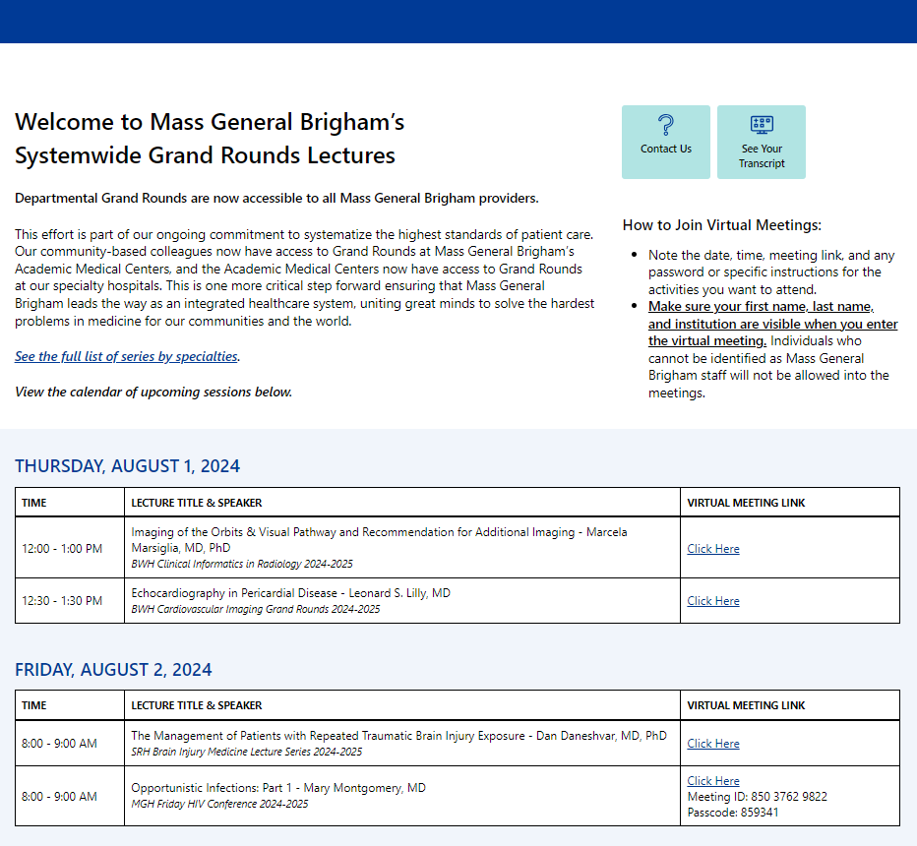
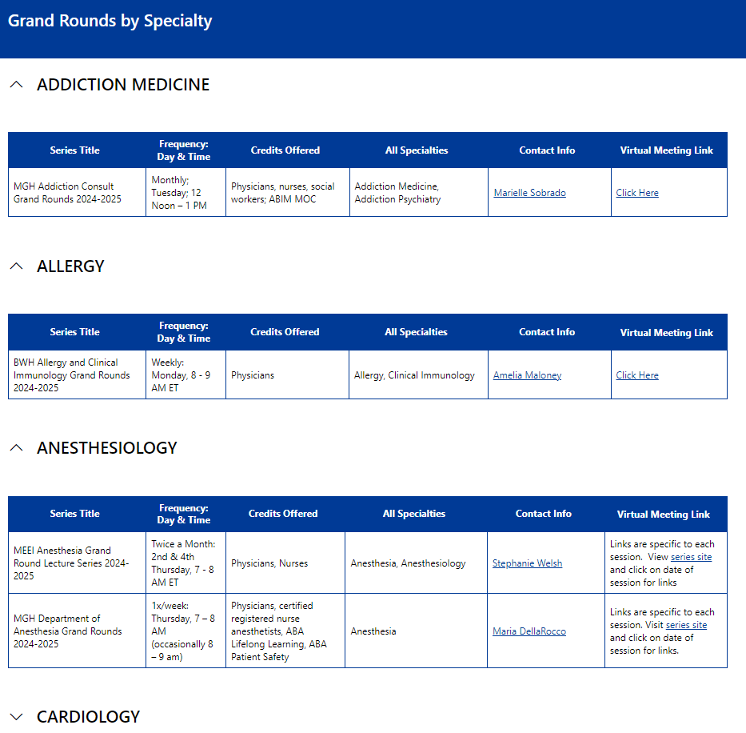
Vitals Site is Live!
Thank You
Systemwide Grand Rounds - Home (sharepoint.com)

Slide 9
Process Map
Department coordinator gathers session information
ETHOS
Department coordinator enters session information
Existing process. Has been modified.
Existing process.
No change.
MANUAL
CPD staff adds session to Vitals page
New process as of July 2024
CPD or MGB sends out message/ promotion (Vitals, Tidbits)
PROMOTION
Learner at community hospital sees message/ promotion
VITALS
Learner views Series opportunities and sees how to participate
SESSION
Learner attends session on Zoom or other virtual meeting platform
TEXT CODE
Learner texts code for attendance and credit
CME CREDIT
Learner receives CME credit and is now on the series participant list in Ethos

Slide 10
Process Map
Department coordinator gathers session information
ETHOS
Department coordinator enters session information
Existing process. Has been modified.
Existing process.
No change.
MANUAL
CPD staff adds session to Vitals page
New process as of July 2024
CPD or MGB sends out message/ promotion (Vitals, Tidbits)
PROMOTION
Learner at community hospital sees message/ promotion
VITALS
Learner views Series opportunities and sees how to participate
SESSION
Learner attends session on Zoom or other virtual meeting platform
TEXT CODE
Learner texts code for attendance and credit
CME CREDIT
Learner receives CME credit and is now on the series participant list in Ethos

Slide 11
Posting to Vitals Process
Department coordinator submits session on Ethos
Session is in one of these statuses:
“Ready for Review”
“Feedback”
“Approved”
CPD staff adds session to Vitals Site
The sooner you submit your session to us, the sooner we can add it to Vitals!
Sessions submitted the same day or that are missing the link to participate may not make it onto the page

Slide 12
Previous vs. Future State
Complete
Previous State:
Marketing is done by department conducting the series.
Department maintains a distribution list of series participants
Department sends invitations, reminders, and links to sessions
CPD was not involved in marketing at all
Future State (AY24-25):
Mass General Brigham will help market series system-wide
We will actively recruit participants from community hospitals on a multitude of levels
We will include series advertising in our monthly internal newsletter to Mass General Brigham learners
We will have a page that lists series titles, directions to participate, and contact information for each series
We will maintain a list of session titles and topics so that learners may view, search and choose which sessions to attend
We will provide directions on how to view the archived videos of sessions, when available

Slide 13
Previous vs. Future State
Starting
Previous State:
Marketing is done by department conducting the series.
Department maintains a distribution list of series participants
Department sends invitations, reminders, and links to sessions
CPD was not involved in marketing at all
Future State (AY24-25):
Mass General Brigham will help market series system-wide
We will actively recruit participants from community hospitals on a multitude of levels
We will include series advertising in our monthly internal newsletter to Mass General Brigham learners
We will have a page that lists series titles, directions to participate, and contact information for each series
We will maintain a list of session titles and topics so that learners may view, search and choose which sessions to attend
We will provide directions on how to view the archived videos of sessions, when available

Slide 14
Previous vs. Future State
Next
Previous State:
Marketing is done by department conducting the series.
Department maintains a distribution list of series participants
Department sends invitations, reminders, and links to sessions
CPD was not involved in marketing at all
Future State (AY24-25):
Mass General Brigham will help market series system-wide
We will actively recruit participants from community hospitals on a multitude of levels
We will include series advertising in our monthly internal newsletter to Mass General Brigham learners
We will have a page that lists series titles, directions to participate, and contact information for each series
We will maintain a list of session titles and topics so that learners may view, search and choose which sessions to attend
We will provide directions on how to view the archived videos of sessions, when available

Slide 15
Information Needed for Site – Accomplished So Far
All MGB clinicians will easily be able to access information for all our in-hospital series, so they can choose what to attend
Absolutely must have:
Name of Series
Series Director
Series Coordinator with email address
Virtual meeting link
Session list with dates
Dates and session topics
Target audience (specialty, professions)
Nice to have:
Speaker name
Link to recordings (when available)
Link to accredited enduring activity (when available)
Calendar function
Search function
Filter function
Out of scope:
Accreditation for archived sessions
Accreditation for select archived sessions

Slide 16
What We Need from Series Directors and Coordinators
Required for all sessions:
Meeting link to participate
Be sure to include passcode if required!
We recommend using 1 meeting link for the entire series
If you have some sessions that are confidential within a series that is overall not confidential, we recommend using a separate link for the confidential sessions
Session topic and speakers
Please put the session topic in the title of the session. Many of you are already doing this.
Bonus points for including the speaker too!
Providing this information up-front will make things easier for you at check-in time
For sessions with “surprise cases” – put something generic in the title
Required for recorded sessions:
Speaker copyright and consent form
Archived video link (if applicable)

Slide 17
Confidential/Private Education Meetings
M&Ms and Tumor boards are considered confidential to the department and are excluded from this initiative
All other series should make some or all sessions available to anyone in the system
HIPAA Concerns: All MGB clinicians are bound by MGB standards of protecting PHI
We recognize your series may have sessions that are meant only for your department.
For these sessions, we ask that you put “DEPARTMENT ONLY” in the session title. Also, don’t list the Zoom link or use a distinct Zoom link. Examples include:
Department meetings
Sessions designed for department only (for example, session that involve discussions about professional challenges and career issues)
Confidential sessions within series (e.g., M&M on the last week each month for a weekly Grand Rounds series.)
Department-specific challenges: Please reach out!
Everyone is doing their series a little bit differently. Does anyone have an example to discuss?
Email us at mgbcpd@mgb.org if you have specific concerns.

Slide 18
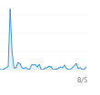
Engagement Statistics
398
40
26
13
15
8
2
1
6/28/24
All Eligible Series – July
 | July 2023 | July 2024 | Percent Change
Community Hospital Enrollments | 153 | 195 | 27% increase
1 Example of a Grand Rounds with 3 sessions to date
 | 2023-2024: 1st 3 sessions | 2024-2025: 1st 3 sessions
Total enrollments | 190 | 125
Total community hospital | 9 | 12
Percent community hospital | 4.7% | 9.6%

Slide 19
Questions/Issues That Have Come Up So Far
Meeting link missing passcode
Sessions built wrong have wrong settings and are searchable on the internet
Confusion on whether this initiative is for live sessions or archived
Series are not confidential but want to stay for department only
How to manage cancelled sessions
Changes to announcements/communications now that there is a centralized site
What changes are you making or have you seen?

Slide 20
What’s Next?
Your next steps:
Start putting the topic (if you aren’t already) and virtual meeting link in each session
Contact us with any issues or questions specific to your series
Provide feedback!
Real-time feedback, problems as they arise, questions
We gladly accept success stories too!
Our next steps:
Phase 2 of this project is to offer archived versions of the live sessions for anyone to access

Slide 21
What’s Next: Explore Automation & Site Functionality
Right now, much of the process for getting information from departments onto Vitals is manual
Long-term, manual is not ideal
We also hope to improve filtering and search functionality on the Vitals site.

Slide 22
What’s Next: Archived Recordings
We are thinking through the next stage now: Archived Recordings
Questions to Answer
Accreditation
Copyright and speaker consent
Audience: Internal to MGB only, or external also
Problems to Solve
Technical
Financial
Operational
Legal

Slide 23
What’s Next: Alumni Initiative Opt-In
The Education Office has a separate initiative to advertise events to alumni
The Alumni Association is launching at the beginning of September
We sent a survey to eligible series asking if you want us to invite alumni to participate
Participation in the alumni initiative is encouraged! (But optional)

Slide 24
Follow Us On Social Media!
We are growing our followers and standing on social media to:
Showcase all the great education projects being done around the system
Market courses to external participants
Follow us and share your news, to help grow the community!
X (formally known as Twitter):
@MassGenBrighCPD
LinkedIn:
Mass General Brigham Continuing Professional Development
https://www.linkedin.com/showcase/mass-general-brigham-office-of-continuing-professional-development

Slide 25
Thank you for attending today’s meeting!
Next webinar is 9/12/24
Reminder to please send all questions to mgbcpd@mgb.org
These slides will be available on the Course Coordinator Virtual Community: https://cpd.partners.org/series-coordinators

Slide 26
Your Feedback and Questions

