Slide 1
Final Check-in Review
Continuing Professional Development July 18, 2024

Slide 2
Agenda
Important Dates & Upcoming Trainings
Joint Accreditation
Why do we have final Check-ins?
What is needed for final Check-in
Session List Requirements
M&M and Case Discussion Session Topics
Cancelled Sessions
Additional Notes
Q&A
Please send questions to PartnersCPD@partners.orgThis webinar is being recorded and slides will be available on our website

Slide 3
Important Dates
Proposal Deadlines have passed:
Series beginning in July or August 2024: March 29, 2024
Series beginning September 1, 2024, or later: May 31, 2024
Late Fees:
Proposals received more than 1 week after the deadline will incur a non-refundable late fee of $500.
CPD Review and Site Build Schedule
We are building all sites so that you will have access to your series 2 weeks before your start date
We are also reviewing proposals received for Sept. start and will send approvals or questions as they are ready
Please be sure to answer any outstanding questions. The questions need to be answered prior to approval and/or admin access to the site.
Tuesday/Thursday Open Hours Meeting:
Tuesdays 10:30 to 11:30
Thursday 2:00 to 3:00 Support Meeting Zoom link: https://partners.zoom.us/j/85164198890
Notes:
Need to update with new dates

Slide 4
2024 Training
Upcoming Trainings | Audience | Training Date | Registration Link
Series Check-Ins | Recommended for anyone with questions about how to do check ins | July 18, 2024 | N/A - today
Systemwide Access Forum | Recommended for all series that are not confidential | August 8, 2024 | https://partners.zoom.us/meeting/register/tZEscuyuqT4vGNM7Qrbkrp-s8X3X2zsAUnWu
Most trainings will be recorded and archived on https://cpd.partners.org/series-coordinators
Notes:
Need to update with new dates

Slide 5
Joint Accreditation
Joint Accreditation for Interprofessional Continuing Education™ offers organizations the opportunity to be simultaneously accredited to provide continuing education activities for multiple professions through a single, unified application process, fee structure, and set of accreditation standards.
Jointly accredited providers may choose to award single profession or interprofessional continuing education credit (IPCE) to:
Athletic Trainers
Dentists
Dietitians
Nurses
Optometrists
Physician Assistants
Pharmacists
Physicians
Psychologists
Social Workers
All Jointly Accredited providers must comply with the ACCME Standards for Integrity and Independence.

Slide 6
What Is the Point of Final Check-ins?
We need to confirm we have
accurate information and we are
compliance with the ACCME Standards for Integrity and Independence

Slide 7
What is needed for Final Check-ins
All approved sessions have the required information
Disclosures
Disclosure Summary Slides
Any other documents as required (mitigation/risk form, etc)
All sessions should be approved or marked cancelled/unpublished
Session List

Slide 8
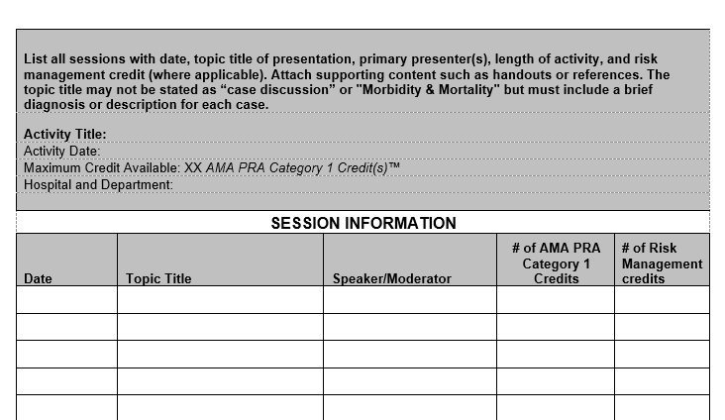
Session List Requirements
Session List (Document 4)
Date of the session
Session Topic/Title
Speaker
Confirm the Session List is the same as the Ethos list
The Session list can be found on the Series Coordinator site: https://cpd.partners.org/series-coordinators
Notes:
Note discrepancies on the session list

Slide 9
M&M and Case Discussion Session What do you add as a topic?
If the information was sent to PartnersCPD@partners.org
On the session list add a note this information was sent to PartnersCPD@partners.org
Upload an example of what was sent to the Final Check-in session
If the information was not sent to PartnersCPD@partners.org
Include the Case Conference or M&M session details on Document 4
Upload the documents with the details to the Final Check-in Session

Slide 10
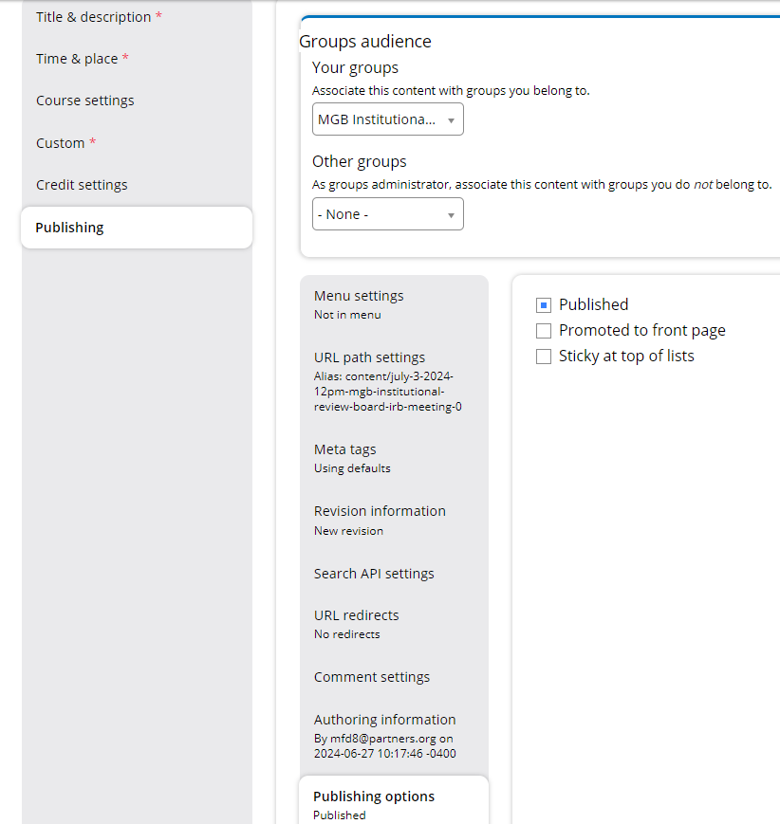
Cancelled/Unpublished Sessions
Please add Cancelled to the title of any sessions that were not held.
These sessions can be unpublished
Open the session
Click Edit
Select the Publishing tab
Select Publishing options
Uncheck Publishing

Slide 11
Additional Notes
If there was a last-minute change to a session – please upload the additional documents to the Final Check-in Session
Speaker was changed or added last minute – need to include the missing disclosure
Additional Change Measure Results (Performance/ Patient Outcomes/ Quality and Safety)
MOC Feedback results – if available

Slide 12
Refresher/Checklist
Confirm all session are approved on Ethos
Any cancelled or unapproved sessions are unpublished
Compare session list and Ethos session dates are the same
Confirm each session has a title on the session list
Open each session and confirm the disclosure for the speaker on the session list is uploaded
The Final Check-in session will be placed in Feedback if any of the information above is missing.

Slide 13
Thank you for attending today’s meeting!
We will email you with our next webinar date
Reminder to please send all questions to PartnersCPD@partners.org
These slides will be available on the Course Coordinator Virtual Community: https://cpd.partners.org/series-coordinators

Slide 14
Follow Us On Social Media!
We are growing our followers and standing on social media to:
Showcase all the great education projects being done around the system
Market courses to external participants
Follow us and share your news, to help grow the community!
X (formally known as Twitter):
@MassGenBrighCPD
LinkedIn:
Mass General Brigham Continuing Professional Development
https://www.linkedin.com/showcase/mass-general-brigham-office-of-continuing-professional-development

