Slide 1
In-Hospital Series Back-to-Basics & Reporting Training Webinar
Continuing Professional Development September 12, 2024

Slide 2
Agenda
Important Dates
Joint Accreditation
Systemwide Access to In-Hospital Series
Vitals
What We Need from Series Directors and Coordinators
Approval and Access to the Series
Flowchart overview
Create Additional Sessions
Update Session
Upload Documents to a session
Forms for Session Approval
Add new or additional administrator to a series
Checklist for Series Website Access and Session Approval
Reports Overview
Q&A
Please send questions to mgbcpd@mgb.org
This webinar is being recorded and slides will be available on our website
Notes:
And the agenda will be…

Slide 3
Important Dates
Deadlines:
All proposal deadlines have passed.
If you haven’t submitted a proposal for 2024-2025, please contact us now!
Proposals received more than 1 week after the deadline incur a late fee of $500.
Michelle has reviewed all proposals and all series have been built
Please contact Michelle with any questions about your series status.
Check ins for 2023-2024 are past due.
Please contact Michelle with any questions about Check ins
Plan Ahead:
Proposals for next year will be due in:
February for series with a summer start date.
May for series with a fall start date.
Tuesday/Thursday Open Hours Meeting:
Tuesdays 10:30 to 11:30
Thursday 2:00 to 3:00 Support Meeting Zoom link: https://partners.zoom.us/j/85164198890

Slide 4
Upcoming Trainings
Upcoming Trainings | Audience | Training Date | Registration Link
Coordinator Refresher Trainings | Recommended for all new series admins and returning admins who would like a refresher on the process and reporting | September 12, 2024, 10-11 am | N/A - today
Oct training | Adding Quality Improvement MOC to your series | Tuesday, Oct 15, 2024 1:00-2:00
Nov training | 2023-2024 Follow up stats/reports | Nov 14, 2024
Dec training | RSS Teams Channel review | Dec 2024
Please let us know if there is any training/webinars that would interest you!!

Slide 5
Joint Accreditation
Mass General Brigham was awarded Joint Accreditation from December 6, 2021, through November 2025.
Joint Accreditation for Interprofessional Continuing Education™ offers organizations the opportunity to be simultaneously accredited to provide continuing education activities for multiple professions through a single, unified application process, fee structure, and set of accreditation standards.
Jointly accredited providers may choose to award single profession or interprofessional continuing education credit (IPCE) to:
Athletic Trainers
Dentists
Dietitians
Nurses
Optometrists
Physician Assistants
Pharmacists
Physicians
Psychologists
Social Workers

Slide 6
Systemwide Access to In-Hospital Series
Goal: Any MGB clinician will have all the information they need to easily participate in any MGB in-hospital series. Confidential series and sessions such as departmental M&Ms & Tumor Boards are excluded.
We will provide information about MGB series via:
A web page on Vitals that all MGB clinicians can easily access
Regular communications to MGB clinicians throughout the system, so that they know what educational opportunities are available to them
We are doing this at the request of Dr. David Roberts, President of the Community Hospitals, Dr. Kevin Tucker, VP of Education, Mass General Brigham, and the Chief Academic Office Leadership
Communications from leadership to department chiefs is also taking place

Slide 7
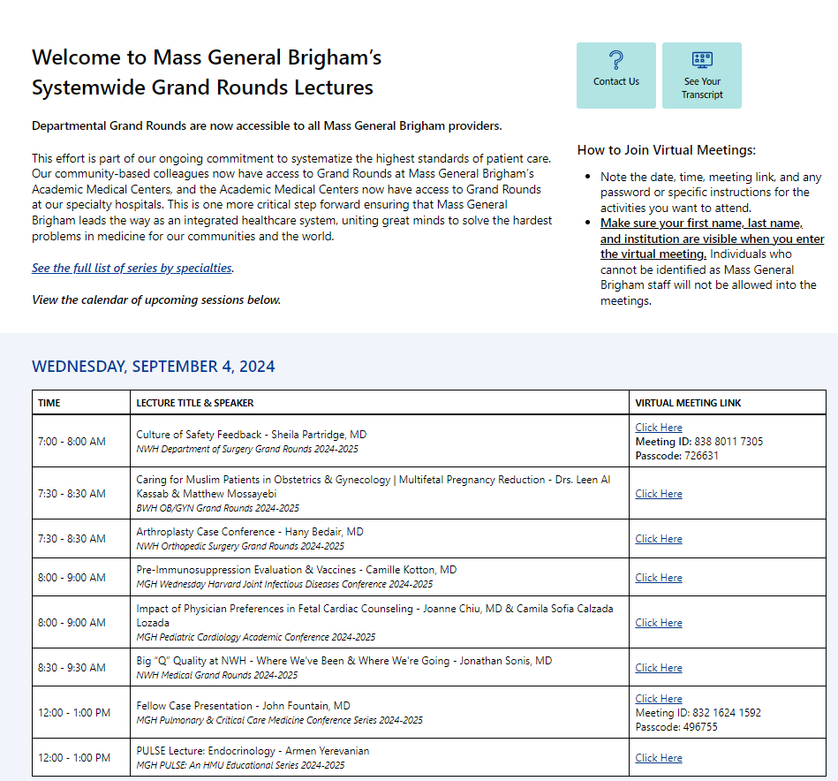
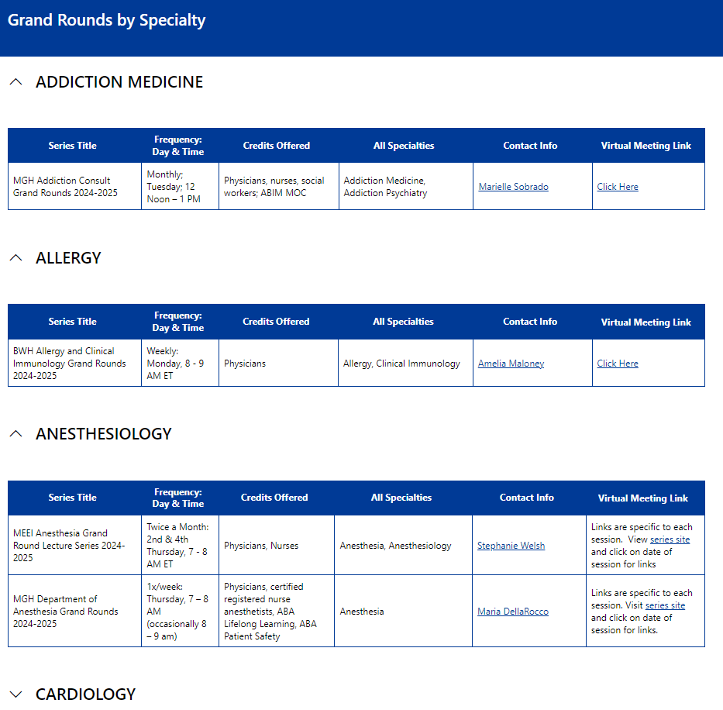
Vitals Site is Live!
Systemwide Grand Rounds - Home (sharepoint.com)

Slide 8
What’s Next
Explore Automation & Site Functionality
Feedback from users:
Improve filtering and search functionality on the Vitals site
Feedback from staff:
Much of the process for getting information from departments onto Vitals is manual
Long-term, manual is not ideal
Archived Recordings
Problems to Solve: Technical, Financial, Operational, Legal
Impact Assessment
Short term measures: Attendance, engagement, satisfaction
Long term: Improvements in knowledge, competence, performance, outcomes

Slide 9
What We Need from Series Directors and Coordinators
Required for all sessions:
Meeting link to participate (we recommend using one link for the series)
Put in the body text of the session
If you are using one link for the series, send to us by email as soon as it’s available: mgbcpd@mgb.org. The link is required for admin access to the series website.
Session topic and speakers
Please put the session topic in the title of the session.
Providing this information up-front will make things easier for you at check-in time
For sessions with “surprise cases” – put something generic in the title
Note about confidential sessions:
We recognize your series may have sessions that are meant only for your department. For these sessions, we ask that you put “DEPARTMENT ONLY” in the session title. Also, don’t list the Zoom link or use a distinct Zoom link. Examples include:
Department meetings
Sessions designed for department only (for example, sessions that involve discussions about professional challenges and career issues)

Slide 10
Approval and Access to the Series
To receive access to your series, you need to:
Submit disclosure and mitigation forms for all planners
Attend one of the live trainings or view the archived version
Material required to built the series
Any Evaluation question updates
Date for the 1st session
The virtual meeting link for your 2024-2025 series.
We need this link in advance to facilitate systemwide access to the series. We will make this link available on the internal site we are building to communicate how MGB clinicians can participate in each series. We will also include this link on your series and session landing pages.

Slide 11
Now what – Flowchart overview
Create additional sessions
Upload the documents
CPD reviews documents
Make necessary updates then click ready for review
Feedback
Approval
Receive code

Slide 12
Flowchart Create Session
Create additional sessions
Upload the documents
CPD reviews documents
Make necessary updates then click ready for review
Feedback
Approval
Receive code

Slide 13
How to create a new session:
Use Repeat this session
x
DO NOT use Add Content

Slide 14
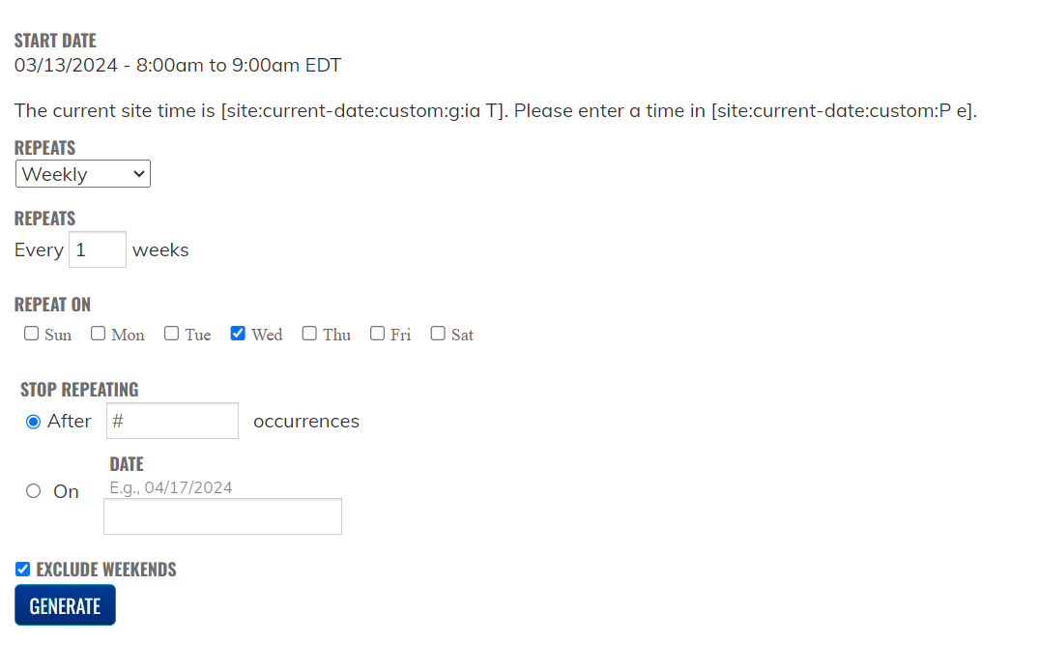
Steps to Create the Session
Open the main page to your series (link was sent with the approval)
Go to the list of sessions
Click on an existing session to open the session
Click on Repeat this session
Follow the steps to repeat the session
Click Generate

Slide 15
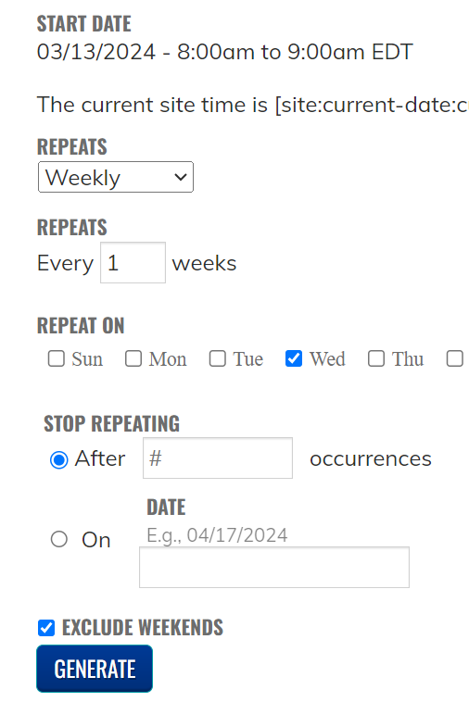
Steps to Create the Session cont.
Select from drop down how often to repeat
Daily
Weekly
Monthly
Yearly

Slide 16
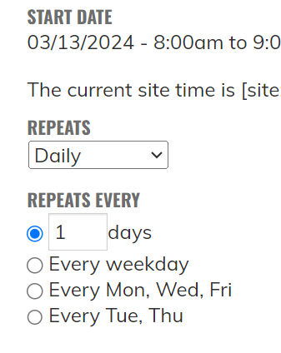
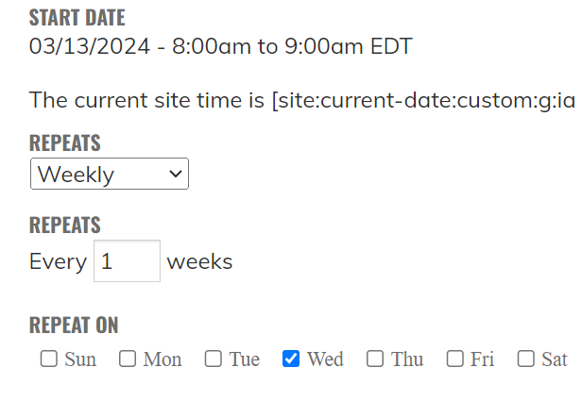
Repeat Daily/Weekly
Daily Options
Weekly Options

Slide 17
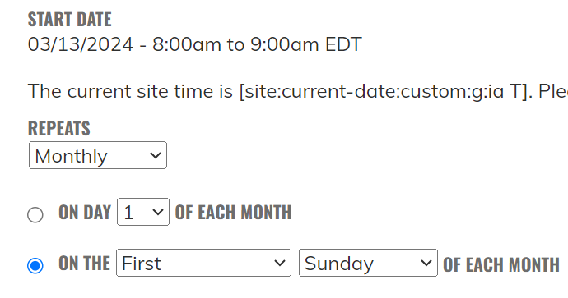
Repeat Monthly
Monthly Options

Slide 18
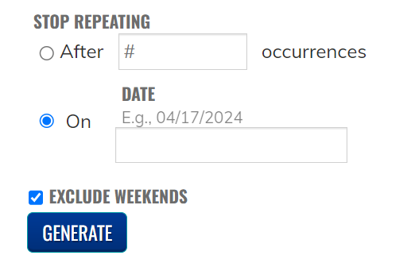
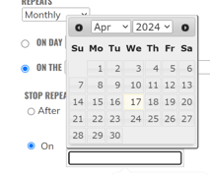
Stop Repeating

Slide 19
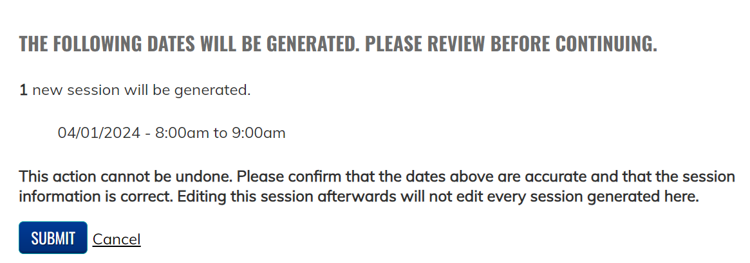
Generate New sessions
Remember: Once your sessions are created you are brought back to your starting session. Go back to the session list before updating a session.

Slide 20
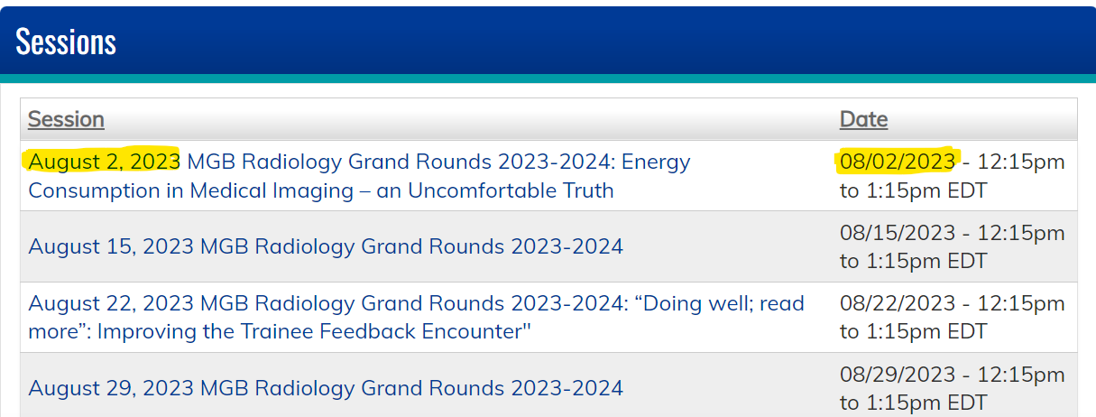
Update New sessions
Go Back to your session list located at the bottom of your series landing page
You will notice after you repeat the sessions all the titles on the left side will have the same name – all these sessions need to be updated. So they look like the screenshot below the date in title on the left side is the same as the date on the right side.

Slide 21
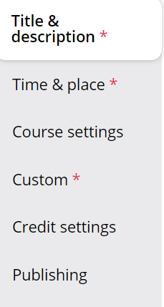
Edit a session
Click on the session to open it
Click the Edit tab
3 Areas to edit in a session
Title & Description
Time & Place (occasionally)
Custom

Slide 22
Edit a session: Title & Description
Click Title & Description Tab
Include in the title:
Date of the session
Title of the series
Topic of the session and speaker name
In the Body of the session
Confirm the Course Director & Coordinator information is correct
Confirm the link for the session is correct

Slide 23
Edit a session: Time & Place
Click Time & Place
Confirm this date matches the date in the title of the session. The system uses this date not the title date.

Slide 24
Flowchart Create Session
Create additional sessions
Upload the documents
CPD reviews documents
Make necessary updates then click ready for review
Feedback
Approval
Receive code

Slide 25
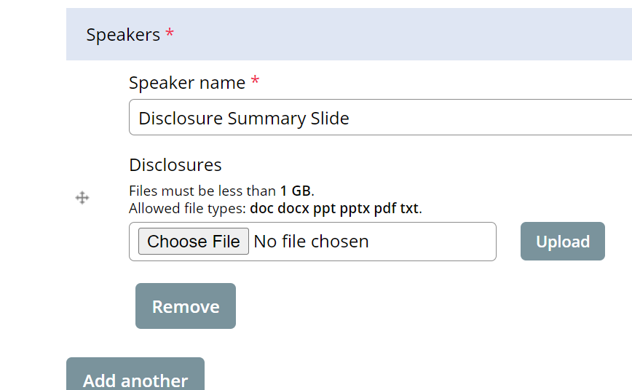
Upload the documents: Custom
Here is where you spend most of your time
The following items are uploaded to this section:
Disclosure Summary Slide Template
Sent in the email with the link to your site
A copy is saved in the final Check-in session)
Disclosures for all speakers/moderators/anyone doing introductions
Mitigation form for any speaker who has a financial disclosure
Any additional forms as needed

Slide 26
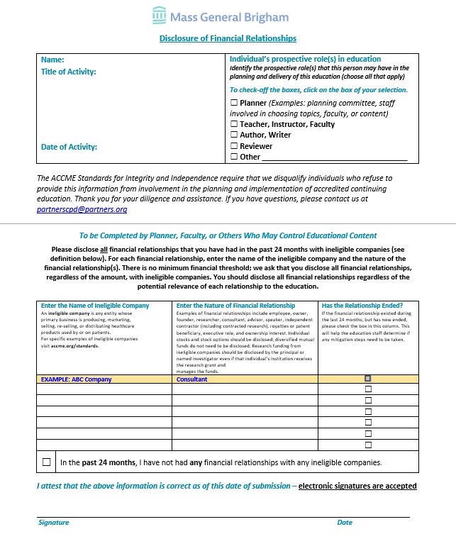
Disclosure form
What should you look for before submitting to us?
Signature for both pages (can be typed)
Dated correctly for 2024-2025 series (not from last year)
Are any of the following listed?
Owner
Founder
Employee
Equity (usually means “private equity”)
Stock in a startup (usually means private stock)

Slide 27
Disclosure Summary & Accreditation Slides

Slide 28
Disclosure Summary & Accreditation Slide (Continued)
On Page 1
Add the title, date and time in the heading section
Add the learning objectives for the session
Update the Faculty/speaker for the session
If the session has risk – confirm the risk statement is included on the slide

Slide 29
Disclosure Summary & Accreditation Slide (Continued)
On Page 2
Add the names of speakers with no disclosures in the speaker has no financial relationships
Add the names of speakers along with the relationships and companies to the speaker has a financial relationship
Format to add speakers with relationships
Speaker Name
Relationship: Company 1, Company 2
Example:
John Smith, MD
Consultant: CVS
Research Support: CVS, Shire

Slide 30
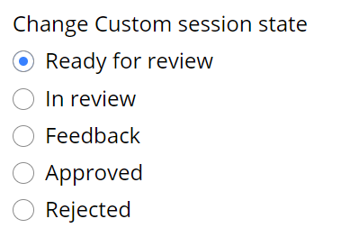
Save the session with the updates
All the documents have been updated and uploaded to the system
Now What?
At the top of the screen
Click Ready For Review
At the bottom of the screen
Click Save

Slide 31
Flowchart Create Session
Create additional sessions
Upload the documents
CPD reviews documents
Make necessary updates then click ready for review
Feedback
Approval
Receive code

Slide 32
CPD review documents
The CPD team will review the documents and the session will either be approved or in Feedback.
An email will be sent to let you know the state.
If a 2x/year or quarterly eval is requested. This is when the CPD team will update the session to include the evaluation information and will update the session and include a comment to let you know a required evaluation is included in the session

Slide 33
Flowchart Create Session
Create additional sessions
Upload the documents
CPD reviews documents
Make necessary updates then click ready for review
Feedback
Approval
Receive code

Slide 34
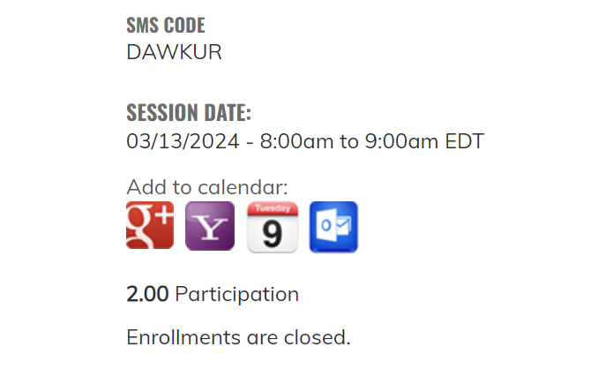
CPD Approved / Receive Code
The code will be available to series admins who are logged into the system once the disclosures and disclosure summary are uploaded, and the session is approved
On the session page towards the bottom of the screen is where you will find the code
The disclosure summary slide should be updated with the code but does not need to be re-uploaded to the system. You will need to show these slides as the start of the session and the code should not be available in recordings that are not eligible for credit.

Slide 35
Flowchart Create Session
Create additional sessions
Upload the documents
CPD reviews documents
Make necessary updates then click ready for review
Feedback
Approval
Receive code

Slide 36
CPD Feedback / add updates and Click Ready for Review
When a session is in Feedback, all emails are set to you.
The CPD team is not notified of any updates until the Ready for review button is selected.

Slide 37
Add a series Admin to the site
Add new or additional administrator to a series
Send an email to mgbcpd@mgb.org
Reminder all series admins should be trained prior to gaining access to the system

Slide 38
Checklists
Series Website Access
Submit to mgbcpd@mgb.org:
Provide the virtual meeting link for the 2024-2025 series, so we can share on the systemwide site
Provide any additional evaluation questions
Provide all planner mitigation forms
Training:
Coordinator should review training material
Session Approval
Upload to “Custom” tab on session:
Add Disclosure form for each speaker
Add Mitigation form for any speaker who has a financial disclosure
Add the Accreditation and Disclosure Summary slides
Update the “Title and Description” tab:
Include the topic of the session in the title
If session is confidential to your department, write “DEPARTMENT ONLY” in the tile
Make sure the date is correct
Add the link to participate in the meeting virtually in the body text section

Slide 39
Help is always available on the weekly open hours calls
Tuesdays 10:30 to 11:30
Thursday 2:00 to 3:00 Here is the Zoom link: https://partners.zoom.us/j/85164198890

Slide 40
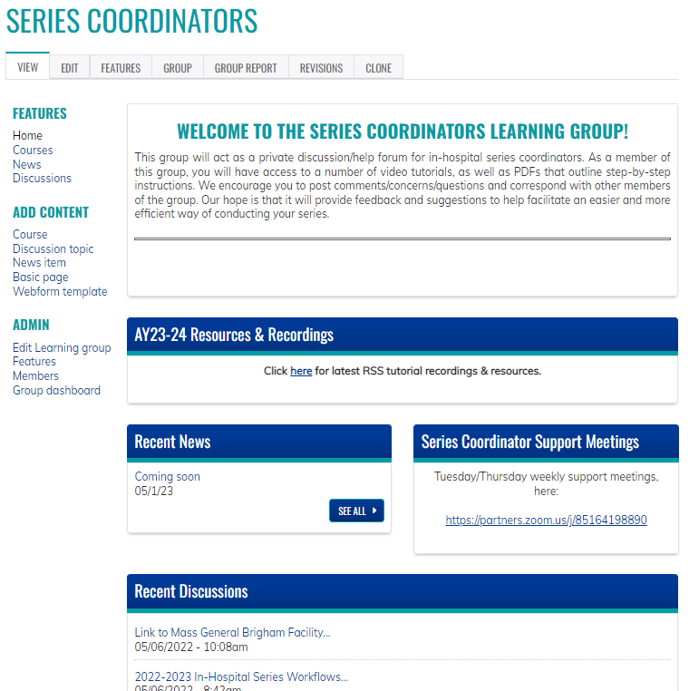
Resources/workflows can be found here: https://cpd.partners.org/series-coordinators/

Slide 41
Reports

Slide 42
How to view Course Report for Series/Session To see who attended the session
Open the session
Click on the Course Report tab
You will receive the following report for the session
The same report is available for the series by clicking Group report on the series landing page.

Slide 43
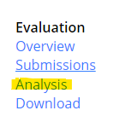
How to view Evaluation Data for Session
Open the session with an evaluation
Click Course Reports
Click Course Objects
Under the evaluation section click Analysis

Slide 44
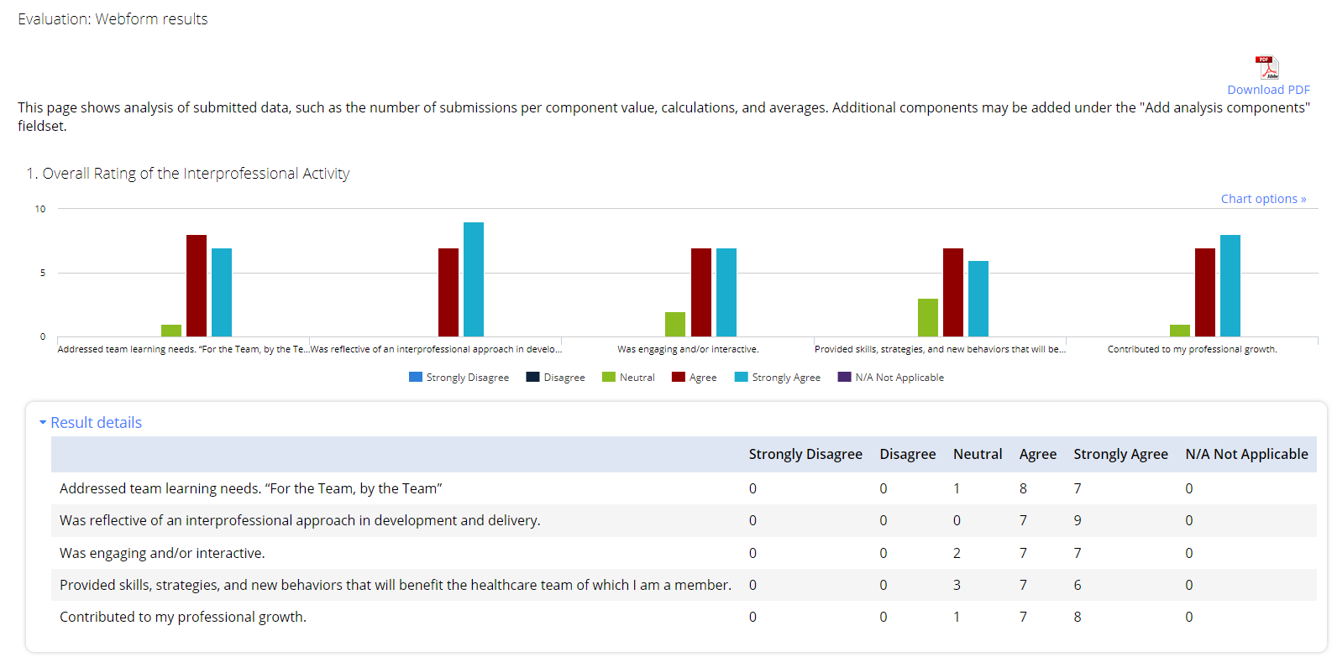
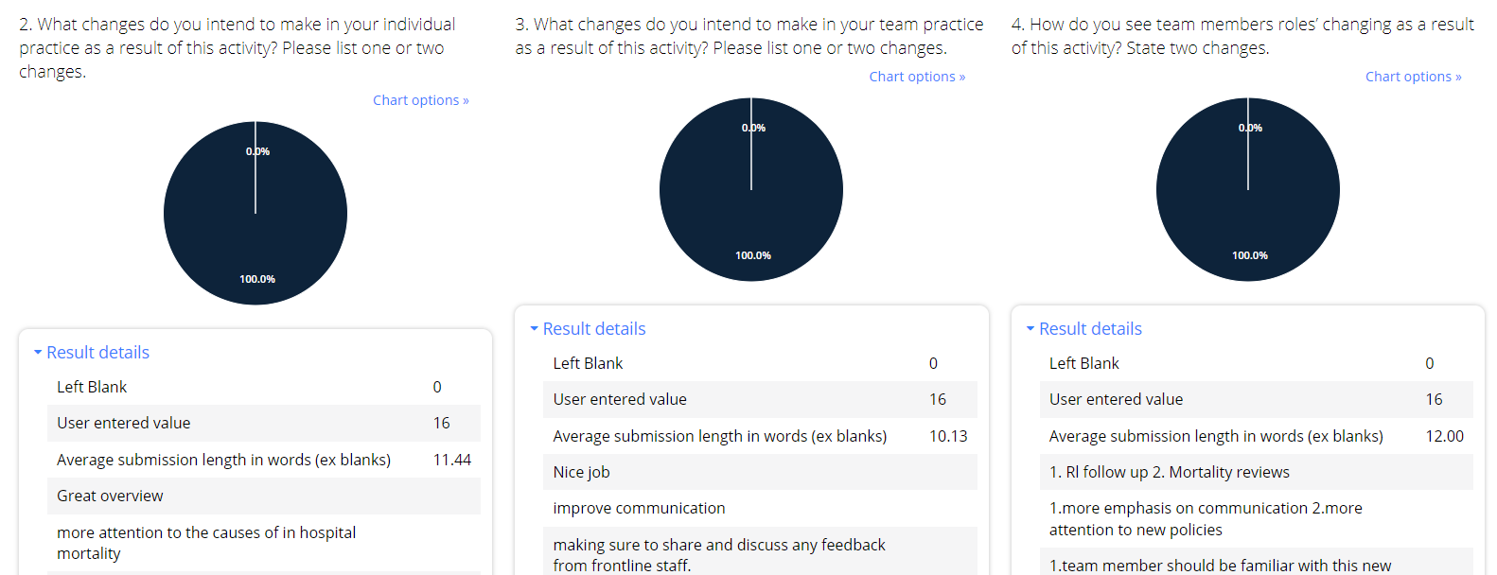
How to view Evaluation Data for Session cont.
Here is an example of the report data
At the top right corner of the screen – there is the option to download a pdf file of the report

Slide 45
Follow Us On Social Media!
We are growing our followers and standing on social media to:
Showcase all the great education projects being done around the system
Market courses to external participants
Follow us and share your news, to help grow the community!
Twitter:
@MassGenBrighCPD
LinkedIn:
Mass General Brigham Continuing Professional Development
https://www.linkedin.com/showcase/mass-general-brigham-office-of-continuing-professional-development

Slide 46
Thank you for attending today’s meeting!
We will email you with our next webinar date
Reminder to please send all questions to mgbcpd@mgb.org
These slides will be available on the Course Coordinator Virtual Community: https://cpd.partners.org/series-coordinators

Slide 48
Appendix

Slide 49
Disclosure Summary & Accreditation Slides
Requirements:
Must be provided/presented prior to the start of the session
ALL planners indicated in proposal must be listed on ALL disclosure summaries (the planner section should not change)
The speaker section will change per session
If a planner is also a speaker, they must be listed in both the planner and speaker sections of the disclosure summary
How to list:
If someone has no financial relationships with an ineligible company to disclose, you just need to list their name
If someone does have financial relationships with an ineligible company to disclose, you need to add their name, the role within the company, and the company name.
If someone does have financial relationships that ended with an ineligible company to disclose, you need to add their name, the role within the company, and the company name. Ended in parenthesis would be added also.
Example:
John Smith, MD Advisory Board: Novartis; Bayer Steering Committee: Pfizer (ended)

Slide 50
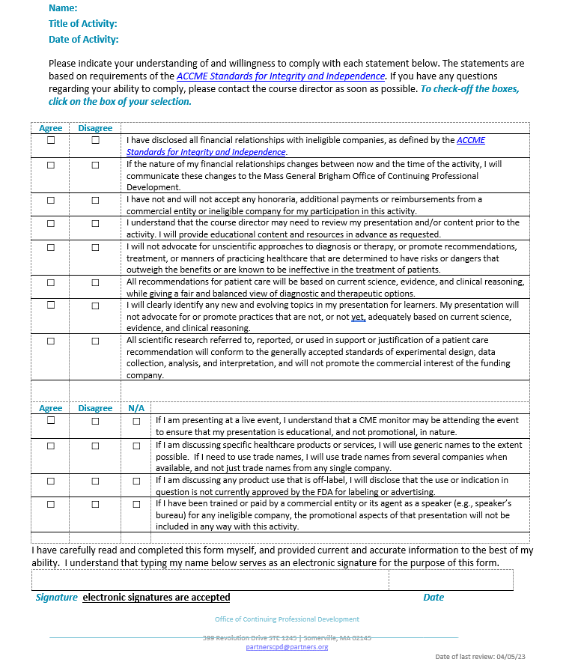
Disclosure Form
On Page 1 the Speakers should list all financial relationships with ineligible companies
Page 2 was updated to align with the ACCME Standards for Integrity and Independence

Slide 51
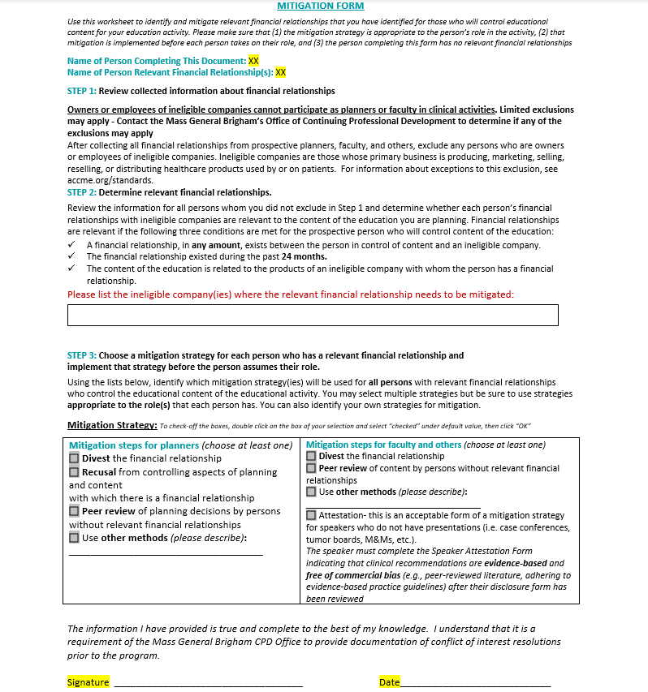
Mitigation Form
Must be completed by a planner with no financial relationships
All series must have a minimum of 1 planner with nothing to disclose.
The person who has the financial relationship(s) cannot complete their own mitigation form
List the ineligible companies related to the presentation
Left side of the chart is to be completed for planners
Right side of the chart is to be completed for speakers
For speakers: attestation is only acceptable as a mitigation strategy if there is no presentation to be peer reviewed
Examples: case conferences, journal clubs, etc.
If attestation is chosen as the mitigation strategy, the speaker will need to complete a separate attestation form after the mitigation form is completed/signed

Slide 52
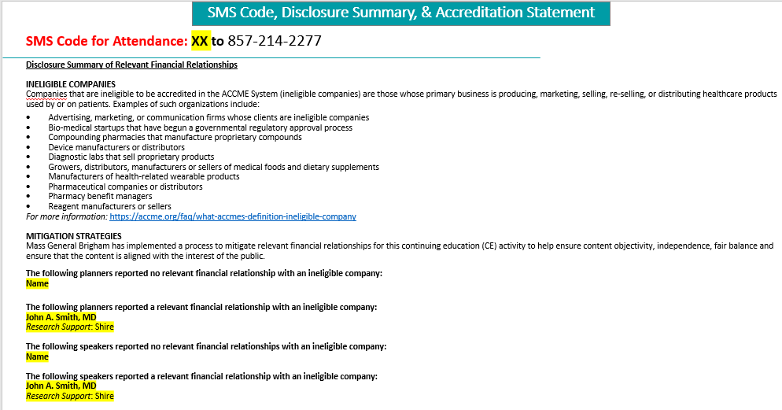
Disclosure Summary & Accreditation Slide (Continued)

Slide 53
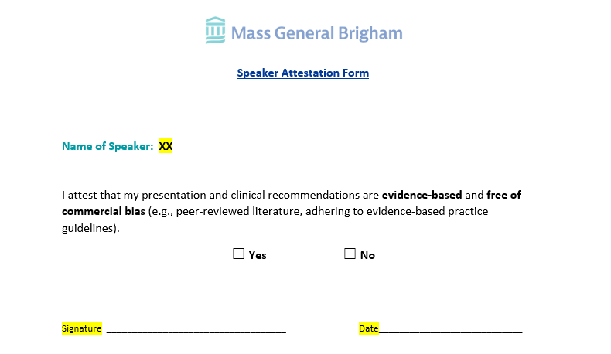
Speaker Attestation Form
Attestation is only acceptable as a mitigation strategy if there is no presentation to be peer reviewed
Examples: case conferences, journal clubs, etc.
This form must be completed by the speaker after the course director/planner reviews the disclosure form

