Slide 1

Adding Quality Improvement MOC to Your Series
Continuing Professional Development
October 28, 2024

Slide 2

Agenda
Important Dates
What is Quality Improvement MOC?
Proposal and approval
Fee
What to do throughout the series
Closing the project and receiving credit
Q&A
  Please send questions to mgbcpd@mgb.org
Slides will be provided by email and posted on the web site.
Notes:
And the agenda will be…

Slide 3

Important Dates
Deadlines:
  Check ins for 2023-2024 are past due.
    Please contact Michelle with any questions about Check ins
Plan Ahead:
  Proposals for next year will be due in:
    March for series with a summer start date.
    May for series with a fall start date.
Tuesday/Thursday Open Hours Meeting:
Tuesdays 10:30 to 11:30
Thursday 2:00 to 3:00
Support Meeting Zoom link: https://partners.zoom.us/j/85164198890

Slide 4
Upcoming Trainings
Upcoming Trainings | Audience | Training Date
Nov training | 2023-2024 Follow up stats/reports | Nov 2024
Dec training | RSS Teams Channel review | Dec 2024
Jan training | Systemwide Grand Rounds Phase 2: Archived Library | Jan 2025
Feb training | Proposal review/questions | Feb 2025
Please let us know if there is any training/webinars that would interest you!!

Slide 5

Joint Accreditation
Mass General Brigham was awarded Joint Accreditation from December 6, 2021, through November 2025.
Joint Accreditation for Interprofessional Continuing Education™ offers organizations the opportunity to be simultaneously accredited to provide continuing education activities for multiple professions through a single, unified application process, fee structure, and set of accreditation standards.
Jointly accredited providers may choose to award single profession or interprofessional continuing education credit (IPCE) to:
  Athletic Trainers
  Dentists
  Dietitians
  Nurses
  Optometrists
  Physician Assistants
  Pharmacists
  Physicians
  Psychologists
  Social Workers

Slide 6
Quality Improvement Credits
Give your providers credit for work they are already doing.
Mass General Brigham Continuing Professional Development is the system-wide sponsor for the American Board of Medical Specialties (ABMS) Portfolio Program. We help Mass General Brigham-affiliated physicians and physician assistants fulfill ABMS Maintenance of Certification (ABMS MOC®) Improvement in Medical Practice (Part IV) requirements. Our goal is for providers to receive credit for work they are already doing and that is meaningful to them.
Projects receive both MOC and CE credits.

Slide 7
Who Can Receive Credit
 | CME/CE | MOC
Physicians | Up to 30 CME credits | Up to 30 ABIM points 25 ABP Improvement in Medical Practice Points
Nurses | Up to 30 CE credits | N/A
Physician Assistants | Up to 30 CE credits | 30 PI CME Credits
Psychologists | Up to 30 CE credits | N/A
NOTE: You can include QI MOC on series that already also have MOC 2/Lifelong Learning MOC.

Slide 8
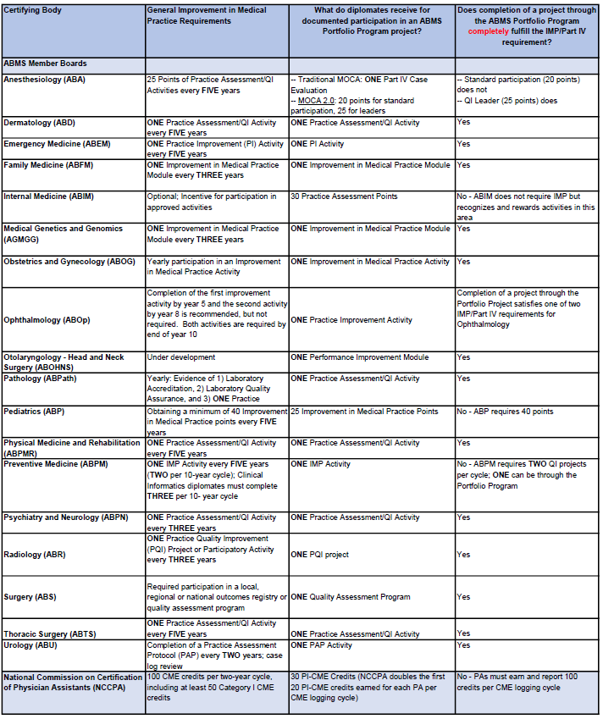
Requirements and Credit Translation for Continuing Certification
Overview:
This table identifies the ABMS Member Boards and the National Commission on Cetrification of Physician Assistants’ (NCCPA) requirements for meeting continuing certification MOC) through the ABMS Portfolio Program.
Conclusion:
Diplomates can meet fully meeting their QI MOC requirements or substantially contribute to their MOC requirements by completing 1 QI project.
Last updated: May 2021

Slide 9
ABMS portfolio program member boards
We can submit quality improvement MOC projects for the following boards:
American Board of Anesthesiology
American Board of Dermatology
American Board of Emergency Medicine
American Board of Family Medicine
American Board of Internal Medicine
American Board of Medical Genetics and Genomics
American Board of Obstetrics and Gynecology
American Board of Ophthalmology
American Board of Otolaryngology – Head and Neck Surgery
American Board of Pathology
American Board of Pediatrics
American Board of Physical Medicine and Rehabilitation
American Board of Preventive Medicine
American Board of Psychiatry and Neurology
American Board of Radiology
American Board of Surgery
American Board of Thoracic Surgery
American Board of Urology

Slide 10
How to Attach QI MOC to a Series
Submit Series Proposal, indicate you want to add QI MOC
We will send you a separate MOC proposal. Complete the proposal.
  You will need to state:
    The problem you want to address
    What you aim to improve
    How you will measure progress
We will send you a separate approval for the MOC project.
Discuss the project with your series attendees so they know what to expect.
Make a plan for how you will involve series participants and ensure meaningful participation
  Plan to communicate baseline data and progress on measures throughout the series
  Plan to dedicate at least 1 session to education around the measure you are trying to improve
  Plan to communicate final data results before the end of the series
Complete project completion report
Compile list of clinicians who meaningfully participated and are eligible for credit
We will build an attestation site where participants can complete their evaluation requirement and provide their board information
We will report all participants by the end of the calendar year the project ends.

Slide 11
Documents Needed to Arrange the Credit
Proposal
Final Project Report
Participant List

Slide 12
Example
Series: MGH Calcium Grand Rounds
Project Title: Reducing Incidence of hypocalcemia in patients who have abnormal renal function and receive denosumab
Project Aim: We will decrease the incidence of hypocalcemia (low blood calcium levels) in patients who have abnormal renal function and receive denosumab from several cases per quarter to 0-1 cases per quarter by 06/2024.
Project Outcomes: Aim achieved
  Note: Not required to meet aim for people to receive credit. It is ok if you don’t meet your aim.

Slide 13
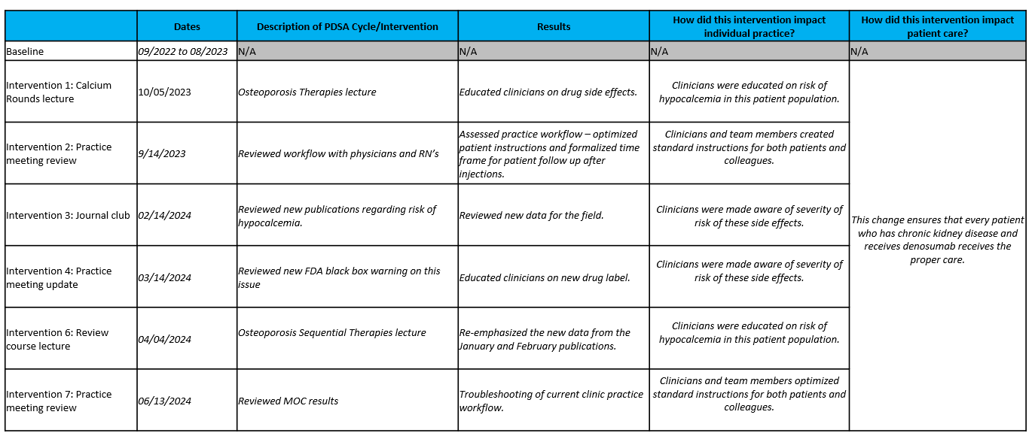
Example Interventions

Slide 14
Next steps
Contact us if you want to add QI MOC to your series!
The fee is $750 additional. This is compared to $2500 + for QI projects not attached to a series.
Many of you are doing education that helps support quality and safety goals – we want to give your participants credit for this work!

Slide 15


Follow Us On Social Media!
We are growing our followers and standing on social media to:
  Showcase all the great education projects being done around the system
  Market courses to external participants
Follow us and share your news, to help grow the community!
  Twitter:
    @MassGenBrighCPD
  LinkedIn:
    Mass General Brigham Continuing Professional Development
    https://www.linkedin.com/showcase/mass-general-brigham-office-of-continuing-professional-development

Slide 16

Thank you for attending today’s meeting!
We will email you with our next webinar date
  Reminder to please send all questions to mgbcpd@mgb.org
These slides will be available on the Course Coordinator Virtual Community: https://cpd.partners.org/series-coordinators

Slide 17


