Slide 1

In-Hospital Series Annual Training Webinar
Continuing Professional Development
April 17, 2025

Slide 2

Agenda
Important Dates & Upcoming Trainings
Joint Accreditation Professions
Systemwide Access Initiative
Approval and Access to the Series
EthosCE Refresh
RSS coordinator site & forms download
  Teams site
Changes to Session builds
Check-In Process
Evaluation Process
Owners, Employees and (Sometimes) Founders
CME That Counts for MOC
Skills for Professional Development
Q&A
Please send questions to mgbcpd@mgb.org
This webinar is being recorded and slides will be available on our website

Slide 3

Important Dates
Proposal Deadlines:
  Series beginning in the Summer (start date: July 1 – Aug 31, 2025): April 7, 2025 (past)
  Series beginning in the Fall (start date Sept 1, 2025, or later): June 7, 2025
Late Fees:
  Proposals received more than 1 week after the deadline will incur a non-refundable late fee of $750.
Tuesday/Thursday Open Hours Meeting:
Tuesdays 9:00 to 10:00
Thursday 2:00 to 3:00
Support Meeting Zoom link: https://partners.zoom.us/j/85164198890

Slide 4
2025 Training
Upcoming Trainings | Audience | Training Date | Registration Link
April training | Required In-Hospital Series training | April 17, 2025 (11::00-12:00PM) | Today's training
May training | In-Hospital Series Back-to-Basics & Reporting Training Webinar | May 15, 2025 (11:00 AM-12:00PM) | Register in advance for this meeting: https://partners.zoom.us/meeting/register/UafrqmXtQsSg-O35pzJ8Ug
June training | Systemwide Grand Rounds Phase 2: Archived Library | June 10, 2025 (1:00-2:00PM) | Register in advance for this meeting: https://partners.zoom.us/meeting/register/mnvdYavrTxSnXrV7oezPyw
August training | In-Hospital Series Back-to-Basics & Reporting Training Webinar | August 2025 | TBD
Trainings material will be archived on https://cpd.partners.org/series-coordinators

Slide 5

Joint Accreditation
Mass General Brigham was awarded Joint Accreditation from December 6, 2021, through November 2025.
Joint Accreditation for Interprofessional Continuing Education™ offers organizations the opportunity to be simultaneously accredited to provide continuing education activities for multiple professions through a single, unified application process, fee structure, and set of accreditation standards.
Jointly accredited providers may choose to award single profession or interprofessional continuing education credit (IPCE) to:
  Athletic Trainers
  Dentists
  Dietitians
  Nurses
  Optometrists
  Physician Assistants
  Pharmacists
  Physicians
  Psychologists
  Social Workers

Slide 6
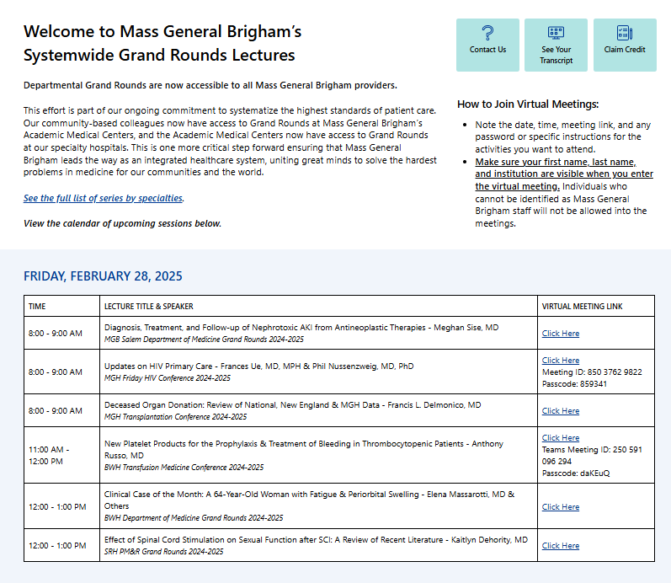
Systemwide Grand Rounds
Expanding Access Across MGB Hospitals
Launched on Vitals July 2024
Unifying Expertise
Access & Flexibility
Careful Content Management
Next Steps:
  Gather feedback and refine processes for continued improvement
  Launch library of on-demand recordings in summer 2025
10,371 site visits since launch
Access Grand Rounds On Vitals Today: https://partnershealthcare.sharepoint.com/sites/VitalsSystemwideGrandRounds
Notes:
Newsletter Blurb/Talking Points:
With the launch of departmental Grand Rounds being available system-wide this July, we have taken one more critical step forward, ensuring that Mass General Brigham leads the way as an integrated healthcare system, uniting great minds to solve the hardest problems in medicine for our communities and the world. Now, our community-based colleagues will have access to Grand Rounds at Mass General Brigham’s Academic Medical Centers, and the Academic Medical Centers will have access to Grand Rounds at our specialty hospitals. Mass General Brigham System-Wide Grand Rounds will be centrally located on the Vitals website. This initiative is being phased in by first providing links to livestream offerings when they occur. Arrangements are underway with Mass General Brigham Digital to archive lectures for on-demand viewing down the road, providing enhanced flexibility. We have been working with Mass General Brigham Vitals Communications to launch and advertise the site, starting at the end of June. Each of Mass General Brigham’s community hospitals has established point persons for cascading communication. Great care has been taken to ensure that sensitive clinical and/or administrative content (e.g., M&M Rounds, Tumor Boards, etc.) have been exempted from this initiative and that these lectures are only accessible internally. Over the next few months, we will focus on procuring feedback and refining our processes.

Slide 7
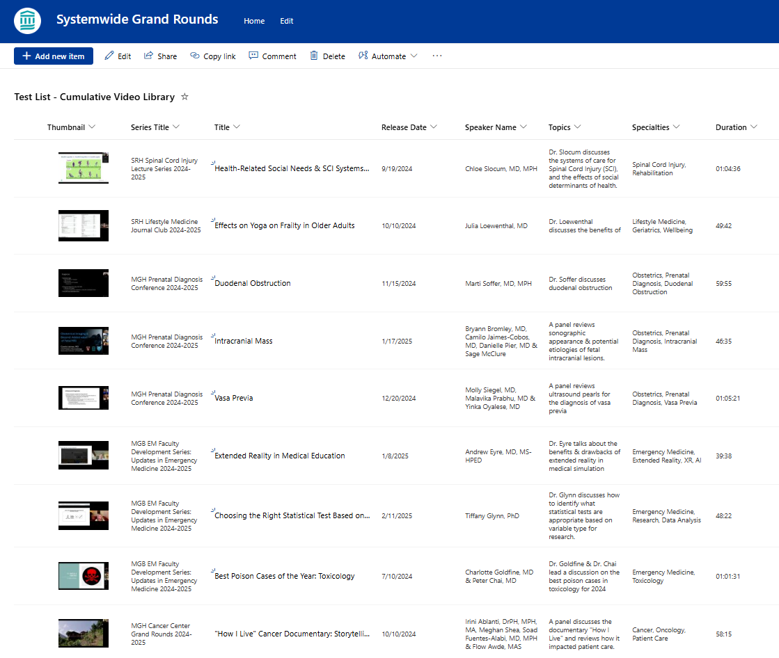
Systemwide Grand Rounds:
Preparing to Launch Library of Recordings
Expansion:
For the next academic cycle, MGB CPD will open a library of recorded sessions to all MGB staff. MGB CPD will continue to build out the platform and communicate with stakeholders (course directors and coordinators, Digital, A/V) to launch the library this summer.
The vision for the library is to make one central repository where all grand rounds recordings are housed. Learners will be able both to search the full list by topic or keyword and to easily view sessions for specific series. Credit will be available for 6 months after the session date.

Slide 8
Approval and Access to the Series
To receive approval to your series, you need to:
  Submit a proposal for the series
  Submit the list of planners for the series
  Send the on-line disclosure link to the planners
    I will compare the planner list and confirm a disclosure is received for all planners.
    An email will be sent to the coordinator with any missing disclosures for you to follow-up.
To receive access to your series, you need to:
  Submit missing mitigation forms for planners.
    A list of the missing mitigation forms will be sent with the approval
  Attend one of the live trainings or view the archived version. (✓doing now)
  Be added to the RSS Teams Site
Material required to build the series
  Date for the 1st session (should be included in the proposal)
  Recommend to provide the series Zoom link if known so the session can be built with the link.
  We plan to build all series a minimum of
  2 weeks prior to the 1st session!!
Notes:
Need to update with new dates

Slide 9
Required Information for Session Approval
Systemwide Grand Round Required Fields
  Add the speaker names and Credentials for all the session speakers
  Add the topic for the session (also include in the session title
    Topic for Session in the Session Title
    More than one topic: Use your judgement
    Surprise cases: Can put something general in the title
    Case topic in approval notes if you don’t want people to see beforehand
      When a session discusses cases – a brief description will be required for credit to be awarded for the series
  Include the zoom link for the live session if the session is not confidential
    Recommend to have 1 link for the series that all sessions use
Disclosure and Mitigation Forms
  A disclosure is needed for anyone speaking at the session
Disclosure Summary Slide
  A Template will be provided for your series and includes a 2025-2026 date (please note this template should be used unless other arrangement are made)

Slide 10
Disclosure and Mitigation Forms
Process Change
Speaker Disclosure/Mitigation Forms
  If using the online MSForms (Microsoft forms)
    All speaker(s) names should be provided
      The online disclosure link for your series and planners will be included when the series is built.
    Upload Mitigation Forms for speakers (not planners)
  If using the pdf disclosure version
    All speaker(s) disclosures should be provided
    Upload the disclosure (mitigation/attestation as needed) for all speakers
Please attend the refresher course in May and August for additional training

Slide 11
Additional Forms that may be Required for Session Approval
  Risk Management Form
    A completed form signed by a planner
    Risk has been an area that is difficult for physicians – please review your session to see if risk can be awarded.
  Attestation Form
    Signed by the speaker when a planner selects attestation as a mitigation strategy
    The speaker should complete the form after the planner completes a mitigation form and selects attestation as a mitigation strategy
    This mitigation strategy should be used only when the speaker has no slides
  Owner/Employee Content Review form and Presentation
    Only when requested should the presentation be uploaded to the session
    The Owner/Employee Content Review should be completed by a planner with no disclosures
  Recording Consent Form
    A speaker should complete this form when a session is being recorded

Slide 12
EthosCE Refresher
Create New Session
  Open an existing session
  Use “Repeat This Session” to generate new sessions
Upload Documents to a session
  Use Edit -> Custom
  Always select “Ready for Review” to sent a notification to the CPD team
  Submit documentation a few days in advance to allow time for review and include on the Systemwide Grand Rounds site
  Always select Ready for Review so an email is sent the session is ready for the CPD team
The code will be available to series admins once the disclosures and disclosure summary are uploaded, and the session is approved
Add new or additional administrator to a series
  Send an email to mgbcpd@mgb.org
  Reminder all series admins must have training prior to gaining access to the system
Please attend the refresher course in May and August for additional training

Slide 13

EthosCE Refresher: How participants claim credit
Process Change
Only attendees who are enrolled in a session can claim credit
  Ways to Enroll
    Texting attendance (most common)
      Text window is 1 hour prior to 6 months after the start date/time of the session
      Recordings on Vitals are eligible for credit for the same timeframe
      Texting phone number is: 857-214-2277
    Manually enroll attendees (series admins have access)

Slide 14
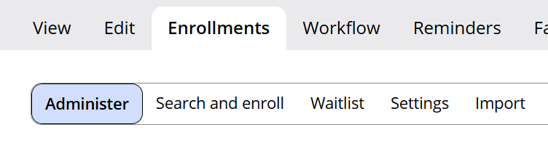
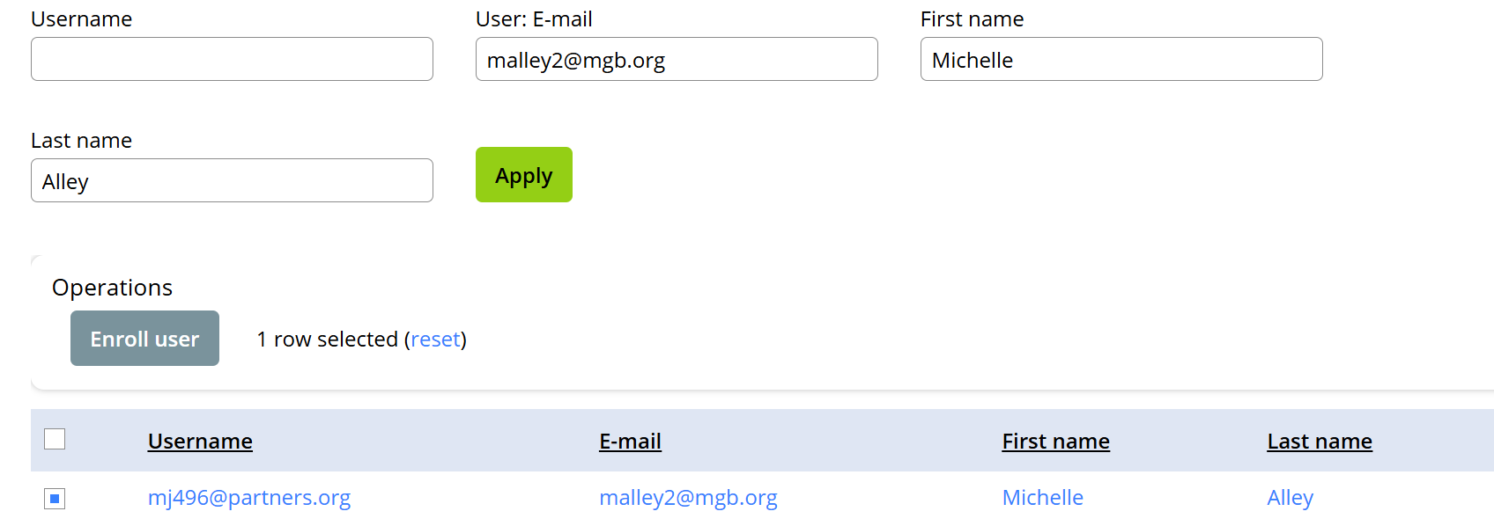
How to Manually Enroll Attendees in a Session
    All Series admins have access to manually enroll attendees
    Here are the steps:
      Open the session
      Select enrollments
      Select Search and enroll (you can search by 1 or multiple fields)
      Check the box next to the attendees name
      Click enroll user
      Click confirm
      Click Administer
      Search for attendee
      Check the box next to the name
      Click mark the box “Mark User Attended”
      Click confirm

Slide 15
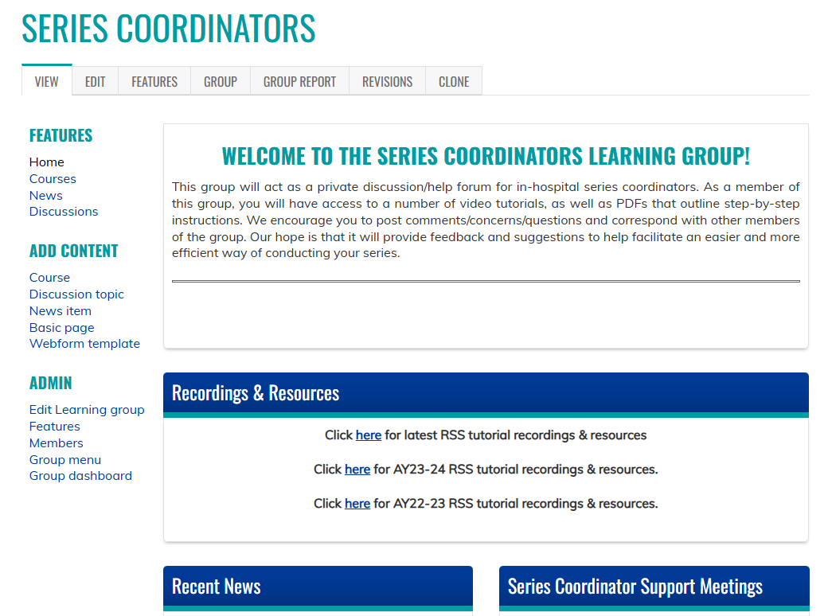
Series Coordinators Site
Resources/workflows can be found here: https://cpd.partners.org/series-coordinators/

Slide 16
Series Coordinators Site cont.
Partial list of documents available on the Series Coordinators Site
Disclosure Form
Mitigation Form
Speaker Attestation Form
Copyright & Consent Form
Employee - Owner Additional Information Form
Employee - Owner Content Review Form
Presentation Review Checklist
Risk Management Request Form
List of Verbs for Formulating Objectives
CME for MOC Program Guide
Patient Safety MOC Credit Request Form
Session Information Form (Final Check-in)
Additional Course Directors - Coordinators – Planners
Evaluation Template
Disclosure Summary Slides
2025-2026 Pricing for In-Hospital Series
https://cpd.partners.org/series-coordinators/

Slide 17

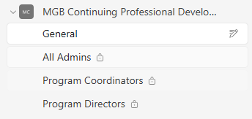
Teams Site: MGB Continuing Professional Development (CPD) - Regularly Scheduled Series
    Once the series is built, Series Directors, Coordinators and any others with admin access will be added to the new MGB Continuing Professional Development – Regularly Scheduled Series Teams Channel.
    A link to the Series Coordinator Learner Group has been added to the Channel
    Coordinators can use this site to reach out to others for questions regarding speaker’s disclosures or ask about session approvals, etc.
    The channel will also be used to share any new information or training/webinars that are scheduled

Slide 18

Check-In Process
Check the Ready for Review button in the Final Check-in Session and
hit Save!
The process can be this easy if…

Slide 19
Check-In Session Requirements
    All sessions includes a title/topic
    Speaker Disclosures for all sessions are uploaded
    Disclosure Summary Slide for all sessions include:
      Session title
      Session objectives
      Planner and Speaker Disclosures
      Accreditation statement for all professions
    All cancelled sessions are labeled cancelled and unpublished

Slide 20
Check-In Process cont.
But if there are questions or information is missing the CPD team will use the check-in session at the end of the series to let you know

Slide 21
Evaluation Process
  Evaluation Options:
  After Every Session
    Optional for any series
  2x Year (Recommended)
      2x/year: The CPD team will send an evaluation to all attendees for the series
        The results for your series will be available
        We will be combining the results for all series and sharing in a Webinar
        For series with ABIM, ABP or ABOHNS MOC, we will also send the evaluation results to the attendees, as part of the "evaluation and feedback" requirement.

Slide 22
Follow Up Surveys
  All series
    ~3-6 months after series closes: Follow-up Survey will be sent to all participants by CPD. Questions ask about changes to individual and team performance.
      The survey is built as an additional session in the series. You can view the results for the survey.
  Series that measure higher-level outcomes
    ~6 months after series closes: Survey to course directors for any series stating they plan to measure performance, quality, safety and/or patient outcomes
      We share a program-level report with all series that participate. We will also post the report on the series coordinator site.

Slide 23

Owners, Employees and (Sometimes) Founders
The following individuals are considered to have unresolvable financial relationships:
  Owners of ineligible companies (includes private stock owners)
  Employees of ineligible companies
  Founders of ineligible companies who are compensated with private stock, salary or stipend. They are the equivalent of an owner or employee.
These individuals may not:
  Control content of accredited education
  Participate as planners
  Participate as faculty
Source: https://www.accme.org/accreditation-rules/standards-for-integrity-independence-accredited-ce/standard-3-identify-mitigate-and-disclose-relevant-financial-relationships

Slide 24



Exceptions
Owners, employees and founders* of ineligible companies can participate as planners or faculty in these specific situations:
Not Related to Business
When the content of the activity is not related to the business lines or products of their employer/company.
Basic Science Research
When the content of the accredited activity is limited to basic science research, such as pre-clinical research and drug discovery, or the methodologies of research, and they do not make care recommendations.
Technicians
When they are participating as technicians to teach the safe and proper use of medical devices, and do not recommend whether or when a device is used.
*When founder receives private stock, salary or stipend
Source: https://www.accme.org/accreditation-rules/standards-for-integrity-independence-accredited-ce/standard-3-identify-mitigate-and-disclose-relevant-financial-relationships

Slide 25

Employees, Owners & Founders – Most Important Takeaway
Contact us as soon as you know you are inviting an owner, founder or employee speaker!
  Review of owners, founders, employees and stock owners of private companies takes time.
  We cannot provide credit until all the steps are complete.
  If we get it wrong, we risk losing accreditation.

Slide 26
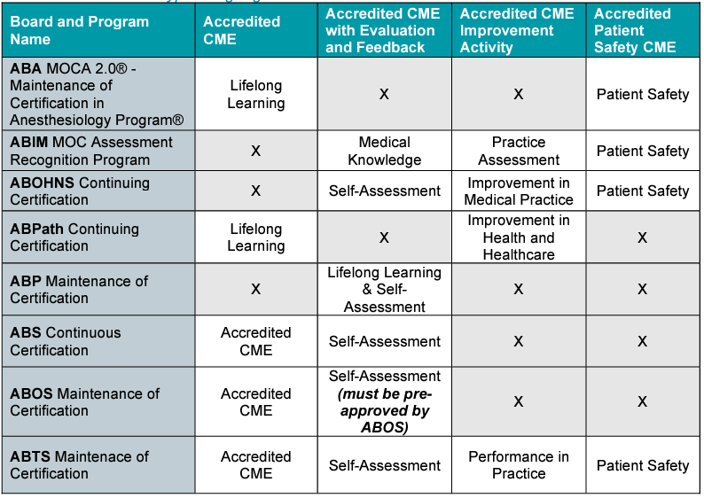
CME That Counts for Maintenance Of Certification (MOC)

Slide 27
MOC Reporting
In 2023, we implemented an update on EthosCE to make MOC credit claim and reporting easier.
Learners add their birthday and board information in their profile.
Reporting of learner participation in activities designated for MOC will be done immediately after the learner claims the MOC credit.
  The LMS has automatic reporting capabilities with the boards through our Joint Accreditation reporting system.
Please remind your learners to update their profiles!
Notes:
Add screen shot

Slide 28

Skills for Professional Development
Compliance with Mass General Brigham CPD’s requirements for Joint Accreditation standards:
  Collect disclosures and attestations from speakers. Escalate as needed to ensure compliance with deadlines.
  Submit timely documentation of series accreditation materials for CPD review
    Documentation for each session includes:
      Speaker and planner disclosure and attestation forms
      Mitigation forms for speakers with financial relationships to disclose
      Session announcements
      Disclosure summary for session as displayed to learners
      Attendance SMS code
    Documentation for series check-ins includes:
      Series session list with each session title, speaker and date
      Evaluation summary
      Answers to any CPD questions
Build each new session on EthosCE, the Mass General Brigham CPD’s learning management system. In 2021, coordinators were required to attend a training on how to use EthosCE. Coordinators create new sessions by copying a sample session built by CPD. Coordinators must ensure that the dates, times and titles for each session they build are accurate. Coordinators upload disclosures before each session. CPD reviews for approval. When CPD approves the session, the coordinator obtains the attendance SMS code and shares with the audience.
Download evaluation reports for series.
Provide customer service to series attendees. Escalate issues that coordinator can’t resolve on own to CPD

Slide 29


Follow Us On Social Media!
We are growing our followers and standing on social media to:
  Showcase all the great education projects being done around the system
  Market courses to external participants
Follow us and share your news, to help grow the community!
  X (formally known as Twitter):
    @MassGenBrighCPD
  LinkedIn:
    Mass General Brigham Continuing Professional Development
    https://www.linkedin.com/showcase/mass-general-brigham-office-of-continuing-professional-development

Slide 30

Thank you for attending today’s meeting!
We will email you with our next webinar date
Reminder to please send all questions to mgbCPD@mgb.org
These slides will be available on the Course Coordinator Virtual Community: https://cpd.partners.org/series-coordinators

Slide 31


