Slide 1

In-Hospital Series
Back-to-Basics
Training Webinar
Continuing Professional Development
May 15, 2025

Slide 2

Agenda
Important Dates
Joint Accreditation and requirements for interprofessional activity
Systemwide Access to In-Hospital Series
Approval and Access to the Series
Flowchart overview
Create Additional Sessions
Update Session
Upload Documents to a session
Forms for Session Approval
Add new or additional administrator to a series
Series Coordinator/Teams site
Zoom exceptions
Q&A
Please send questions to mgbcpd@mgb.org
This webinar is being recorded and slides will be available on our website

Slide 3

Important Dates
Proposal Deadlines:
  Series beginning in the Summer (start date: July 1 – Aug 31, 2025): April 7, 2025 (past)
  Series beginning in the Fall (start date Sept 1, 2025, or later): June 7, 2025
Late Fees:
  Proposals received more than 1 week after the deadline will incur a non-refundable late fee of $750.
Tuesday/Thursday Open Hours Meeting:
Tuesdays 9:00 to 10:00
Thursday 2:00 to 3:00
Support Meeting Zoom link: https://partners.zoom.us/j/85164198890
  (Note These meeting format will be changing to Teams – an email will be sent when this change will happen)
Notes:
\

Slide 4
Upcoming Trainings
Upcoming Trainings | Audience | Training Date | Registration Link
April training (Required) | Required In-Hospital Series training | April 17, 2025 (11:00AM-12:00PM) | Recording available: https://cpd.partners.org/series-coordinators/content/hospital-series-workflows-and-videos
May training | In-Hospital Series Back-to-Basics & Reporting Training Webinar | May 15, 2025 (11:00 AM-12:00PM) | Register in advance for this meeting: https://partners.zoom.us/meeting/register/UafrqmXtQsSg-O35pzJ8Ug
June training | Systemwide Grand Rounds Phase 2: Archived Library | June 10, 2025 (1:00-2:00PM) | Register in advance for this meeting: https://partners.zoom.us/meeting/register/mnvdYavrTxSnXrV7oezPyw
August training | In-Hospital Series Back-to-Basics & Reporting Training Webinar | August 2025 | TBD

Slide 5

Joint Accreditation
Mass General Brigham was awarded Joint Accreditation from December 6, 2021, through November 2025.
Joint Accreditation for Interprofessional Continuing Education™ offers organizations the opportunity to be simultaneously accredited to provide continuing education activities for multiple professions through a single, unified application process, fee structure, and set of accreditation standards.
Jointly accredited providers may choose to award single profession or interprofessional continuing education credit (IPCE) to:
  Athletic Trainers
  Dentists
  Dietitians
  Nurses
  Optometrists
  Physician Assistants
  Pharmacists
  Physicians
  Psychologists
  Social Workers

Slide 6
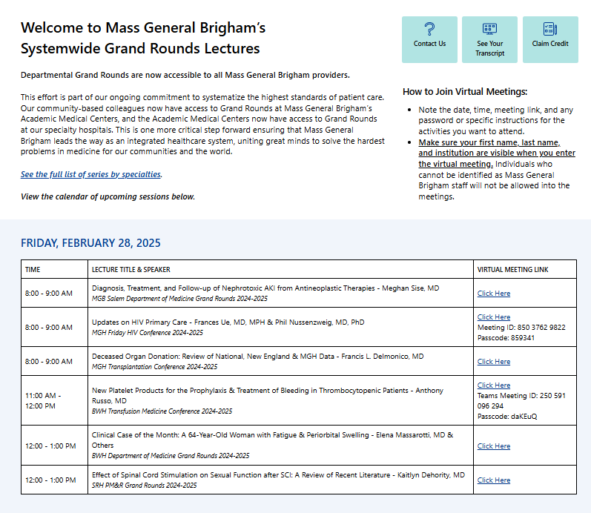
Systemwide Grand Rounds
Expanding Access Across MGB Hospitals
Launched on Vitals July 2024
Unifying Expertise
Access & Flexibility
Careful Content Management
Next Steps:
  Gather feedback and refine processes for continued improvement
  Launch library of on-demand recordings in summer 2025
10,371 site visits since launch
Access Grand Rounds On Vitals Today: https://partnershealthcare.sharepoint.com/sites/VitalsSystemwideGrandRounds
Notes:
Newsletter Blurb/Talking Points:
With the launch of departmental Grand Rounds being available system-wide this July, we have taken one more critical step forward, ensuring that Mass General Brigham leads the way as an integrated healthcare system, uniting great minds to solve the hardest problems in medicine for our communities and the world. Now, our community-based colleagues will have access to Grand Rounds at Mass General Brigham’s Academic Medical Centers, and the Academic Medical Centers will have access to Grand Rounds at our specialty hospitals. Mass General Brigham System-Wide Grand Rounds will be centrally located on the Vitals website. This initiative is being phased in by first providing links to livestream offerings when they occur. Arrangements are underway with Mass General Brigham Digital to archive lectures for on-demand viewing down the road, providing enhanced flexibility. We have been working with Mass General Brigham Vitals Communications to launch and advertise the site, starting at the end of June. Each of Mass General Brigham’s community hospitals has established point persons for cascading communication. Great care has been taken to ensure that sensitive clinical and/or administrative content (e.g., M&M Rounds, Tumor Boards, etc.) have been exempted from this initiative and that these lectures are only accessible internally. Over the next few months, we will focus on procuring feedback and refining our processes.

Slide 7
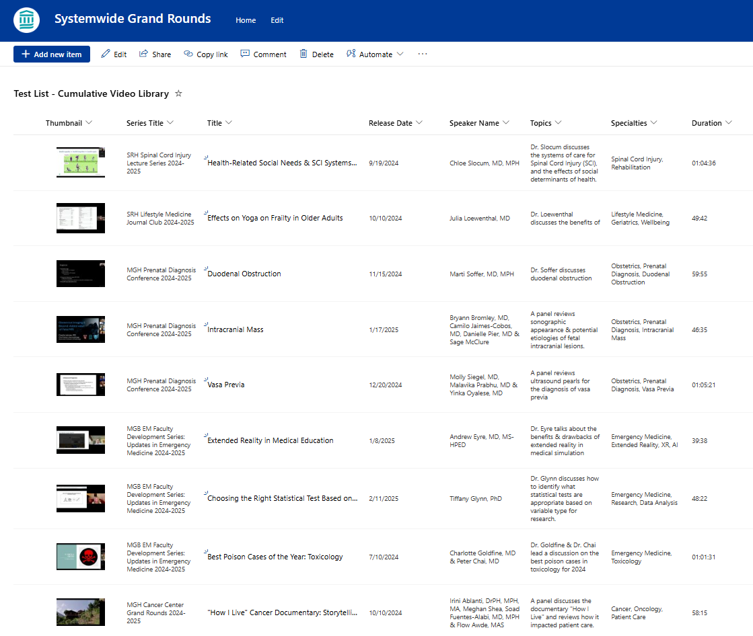
Systemwide Grand Rounds:
Preparing to Launch Library of Recordings
Expansion:
For the next academic cycle, MGB CPD will open a library of recorded sessions to all MGB staff. MGB CPD will continue to build out the platform and communicate with stakeholders (course directors and coordinators, Digital, A/V) to launch the library this summer.
The vision for the library is to make one central repository where all grand rounds recordings are housed. Learners will be able both to search the full list by topic or keyword and to easily view sessions for specific series. Credit will be available for 6 months after the session date.

Slide 8
Approval and Access to the Series
To receive approval for your series, you need to:
  Submit disclosure for all planners
    An email will be sent if a planner disclosure is missing
    . There must be a planner from each credit offered to represent the profession and offer input from the profession's perspective.
    There must be at lease 1 planner who does not have any relationships
  Attend the required April In-hospital session or view the archived version
To build and receive access for your series, the following is needed:
  Date for the 1st session (included in the proposal)
  Mitigation forms for planners with disclosures (the list of planners requiring mitigation form will be provided in the approval email)
  We plan to build all series a minimum of
  2 weeks prior to the 1st session!!

Slide 9
Now what – Flowchart overview
Create additional sessions
Upload the documents
CPD reviews documents
Make necessary updates then click ready for review
Feedback
Approval
Receive code

Slide 10
Flowchart Create Session
Create additional sessions
Upload the documents
CPD reviews documents
Make necessary updates then click ready for review
Feedback
Approval
Receive code

Slide 11
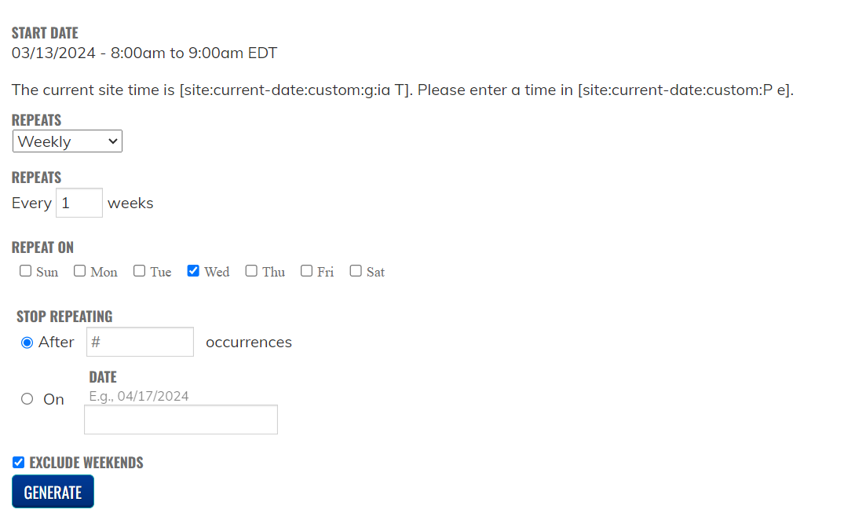
Steps to Create the Session
Open the main page to your series (link was sent with the series is ready email)
Go to the list of sessions
Click on an existing session to open the session
Click on Repeat this session
Follow the steps to repeat the session
Click Generate

Slide 12
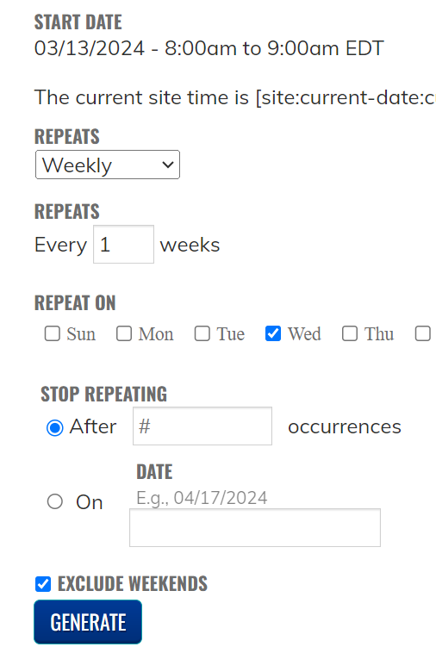
Steps to Create the Session cont.
Select from drop down how often to repeat
  Daily
  Weekly
  Monthly
  Yearly

Slide 13
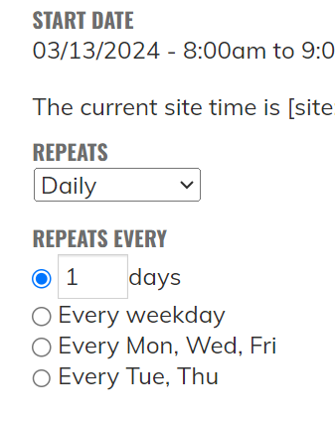
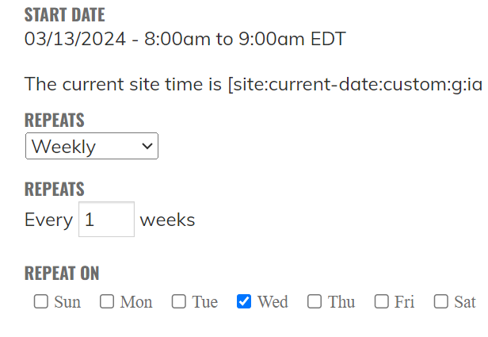
Repeat Daily/Weekly
Daily Options
Weekly Options

Slide 14
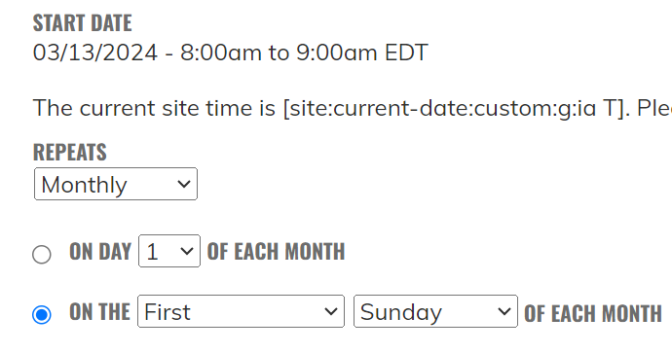
Repeat Monthly
Monthly Options

Slide 15
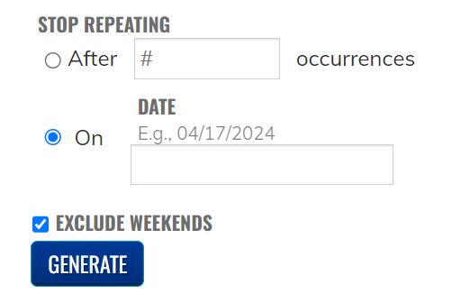
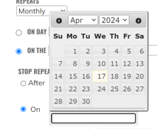
Stop Repeating

Slide 16
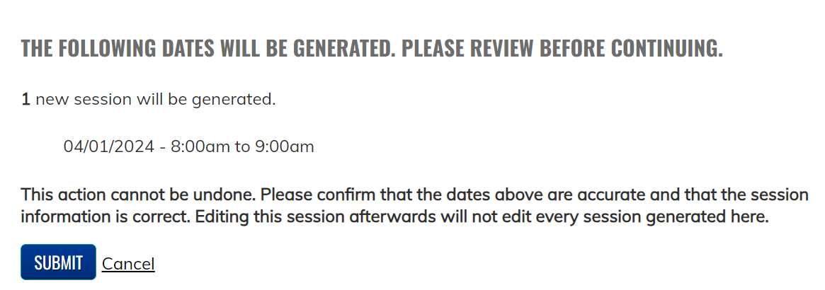
Generate New sessions
Remember: Once your sessions are created you are brought back to your starting session. Go back to the session list before updating a session.

Slide 17
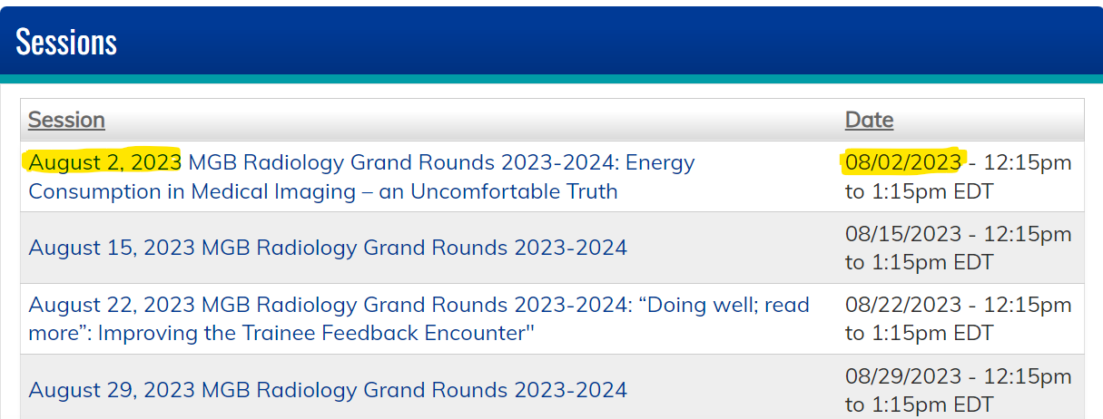
Update New sessions
Go Back to your session list located at the bottom of your series landing page
You will notice after you repeat the sessions all the titles on the left side will have the same name – all these sessions need to be updated. So they look like the screenshot below the date in title on the left side is the same as the date on the right side.
Notes:
You will notice after you update all the titles on the left side will have the same name – all these sessions need to be updated. So they look like the series screenshot below the date in title on the left side is the same as the date on the right side.

Slide 18
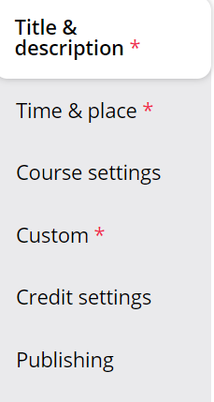
Edit a session
Click on the session to open it
Click the Edit tab
3 Areas to edit in a session
Title & Description
Time & Place (occasionally)
Custom

Slide 19
Edit a session: Title & Description
Click Title & Description Tab
  Include in the title:
    Date of the session
    Title of the series
    Topic of the session
  In the Body of the session
    Confirm the Course Director information is correct
    Confirm the link for the session is correct

Slide 20
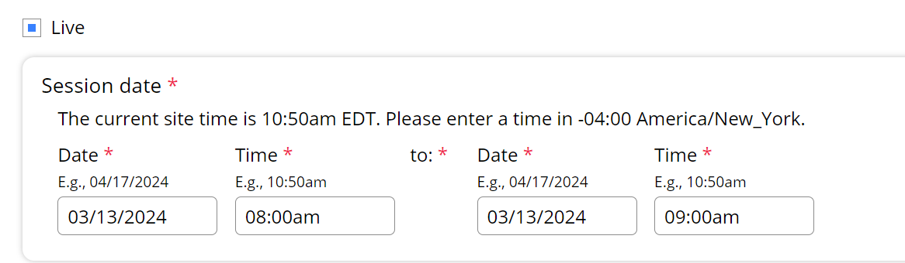
Edit a session: Time & Place
Click Time & Place
Confirm this date matches the date in the title of the session. The system uses this date not the title date.

Slide 21
Flowchart Create Session
Create additional sessions
Upload the documents
CPD reviews documents
Make necessary updates then click ready for review
Feedback
Approval
Receive code

Slide 22
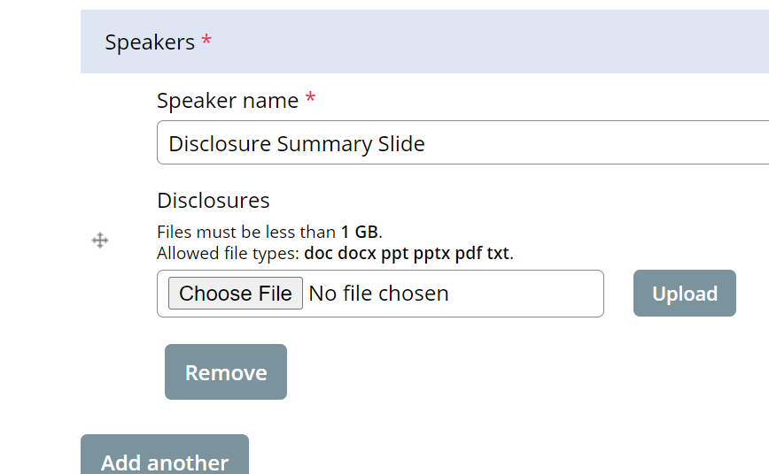
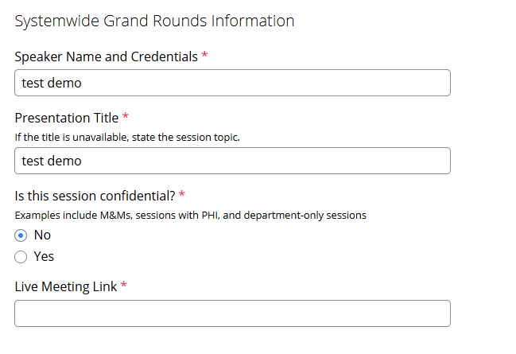
Upload the documents: Custom
Here is where you spend most of your time
The following items are uploaded to this section:
Disclosure Summary Slide (A template will be sent in the approval email we send with the link to your site)
Disclosures for all speakers/moderators/anyone doing introductions
Mitigation form for any speaker who has a financial disclosure
Any additional forms as needed
Don’t forget to update the Systemwide Grand Round section for the session

Slide 23
Additional Forms that may be Required for Session Approval
  Risk Management Form
    A completed form signed by a planner
    Risk has been an area that is difficult for physicians – please review your session to see if risk can be awarded.
  Attestation Form
    Signed by the speaker when a planner selects attestation as a mitigation strategy
    The speaker should complete the form after the planner completes a mitigation form and selects attestation as a mitigation strategy
    This mitigation strategy should be used only when the speaker has no slides
  Owner/Employee Content Review form and Presentation
    Only when requested should the presentation be uploaded to the session
    The Owner/Employee Content Review should be completed by a planner with no disclosures
  Recording Consent Form
    A speaker should complete this form when a session is being recorded

Slide 24
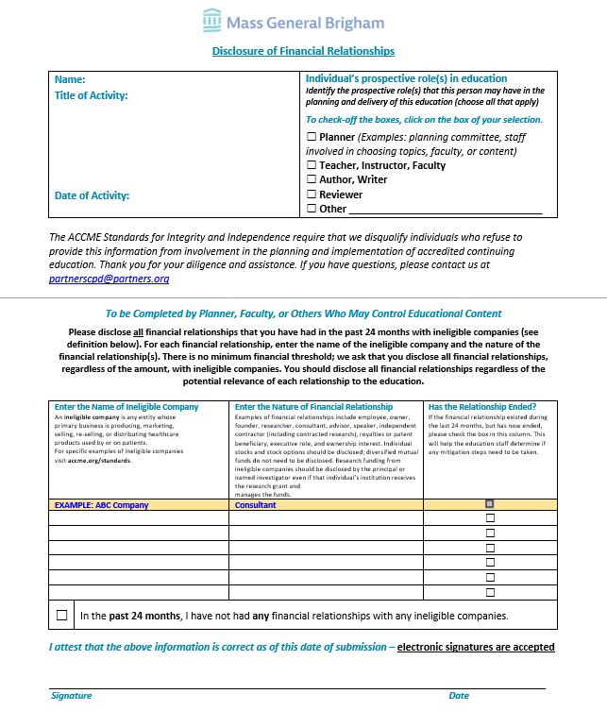
Disclosure form
What should you look for before submitting to us?
Signature for both pages (can be typed)
Dated correctly (not from last year)
Are any of the following listed?
  Owner
  Founder
  Employee
  Equity (usually means “private equity”
  Stock in a startup (usually means private stock)
Notes:
Recommend June training – sent ot us as soon as possible

Slide 25
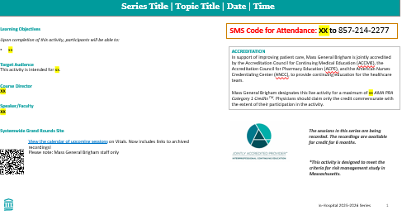
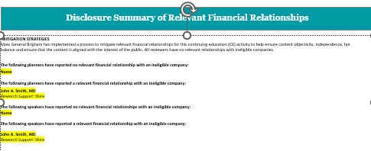
Disclosure Summary & Accreditation Slide

Slide 26
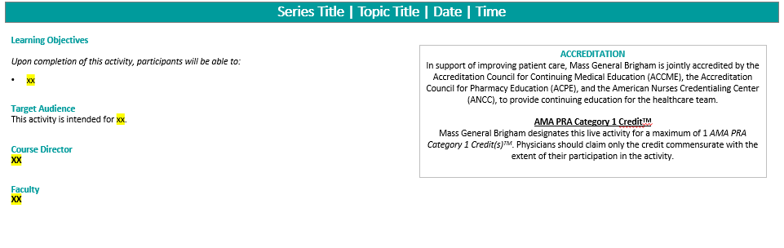
Disclosure Summary & Accreditation Slide (Continued)
On Page 1
Add the title, date and time in the heading section
Add the learning objectives for the session
Update the Faculty/speaker for the session

Slide 27
Disclosure Summary & Accreditation Slide (Continued)
On Page 2
Add the names of speakers with no disclosures in the speaker has no financial relationships
Add the names of speakers along with the relationships and companies to the speaker has a financial relationship
Format to add speakers with relationships
Speaker Name
Relationship: Company 1, Company 2
Example:
John Smith, MD
Consultant: CVS
Research Support: CVS, Shire

Slide 28
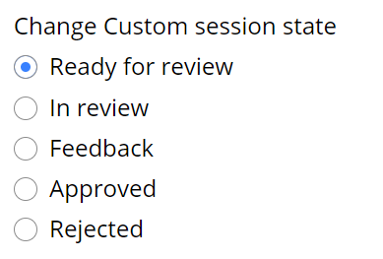
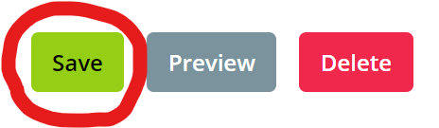
Save the session with the updates
All the documents have been updated and uploaded to the system
Now What?
At the top of the screen
Click Ready For Review
At the bottom of the screen
Click Save

Slide 29
Flowchart Create Session
Create additional sessions
Upload the documents
CPD reviews documents
Make necessary updates then click ready for review
Feedback
Approval
Receive code

Slide 30
CPD review documents
The CPD team will review the documents and the session will either be approved or in Feedback.
An email will be sent to let you know the state.
If risk is requested. This is when the CPD team will update the session to include the risk information and include a comment to let you know a risk has been added in the session

Slide 31
Flowchart Create Session
Create additional sessions
Upload the documents
CPD reviews documents
Make necessary updates then click ready for review
Feedback
Approval
Receive code

Slide 32
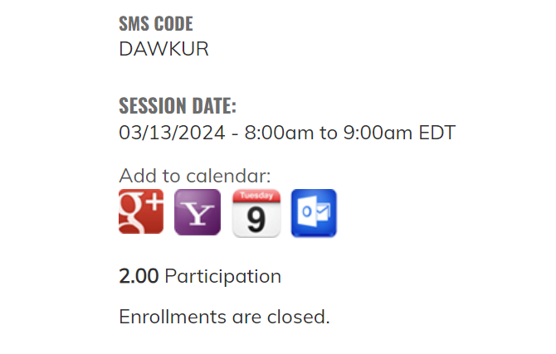

CPD Approved / Receive Code
The code will be available to series admins who are logged into the system once the disclosures and disclosure summary are uploaded, and the session is approved
On the session page towards the bottom of the screen is where you will find the code
The disclosure summary slide should be updated with the code but does not need to be re-uploaded to the system. You will need to show these slides as the start of the session and the code should not be available in recordings that are not eligible for credit.

Slide 33
Flowchart Create Session
Create additional sessions
Upload the documents
CPD reviews documents
Make necessary updates then click ready for review
Feedback
Approval
Receive code

Slide 34
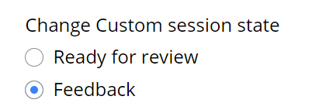
CPD Feedback / add updates and Click Ready for Review
When a session is in Feedback, all emails are set to you.
The CPD team is not notified of any updates until the Ready for review button is selected.

Slide 35
Add a series Admin to the site
Add new or additional administrator to a series
  Send an email to mgbcpd@mgb.org
  Reminder all series admins must have training prior to gaining access to the system
  The new admin must have an account on the system
  Go to https://cpd.partners.org and login with single sign on (SSO)

Slide 36
Checklists
Series Website Access
Submit to mgbcpd@mgb.org:
Provide the virtual meeting link for the 2025-2026 series, so we can share on the systemwide site
Provide all planner mitigation forms
Training:
Coordinator needs to take a training (either today’s or the one from 4/17)
Session Approval
Upload to “Custom” tab on session:
Disclosure form for each speaker
Mitigation form for any speaker who has a financial disclosure
Accreditation and Disclosure Summary slides
Update the “Title and Description” tab:
Include the topic of the session in the title
  If session is confidential to your department, write “DEPARTMENT ONLY” in the tile
Make sure the date is correct
Add the link to participate in the meeting virtually in the body text section
Notes:
Create 2 checklists
Checklist for access to their series and check list for approval

Slide 37
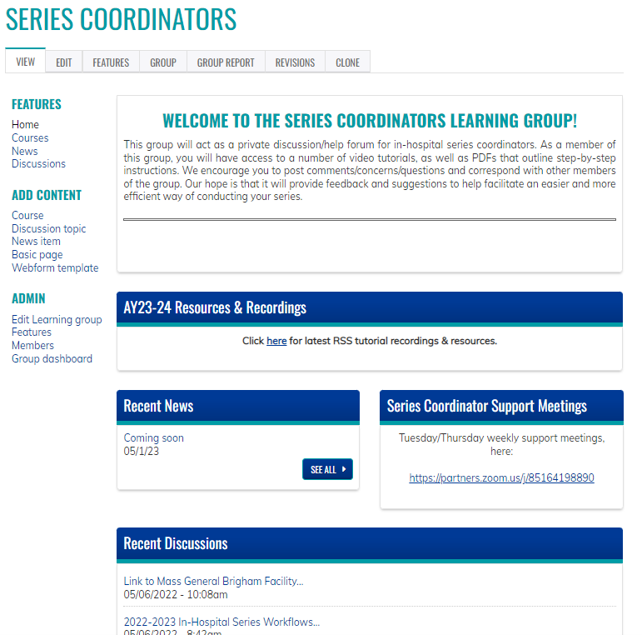
Resources/workflows can be found here: https://cpd.partners.org/series-coordinators/

Slide 38
Series Coordinators Site cont.
Partial list of documents available on the Series Coordinators Site
Disclosure Form
Mitigation Form
Speaker Attestation Form
Copyright & Consent Form
Employee - Owner Additional Information Form
Employee - Owner Content Review Form
Presentation Review Checklist
Risk Management Request Form
List of Verbs for Formulating Objectives
CME for MOC Program Guide
Patient Safety MOC Credit Request Form
Session Information Form (Final Check-in)
Additional Course Directors - Coordinators – Planners
Evaluation Template
Disclosure Summary Slides
2025-2026 Pricing for In-Hospital Series
https://cpd.partners.org/series-coordinators/

Slide 39
Series Coordinators Site cont.
Partial list of documents available on the Series Coordinators Site
Disclosure Form
Mitigation Form
Speaker Attestation Form
Copyright & Consent Form
Employee - Owner Additional Information Form
Employee - Owner Content Review Form
Presentation Review Checklist
Risk Management Request Form
List of Verbs for Formulating Objectives
CME for MOC Program Guide
Patient Safety MOC Credit Request Form
Session Information Form (Final Check-in)
Additional Course Directors - Coordinators – Planners
Evaluation Template
Disclosure Summary Slides
2025-2026 Pricing for In-Hospital Series
https://cpd.partners.org/series-coordinators/

Slide 40

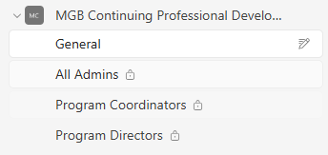
Teams Site: MGB Continuing Professional Development (CPD) - Regularly Scheduled Series
    Once the series is built, Series Directors, Coordinators and any others with admin access will be added to the new MGB Continuing Professional Development – Regularly Scheduled Series Teams Channel.
    A link to the Series Coordinator Learner Group has been added to the Channel
    Coordinators can use this site to reach out to others for questions regarding speaker’s disclosures or ask about session approvals, etc.
    The channel will also be used to share any new information or training/webinars that are scheduled

Slide 41
Help is always available on the weekly open hours calls
Tuesdays 9:00 to 10:00
Thursday 2:00 to 3:00
Here is the Zoom link: https://partners.zoom.us/j/85164198890

Slide 42
Education Exemptions: Changes to Zoom
Message from the MGB Education Office Leadership
As many of you know, MGB Digital is phasing out generalized use of Zoom and Dropbox in favor of Teams and the One Drive for internal-facing communications. For ZOOM, the MGB Education office have secured exceptions for individual people engaged in select education activities. These include virtual recruiting, external-facing grand rounds, and events with external participants, or in numbers larger than Teams can currently accommodate. Due to the large number of requests and the limited timeframe, the education office was unable to pre-approve these exceptions in advance, but we were able to have Digital outline the system's plans and the education-approved exceptions.
Please do be parsimonious and coordinate to the minimum number of accounts required to successfully continue your essential activities, as mass requests for all education personnel will not be approved and could jeopardize our ability to maintain those exceptions that are necessary.
We did not receive education exceptions for Dropbox, but it appears to be the case that there are quite a few parameters that are allowed for continued access for many active users. We did hear from a handful of people who work organizing educational events with non-MGB collaborators, and would encourage those people to ask for exceptions should the need arise in their individual cases.
We thank you in advance for balancing the need for professional recruitment and events with careful stewardship of MGB resources as software firms institute more aggressive pricing models.

Slide 43
Education Exemptions: Changes to Zoom
Who should request an exemption:
Series that run external grand rounds (outside Mass General Brigham)
Series that host sessions with a numbers larger than Teams can currently accommodate (many hundreds or thousands of participants)
Timeframe for exemption:
Exemptions are SHORT TERM
Exemptions will be granted through September 2025. Exemptions will be re-evaluated in fall 2025.
Deadline for exemption request:
You must switch to Teams or re-register for Zoom by June 13
It appears your exemption will need to be in place before June 13 to make this deadline
So, do it as soon as possible

Slide 44
Education Exemptions: Changes to Zoom
Only series that broadcast outside of MGB should request an exemption
How to request your exemption:
Email General Support: Digital Collaborative Media Team (PCMVideoconferencing@partnershealthcare.onmicrosoft.com)
Email for urgent escalations: ResearchTechEscalations@mgb.org (Also applies to education.)
Be sure to coordinate to the minimum number of accounts required to successfully continue your essential activities.
Example: If you are using the course director’s Zoom account, and that account will continue for patient care purposes, continue to use that account and do not request a second exemption.
Note about Dropbox:
We encourage those in education using Dropbox for outside collaboration to ask for exceptions should the need arise in their individual cases.

Slide 45


Follow Us On Social Media!
We are growing our followers and standing on social media to:
  Showcase all the great education projects being done around the system
  Market courses to external participants
Follow us and share your news, to help grow the community!
  X (formally known as Twitter):
    @MassGenBrighCPD
  LinkedIn:
    Mass General Brigham Continuing Professional Development
    https://www.linkedin.com/showcase/mass-general-brigham-office-of-continuing-professional-development

Slide 46

Thank you for attending today’s meeting!
We will email you with our next webinar date
Reminder to please send all questions to mgbcpd@mgb.org
These slides will be available on the Course Coordinator Virtual Community: https://cpd.partners.org/series-coordinators

Slide 47


Slide 48
Appendix

Slide 49
Disclosure Summary & Accreditation Slides
Requirements:
Must be provided/presented prior to the start of the session
ALL planners indicated in proposal must be listed on ALL disclosure summaries (the planner section should not change)
The speaker section will change per session
If a planner is also a speaker, they must be listed in both the planner and speaker sections of the disclosure summary
How to list:
  If someone has no financial relationships with an ineligible company to disclose, you just need to list their name
  If someone does have financial relationships with an ineligible company to disclose, you need to add their name, the role within the company, and the company name.
  If someone does have financial relationships that ended with an ineligible company to disclose, you need to add their name, the role within the company, and the company name. Ended in parenthesis would be added also.
Example:
John Smith, MD
Advisory Board: Novartis; Bayer
Steering Committee: Pfizer (ended)
Notes:
Add a note - we will provide a template for your series

Slide 50
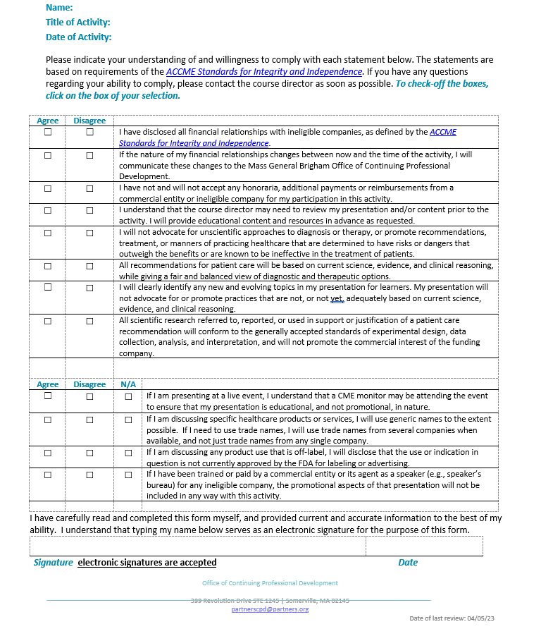
Disclosure Form
On Page 1 the Speakers should list all financial relationships with ineligible companies
Page 2 was updated to align with the ACCME Standards for Integrity and Independence

Slide 51
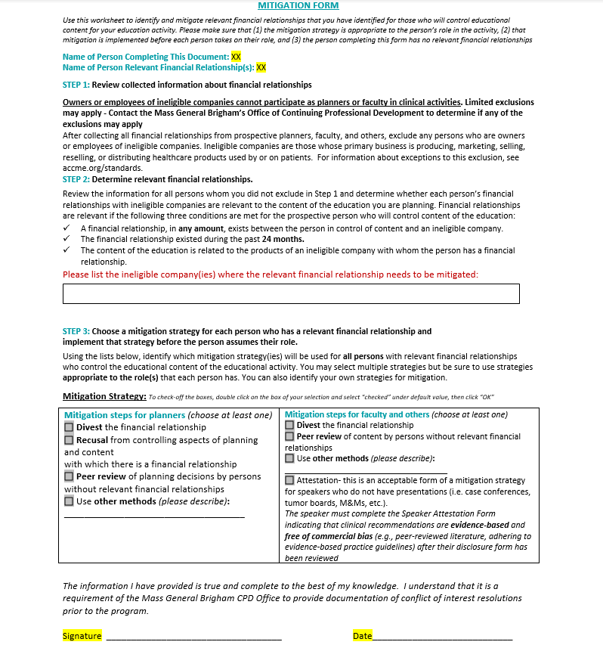
Mitigation Form
Must be completed by a planner with no financial relationships
  All series must have a minimum of 1 planner with nothing to disclose.
  The person who has the financial relationship(s) cannot complete their own mitigation form
List the ineligible companies related to the presentation
Left side of the chart is to be completed for planners
Right side of the chart is to be completed for speakers
For speakers: attestation is only acceptable as a mitigation strategy if there is no presentation to be peer reviewed
  Examples: case conferences, journal clubs, etc.
  If attestation is chosen as the mitigation strategy, the speaker will need to complete a separate attestation form after the mitigation form is completed/signed

Slide 52
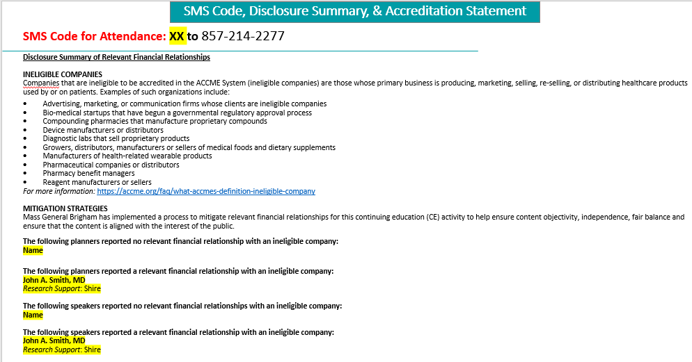
Disclosure Summary & Accreditation Slide (Continued)

Slide 53
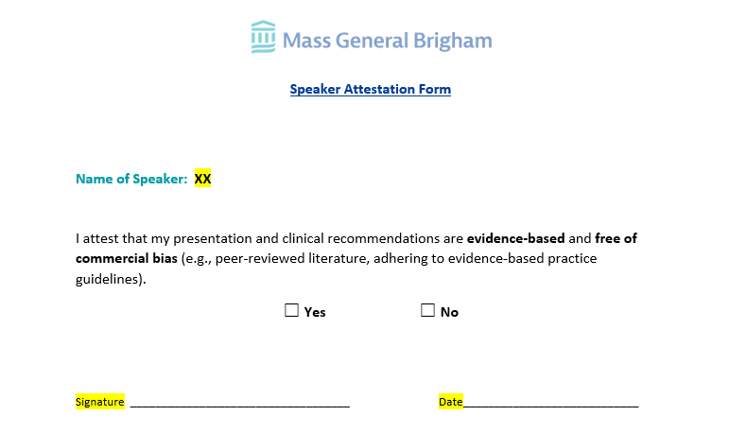
Speaker Attestation Form
Attestation is only acceptable as a mitigation strategy if there is no presentation to be peer reviewed
  Examples: case conferences, journal clubs, etc.
This form must be completed by the speaker after the course director/planner reviews the disclosure form

Slide 54
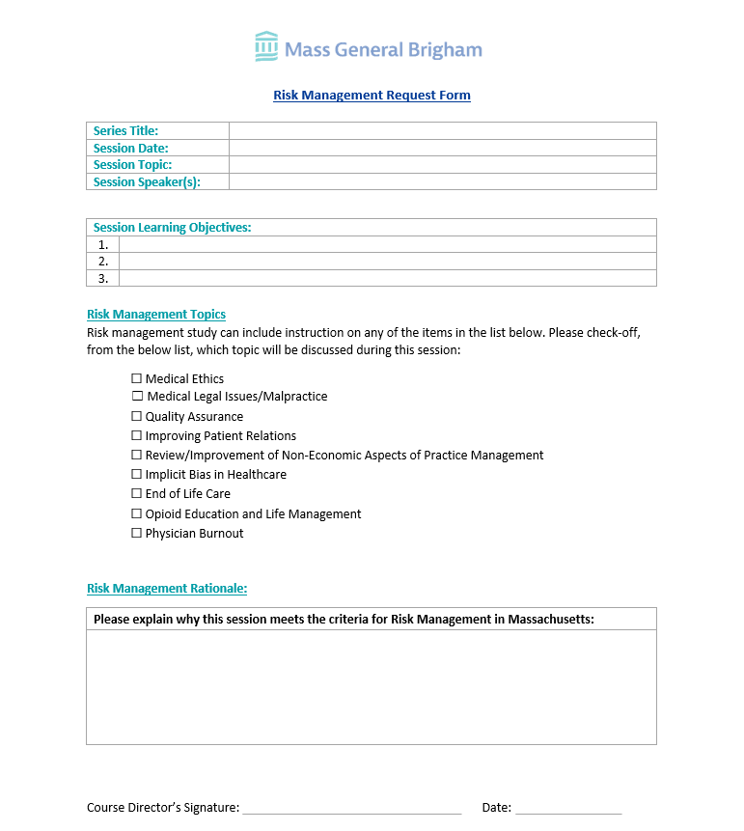
Risk Management Request Form
When risk is being requested for a single session in a series the Risk Management Request Form should be completed and uploaded to the session.
During the review process the CPD team will update the session to include the comment below
Comment added to the Workflow during Approval:
This session meets the criteria for Risk Management. The website and certificate have been updated. Please add the following statement to the announcement and disclosure summary: *This session is designed to meet the criteria for risk management study in Massachusetts
Please note: When all the sessions in a series are approved for Risk or the session is labeled M&M – the Risk Management Request form is not required

