Slide 1

In-Hospital Series Systemwide Grand Rounds Phase 2: Archived Library
Training Webinar
Continuing Professional Development June 10, 2025
Notes:
Michelle

Slide 2

Agenda
Important Dates
Joint Accreditation and requirements for interprofessional activity
Systemwide Access to In-Hospital Series
New Recording Process
Disclosure Form Changes
How to add disclosure information to Ethos
Fillable PDF process
Online disclosure
Additional Information
Q&A
Please send questions to mgbcpd@mgb.org
This webinar is being recorded and slides will be available on our website
Notes:
Michelle

Slide 3

Important Dates
Proposal Deadlines:
Series beginning in the Summer (start date: July 1 – Aug 31, 2025): April 7, 2025 (past)
Series beginning in the Fall (start date Sept 1, 2025, or later): June 6, 2025 (past)
Late Fees:
Proposals received more than 1 week after the deadline will incur a non-refundable late fee of $750.
Tuesday/Thursday Open Hours Meeting:
Tuesdays 9:00 to 10:00
Thursday 2:00 to 3:00 Teams meeting link for open hours meeting
(Note: The new teams link started today June 10)
Notes:
\

Slide 4
Upcoming Trainings
Upcoming Trainings | Audience | Training Date | Registration Link
April training (Required) | Required In-Hospital Series training | April 17, 2025 (11:00AM-12:00PM) | Recording available: https://cpd.partners.org/series-coordinators/content/hospital-series-workflows-and-videos
May training | In-Hospital Series Back-to-Basics & Reporting Training Webinar | May 15, 2025 (11:00 AM-12:00PM) | Recording available: https://cpd.partners.org/series-coordinators/content/hospital-series-workflows-and-videos
June training | Systemwide Grand Rounds Phase 2: Archived Library | June 10, 2025 (1:00-2:00PM) | Todays training – recording will be available in the Series coordinators site
August training | In-Hospital Series Back-to-Basics & Reporting Training Webinar | August 2025 | TBD

Slide 5

Joint Accreditation
Mass General Brigham was awarded Joint Accreditation from December 6, 2021, through November 2025.
Joint Accreditation for Interprofessional Continuing Education™ offers organizations the opportunity to be simultaneously accredited to provide continuing education activities for multiple professions through a single, unified application process, fee structure, and set of accreditation standards.
Jointly accredited providers may choose to award single profession or interprofessional continuing education credit (IPCE) to:
Athletic Trainers
Dentists
Dietitians
Nurses
Optometrists
Physician Assistants
Pharmacists
Physicians
Psychologists
Social Workers

Slide 6
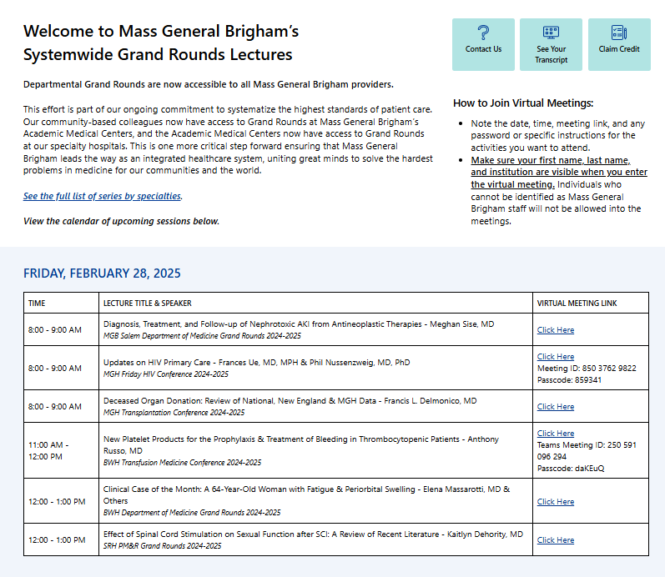
Systemwide Grand Rounds Expanding Access Across MGB Hospitals
Launched on Vitals July 2024
Unifying Expertise
Access & Flexibility
Careful Content Management
Next Steps:
Gather feedback and refine processes for continued improvement
Launch library of on-demand recordings in summer 2025
11,988 site visits since launch
Access Grand Rounds On Vitals Today: https://partnershealthcare.sharepoint.com/sites/VitalsSystemwideGrandRounds
Notes:
Newsletter Blurb/Talking Points:
With the launch of departmental Grand Rounds being available system-wide this July, we have taken one more critical step forward, ensuring that Mass General Brigham leads the way as an integrated healthcare system, uniting great minds to solve the hardest problems in medicine for our communities and the world. Now, our community-based colleagues will have access to Grand Rounds at Mass General Brigham’s Academic Medical Centers, and the Academic Medical Centers will have access to Grand Rounds at our specialty hospitals. Mass General Brigham System-Wide Grand Rounds will be centrally located on the Vitals website. This initiative is being phased in by first providing links to livestream offerings when they occur. Arrangements are underway with Mass General Brigham Digital to archive lectures for on-demand viewing down the road, providing enhanced flexibility. We have been working with Mass General Brigham Vitals Communications to launch and advertise the site, starting at the end of June. Each of Mass General Brigham’s community hospitals has established point persons for cascading communication. Great care has been taken to ensure that sensitive clinical and/or administrative content (e.g., M&M Rounds, Tumor Boards, etc.) have been exempted from this initiative and that these lectures are only accessible internally. Over the next few months, we will focus on procuring feedback and refining our processes.

Slide 7
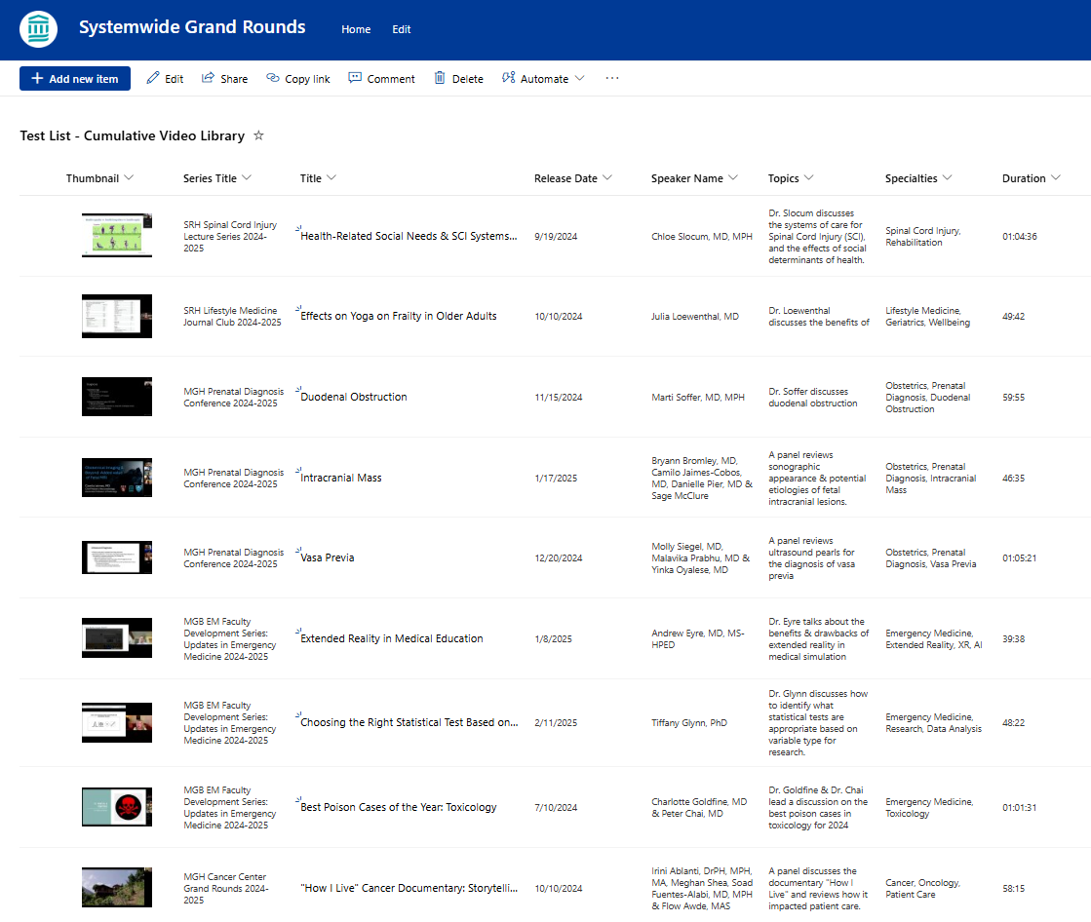
Systemwide Grand Rounds: Preparing to Launch Library of Recordings
Expansion:
For the next academic cycle, MGB CPD will open a library of recorded sessions to all MGB staff. MGB CPD will continue to build out the platform and communicate with stakeholders (course directors and coordinators, Digital, A/V) to launch the library this summer.
The vision for the library is to make one central repository where all grand rounds recordings are housed. Learners will be able both to search the full list by topic or keyword and to easily view sessions for specific series. Credit will be available for 6 months after the session date.

Slide 8
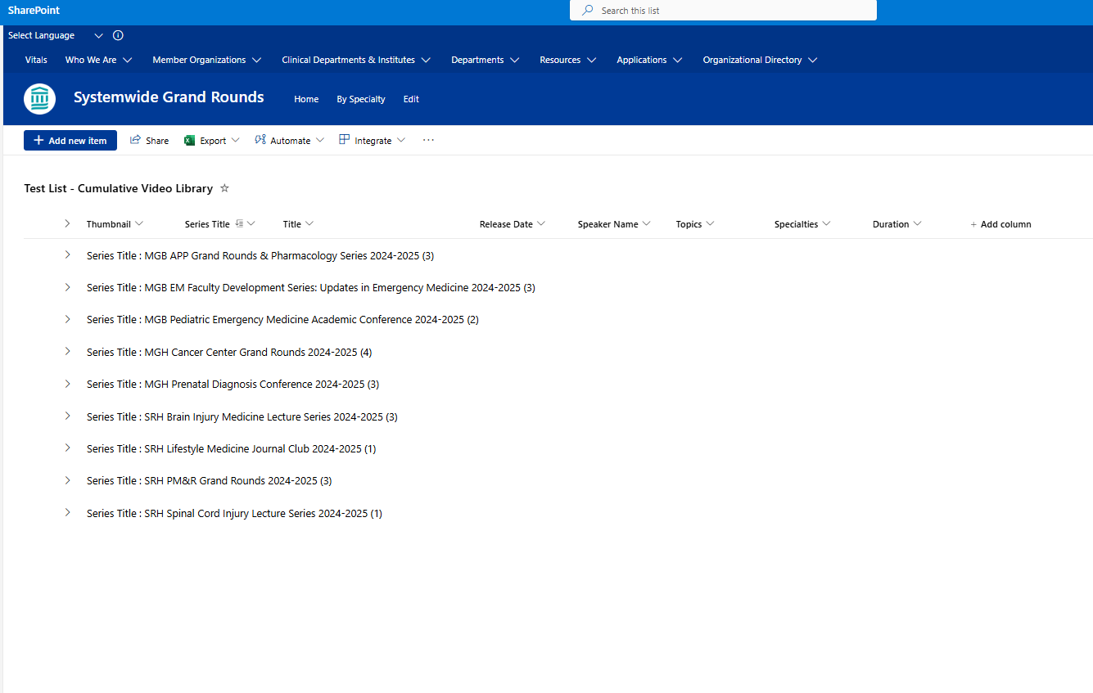
Library Prototype - Example

Slide 9
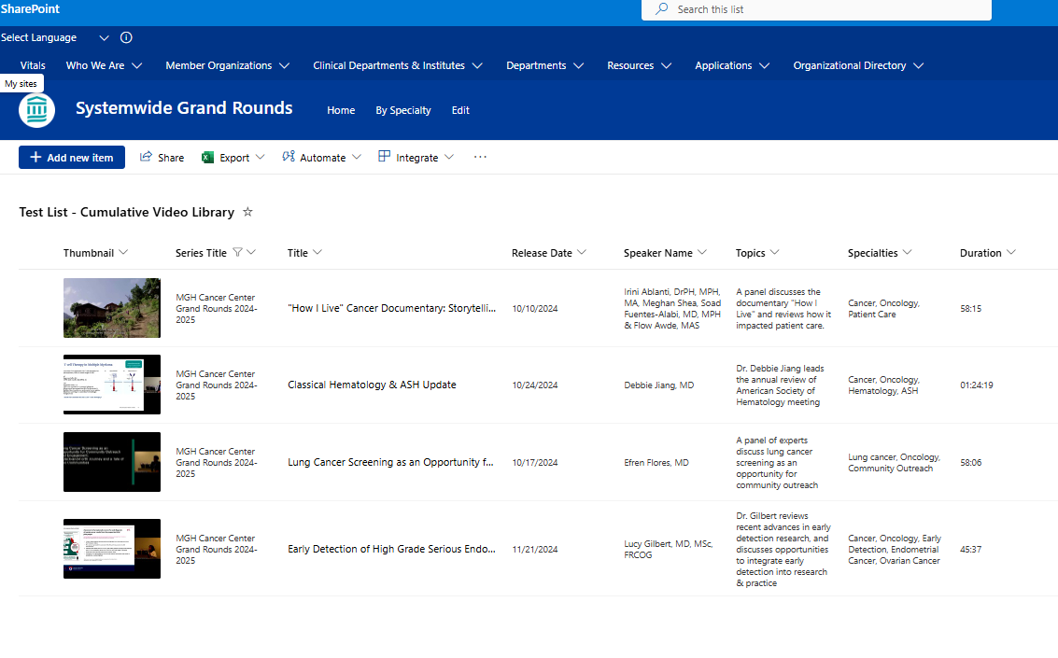
Filtered by Series - Example

Slide 10
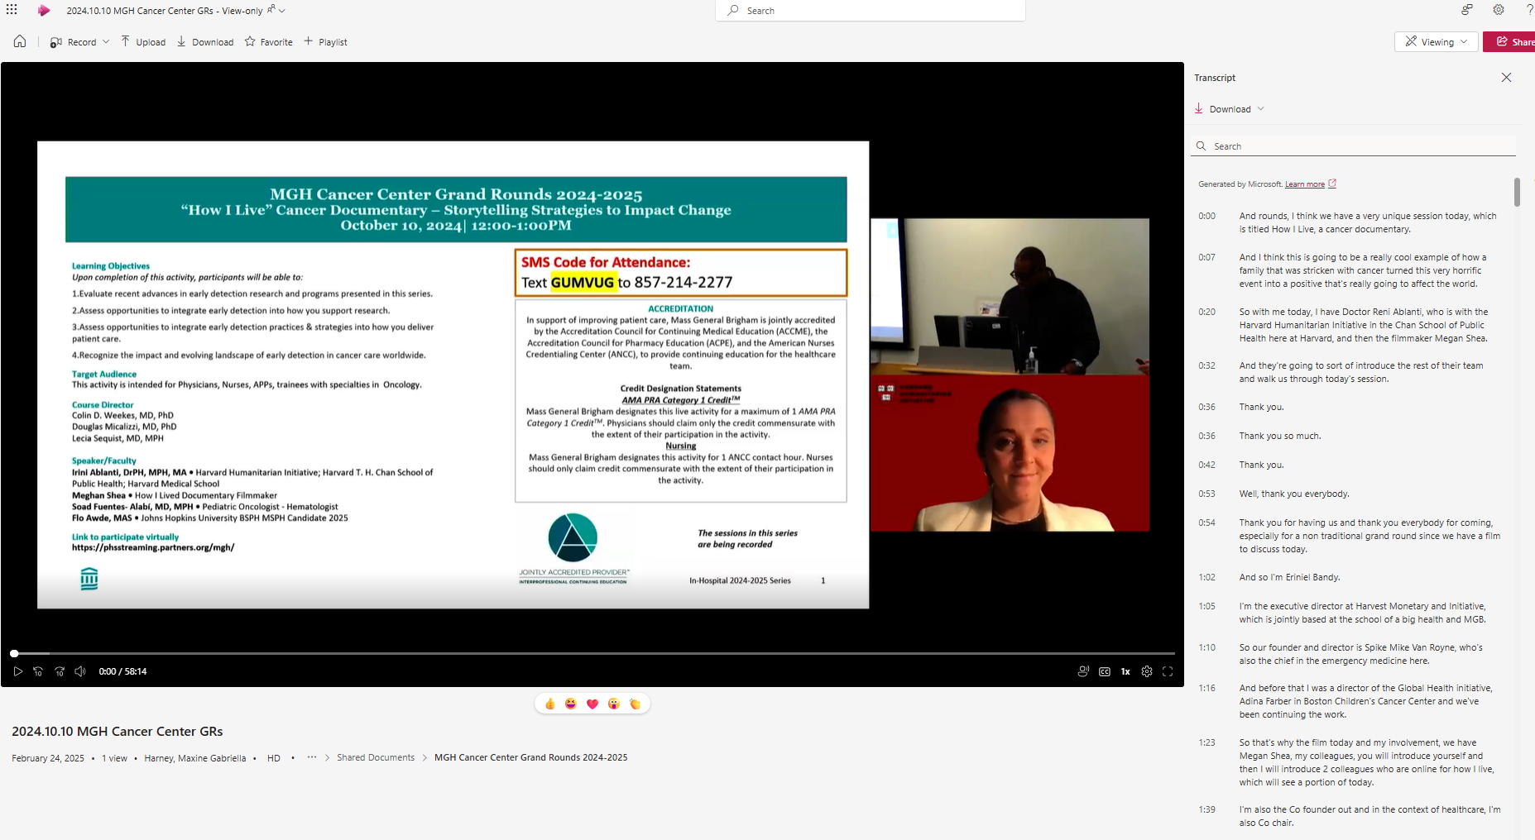
Recording with Transcript - Example

Slide 11
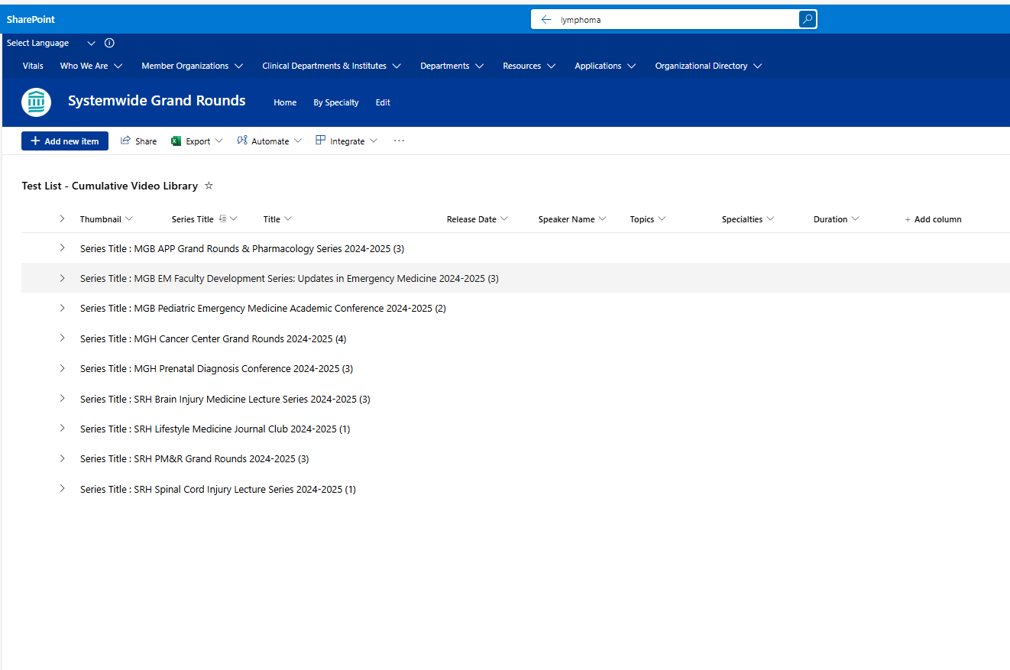

Search - Example

Slide 12
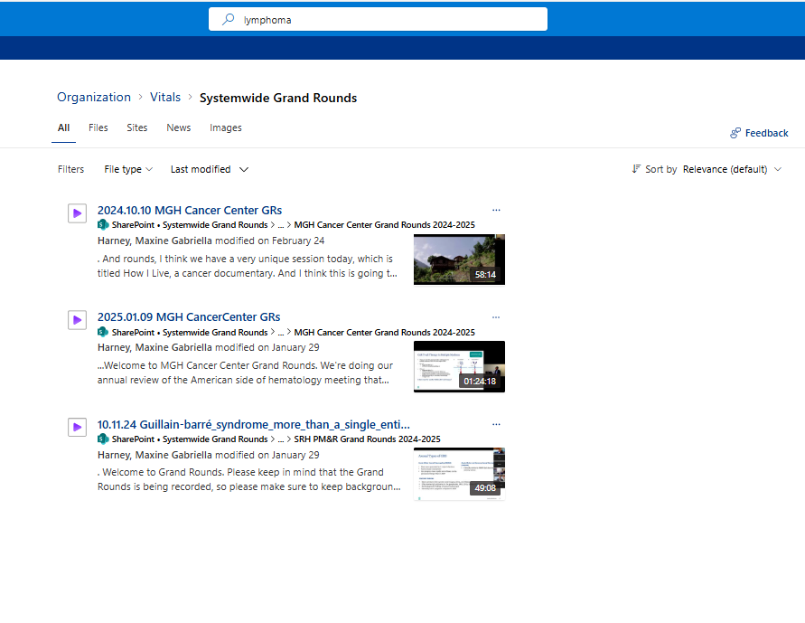
Search Results – Example
These are all the recordings where “lymphoma” is in the transcript

Slide 13
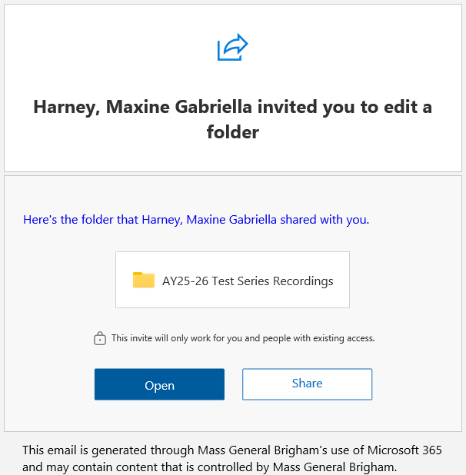
Overview of New Recording Process
Systemwide Grand Rounds site on Vitals – currently hosts calendar of live sessions
Will be adding a video library at the start of new academic year
Each series will have its own folder to upload recordings
Coordinator handling recordings will need to upload video files to series folder on Vitals
Access to add and delete video files
Will receive autogenerated email with invitation to edit
Link for each series will also be provided with the ”your site is built” email
Contact mgbcpd@mgb.org to request editing permission for additional people
Option to use your current recording site, in addition to Vitals video library
Video library on Vitals is only accessible internally

Slide 14
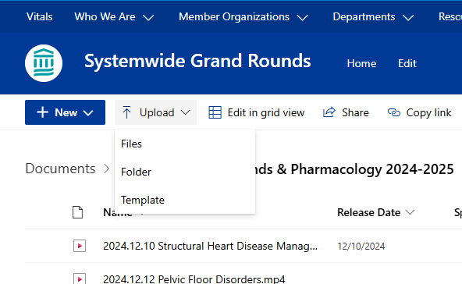
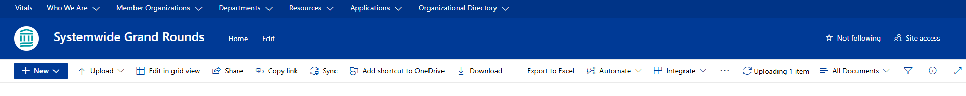
How to Upload Recordings – Screenshots
Navigate to your series folder.
Click ‘Upload’
Locate & select the video file you want to upload. Then, click ‘Open’
Wait for the video to upload to your folder. Upload status can be found by clicking the rotating ‘Uploading item’ button
Notes:
** Series folders in Sharepoint will be shared shortly – along with link to series in Ethos, etc.

Slide 15
Live demo
AY25-26 Test Series Recordings

Slide 16
Disclosure Form Changes
When you receive your approval, 2 links for the online disclosures will be provided
Share one with the speakers
The other will be for the admins
(Note: the shorter link is the one you share and the longer one only for the admins)
This link will be used for the speakers for your series. The planners will not be included in this link.
Planners are on a separate CPD link.
There is the option to use the fillable PDF – which is available on the Series Coordinator site
https://cpd.partners.org/series-coordinators

Slide 17

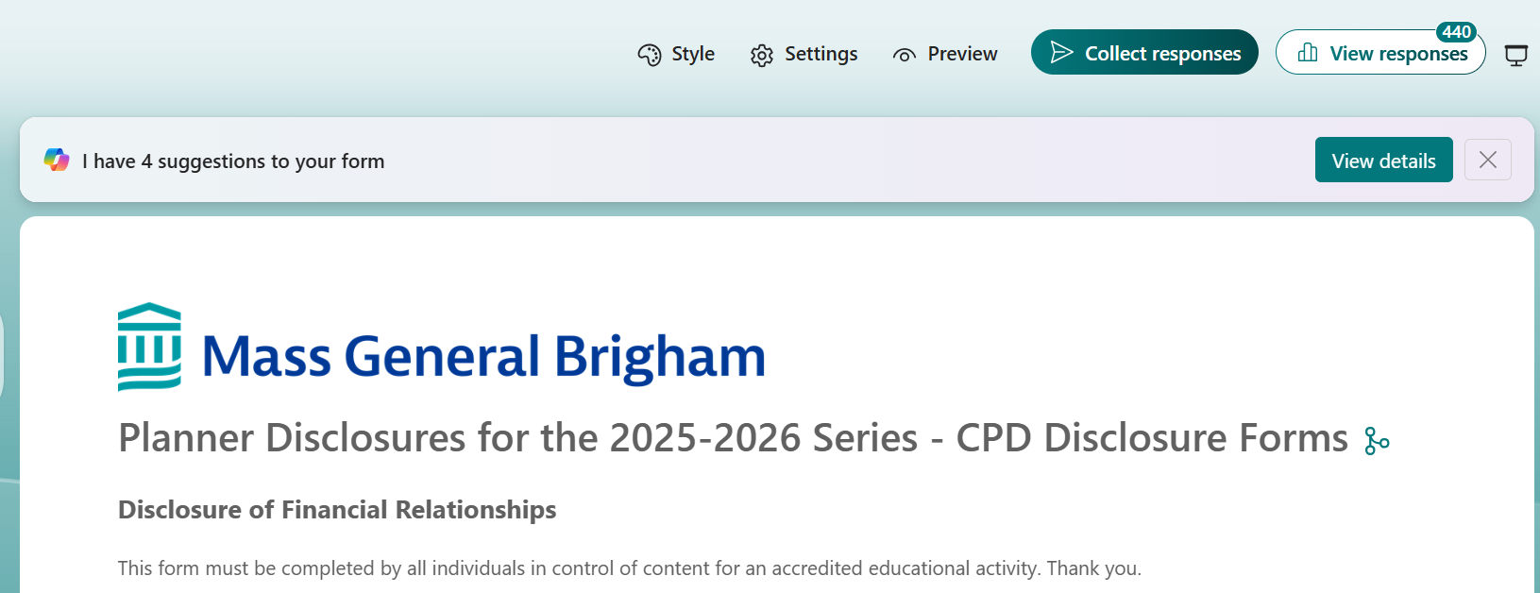
Microsoft Forms Online Disclosure form – Screenshots
Screenshot of the Form the Speakers will see
Screenshot of the Form the Admins use
Notice the Heading is white, and you can collect and view responses
Any field filled in this form will be visible to all users.
(There is an option to send a fillable form.)

Slide 18
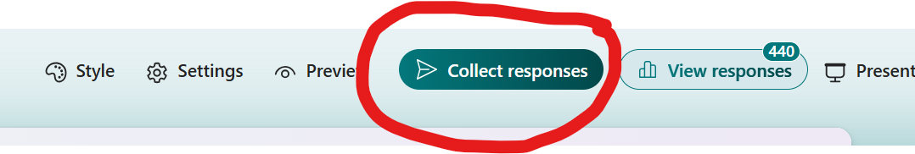
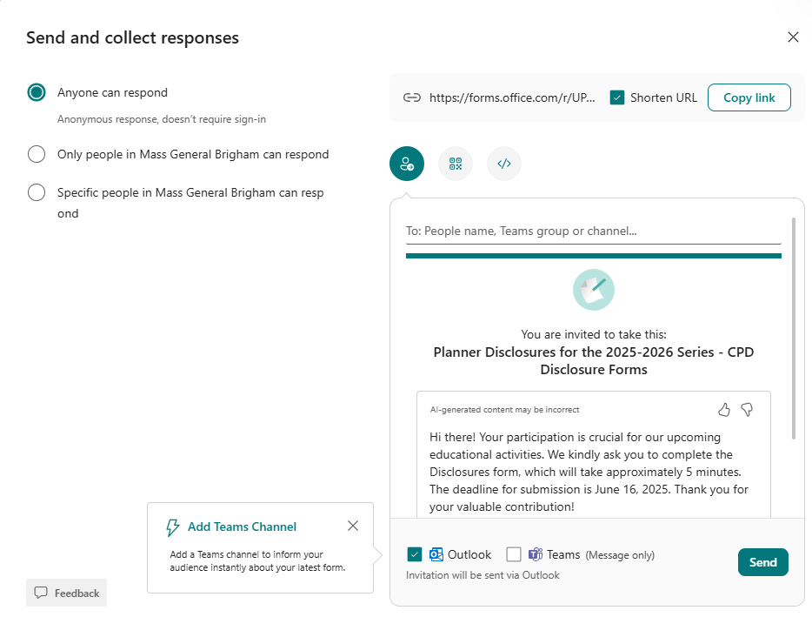
Microsoft Forms Disclosure form – For admins
Click Collect responses
The email can be sent to the speaker from the system
You can copy the link and sent the link in the existing email format you currently use. (or use the link sent in the approval email)

Slide 19
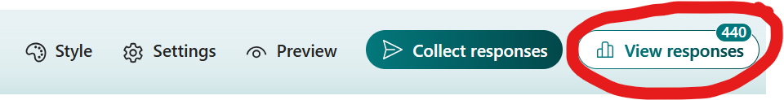
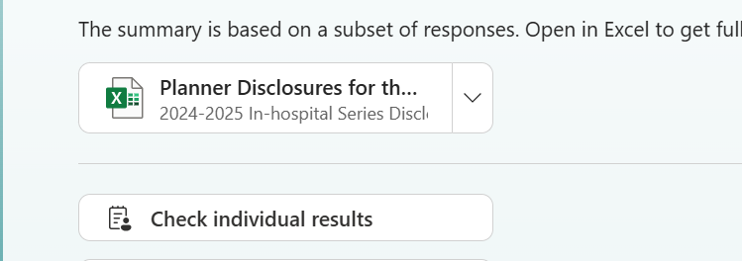
Microsoft Forms Disclosure form – How to view the forms
Click on view responses
There are 2 opens to view the responses
Excel Spreadsheet
Individual results

Slide 20
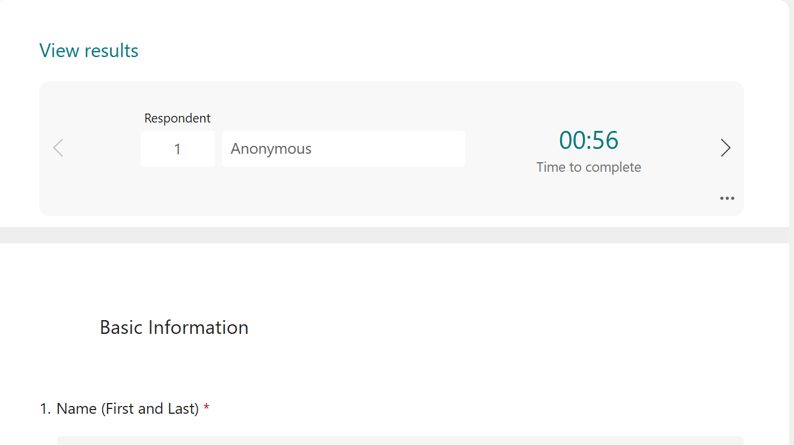
Microsoft Forms Disclosure form – Individual responses
Click check individual results
This view will show 1 disclosure at a time.
To see a different speaker
click through the disclosures using the arrow button
click in the respondent cell and change the number to see a different speaker's disclosure

Slide 21
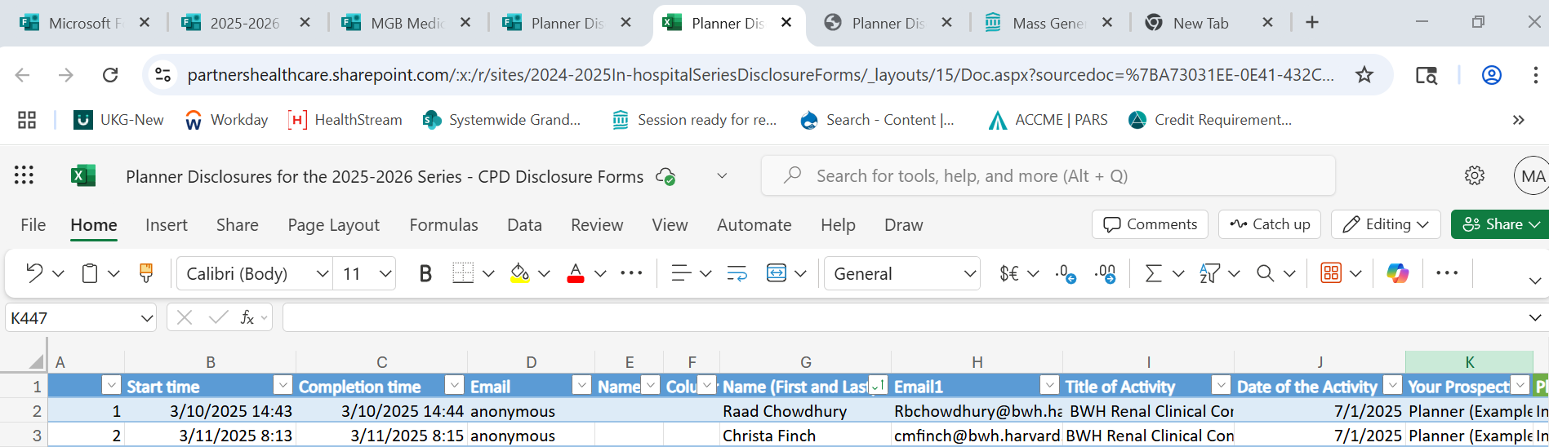
Microsoft Forms Disclosure form – Excel spreadsheet responses
This view will show all the disclosure in an excel spreadsheet format.
To see a speaker
Using column G you can search by the speaker's name.

Slide 22
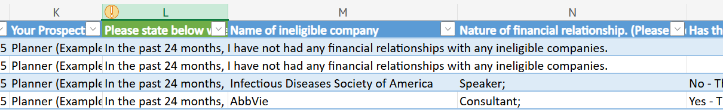
Microsoft Forms Disclosure form – Excel spreadsheet responses cont.
This view will show all the disclosure in an excel spreadsheet format.
To see a speaker
Column L will let you know if there is a relationship. If there is no relationship – you are all set
If there is a relationship you can see the relationships starting in column M – note the relationship in the 3rd and 4th rows below. The last column in the screenshot states if the relationship ended or not.
Please note on the disclosure summary slide if the relationship has ended.

Slide 23
Fillable PDF process (not recommended)
The process will remain the same for those using the pdf version. All documents for the session will need to be uploaded.
The fillable pdf disclosure form is available here:
https://cpd.partners.org/series-coordinators

Slide 24
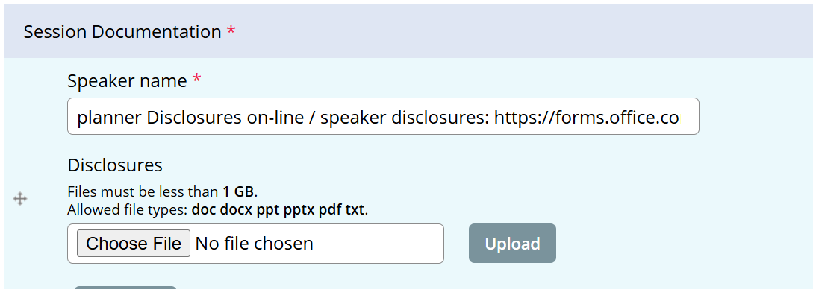
How to link Microsoft Forms to Ethos
The sessions in the series will have the following information included. This will let us know if the series is using online or the fillable pdf

Slide 25
How to link Microsoft Forms to Ethos cont.
Online disclosure forms:
The name of all the speakers needs to be included in the speaker field in the Custom tab
Documents to upload
Disclosures/Mitigation Forms for planners who are speaking
Disclosure for Speakers who completed the online form
Additional upload documents
Disclosure summary slide
Mitigation form for a speaker
Session specific forms (e.g., risk, employee/owner form, presentation, etc)
PDF fillable form
The process remails the same
All documents for the session need to be uploaded

Slide 26
Additional Information
An email with the series link will be sent 2 weeks prior to the first session date.
Resources/workflows can be found here: https://cpd.partners.org/series-coordinators/
Send an email to mgbcpd@mgb.org to add an admin or for any additional questions
The Session needs to be approved prior to the session start so the disclosure summary includes the code for the recording – otherwise you will need to add contact information on the disclosure summary for the attendee watching to get the text code for credit
Changes to Zoom
Email General Support to request an exception: Digital Collaborative Media Team (PCMVideoconferencing@partnershealthcare.onmicrosoft.com)

Slide 27
Help is always available on the weekly open hours calls
Tuesdays 9:00 to 10:00
Thursday 2:00 to 3:00 Teams meeting link for open hours meeting

Slide 28


Follow Us On Social Media!
We are growing our followers and standing on social media to:
Showcase all the great education projects being done around the system
Market courses to external participants
Follow us and share your news, to help grow the community!
X (formally known as Twitter):
@MassGenBrighCPD
LinkedIn:
Mass General Brigham Continuing Professional Development
https://www.linkedin.com/showcase/mass-general-brigham-office-of-continuing-professional-development

Slide 29

Thank you for attending today’s meeting!
We will email you with our next webinar date
Reminder to please send all questions to mgbcpd@mgb.org
These slides will be available on the Course Coordinator Virtual Community: https://cpd.partners.org/series-coordinators

Slide 30


