Slide 1
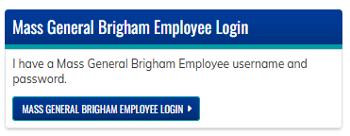
Learner Instructions to Set Up Texting for Attendance
Click “My Account” >>“Edit” >> “Profile”
PROFESSION TYPE
  Choose your profession from the dropdown list
MOBILE NUMBER
  Click “My Account” >> “Edit” >> “Mobile”
  Enter your cell phone number. Then, confirm
  your number when prompted.
CLICK “SAVE”
SAVE TEXT NUMBER TO YOUR PHONE
  Add the phone number 857-214-2277 to the contacts on your phone. This will be the number you will always use to text your credit
Go to cpd.partners.org & log in
  Click “Log in” at the top of the page
  Choose “Mass General Brigham Employee” login if you have an MGB username and password
  Choose “Visitor Login” if you do not have an MGB username and password
  Complete required fields
Email us with any questions at mgbcpd@mgb.org

Slide 2
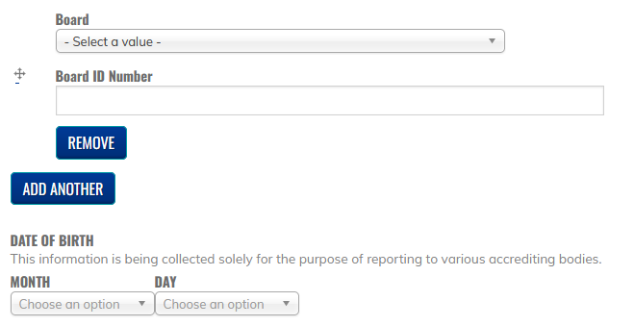

Physician Instructions to Update Profile for MOC
Go to cpd.partners.org & log in
  Click “My Account” >>“Edit” >> “Profile”
PROFESSION TYPE
  Choose “physician”
BOARDS
  Choose your board
  Enter your board ID
  Click “add another” as needed
DATE OF BIRTH
  Enter the date and month of your birthdate
CLICK “SAVE”
Email us with any questions at mgbcpd@mgb.org

