Slide 1

In-Hospital Series
Systemwide Grand Rounds Forum Webinar
Continuing Professional Development
November 13, 2025
Notes:
Michelle

Slide 2

Agenda
Important Dates
Joint Accreditation and requirements for interprofessional activity
Systemwide Grand Rounds Site Demo
  Calendar, List of Series by Specialty, Video Library
  Current Analytics
Quality Assurance for Sessions and Videos
  Avoid ‘Video 404 error’
  Populate the Session details on Ethos
  Stop recording when educational session ends
  Show the Disclosure summary slide and text code (start recording prior to showing slides)
  Pin speaker before starting recording
Discussion and Feedback
Q&A
Please send questions to mgbcpd@mgb.org
This webinar is being recorded and slides will be available on our website
Notes:
Michelle

Slide 3
Upcoming Trainings
We will start the Webinars back up in January 2026.
Please let us know if there are any topics you are interested in learning more about.

Slide 4

Joint Accreditation
Mass General Brigham was awarded Joint Accreditation from December 6, 2021, through November 2025.
Joint Accreditation for Interprofessional Continuing Education™ offers organizations the opportunity to be simultaneously accredited to provide continuing education activities for multiple professions through a single, unified application process, fee structure, and set of accreditation standards.
Jointly accredited providers may choose to award single profession or interprofessional continuing education credit (IPCE) to:
  Athletic Trainers
  Dentists
  Dietitians
  Nurses
  Optometrists
  Physician Assistants
  Pharmacists
  Physicians
  Psychologists
  Social Workers

Slide 5
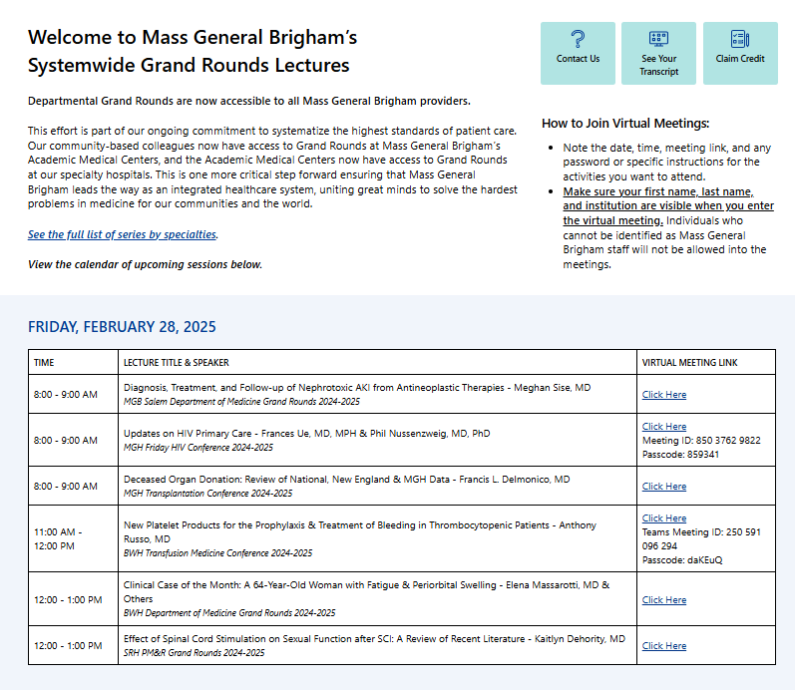
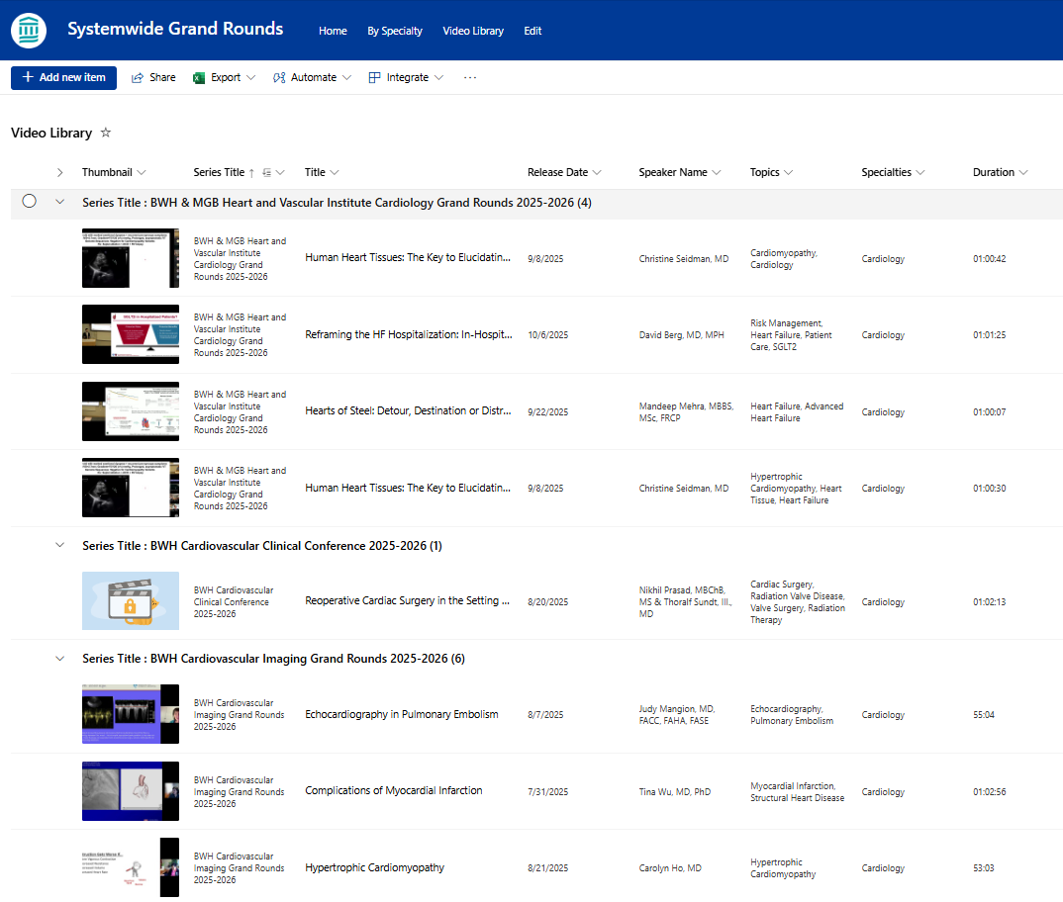
Systemwide Grand Rounds
Expanding Access Across MGB Hospitals
Live Sessions Calendar
Updated daily
17,000+ visitors since launch
75 visitors/day
130+ series participating
Recordings Library
63 series participating
200+ recordings uploaded to date
1,000+ recordings expected by June 2026
Next steps:
Improve search and filter functionality
Quality and consistency of recordings, links
Access Grand Rounds On Vitals Today: https://partnershealthcare.sharepoint.com/sites/VitalsSystemwideGrandRounds
Notes:
Systemwide Grand Rounds – Home

Slide 6
Systemwide Grand Rounds Demo
Live Sessions
Calendar: Systemwide Grand Rounds - Home
  Search
Recordings Library:
List of participating series: Systemwide Grand Rounds - Video Library - All Recordings by Series
Filter
Search
Browse by Specialty:
Lists all participating series with general information (times, dates, contacts, links to recordings):
Grand Rounds by Specialty

Slide 7
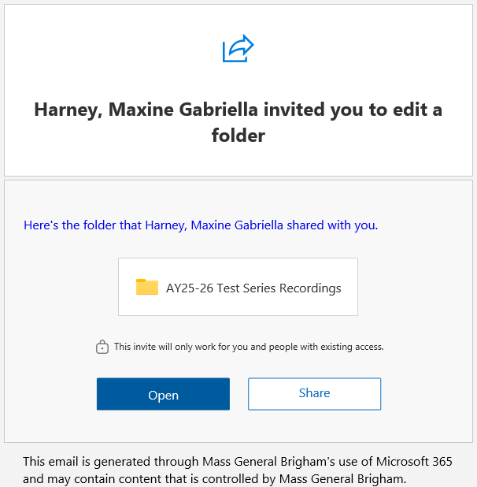
Overview of New Recording Process
Systemwide Grand Rounds site on Vitals – currently hosts calendar of live sessions
  Will be adding a video library at the start of new academic year
Each series will have its own folder to upload recordings
  Coordinator handling recordings will need to upload video files to series
  folder on Vitals
      Access to add and delete video files
      Will receive autogenerated email with invitation to edit
Contact mgbcpd@mgb.org to request editing permission for additional people
Option to use your current recording site, in addition to Vitals video library
  Video library on Vitals is only accessible internally

Slide 8
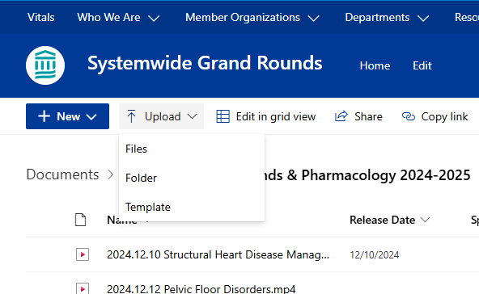
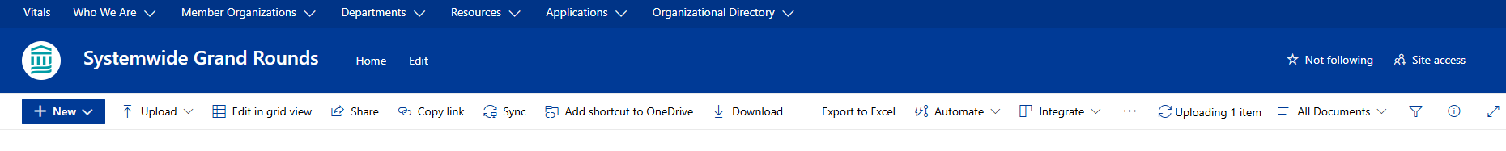
How to Upload Recordings – Screenshots
Navigate to your series folder.
Click ‘Upload’
Locate & select the video file you want to upload. Then, click ‘Open’
Wait for the video to upload to your folder. Upload status can be found by clicking the rotating ‘Uploading item’ button
Notes:
** Series folders in Sharepoint will be shared shortly – along with link to series in Ethos, etc.

Slide 9
Quality Assurance for Sessions and Videos
  Populate the Session details on Ethos
    Presentation Title & Speaker Name – Calendar + Video Library
    Virtual Meeting Link – Calendar
      Correct format (Zoom or Teams link)
Error: ‘404 Not Found’
    Do not change or remove recording that you have uploaded
    If necessary, send email to mgbcpd@mgb.org to notify us of any changes
  Stop recording when educational session ends
    Prevents long recordings
  Show the Disclosure summary slide and text code
    Start recording prior to showing slides
    Ensures learners can claim credit for watching recording
  Recommendation: pin speaker before starting recording

Slide 10
Help is always available on the weekly open hours calls
Tuesdays 9:00 to 10:00
Thursday 2:00 to 3:00
Teams meeting link for open hours meeting

Slide 11


Follow Us On Social Media!
We are growing our followers and standing on social media to:
  Showcase all the great education projects being done around the system
  Market courses to external participants
Follow us and share your news, to help grow the community!
  X (formally known as Twitter):
    @MassGenBrighCPD
  LinkedIn:
    Mass General Brigham Continuing Professional Development
    https://www.linkedin.com/showcase/mass-general-brigham-office-of-continuing-professional-development

Slide 12

Thank you for attending today’s meeting!
We will email you with our next webinar date
Reminder to please send all questions to mgbcpd@mgb.org
These slides will be available on the Course Coordinator Virtual Community: https://cpd.partners.org/series-coordinators

Slide 13


