Slide 1

In-Hospital Series MOC Review & Alumni & Public Promotion Review
Webinar
Continuing Professional Development September 16, 2025

Slide 2

Agenda
MOC
Alumni
Content and Strategy
Q&A
Please send questions to mgbcpd@mgb.org
This webinar is being recorded and slides will be available on our website

Slide 3
Upcoming Trainings
Upcoming Trainings | Audience | Training Date | Registration Link
October training | Systemwide Grand Rounds Forum | October 30, 2025, 10:00AM | TBD
Recording available for past webinars: https://cpd.partners.org/series-coordinators/content/hospital-series-workflows-and-videos

Slide 4
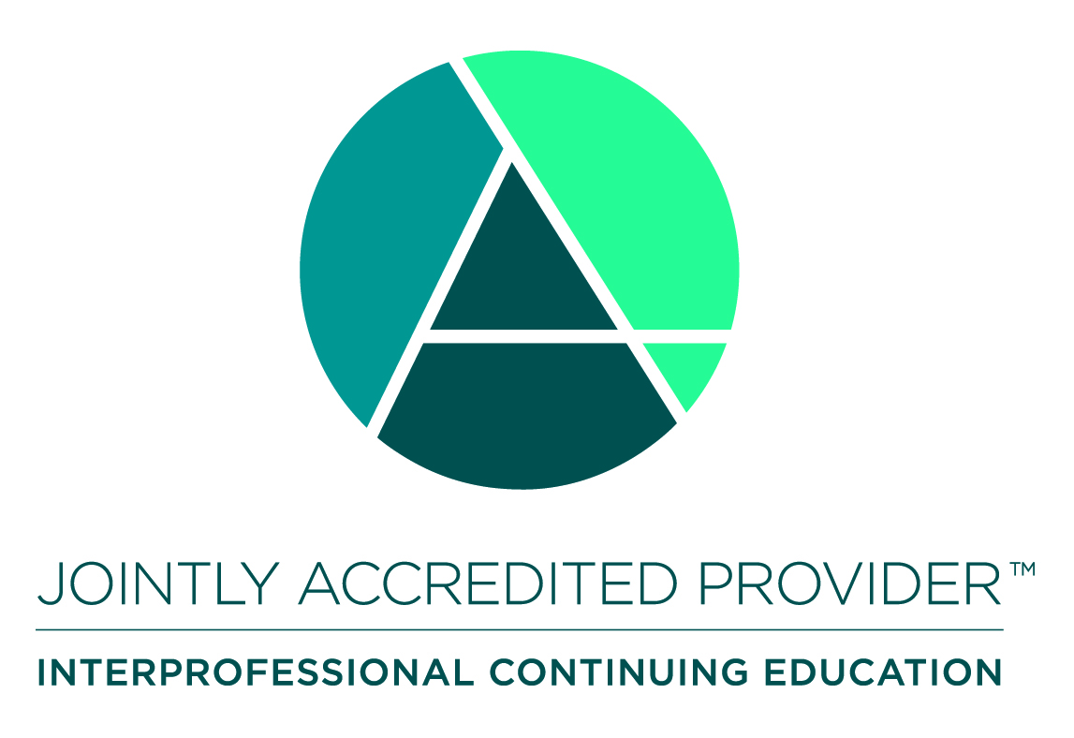
Joint Accreditation
Mass General Brigham was awarded Joint Accreditation from December 6, 2021, through November 2025.
Joint Accreditation for Interprofessional Continuing Education™ offers organizations the opportunity to be simultaneously accredited to provide continuing education activities for multiple professions through a single, unified application process, fee structure, and set of accreditation standards.
Jointly accredited providers may choose to award single profession or interprofessional continuing education credit (IPCE) to:
Athletic Trainers
Dentists
Dietitians
Nurses
Optometrists
Physician Assistants
Pharmacists
Physicians
Psychologists
Social Workers

Slide 5
Why Physician Learners Need MOC
What is MOC?
MOC = Maintenance of Certification
To remain certified in their specialty, physicians must meet continuing education requirements that are set by the certifying boards.
Physicians can earn credit toward meeting these requirements by participating in accredited CME activities that count for MOC.
Examples of MOC Requirements:
ABIM: 100 MOC points every 2 years Must be reported by Accredited Provider
ABS: 150 credits of Category-1 CME over five years Must be reported by Accredited Provider
ABP: 50 points for lifelong learning activities every 5 years
https://www.abim.org/maintenance-of-certification/moc-requirements/ https://www.absurgery.org/stay-certified/ongoing-certification-requirements/cme/
https://www.abp.org/content/lifelong-learning-and-self-assessment-part-2

Slide 6
What We Offer
MOC 2:
“Lifelong Learning”
“Accredited CME”
“Self-Assessment”
“Medical Knowledge”
MOC 4:
“Quality Improvement”
“Practice Assessment”
“Performance Improvement”

Slide 7
We can submit MOC 2 for the following Boards :
American Board of Anesthesiology (ABA)
American Board of Internal Medicine (ABIM)
American Board of Otolaryngology – Head and Neck Surgery (ABOHNS)
American Board of Pathology (ABPath)
American Board of Pediatrics (ABP)
American Board of Surgery (ABS)
American Board of Orthopaedic Surgery (ABOS)
American Board of Thoracic Surgery (ABTS)

Slide 8
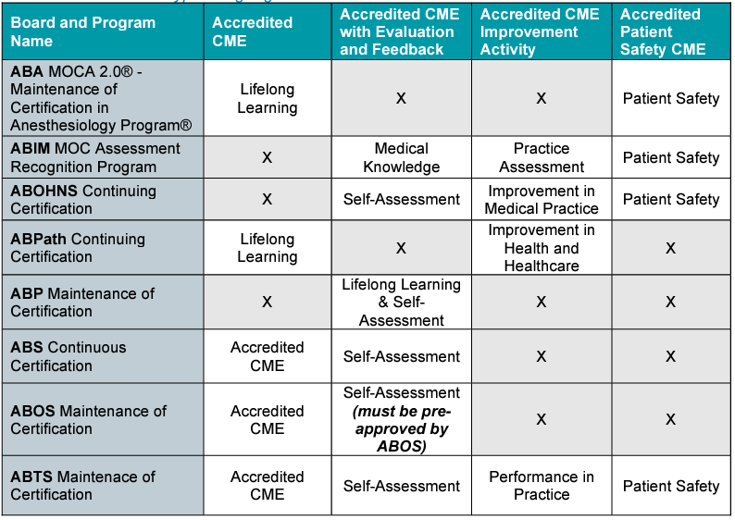
MOC 2: Credits Available through MGB CPD

Slide 9
MOC with Same Requirements as CME
Post-Activity Evaluation Frequency Options:
After every session
Semi-annually

Slide 10
MOC with Additional Evaluation & Feedback Requirements

Slide 11
MOC Reporting — What Learners Need to Know
Physicians need to update their profiles to ensure MOC credit is reported to their board.
MOC credit is awarded automatically through our LMS for all series that included MOC
We started automatic reporting in May 2024.
By updating their profile on cpd.partners.org, physicians give us permission to report their MOC to their board.
Physicians should leave the board section blank if they don’t want us to report.
Activities that count for MOC include an MOC Recognition Statement in addition to the accreditation statement. This is how physicians can confirm if their activity includes MOC.

Slide 12
Learners — What to Expect for Activities that Include MOC
Learners receive email confirmation when MOC credit is awarded for each session.
Unless there is an error with the information provided, they can expect to see the credit within a few days of texting attendance and completing any required evaluation.
If there is an error in reporting, they will receive an email stating there was an error.
They will need to update their profile to fix the error.
If they don’t fix the error, their transcript on cpd.partners.org will still show the MOC credit. However, they won’t receive credit until the board awards it.
The true source to view MOC credit is the physician’s board profile.
Leaners should be sure to check their board profile periodically to ensure credit is being awarded.
The CPD account will also show the status of MOC in the “Reported Credit” tab under “My Activities.” If there was an error in reporting, the error will be listed here.
Known Issue
Physicians who have “M.D.” as part of their name in the MGB system will need to be manually updated by Digital. We pull a report and send to Digital on a regular basis.

Slide 13
Evaluation & Feedback Requirement: ABIM, ABP, ABOHNS
Component | Requirement | Expectation
Evaluation Mechanism | All activities, including live activities, must include a comprehensive evaluation component that assesses individual learner competence, knowledge and/or skill. | The evaluation measures the competence or performance of the individual learner and not of the activity. Evaluation methods employed should identify individual learning (not anonymous).
Participation Threshold | The provider determines and communicates the participation threshold, also known as a passing standard, for the learner to earn MOC credit. | The participation threshold must be clearly communicated to the learner prior to engagement in the activity. The learner must meet the participation threshold set by the provider before credit is reported.
Feedback | All activities must include feedback to participants, identifying learner results with rationales for correct answers or attainment of applicable skill(s), and/or relevant citations where appropriate. | Evaluation of the learner and feedback to the learner must be completed before completion credit may be awarded.
Source: 2020 Accreditation Council for Continuing Medical Education (ACCME®) CME for MOC – Evaluation Guide 839_20201215

Slide 14
ACCME Evaluation Tips
The ACCME provides the following guidance:
The accredited provider may choose to evaluate the activity at the session level or at the activity level.
The provider does not need to be limited to a single method of evaluation per activity. Combinations of approaches to evaluation may produce rich information about learner change.
The accredited provider determines the passing standard/participation threshold of the evaluation and should give clear instructions to their learners on what they need to do in order to earn MOC credit.
The accredited provider must be able to demonstrate that the learner participated in/completed the evaluation for the educational activity for the learner to earn MOC credit.
If the activity is selected for review, the accredited provider will be asked to submit the evaluation mechanism, a description of how the evaluation was implemented, how feedback was provided to learners (if applicable), and a list of the physician learners who met the requirements to earn MOC credit. This does not need to include the answers submitted by learners.
Source: 2020 Accreditation Council for Continuing Medical Education (ACCME®) CME for MOC – Evaluation Guide 839_20201215

Slide 15
Evaluation & Feedback Requirement: Applicable to Series
Mechanism | Evaluation Method | Participation Threshold | Feedback Method | Implementation - Ideas/Options
Written responses | Learners write down what they have learned and indicate commitment to change or maintain an element of practice. | Learner writes a reflective statement and makes a commitment to change or maintain an element of practice. | Leader/facilitator summarizes what was discussed and best next steps for learners. | Eval after ever session (current) Meeting chat Learner journals
Case discussion | Learners asked to share with each other and group how they would approach the case at various stages. | Learner actively participates in the conversation as judged by a group leader or observer. | The outcome of the case is shared. | Course director attestation that outcome was shared Course facilitator sends summary of the discussion after the activity to learners
Audience response system | Learners select answers to provocative questions or using the ARS. Must be traceable to the individual. | Learners engage adequately with an acceptable number of attempts. Threshold set by provider. | Answer to each question is shared in dialogue or writing, including rationale for correct answers with relevant citations. | You must be able to track individual responses. Our office need copies of the questions with the correct answers, rationales and citations. Compliant options: Online quiz tool Kahoot Meeting chat
Quiz | Learners complete answers to a quiz during or after an activity. Must be traceable to the individual. | Percent of correct answers set by provider. | Best answer to each question is discussed or shared, including rationale for correct answers with relevant citations. | You must be able to track individual responses. Our office need copies of the questions with the correct answers, rationales and citations. Compliant options: Online quiz tool Kahoot Meeting chat

Slide 16
MOC 4: Quality Improvement Credits
Give your providers credit for work they are already doing.
Mass General Brigham Continuing Professional Development is the system-wide sponsor for the American Board of Medical Specialties (ABMS) Portfolio Program. We help Mass General Brigham-affiliated physicians and physician assistants fulfill ABMS Maintenance of Certification (ABMS MOC®) Improvement in Medical Practice (Part IV) requirements. Our goal is for providers to receive credit for work they are already doing and that is meaningful to them.
Projects receive both MOC and CE credits.

Slide 17
Who Can Receive Credit
 | CME/CE | MOC
Physicians | Up to 30 CME credits | Up to 30 ABIM points 25 ABP Improvement in Medical Practice Points
Nurses | Up to 30 CE credits | N/A
Physician Assistants | Up to 30 CE credits | 30 PI CME Credits
Psychologists | Up to 30 CE credits | N/A
NOTE: You can include QI MOC on series that already also have MOC 2/Lifelong Learning MOC.

Slide 18
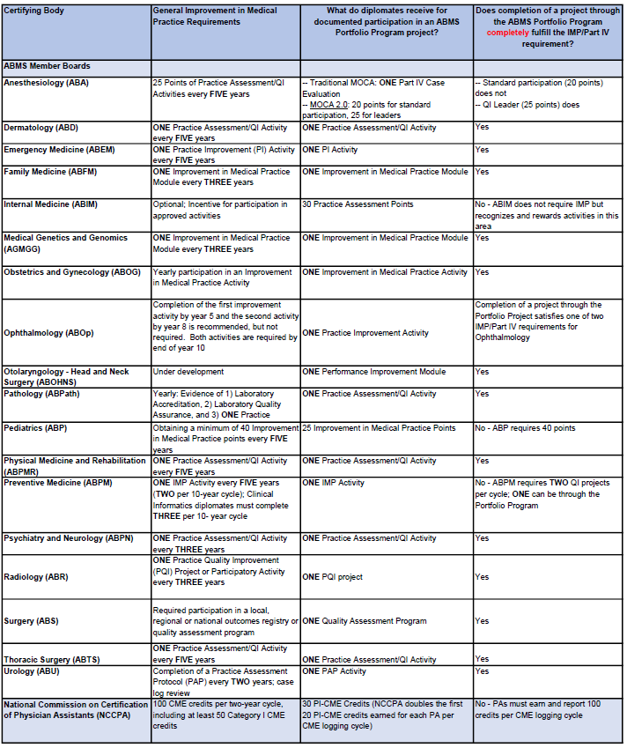
Requirements and Credit Translation for Continuing Certification
Overview:
This table identifies the ABMS Member Boards and the National Commission on Certification of Physician Assistants’ (NCCPA) requirements for meeting continuing certification MOC through the ABMS Portfolio Program.
Conclusion:
Diplomates can meet their QI MOC requirements or substantially contribute to their MOC requirements by completing 1 QI project.
Last updated: May 2021

Slide 19
ABMS portfolio program member boards
We can submit quality improvement MOC projects for the following boards:
American Board of Anesthesiology
American Board of Dermatology
American Board of Emergency Medicine
American Board of Family Medicine
American Board of Internal Medicine
American Board of Medical Genetics and Genomics
American Board of Obstetrics and Gynecology
American Board of Ophthalmology
American Board of Otolaryngology – Head and Neck Surgery
American Board of Pathology
American Board of Pediatrics
American Board of Physical Medicine and Rehabilitation
American Board of Preventive Medicine
American Board of Psychiatry and Neurology
American Board of Radiology
American Board of Surgery
American Board of Thoracic Surgery
American Board of Urology

Slide 20
How to Attach QI MOC to a Series
Submit Series Proposal, indicate you want to add QI MOC
We will send you a separate MOC proposal. Complete the proposal.
You will need to state:
The problem you want to address
What you aim to improve
How you will measure progress
We will send you a separate approval for the MOC project.
Discuss the project with your series attendees so they know what to expect.
Make a plan for how you will involve series participants and ensure meaningful participation
Plan to communicate baseline data and progress on measures throughout the series
Plan to dedicate at least 1 session to education around the measure you are trying to improve
Plan to communicate final data results before the end of the series
Complete project completion report
Compile list of clinicians who meaningfully participated and are eligible for credit
We will build an attestation site where participants can complete their evaluation requirement and provide their board information
We will report all participants by the end of the calendar year the project ends.

Slide 21
Documents Needed to Arrange the Credit
Proposal
Final Project Report
Participant List

Slide 22
Example
Series: MGH Calcium Grand Rounds
Project Title: Reducing Incidence of hypocalcemia in patients who have abnormal renal function and receive denosumab
Project Aim: We will decrease the incidence of hypocalcemia (low blood calcium levels) in patients who have abnormal renal function and receive denosumab from several cases per quarter to 0-1 cases per quarter by 06/2024.
Project Outcomes: Aim achieved
Note: Not required to meet aim for people to receive credit. It is ok if you don’t meet your aim.

Slide 23
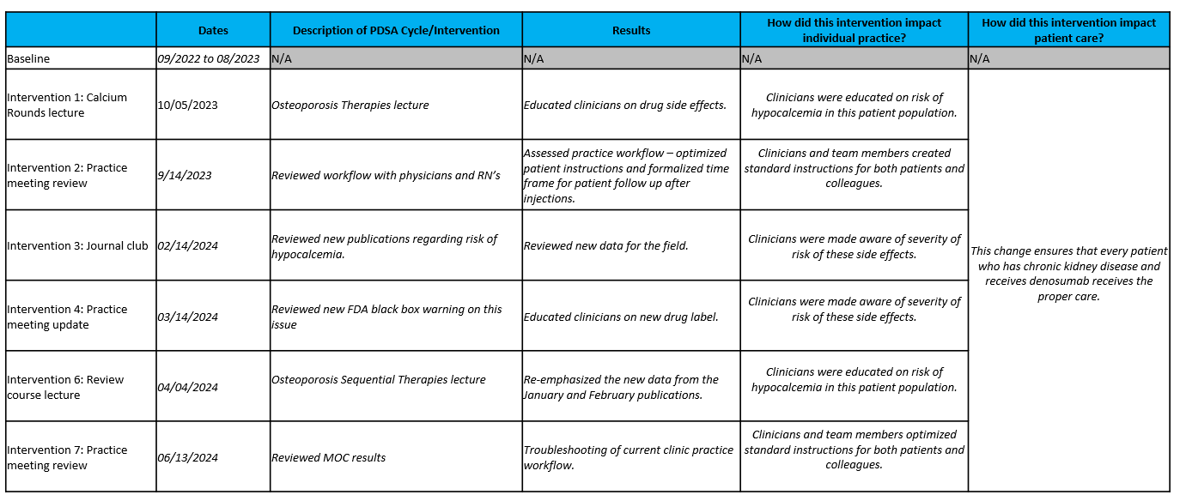
Example Interventions

Slide 24
MOC Fees
Contact us if you want to add MOC to your series!
Lifelong Learning MOC: The fee is $500 additional.
QI MOC: The fee is $750 additional. This is compared to $2500 + for QI projects not attached to a series.
Many of you are doing education that helps support quality and safety goals – we want to give your participants credit for this work!

Slide 25
Alumni Network
MGB CPD is collaborating with the Mass General Brigham Alumni Association to offer educational opportunities to alumni of Mass General Brigham training programs.
Alumni can view and sign up for upcoming sessions on the Alumni Association Network.
Alumni must create an account and receive approval to participate in the network.
GME staff verifies alumni status before approving the account.
Confidential series are excluded from this initiative.
Series will be listed here: https://cpdlearn.massgeneralbrigham.org/alumni/

Slide 26
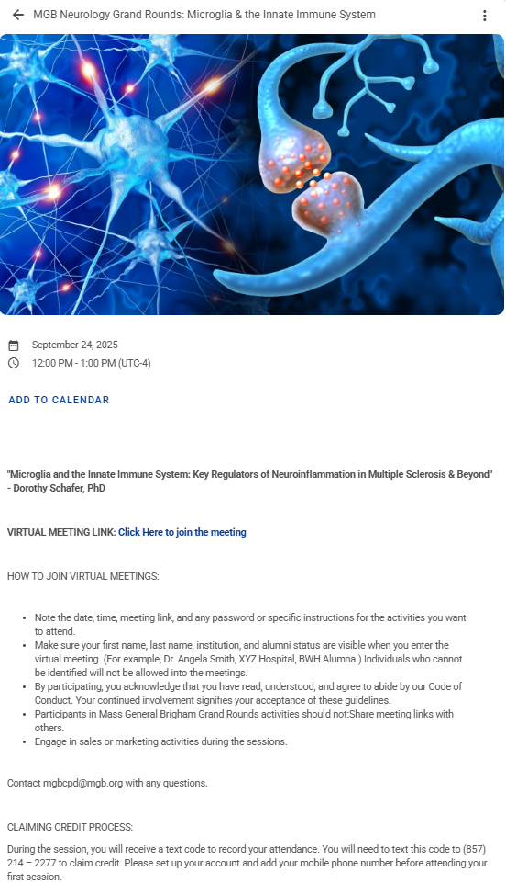
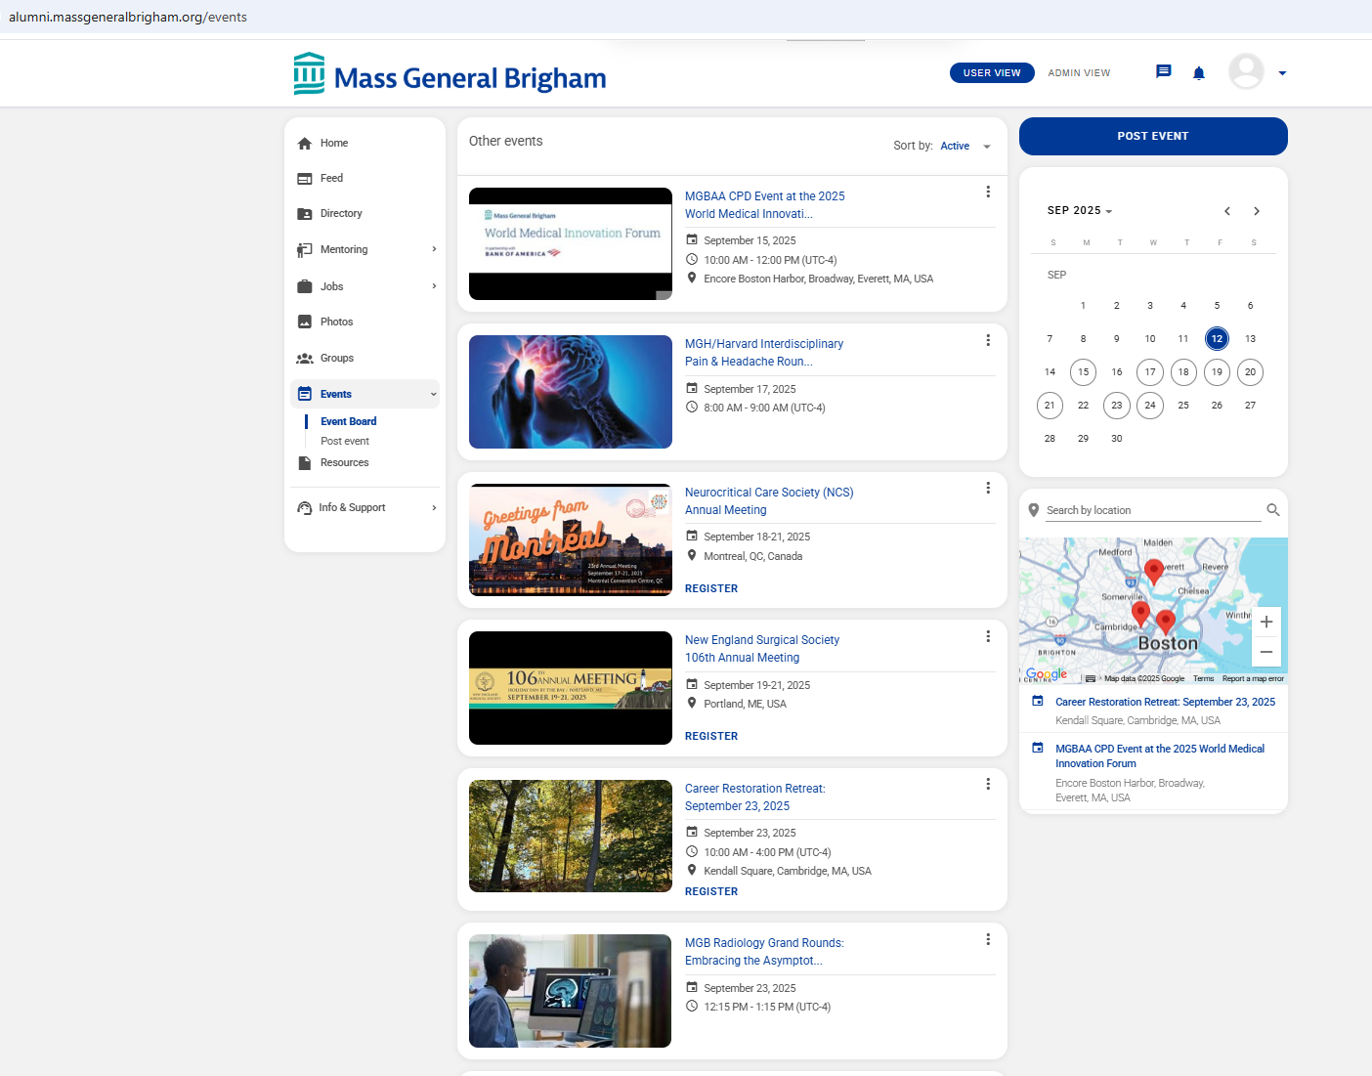
Alumni Network

Slide 27
Public Promotion of Series or Sessions
MGB CPD is developing a content strategy to offer education outside of our system. We are building processes to support and market series that want to attract an audience outside of MGB to participate in their live sessions or watch their recorded sessions.
We will use Ethos to host the series and sessions
Content can be offered for free (no charge to department) or for a fee (will include charge to the department & CPD will distribute revenue to department
CPD will advertise the education in our newsletters and with social media posts
Participating Series Need to Have:
Quality recordings
Completed copyright & consent forms for speakers
Consistent communication on which sessions should/should not be included.

Slide 28
Help is always available on the weekly open hours calls
Tuesdays 9:00 to 10:00
Thursday 2:00 to 3:00 Teams meeting link for open hours meeting

Slide 29


Follow Us On Social Media!
We are growing our followers and standing on social media to:
Showcase all the great education projects being done around the system
Market courses to external participants
Follow us and share your news, to help grow the community!
X (formally known as Twitter):
@MassGenBrighCPD
LinkedIn:
Mass General Brigham Continuing Professional Development
https://www.linkedin.com/showcase/mass-general-brigham-office-of-continuing-professional-development

Slide 30

Thank you for attending today’s meeting!
We will email you with our next webinar date
Reminder to please send all questions to mgbcpd@mgb.org
These slides will be available on the Course Coordinator Virtual Community: https://cpd.partners.org/series-coordinators

Slide 31


