Slide 1
In-Hospital Series Annual Training Webinar
Rose Desilets & Michelle Alley
Continuing Professional Development
April 21, 2026
Notes:
I want to remind everyone this webinar is being recorded.
Welcome to the 2026-2027 In-hospital Series Annual training. I’m looking forward to working with you all and having another successful year.

Slide 2
Agenda
Important Dates & Upcoming Trainings Joint Accreditation Professions Approval and Access to the Series EthosCE Refresh RSS coordinator site & forms download Changes to Session builds Evaluation Process Owners, Employees and (Sometimes) Founders CME That Counts for MOC Check-In Process Systemwide Access Initiative Skills for Professional Development Q&A
Notes:
Here is the agenda for today’s meeting

Slide 3
Important Dates
Notes:
Let’s talk about some of the important dates

Slide 4

Important Dates
Proposal Deadlines:
  Series beginning in the Summer (start date: July 1 – Aug 31, 2026): April 6, 2026 (past)
  Series beginning in the Fall (start date Sept 1, 2026, or later): May 18, 2026
Late Fees:
  Proposals received more than 1 week after the deadline will incur a non-refundable late fee of $750.
Tuesday/Thursday Open Hours Meeting:
Tuesdays 9:00 to 10:00
Thursday 2:00 to 3:00
Teams link: Link for the RSS/In-hospital Open Hours meeting
Notes:
We have received about 120 proposals and I am working my way through them.
The deadline to submit proposals for the Summer series (July & August timeframe) has passed. If you have not submitted yours - please reach out to me and let me know.
The deadline for the Fall series (any series starting Sept 1 or later) is May 18th.
As most of you know I have 2 open hour session every week. Please join the call if you have a question or want to review the process. I stay on the call for the full hour. And if I am on PTO – someone from the team always fills in.

Slide 5
2026 Training
Upcoming Trainings | Audience | Training Date | Registration Link
April Training | Required In-Hospital Series training | April 21, 2026 (11::00-12:00PM) | Today's training
May Training | In-Hospital Series Back-to-Basics & Reporting Training Webinar | May 28, 2026 (10:00 AM-11:00PM) | Register in advance for this meeting 2026-2027 In-hospital Series Back to Basics
June Training | Systemwide Grand Rounds Phase 3: Recordings (External) | June 23, 2026 (11:00-12:00PM) | Register in advance for this meeting 2026-2027 In-hospital Series Systemwide Grand Rounds Phase 3: Recordings (External)
August Training | In-Hospital Series Back-to-Basics & Reporting Training Webinar | August 20, 2026 (10:00 AM-11:00PM) | Register in advance for this meeting 2026-2027 In-hospital Series Back to Basics
September Training | Data Review | TBD | Register in advance for this meeting
Trainings material will be archived on https://cpd.partners.org/series-coordinators
Notes:
Here is some training we have scheduled. These include the Back to Basics and the Phase 3 of the Systemwide Grand Rounds site, I would suggest anyone new should go to one of the Back to Basic webinars in May or August. Also, if you answered yes to the Public Promotion of Series or Sessions – you should attend the June Webinar
These dates will also be included in the approval emails and on the Series Coordinator site.

Slide 6
Joint Accreditation
Notes:
Next we will quickly review the Joint Accreditation

Slide 7

Joint Accreditation with Commendation
Mass General Brigham was awarded Joint Accreditation with Commendation from November 2025 through November 2031.
Joint Accreditation for Interprofessional Continuing Education™ offers organizations the opportunity to be simultaneously accredited to provide continuing education activities for multiple professions through a single, unified application process, fee structure, and set of accreditation standards.
Jointly accredited providers may choose to award single profession or interprofessional continuing education credit (IPCE) to:
  Athletic Trainers
  Dentists
  Dietitians
  Nurses
  Optometrists
  Physician Assistants
  Pharmacists
  Physicians
  Psychologists
  Social Workers
Notes:
As most of you know we have joint accreditation and we were just approved in November for Joint Accreditation with Commendation. We offer credit for the 10 professions listed there.

Slide 8
Approval and Access to Site Process
Notes:
Next let’s Discuss the Approval and Access to your Site Process

Slide 9
Approval and Access to the Series
To receive approval to your series, you need to:
  Submit a proposal for the series
  Submit the list of planners for the series
    A planner is needed for each profession you are offering credit
  Send the on-line disclosure link to the planners
    I will compare the planner list and confirm a disclosure is received for all planners.
    An email will be sent to the coordinator with any missing disclosures for follow-up.
To receive access to your series, you need to:
  Submit missing mitigation forms for planners.
    A list of the missing mitigation forms will be sent with the approval
  Attend one of the live trainings or view the archived version. (✓doing now)
Material required to build the series
  Date for the 1st session (should be included in the proposal)
  Recommend to provide the series Zoom link if known so the session can be built with the link.
  We plan to build all series a minimum of
  2 weeks prior to the 1st session!!
Notes:
Thank you to everyone who has submitted a proposal – we have about 120. I have reviewed about 50 to 60 proposals and about 40 are ready for approvals. These will be sent by the end of this month. If you received an email requiring additional information, please get that back as quick as possible. It will start to get very busy for us when we start building the sites in May. The emails for the series links will start going out May 22nd. The series starting in July will be built 1st and then the order will be based on the date of the 1st session. the plan is to have all series built a minimum of 2 weeks before the 1st session date.
Reminder if you use the on-line disclosures, please do not remove the link from the session. This is needed to review the disclosures for the session

Slide 10
Required Information for Session Approval
Systemwide Grand Round Required Fields
  Add the speaker names and Credentials for all the session speakers
  Add the topic for the session (also include in the session title
    Topic for Session in the Session Title
    More than one topic: Use your judgement
    Surprise cases: Can put something general in the title
    Case topic in approval notes if you don’t want people to see beforehand
      When a session discusses cases – a brief description will be required for credit to be awarded for the series
  Include the zoom link for the live session if the session is not confidential
    Recommend to have 1 link for the series that all sessions use
Disclosure and Mitigation Forms
  A disclosure is needed for anyone speaking at the session
Disclosure Summary Slide
  A Template will be provided for your series and includes a 2026-2027 date (please note this template should be used unless other arrangement are made)
Notes:
The systemwide grand round section should be completed with the speaker names, (all speakers should be listed), the session title, and check if the session is confidential. If the session is not confidential – you must include the link to the session. The link should start with http.

Slide 11
Disclosure and Mitigation Forms
Speaker Disclosure/Mitigation Forms
  If using the online MSForms (Microsoft forms)
    All speaker(s) names should be provided
      The online disclosure link for your series and planners will be included when the series is built.
    Upload Mitigation Forms for speakers (not planners)
  If using the pdf disclosure version
    All speaker(s) disclosures should be uploaded
    Upload the disclosure (mitigation/attestation as needed) for speakers (not planners)
Please attend the refresher course in May and August for additional training
Notes:
No disclosures or mitigation forms for planners need to be uploaded (even if the planner is a speaker).
Even though the disclosures are not needed for planners who are speaking they still need to be listed in the speaker section of the disclosure summary slideand the name needs to be included in the speaker section of the systemwide grand rounds section.

Slide 12
Additional Forms that may be Required for Session Approval
  Risk Management Form
    A completed form signed by a planner
    Risk has been an area that is difficult for physicians – please review your session to see if risk can be awarded.
  Attestation Form
    Signed by the speaker when a planner selects attestation as a mitigation strategy
    The speaker should complete the form after the planner completes a mitigation form and selects attestation as a mitigation strategy
    This mitigation strategy should be used only when the speaker has no slides
  Owner/Employee Content Review form and Presentation
    Only when requested should the presentation be uploaded to the session
    The Owner/Employee Content Review should be completed by a planner with no disclosures
  Recording Consent Form
    A speaker should complete this form when a session is being recorded
  Patient Safety MOC Credit Request Form
    This should be completed for the sessions requiring MOC patient safety
Notes:
Here is a list of some additional forms that may be required for the session approval. Risk Management, Attestation (this doc is only needed if the planner who completes the mitigation checks attestation because there is no presentation, Then the attestation should be completed by the speaker (so the date should be the same or later than the mitigation date).

Slide 13
Ethos Refresher
Notes:
Now let’s go over a quick refresher for Ethos. The Back to Basic webinar session in May and August will provide more in-depth details.

Slide 14
EthosCE Refresher
Create New Session
  Open an existing session
  Use “Repeat This Session” to generate new sessions
Upload Documents to a session
  Use Edit -> Custom
  Always select “Ready for Review” to sent a notification to the CPD team
  Submit documentation a few days in advance to allow time for review and include on the Systemwide Grand Rounds site
  Always select Ready for Review so an email is sent the session is ready for the CPD team
The code will be available to series admins once the disclosures and disclosure summary are uploaded, and the session is approved
Add new or additional administrator to a series
  Send an email to mgbcpd@mgb.org
  Reminder all series admins must have training prior to gaining access to the system
Please attend the refresher course in May and August for additional training
Notes:
To create a new session – open an existing session. Use the repeat session to generate a new session. Do not use the Session under Add Content – this will create a blank session, and the session will be missing lots of important details.
To upload documents to a session. Edit the session, click custom, when everything has been updated and uploaded – you should click ready for review, If ready for review is not selected – the session will not be included in the dashboard and I will not know to approve it. Please try to have the session set to ready for review at least 24 hours prior to the session start time. I usually review the sessions at the end and start of the day – when time permits, I check throughout the day. If the session has started it no longer shows on the dashboard I use for the approval list.
Admis for a series can be added at any time – please make sure they have reviewed this recording and have been trained on how to use the system.

Slide 15

EthosCE Refresher: How participants claim credit
Only attendees who are enrolled in a session can claim credit
  Ways to Enroll
    Texting attendance (most common)
      Text window is 1 hour prior to 6 months after the start date/time of the session
      Recordings on Vitals are eligible for credit for the same timeframe
      Texting phone number is: 857-214-2277
    Manually enroll attendees (series admins have access)
Notes:
Only attendees enrolled in a session can claim credit. The text code is valid for 6 months (for live and recorded sessions), That is true for this academic year also. I have seen a few disclosure summary slides mention recording cannot claim credit,

Slide 16
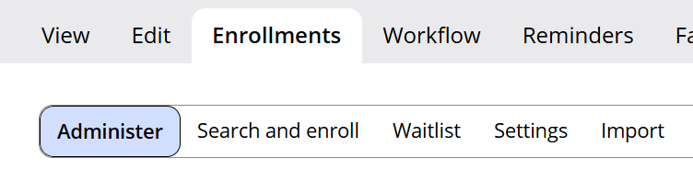
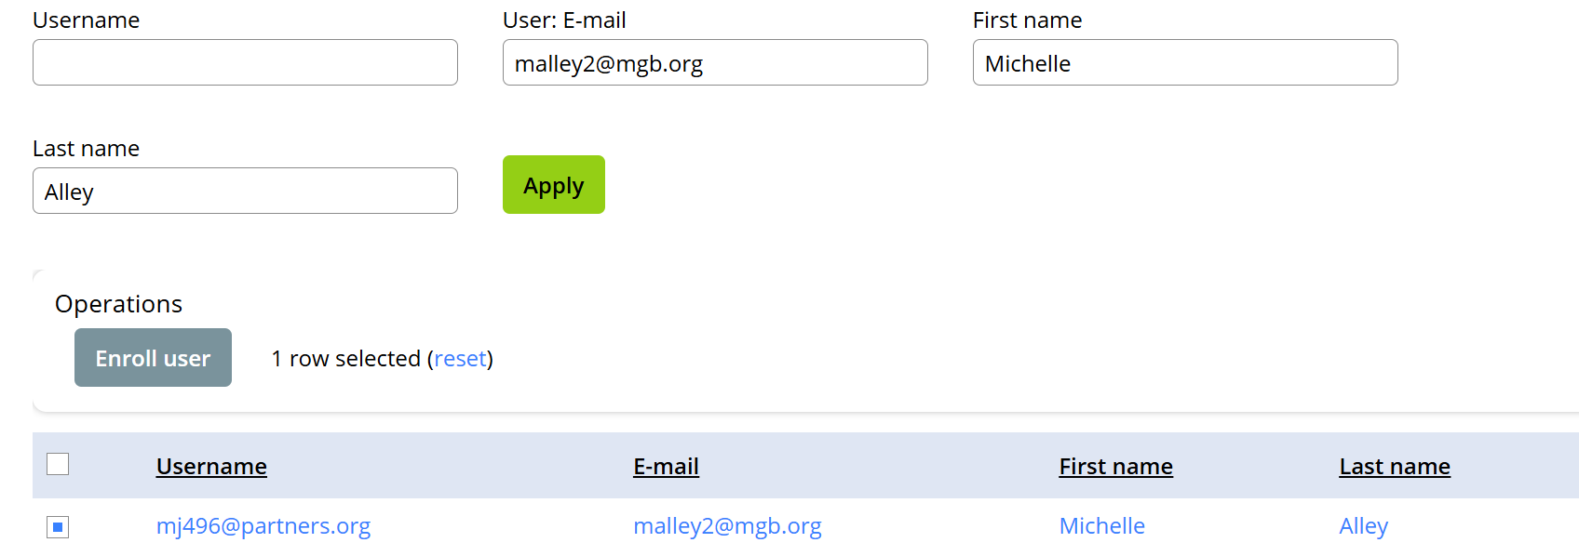
How to Manually Enroll Attendees in a Session
    All Series admins have access to manually enroll attendees
    Here are the steps:
      Open the session
      Select enrollments
      Select Search and enroll (you can search by 1 or multiple fields)
      Check the box next to the attendees name
      Click enroll user
      Click confirm
      Click Administer
      Search for attendee
      Check the box next to the name
      Click mark the box “Mark User Attended”
      Click confirm
Notes:
Attendees can be manually enrolled in a session and here are the steps – we will go over these steps in the May and August webinars.

Slide 17
Series Coordinator Site
Notes:
Let’s take a quick look at the Series Coordinator site,

Slide 18
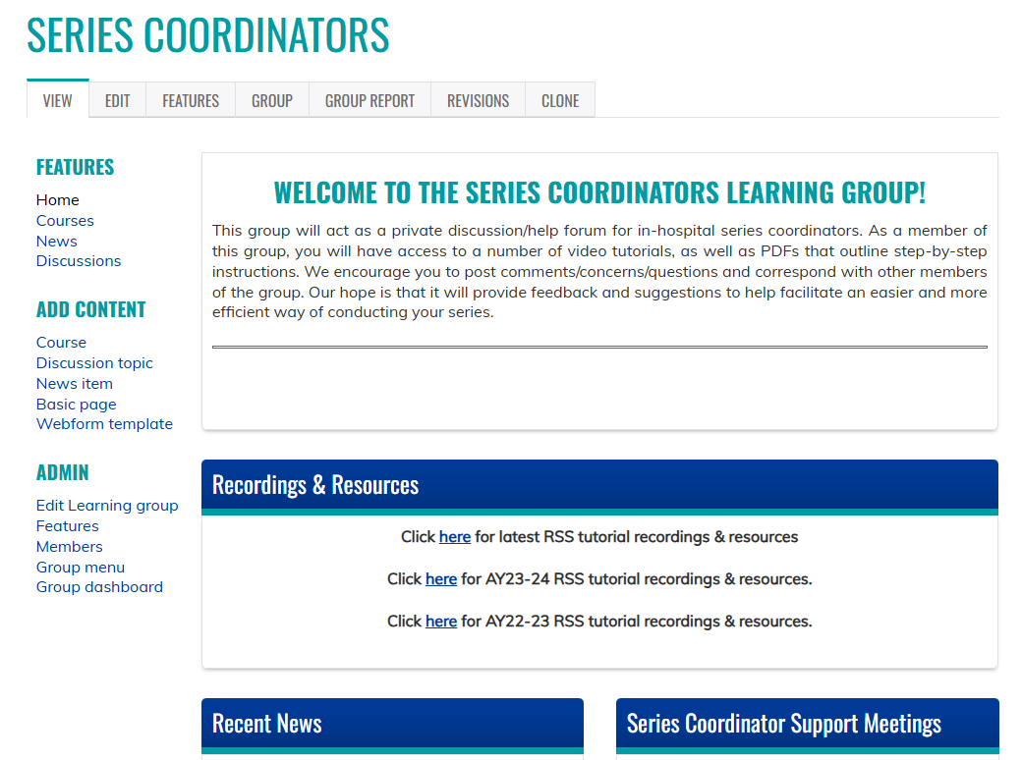
Series Coordinators Site
Resources/workflows can be found here: https://cpd.partners.org/series-coordinators/
Notes:
The Series Coordinator site is a great resource for any documents you will need. The latest version is always updated here.
As you see above there is a link to the recordings – this will be added along with the slides. It also has the link for the Open Hours meeting on Tuesday at 9:00 and Thursday at 2:00

Slide 19
Series Coordinators Site cont.
Partial list of documents available on the Series Coordinators Site
Disclosure Form
Mitigation Form
Speaker Attestation Form
Copyright & Consent Form
Employee - Owner Additional Information Form
Employee - Owner Content Review Form
Presentation Review Checklist
Risk Management Request Form
List of Verbs for Formulating Objectives
CME for MOC Program Guide
Patient Safety MOC Credit Request Form
Session Information Form (Final Check-in)
Additional Course Directors - Coordinators – Planners
Evaluation Template
Disclosure Summary Slides
2025-2026 Pricing for In-Hospital Series
https://cpd.partners.org/series-coordinators/
Notes:
Here is a partial list of the documents on the site. I am always adding new ones too. As an example the full pdf of the proposal for both the new and renewal has been added to the site. Check it out and let me know is anything is missing.

Slide 20
Evaluation Process
Notes:
Now lets review the evaluation process

Slide 21
Evaluation Process
  Evaluation Options:
  After Every Session
    Optional for any series
  2x Year (Recommended)
      2x/year: The CPD team will send an evaluation to all attendees for the series
        The results for your series will be available
        We will be combining the results for all series and sharing in a Webinar
        For series with ABIM, ABP or ABOHNS MOC, we will also send the evaluation results to the attendees, as part of the "evaluation and feedback" requirement.
Notes:
There are 2 ways to evaluate sessions. If you chose after every session in the proposal we will build your sessions with an evaluation and the evaluation must be completed for learners to receive credit for the session. You will also receive the follow-up survey in the July/August timeframe.
If you chose 2x/year then the evaluation will be sent by SurveyMonkey in the Dec/Jac timeframe and the same July/August followup will be sent by SurveyMonkey.
We plan to have the 2025-2026 results pulled together in the September timeframe.

Slide 22
Follow Up Surveys
  All series
    ~3-6 months after series closes: Follow-up Survey will be sent to all participants by CPD. Questions ask about changes to individual and team performance.
      The survey is built as an additional session in the series. You can view the results for the survey.
  Series that measure higher-level outcomes
    ~6 months after series closes: Survey to course directors for any series stating they plan to measure performance, quality, safety and/or patient outcomes
      We share a program-level report with all series that participate. We will also post the report on the series coordinator site.
Notes:
This slide explains the Follow-up surveys process we send in the July/August timeframe.

Slide 23
Owners, Employees and (Sometimes) Founders
Notes:
Some of you are lucky enough to never have Owner, Employees and Founders relationships, but for those who do let quickly review the process.

Slide 24

Owners, Employees and (Sometimes) Founders
The following individuals are considered to have unresolvable financial relationships:
  Owners of ineligible companies (includes private stock owners)
  Employees of ineligible companies
  Founders of ineligible companies who are compensated with private stock, salary or stipend. They are the equivalent of an owner or employee.
  This include private stock
These individuals may not:
  Control content of accredited education
  Participate as planners
  Participate as faculty
Source: https://www.accme.org/accreditation-rules/standards-for-integrity-independence-accredited-ce/standard-3-identify-mitigate-and-disclose-relevant-financial-relationships
Notes:
When a speaker or planner are owners, employees or founders of a company the speakers are considered to have unresolvable relationships. This could include owning stock in a private company. I would suggest to give the speaker a heads-up the presentation may be required for the session to be approved. Reminder too the presentation can be a draft.

Slide 25



Exceptions
Owners, employees and founders* of ineligible companies can participate as planners or faculty in these specific situations:
Not Related to Business
When the content of the activity is not related to the business lines or products of their employer/company.
Basic Science Research
When the content of the accredited activity is limited to basic science research, such as pre-clinical research and drug discovery, or the methodologies of research, and they do not make care recommendations.
Technicians
When they are participating as technicians to teach the safe and proper use of medical devices, and do not recommend whether or when a device is used.
*When founder receives private stock, salary or stipend
Source: https://www.accme.org/accreditation-rules/standards-for-integrity-independence-accredited-ce/standard-3-identify-mitigate-and-disclose-relevant-financial-relationships
Notes:
There are a few exceptions listed above. To confirm if an exception can be met, we request the presentation and a planner would review the presentation and complete the Employee - Owner Content Review Form which is available you guess it on the series coordinator site. When we receive the signed form and the presentation our team will review and confirm the exception meets ACCME standards

Slide 26

Employees, Owners & Founders – Most Important Takeaway
Contact us as soon as you know you are inviting an owner, founder or employee speaker!
  Review of owners, founders, employees and stock owners of private companies takes time.
  We cannot provide credit until all the steps are complete.
  If we get it wrong, we risk losing accreditation.
Notes:
This process takes a bit of time to review the companies so the sooner we are aware of the relationships. Hopefully the quicker we can get confirm if an exception can be met.

Slide 27
MOC (Maintenance of Certification)
Notes:
Lets take a look at the MOC process and the few changes we made this year

Slide 28
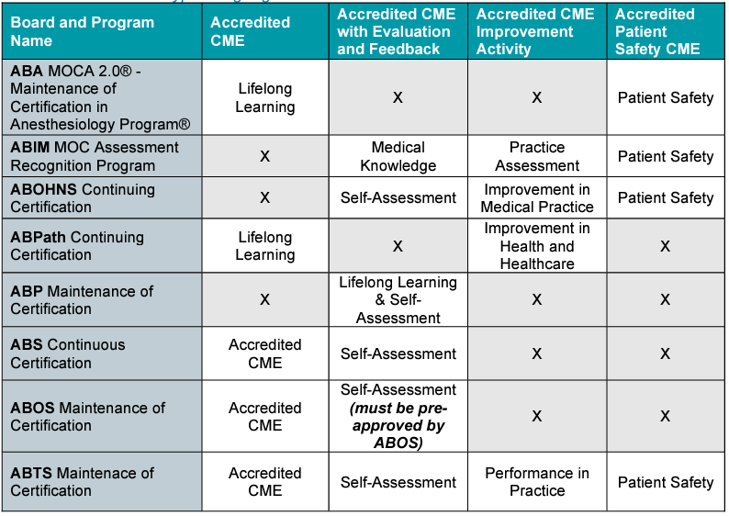
CME That Counts for Maintenance Of Certification (MOC)
Notes:
There is only 1 change to MOC. Patient Safety is now available for the ABIM, ABOHNS and ABTS boards (see the blue boxes above). There is an added form for patient safety which is included on the Series Coordinator Site.

Slide 29
MOC Reporting
In 2023, we implemented an update on EthosCE to make MOC credit claim and reporting easier.
Learners add their birthday (month/day) and board information in their profile.
Reporting of learner participation in activities designated for MOC will be done immediately after the learner claims the MOC credit.
  The LMS has automatic reporting capabilities with the boards through our Joint Accreditation reporting system.
Please remind your learners to update their profiles!
Notes:
Learners will receive credit for MOC automatically. If the profile is not setup correctly the system will send an email and the learner can contact mgbCPD@mgb.org and we will investigate.

Slide 30
Check-in Process
Notes:
Onward to the Check-in Process

Slide 31

Check-In Process
Check the Ready for Review button in the Final Check-in Session and
hit Save!
The process can be this easy if…
Notes:
We have had much success with the check-in process and you have all been great! Quick review - Once you have your last session you should go into the check-in session. This is the last session in your series and the session has your disclosure summary template and the proposal and click ready for review, The process is this easy if

Slide 32
Check-In Session Requirements
    All sessions includes a title/topic (should be in the Systemwide Grand Rounds title)
    Speaker Disclosures for all sessions are uploaded
    Disclosure Summary Slide for all sessions include:
      Session title
      Session objectives
      Planner and Speaker Disclosures
      Accreditation statement for all professions
    All cancelled sessions are labeled cancelled and unpublished
Notes:
If the titles or cases are missing - please upload a list in the final check-in session.
If the session is marked cancelled – I can unpublish.
When we approve the session your check-in has been completed. If there ar any questions…

Slide 33
Check-In Process cont.
But if there are questions or information is missing the CPD team will use the check-in session at the end of the series to let you know
Notes:
the session will be set to feedback for additional information.
I will noe turn it over to Rose to discuss the Systemwide Grand Rounds

Slide 34
Systemwide Grand Rounds

Slide 35
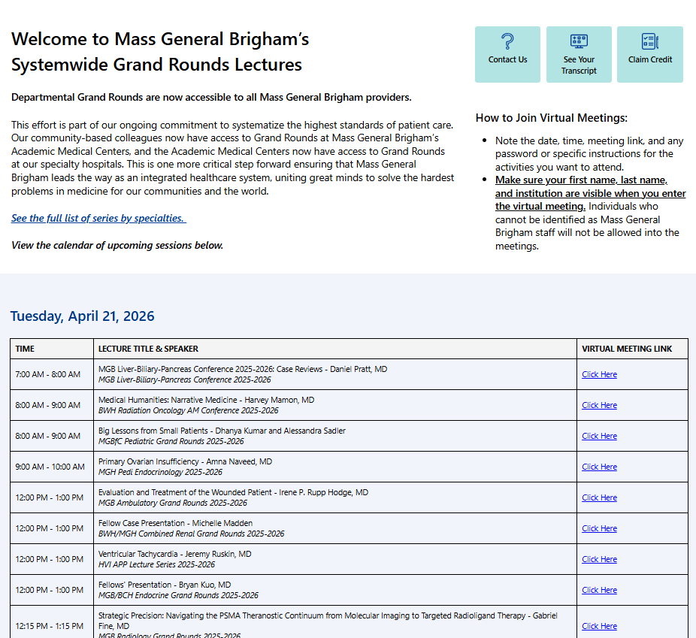
Systemwide Grand Rounds
Expanding Access Across MGB Hospitals
Launched live access systemwide on Vitals July 2024
Unifying Expertise
Access & Flexibility
Careful Content Management
Launched Vitals Recordings July 2025
Now has more than 500 recordings
Next Steps:
  Pilot external access to recordings
  starting in July 2026
23K site visits since launch
Access Grand Rounds On Vitals Today: https://partnershealthcare.sharepoint.com/sites/VitalsSystemwideGrandRounds
Notes:
Newsletter Blurb/Talking Points:
With the launch of departmental Grand Rounds being available system-wide this July, we have taken one more critical step forward, ensuring that Mass General Brigham leads the way as an integrated healthcare system, uniting great minds to solve the hardest problems in medicine for our communities and the world. Now, our community-based colleagues will have access to Grand Rounds at Mass General Brigham’s Academic Medical Centers, and the Academic Medical Centers will have access to Grand Rounds at our specialty hospitals. Mass General Brigham System-Wide Grand Rounds will be centrally located on the Vitals website. This initiative is being phased in by first providing links to livestream offerings when they occur. Arrangements are underway with Mass General Brigham Digital to archive lectures for on-demand viewing down the road, providing enhanced flexibility. We have been working with Mass General Brigham Vitals Communications to launch and advertise the site, starting at the end of June. Each of Mass General Brigham’s community hospitals has established point persons for cascading communication. Great care has been taken to ensure that sensitive clinical and/or administrative content (e.g., M&M Rounds, Tumor Boards, etc.) have been exempted from this initiative and that these lectures are only accessible internally. Over the next few months, we will focus on procuring feedback and refining our processes.

Slide 36
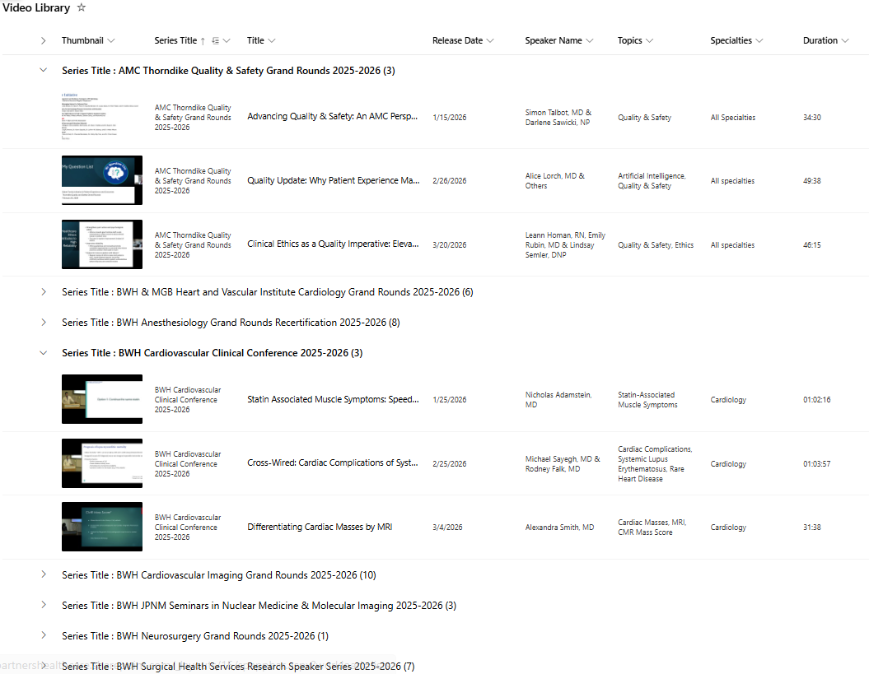
Systemwide Grand Rounds:
Library of Recordings
Last summer, MGB CPD opened a library of recorded sessions to all MGB staff.
This library created one central repository where all grand rounds recordings are housed.
Learners are able both to search the full list by topic or keyword and to easily view sessions for specific series.
Credit is available for 6 months after the session date.
1.7K views since summer 2025.
Please send us your videos!
There are about 400 sessions that have been recorded but aren’t on the site yet.

Slide 37
Systemwide Grand Rounds:
External Access Pilot
Public Promotion of Series or Sessions:
MGB CPD is developing a site to offer a library of recordings of sessions outside of our system.
The purpose of this initiative is to grow recognition of MGB Education and to disseminate the excellent education content to audiences outside of our system.
Speakers will opt in to allowing a recording of their session to be shared outside of MGB.
Speakers will be required to provide a copyright and consent form.
The recordings will be available for free.
Coordinators will use the “custom” tab to identify sessions that should be included in the external library.
Credit will not be included in the external library.
Confidential series are excluded from this initiative.
We ask if you want to participate in this initiative on the 2026-27 academic year proposal.
If you answered ‘yes’: we will invite you to participate in the pilot.

Slide 38
Wrap up

Slide 39

Skills for Professional Development
Compliance with Mass General Brigham CPD’s requirements for Joint Accreditation standards:
  Collect disclosures and attestations from speakers. Escalate as needed to ensure compliance with deadlines.
  Submit timely documentation of series accreditation materials for CPD review
    Documentation for each session includes:
      Speaker and planner disclosure and attestation forms
      Mitigation forms for speakers with financial relationships to disclose
      Session announcements
      Disclosure summary for session as displayed to learners
      Attendance SMS code
    Documentation for series check-ins includes:
      Series session list with each session title, speaker and date
      Evaluation summary
      Answers to any CPD questions
Build each new session on EthosCE, the Mass General Brigham CPD’s learning management system. In 2021, coordinators were required to attend a training on how to use EthosCE. Coordinators create new sessions by copying a sample session built by CPD. Coordinators must ensure that the dates, times and titles for each session they build are accurate. Coordinators upload disclosures before each session. CPD reviews for approval. When CPD approves the session, the coordinator obtains the attendance SMS code and shares with the audience.
Download evaluation reports for series.
Provide customer service to series attendees. Escalate issues that coordinator can’t resolve on own to CPD

Slide 40


Follow Us On Social Media!
We are growing our followers and standing on social media to:
  Showcase all the great education projects being done around the system
  Market courses to external participants
Follow us and share your news, to help grow the community!
  X (formally known as Twitter):
    @MassGenBrighCPD
  LinkedIn:
    Mass General Brigham Continuing Professional Development
    https://www.linkedin.com/showcase/mass-general-brigham-office-of-continuing-professional-development

Slide 41

Thank you for attending today’s meeting!
We will email you with our next webinar date
Reminder to please send all questions to mgbCPD@mgb.org
These slides will be available on the Course Coordinator Virtual Community: https://cpd.partners.org/series-coordinators

Slide 42

Questions

