Slide 1


In-Hospital Series:
Back-to-Basics
Training Webinar
Michelle Alley
Continuing Professional Development
May 28, 2026
Notes:
Welcome. Today is the In-Hospital Series Back-to Basics Training webinar. This is a great refresher and a good how-to introduction for beginners.
This session is being recorded. We will not record the August session

Slide 2

Agenda
Important Dates / Upcoming Training
Joint Accreditation and requirements for interprofessional activity
Systemwide Access to In-Hospital Series
Approval and Access to the Series
Flowchart overview
Create Additional Sessions
Update Session
Upload Documents to a session
Forms for Session Approval
Add new or additional administrator to a series
Series Coordinator site
Q&A
Please send questions to mgbcpd@mgb.org
All recordings and slides will be available on the series coordinator website
Notes:
Here is the agenda

Slide 3

Important Dates
Proposal Deadlines:
  The deadline for all Proposal has passed.
Late Fees:
  Proposals received more than 1 week after the deadline will incur a non-refundable late fee of $750.
Tuesday/Thursday Open Hours Meeting:
Tuesdays 9:00 to 10:00
Thursday 2:00 to 3:00
Teams Link: Link for the RSS/In-hospital Open Hours meeting
Notes:
The deadline for the summer and fall proposals has past and all proposals received now may be subject to a late fee of $750 per series
Please reach out to me if you have any questions on the proposals.
Thank you to all who have submitted – I am reviewing the over 184 proposals and close to 375 planner disclosures which we received to date. By the end of the day today all series starting in the summer have been reviewed and either an approval email or an email requesting additional information was or will be sent today. Please have this information back to us as quick as possible, We are starting the builds and want to make sure all series are built on time.

Slide 4
Upcoming Trainings
Upcoming Trainings | Audience | Training Date | Registration Link
May Training | In-Hospital Series Back-to-Basics & Reporting Training Webinar | May 28, 2026 (10:00 AM-11:00PM) | Todays meeting
June Training | Systemwide Grand Rounds Phase 3: Recordings (External) | June 23, 2026 (11:00-12:00PM) | Register in advance for this meeting 2026-2027 In-hospital Series Systemwide Grand Rounds Phase 3: Recordings (External)
August Training | In-Hospital Series Back-to-Basics & Reporting Training Webinar | August 20, 2026 (10:00 AM-11:00PM) | Register in advance for this meeting 2026-2027 In-hospital Series Back to Basics
Recordings for past webinars are available:
https://cpd.partners.org/series-coordinators/content/hospital-series-workflows-and-videos
Notes:
Here are the upcoming trainings and the link to the webinars and/or slides

Slide 5

Joint Accreditation with Commendation
Mass General Brigham was awarded Joint Accreditation with Commendation from November 2025 through November 2031.
Joint Accreditation for Interprofessional Continuing Education™ offers organizations the opportunity to be simultaneously accredited to provide continuing education activities for multiple professions through a single, unified application process, fee structure, and set of accreditation standards.
Jointly accredited providers may choose to award single profession or interprofessional continuing education credit (IPCE) to:
  Athletic Trainers
  Dentists
  Dietitians
  Nurses
  Optometrists
  Physician Assistants
  Pharmacists
  Physicians
  Psychologists
  Social Workers
Notes:
As most of you know we have joint accreditation and we were just approved in November for Joint Accreditation with Commendation. We offer credit for the 10 professions listed there.

Slide 6
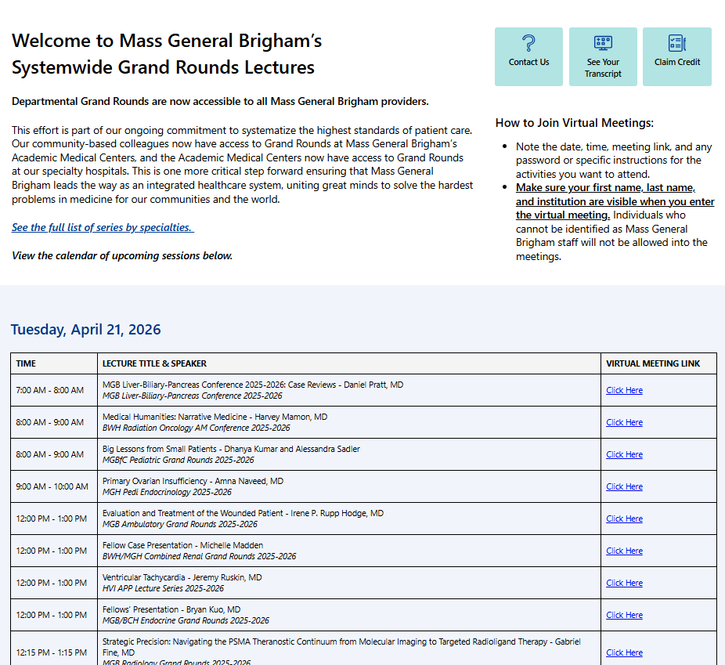
Systemwide Grand Rounds
Expanding Access Across MGB Hospitals
Launched live access systemwide on Vitals July 2024
Unifying Expertise
Access & Flexibility
Careful Content Management
Launched Vitals Recordings July 2025
Now has more than 500 recordings
Next Steps:
  Pilot external access to recordings
  starting in July 2026
23K site visits since launch
Access Grand Rounds On Vitals Today: https://partnershealthcare.sharepoint.com/sites/VitalsSystemwideGrandRounds
Notes:
The Systemwide Grand Rounds site has been very successful since is launch in July 2024 with over 23K site visits. We continue to improve the site by adding over 500 recording since the launch in July 2025 And for the next academic year we are putting together a pilot for external recordings.

Slide 7
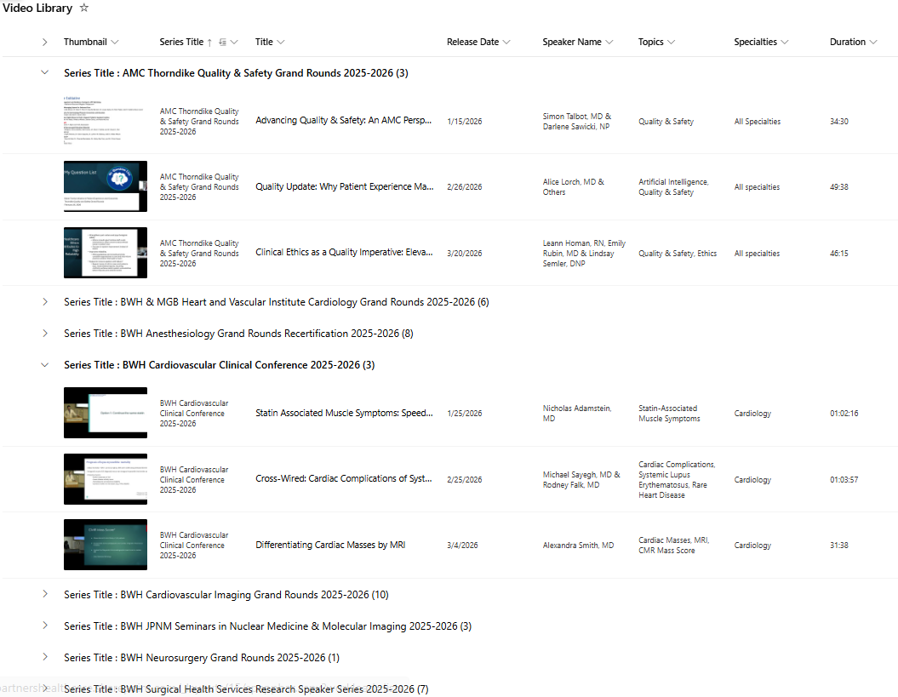
Systemwide Grand Rounds:
Library of Recordings
Last summer, MGB CPD opened a library of recorded sessions to all MGB staff.
This library created one central repository where all grand rounds recordings are housed.
Learners are able both to search the full list by topic or keyword and to easily view sessions for specific series.
Credit is available for 6 months after the session date.
1.7K views since summer 2025.
Please send us your videos!
There are about 400 sessions that have been recorded but aren’t on the site yet.
Notes:
Here is some information on central repository of recording, This creates an area where learners can search by list of topics or keywords. And again, very successful with over 1.7K views,

Slide 8
Systemwide Grand Rounds:
External Access Pilot
Public Promotion of Series or Sessions:
MGB CPD is developing a site to offer a library of recordings of sessions outside of our system.
The purpose of this initiative is to grow recognition of MGB Education and to disseminate the excellent education content to audiences outside of our system.
Speakers will opt in to allowing a recording of their session to be shared outside of MGB.
Speakers will be required to provide a copyright and consent form.
The recordings will be available for free.
Coordinators will use the “custom” tab to identify sessions that should be included in the external library.
Credit will not be included in the external library.
Confidential series are excluded from this initiative.
We ask if you want to participate in this initiative on the 2026-27 academic year proposal.
If you answered ‘yes’: we will invite you to participate in the pilot.
Notes:
Here are some highlights for the external pilot. I believe we have the list of series – but if you are intere

Slide 9
Approval and Access to the Series
To receive approval for your series, you need to:
  Submit disclosure for all planners
    An email will be sent if a planner disclosure is missing
    . There must be a planner from each credit offered to represent the profession and offer input from the profession's perspective.
    There must be at lease 1 planner who does not have any relationships
  Attend the required April In-hospital session or view the archived version
To build and receive access for your series, the following is needed:
  Date for the 1st session (included in the proposal)
  Mitigation forms for planners with disclosures (the list of planners requiring mitigation form will be provided in the approval email)
  We plan to build all series a minimum of
  2 weeks prior to the 1st session!!
Notes:
To receive approval for a series all planner disclosures must be received. There need to be at least 1 planner who does not have any relationships. Each credit offered should have a representative from the profession to represent the profession and offer input from the professions perspective.
There also should be at least 1 objective to address the team and how they learn from each other.
I will build the site and provide access for the admin list that was provided in the proposal if there is no missing information. In the email I will also include the disclosure summary template for your series.
The disclosure summary template along with the 2025-2026 proposal will be included in the final check-in session
If there is I will include any missing information needed to receive admin access for your site. Examples of missing things could be mitigation forms for planners, Risk forms for the whole series (this will save creating and uploading a risk form for every session), etc
The plan will be to have all series built a minimum of 2 weeks prior to your first session.

Slide 10
Now what – Flowchart overview
Create additional sessions
Upload the documents
CPD reviews documents
Make necessary updates then click ready for review
Feedback
Approval
Receive code
Notes:
Your series is built with the series landing page and 1 session. What do I do now?
Now comes the fun part – you get to create your sessions, upload the documents, set for review and get your approval so credit can be provided to the attendees.

Slide 11
Flowchart Create Session
Create additional sessions
Upload the documents
CPD reviews documents
Make necessary updates then click ready for review
Feedback
Approval
Receive code
Notes:
We will start with creating a session

Slide 12
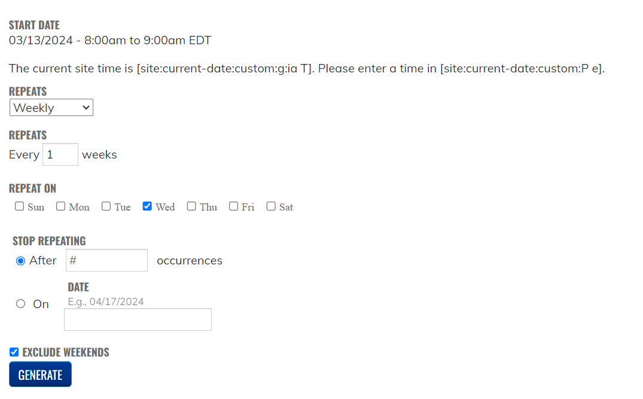
Steps to Create the Session
Open the main page to your series (link was sent with the series is ready email)
Go to the list of sessions
Click on an existing session to open the session
Click on Repeat this session
Follow the steps to repeat the session
Click Generate
Notes:
Open the main page to your series – the link was provided in the series is ready email.
At the bottom of the page is the list of 1 session
Open the session and click on repeat this session.
Follow the steps to repeat the session. (frequency to repeat daily/weekly, etc) and how many session to create.
Click generate to create the sessions.
There are a couple things to remember with this – if you will be uploading the same documents for every session – I recommend adding the documents prior to creating the session. So, you do not need to upload this information for all sessions. This will be helpful for any series using fillable pdf forms and have the same person introducing the speaker for all or most sessions.

Slide 13
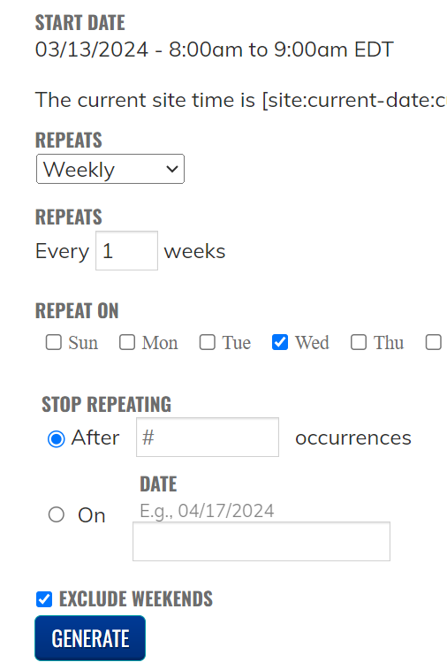
Steps to Create the Session cont.
Select from drop down how often to repeat
  Daily
  Weekly
  Monthly
  Yearly
Notes:
Select from the drop down list how often to repeat the sessions. Weekly/Monthly

Slide 14
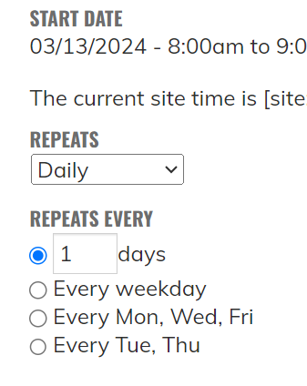
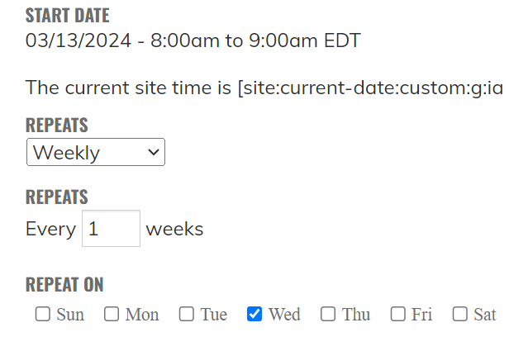
Repeat Daily/Weekly
Daily Options
Weekly Options
Notes:
Here are the selections for Daily option and Weekly option

Slide 15
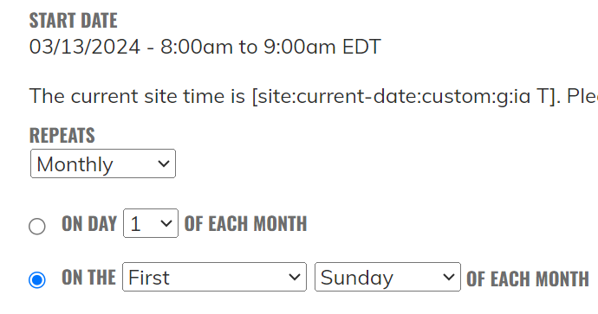
Repeat Monthly
Monthly Options
Notes:
Here are the selections for Monthly option
Before repeating and creating all your session – we would suggest to only create 1 or a few and wait for you’re your first approval. This way you know the sessions were built correctly and this will assist with not having a lot of updates.

Slide 16
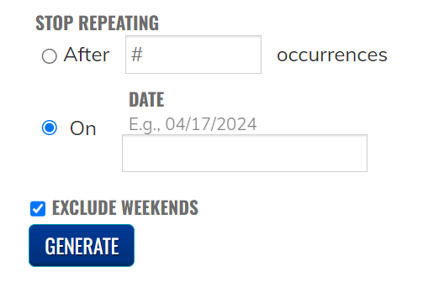
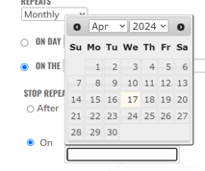
Stop Repeating
Notes:
You can either enter a date or # of occurrences you want to create.
I would not recommend building the whole series at 1 time – this will take a while, and you could receive a time-out error. I suggest doing in 2 increments till end of year and then build out 2026.
Click Generate

Slide 17
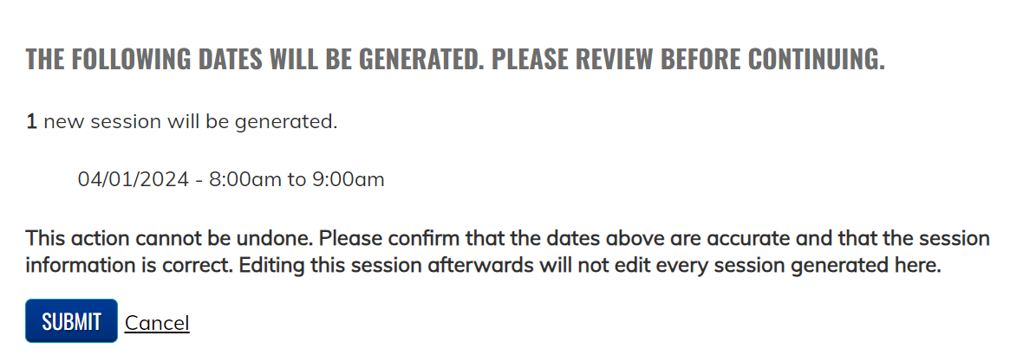
Generate New sessions
Remember: Once your sessions are created you are brought back to your starting session. Go back to the session list before updating a session.
Notes:
You will see the following after clicking generate
If everything looks good – click submit

Slide 18
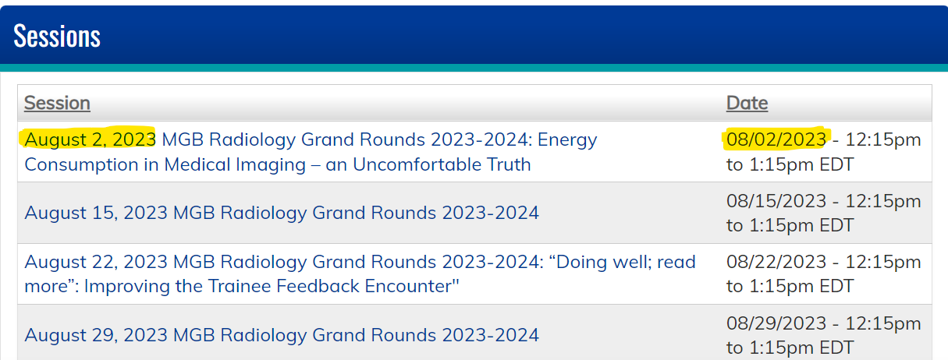
Update New sessions
Go Back to your session list located at the bottom of your series landing page
You will notice after you repeat the sessions all the titles on the left side will have the same name – all these sessions need to be updated. So they look like the screenshot below the date in title on the left side is the same as the date on the right side.
Notes:
You will be brought to the session you started with.
Be sure to go to the main list and select the session you want to update.
Anything can be written in the session title (the left column). The system uses the date listed in the right column. For example the text code will not work if the date listed in the session date (the date in the right column is in the future).
You will notice after you update all the titles on the left side will have the same name – all these sessions need to be updated. So they look like the series screenshot below the date in title on the left side is the same as the date on the right side.

Slide 19
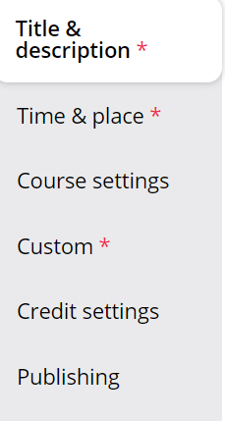
Edit a session
Click on the session to open it
Click the Edit tab
3 Areas to edit in a session
Title & Description
Time & Place (occasionally)
Custom
Notes:
Click on the session to open it and click the edit tab
There are 2 area you need to update and occasionally there may be a 3rd when the date needs to be updated

Slide 20
Edit a session: Title & Description
Click Title & Description Tab
  Include in the title:
    Date of the session
    Title of the series
    Topic of the session
  In the Body of the session
    Confirm the Course Director information is correct
    Confirm the link for the session is correct
Notes:
Update the title & description of the session – be sure to add the correct date and leave the series name in the tile. Also add the session title – this will assist with final check-ins

Slide 21
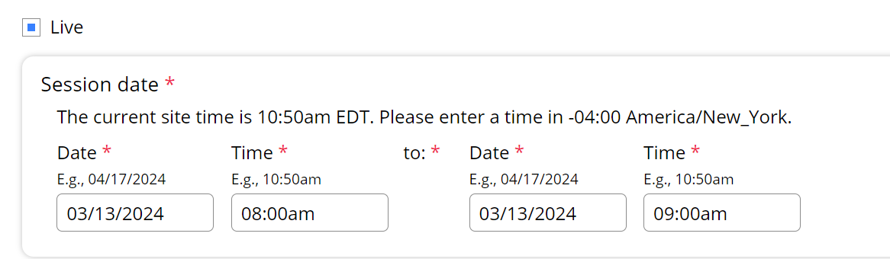
Edit a session: Time & Place
Click Time & Place
Confirm this date matches the date in the title of the session. The system uses this date not the title date.
Notes:
Most times this area does not need to be updated – but please confirm the date in the time/place tab is the expected date because this is the date the system will be using

Slide 22
Flowchart Create Session
Create additional sessions
Upload the documents
CPD reviews documents
Make necessary updates then click ready for review
Feedback
Approval
Receive code
Notes:
Back to the flowchart – next we will review how to upload the disclosure, disclosure summary and any other documents that are need for the session approval

Slide 23
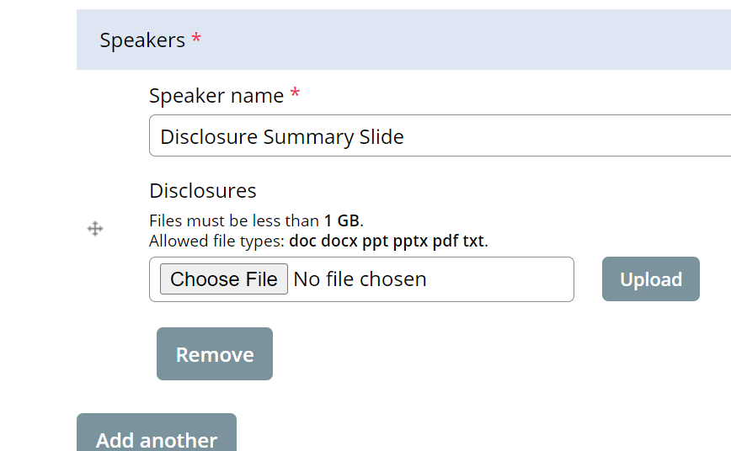
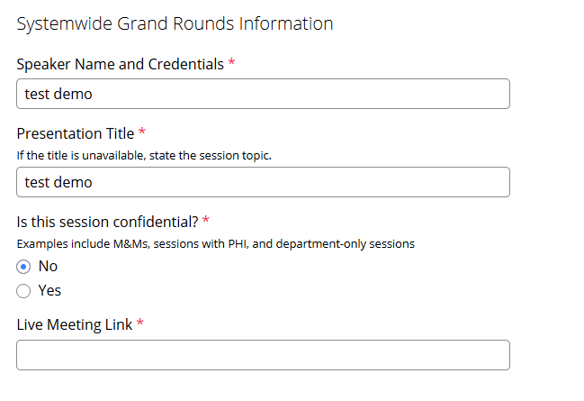
Upload the documents: Custom
Here is where you spend most of your time
The following items are uploaded to this section:
Disclosure Summary Slide (A template will be sent in the approval email we send with the link to your site)
Disclosures for all speakers/moderators/anyone doing introductions
Mitigation form for any speaker who has a financial disclosure
Any additional forms as needed
Don’t forget to update the Systemwide Grand Round section for the session
Notes:
Here is where you will spend most of your time
Here is a list of the items you will be uploading to this section for approval
Please note the new or not so new required fields for the Systemwide Grand Rounds. These fields will be used for updating the Systemwide section Rose spoke about earlier.

Slide 24
Additional Forms that may be Required for Session Approval
  Risk Management Form
    A completed form signed by a planner
    Risk has been an area that is difficult for physicians – please review your session to see if risk can be awarded.
  Attestation Form
    Signed by the speaker when a planner selects attestation as a mitigation strategy
    The speaker should complete the form after the planner completes a mitigation form and selects attestation as a mitigation strategy
    This mitigation strategy should be used only when the speaker has no slides
  Owner/Employee Content Review form and Presentation
    Only when requested should the presentation be uploaded to the session
    The Owner/Employee Content Review should be completed by a planner with no disclosures
  Recording Consent Form
    A speaker should complete this form when a session is being recorded
Notes:
Here is a list of additional documents that may be need for the session approval.
One area I do want to mention is Risk – This is an area that is difficult for physicians to get the required credit. Please review your sessions to see if the session meets a risk area so we can award the risk credit when possible,
Another one is the speaker attestation form. This is only needed when a speaker has a disclosure and there are no slides to review. The planner completing the mitigation form would select attestation and then the speaker should be asked to complete the speaker attestation form. If the attestation form has an earlier date than the mitigation form I will request a new form.

Slide 25
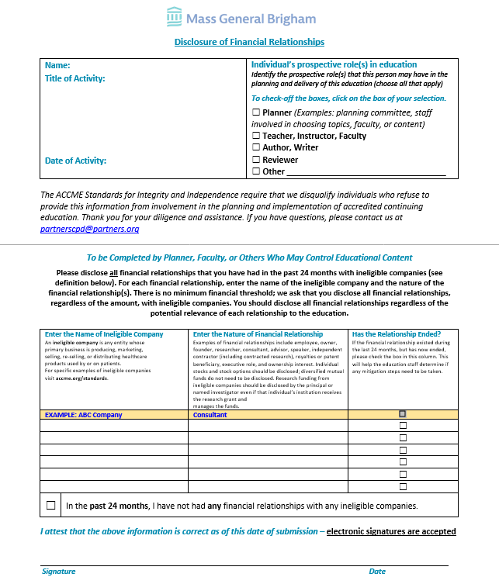
Disclosure form
What should you look for before submitting to us?
Signature for both pages (can be typed)
Dated correctly (not from last year)
Are any of the following listed?
  Owner
  Founder
  Employee
  Equity (usually means “private equity”
  Stock in a startup (usually means private stock)
Notes:
To assist with a quicker approval for your session here are items you can look for on the disclosure form – with the on-line form some of these will be addressed.
If any of the items (founder, owner, private stock, etc) from #3 are on the disclosure additional investigation for the relationship is needed and the presentation may be required.

Slide 26
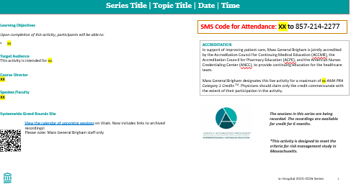
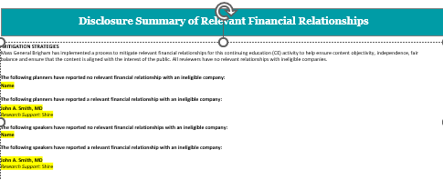
Disclosure Summary & Accreditation Slide
Notes:
Here are examples of the disclosure summary slide – be sure to use the template that was created for your series this year. There will be a QR code for the Systemwide Grand Rounds on the slide.

Slide 27
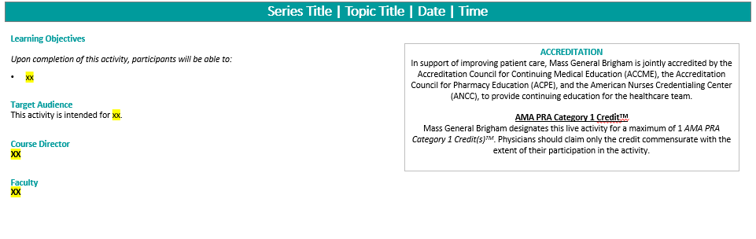
Disclosure Summary & Accreditation Slide (Continued)
On Page 1
Add the title, date and time in the heading section
Add the learning objectives for the session
Update the Faculty/speaker for the session
Notes:
Add the topic of the session and Date
Add the learning objectives for the session if know – or you can use the series objectives
Add the name of the faculty/speaker
Keep the QR code on the slide along with the date in the footer – that is how we will determine this is the correct slide for this year.

Slide 28
Disclosure Summary & Accreditation Slide (Continued)
On Page 2
Add the names of speakers with no disclosures in the speaker has no financial relationships
Add the names of speakers along with the relationships and companies to the speaker has a financial relationship
Format to add speakers with relationships
Speaker Name
Relationship: Company 1, Company 2
Example:
John Smith, MD
Consultant: CVS
Research Support: CVS, Shire
Notes:
The planner information will be included on your template – you will need to update the speaker section by adding the speaker name. When a speaker has a relationship you will add the speaker name and the company and relationship in the speaker has a relationship section.
When a speaker has a relationship that ended – a mitigation form is not needed but the relationship should be included in the speaker has a relationship section and included (ended) after the relationship.

Slide 29
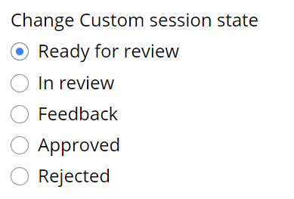
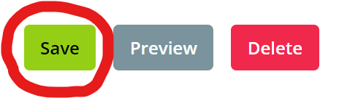
Save the session with the updates
All the documents have been updated and uploaded to the system
Now What?
At the top of the screen
Click Ready For Review
At the bottom of the screen
Click Save
Notes:
Once all the documents have been uploaded – click the session is ready for review and the save button

Slide 30
Flowchart Create Session
Create additional sessions
Upload the documents
CPD reviews documents
Make necessary updates then click ready for review
Feedback
Approval
Receive code
Notes:
Now that the documents have been uploaded and the session has been saved An email will be sent to the cpd team.

Slide 31
CPD review documents
The CPD team will review the documents and the session will either be approved or in Feedback.
An email will be sent to let you know the state.
If risk is requested. This is when the CPD team will update the session to include the risk information and include a comment to let you know a risk has been added in the session
Notes:
The session will be included on the approval dashboard. Reminder though the session falls off the dashboard when the date has passed. I will review the session and either approve or set the session to feedback. Any additional update or notes are added to the comments – like session was updated and approved for risk.

Slide 32
Flowchart Create Session
Create additional sessions
Upload the documents
CPD reviews documents
Make necessary updates then click ready for review
Feedback
Approval
Receive code
Notes:
Now we will review the approval of a session – which I must say – great job to you all most sessions have the correct information and are approved right away.

Slide 33
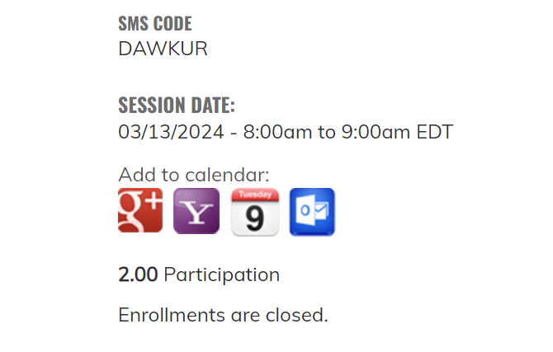

CPD Approved / Receive Code
The code will be available to series admins who are logged into the system once the disclosures and disclosure summary are uploaded, and the session is approved
On the session page towards the bottom of the screen is where you will find the code
The disclosure summary slide should be updated with the code but does not need to be re-uploaded to the system. You will need to show these slides as the start of the session and the code should not be available in recordings that are not eligible for credit.
Notes:
When the session is approved – you will receive an email to let you know and the code will be available on the session towards the bottom of the screen. You must be logged in to see the code. You can update the disclosure summary slide with the code and this slide must be shown at the start of the session. This is very important for session being recorded so attendees watching the video can text the code and receive credit within the 6 month timeframe. I would suggest if the code is not available to add contact information to the recording (suggest to the slide) so someone watching the session can contact you for the session code and receive credit.
This is a good reason to have session documents uploaded at least 24 hours prior to the start of the session so the code will be available prior to the session start.
I review the dashboard a minimum of 2 times a day at the start (about 8:00ish) and end (about 4:30ish) every day. I do try to review during the middle of the day at time permits and those that need to can send me an email, message in teams or call my cell phone. If anyone need the number please reach out to me.

Slide 34
Flowchart Create Session
Create additional sessions
Upload the documents
CPD reviews documents
Make necessary updates then click ready for review
Feedback
Approval
Receive code
Notes:
There are a few exceptions where the feedback button is needed – but I do think that could be the system can be to blame for some of these, When the document is not uploaded is a great example of this.

Slide 35
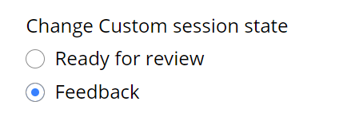
CPD Feedback / add updates and Click Ready for Review
When a session is in Feedback, all emails are set to you.
The CPD team is not notified of any updates until the Ready for review button is selected.
Notes:
When is does happen though I will add a comment for the missing or additional information that is needed and set the session to feedback. When this does happen – if you make the changes and keep the session in feedback I do not get an email and the session is not on my dashboard, so I do not know to the update are completed and the session can be approved. (Where the session is in feedback you will likely get the email and I understand that because I have done this a time of time when I am approving I review and forget to click the session is approved and it remains in ready for review state.)

Slide 36
Add a series Admin to the site
Add new or additional administrator to a series
  Send an email to mgbcpd@mgb.org
  Reminder all series admins must have training prior to gaining access to the system
  The new admin must have an account on the system
  Go to https://cpd.partners.org and login with single sign on (SSO)
Notes:
Admins can be added to the system at any time – we do ask that training be dome so they know how to use the system, They can watch the required recording and/or this video or drop into one of the weekly open-hours session. Reminder too an admin can not be added until they create an account on the system – and to create an account they need to login.

Slide 37
Checklists
Session Approval
Upload to “Custom” tab on session:
Disclosure form for each speaker
Mitigation form for any speaker who has a financial disclosure
Accreditation and Disclosure Summary slides
Update the “Title and Description” tab:
Include the topic of the session in the title
  If session is confidential to your department, write “DEPARTMENT ONLY” in the tile
Make sure the date is correct
Add the link to participate in the meeting virtually in the body text section
Series Website Access
Submit to mgbcpd@mgb.org:
Provide the virtual meeting link for the 2025-2026 series, so we can share on the systemwide site
Provide all planner mitigation forms
Training:
Coordinator needs to take a training (either today’s or the one from 4/17)
Notes:
Here is a checklist for the website access and session approval

Slide 38
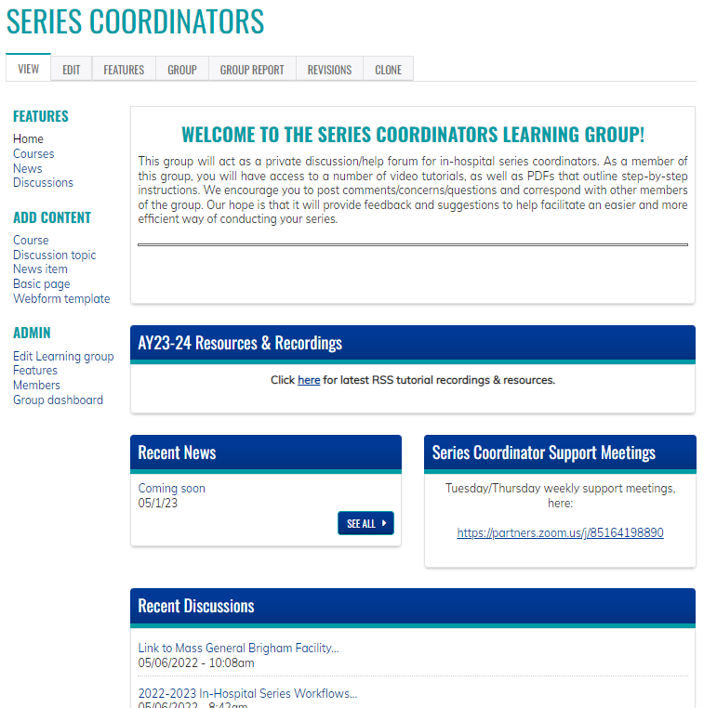
Resources/workflows can be found here: https://cpd.partners.org/series-coordinators/
Notes:
Here is the link to the Series Coordinator site, Thit site has the latest version of the documents, training material and recordings.

Slide 39
Series Coordinators Site cont.
Partial list of documents available on the Series Coordinators Site
Disclosure Form
Mitigation Form
Speaker Attestation Form
Copyright & Consent Form
Employee - Owner Additional Information Form
Employee - Owner Content Review Form
Presentation Review Checklist
Risk Management Request Form
List of Verbs for Formulating Objectives
CME for MOC Program Guide
Patient Safety MOC Credit Request Form
Session Information Form (Final Check-in)
Additional Course Directors - Coordinators – Planners
Evaluation Template
Disclosure Summary Slides
2025-2026 Pricing for In-Hospital Series
https://cpd.partners.org/series-coordinators/
Notes:
Here is a partial list of the document links available on the Series Coordinator Site. Most of these you have seen.

Slide 40
Help is always available on the weekly open hours calls
Tuesdays 9:00 to 10:00
Thursday 2:00 to 3:00
Here is the Zoom link: https://partners.zoom.us/j/85164198890
Notes:
Help is always available – reminder these sessions are for you – so if you have any questions – even to ask to have a session approved join the call.
There are some screen shots of the forms in the appendix of this slide deck if anyone is interested the slides will be uploaded to the Series Coordinator site.

Slide 41


Follow Us On Social Media!
We are growing our followers and standing on social media to:
  Showcase all the great education projects being done around the system
  Market courses to external participants
Follow us and share your news, to help grow the community!
  X (formally known as Twitter):
    @MassGenBrighCPD
  LinkedIn:
    Mass General Brigham Continuing Professional Development
    https://www.linkedin.com/showcase/mass-general-brigham-office-of-continuing-professional-development
Notes:
Don’t forget to follow us on social media

Slide 42

Thank you for attending today’s meeting!
We will email you with our next webinar date
Reminder to please send all questions to mgbcpd@mgb.org
These slides will be available on the Course Coordinator Virtual Community: https://cpd.partners.org/series-coordinators
Notes:
Thank you for attending

Slide 43

Notes:
Questions

Slide 44
Appendix

Slide 45
Disclosure Summary & Accreditation Slides
Requirements:
Must be provided/presented prior to the start of the session
ALL planners indicated in proposal must be listed on ALL disclosure summaries (the planner section should not change)
The speaker section will change per session
If a planner is also a speaker, they must be listed in both the planner and speaker sections of the disclosure summary
How to list:
  If someone has no financial relationships with an ineligible company to disclose, you just need to list their name
  If someone does have financial relationships with an ineligible company to disclose, you need to add their name, the role within the company, and the company name.
  If someone does have financial relationships that ended with an ineligible company to disclose, you need to add their name, the role within the company, and the company name. Ended in parenthesis would be added also.
Example:
John Smith, MD
Advisory Board: Novartis; Bayer
Steering Committee: Pfizer (ended)
Notes:
Add a note - we will provide a template for your series

Slide 46
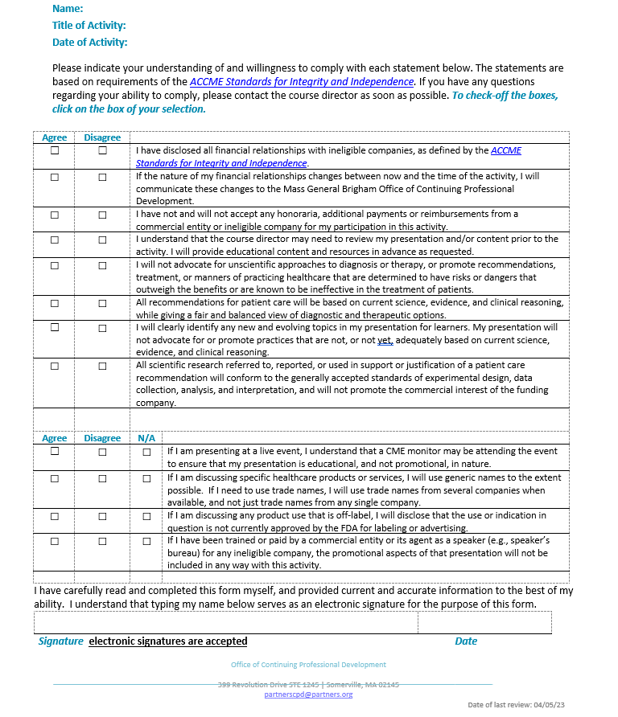
Disclosure Form
On Page 1 the Speakers should list all financial relationships with ineligible companies
Page 2 was updated to align with the ACCME Standards for Integrity and Independence

Slide 47
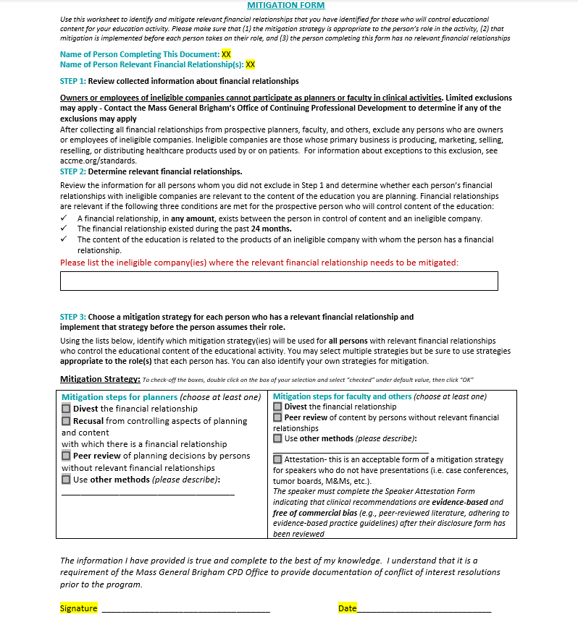
Mitigation Form
Must be completed by a planner with no financial relationships
  All series must have a minimum of 1 planner with nothing to disclose.
  The person who has the financial relationship(s) cannot complete their own mitigation form
List the ineligible companies related to the presentation
Left side of the chart is to be completed for planners
Right side of the chart is to be completed for speakers
For speakers: attestation is only acceptable as a mitigation strategy if there is no presentation to be peer reviewed
  Examples: case conferences, journal clubs, etc.
  If attestation is chosen as the mitigation strategy, the speaker will need to complete a separate attestation form after the mitigation form is completed/signed

Slide 48
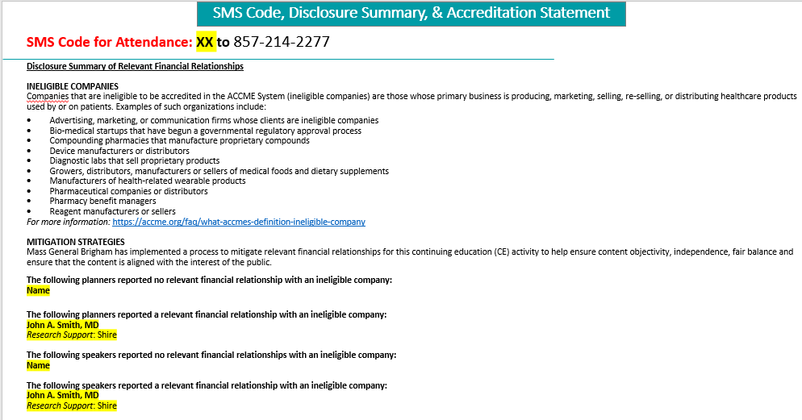
Disclosure Summary & Accreditation Slide (Continued)

Slide 49
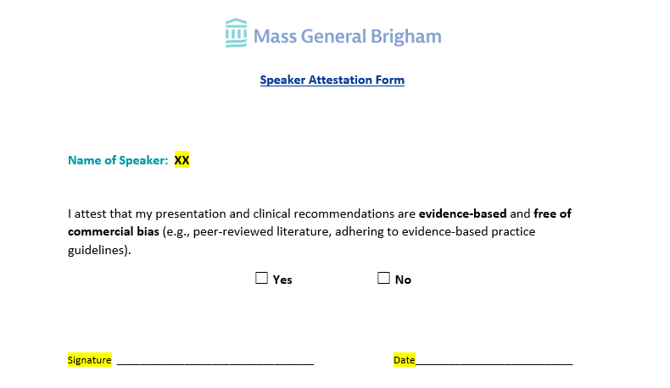
Speaker Attestation Form
Attestation is only acceptable as a mitigation strategy if there is no presentation to be peer reviewed
  Examples: case conferences, journal clubs, etc.
This form must be completed by the speaker after the course director/planner reviews the disclosure form

Slide 50
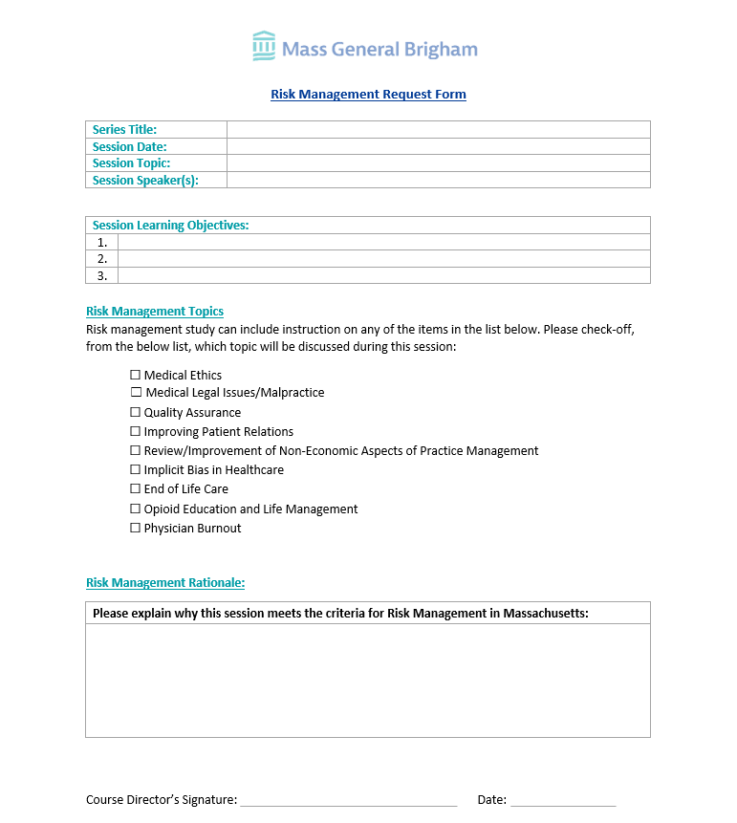
Risk Management Request Form
When risk is being requested for a single session in a series the Risk Management Request Form should be completed and uploaded to the session.
During the review process the CPD team will update the session to include the comment below
Comment added to the Workflow during Approval:
This session meets the criteria for Risk Management. The website and certificate have been updated. Please add the following statement to the announcement and disclosure summary: *This session is designed to meet the criteria for risk management study in Massachusetts
Please note: When all the sessions in a series are approved for Risk or the session is labeled M&M – the Risk Management Request form is not required

