Slide 1
Anaphylaxis

Slide 2
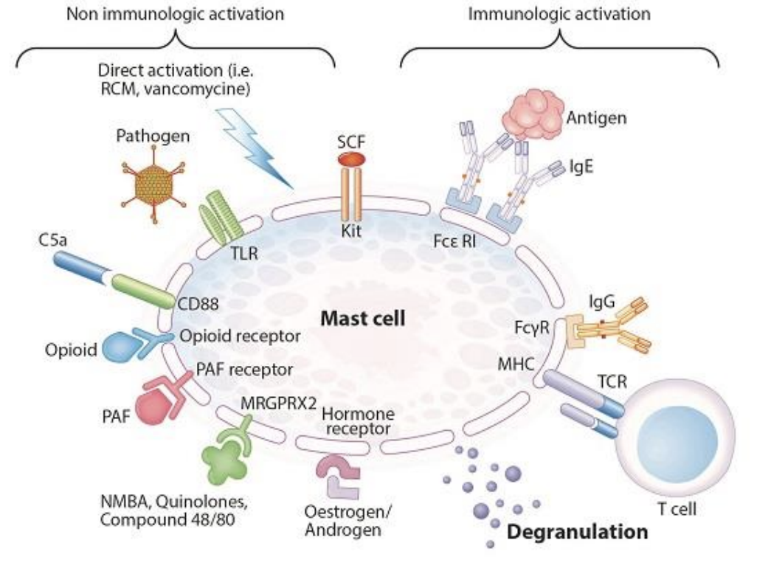
ANAPHYLAXIS
Life-threatening systemic allergic reaction
“Generalized” or “Systemic” or “Multi-organ” used but can be a single system
Lifetime prevalence 1.6-5.1%
- Difficult to accurately diagnose
Historically:
IgE-mediated mechanism: Anaphylaxis
Not IgE-mediated: Anaphylactoid reaction
Anaphylactoid no longer used as:
Clinically indistinguishable
All require treatment with epinephrine
Golden DBK et al, Ann Allergy Asthma Immunol 2023.
Chapel and Haeney's Essentials of Clinical Immunology, 7th Edition.

Slide 3
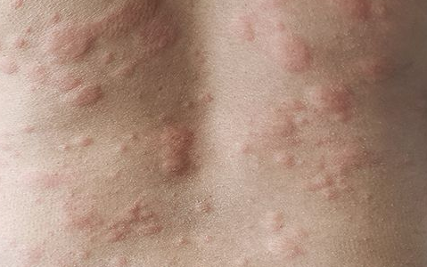
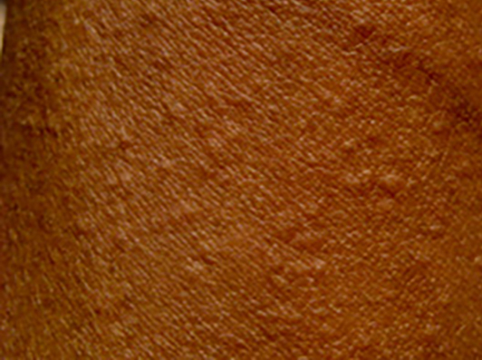
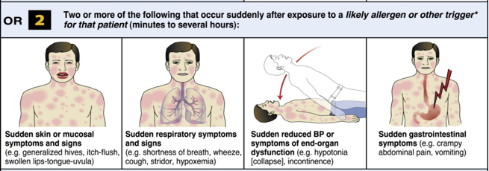
RECOGNIZING ANAPHYLAXIS
  Symptoms of an allergic reaction:
  Generalized itching or hives
  Swelling of lips, face, eyes, tongue
  Tightness in throat or difficulty swallowing
  Difficulty breathing or shortness of breath
  Nausea, abdominal pain, or vomiting
  Dizziness or lightheadedness

Slide 4
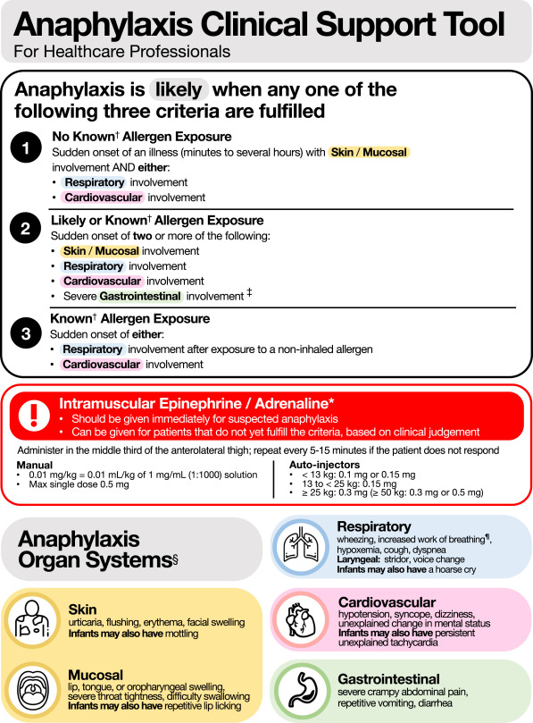
RECOGNIZING ANAPHYLAXIS
Dribin TE, J Allergy Clin Immunol 2024.

Slide 5
RECOGNIZING ANAPHYLAXIS
  If patient has these symptoms:
  Lay person flat or allow them to sit
  Assess vital signs including heart rate, blood pressure, oxygen saturation
  Examine patient’s skin, airway, heart, and lungs
  History including symptoms, vital signs and exam should be recorded on Anaphylaxis Flow Sheet.

Slide 6
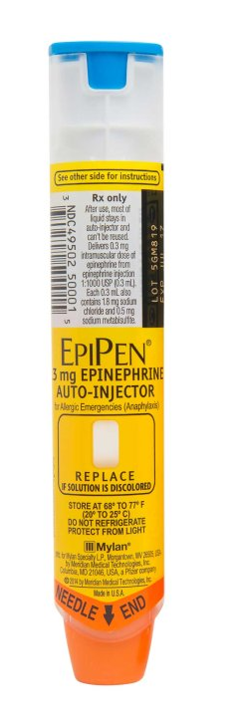
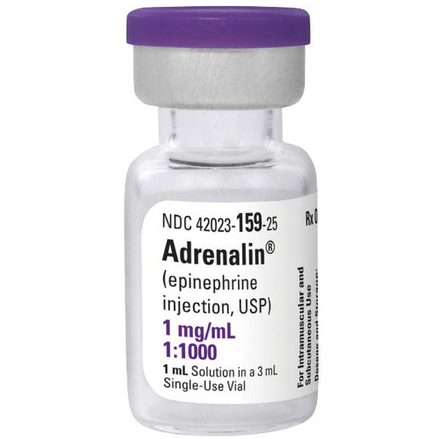
TREATMENT OF ANAPHYLAXIS
If patient has symptoms in 2 symptoms or signs of a severe reaction including respiratory compromise or hypotension, GIVE EPINEPHRINE.
Epinephrine autoinjector
  For patients 10-30kg (22lbs-66lbs), use 0.15mg (Jr)
  For patients >30kg (>66lbs), use 0.3mg
  If available, use 0.1mg for patient under 15kg (15-33lbs)
Epinephrine 1:1000 (1mg/mL) – NOT the same dosing as in arrest
  For infants and children, use 0.01 mg/kg (up to 0.3mg)
  For adults, use 0.3mg
  For patients >50kg (>110lbs), can start with 0.5mg
Inject intramuscularly (IM) in mid-outer thigh (vastus lateralis muscle)
Repeat dose in 5-10 minutes if no improvement in symptoms
Can consider IV drip if not responding to IM:
- 1 mg (1 ml) of a 1:1,000 concentration to 250 ml of dextrose 5% in water and infuse at an initial rate of 1 mcg per minute

Slide 7
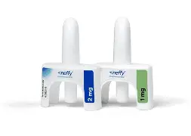
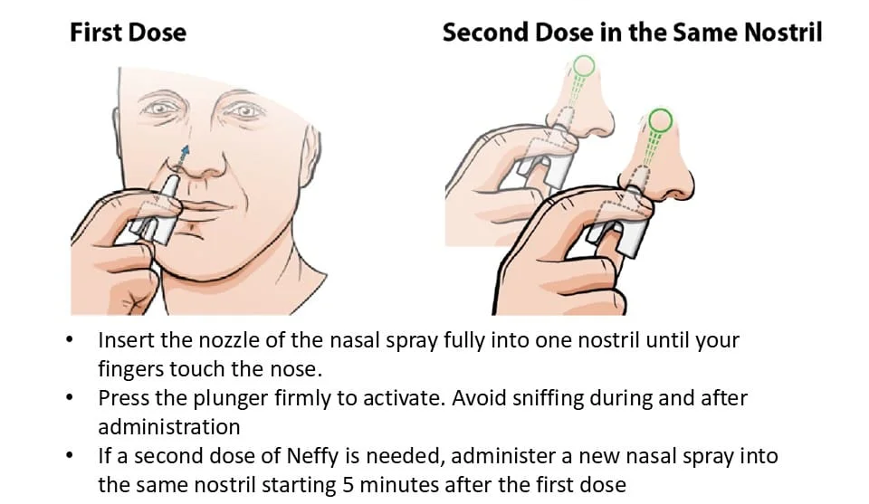
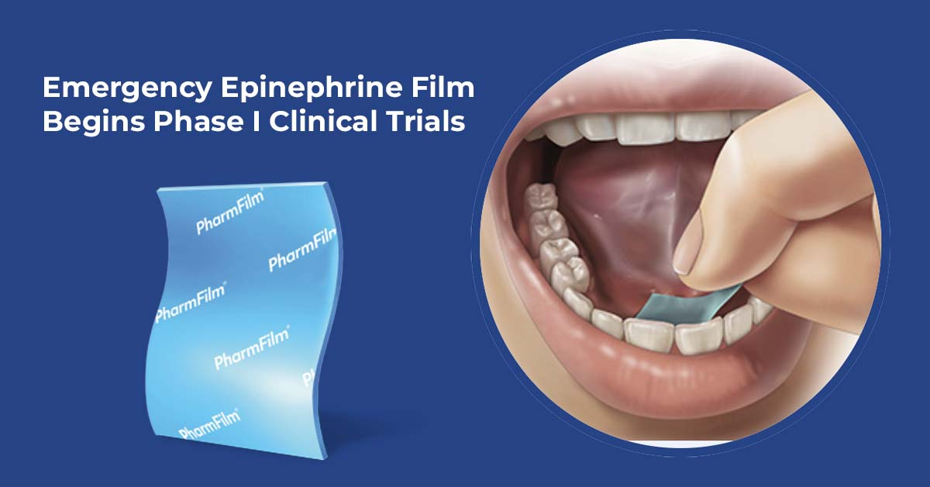
TREATMENT OF ANAPHYLAXIS
FDA approval Aug 2024 adults and children greater than 30kg
FDA approval anticipated within the year

Slide 8
TREATMENT OF ANAPHYLAXIS
First line treatment
Give if there is suspicion of anaphylaxis to reduce morbidity and mortality
  Failure to administer early is linked to increased risk of fatality and increased risk of biphasic reaction
IM is preferred route (1:1000)
May need second dose in 10-35% of cases
There is no absolute contraindication for epinephrine in the treatment of anaphylaxis.
Giving epinephrine does not diagnose anaphylaxis.

Slide 9
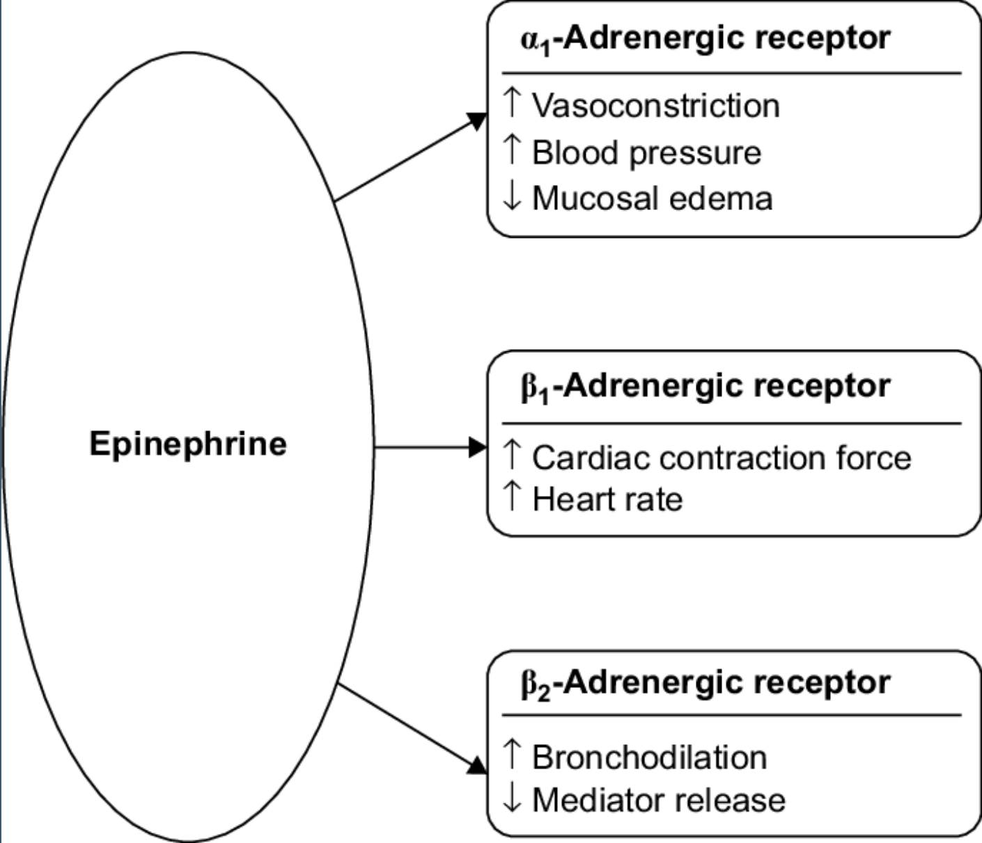
EPINEPHRINE
β2-Adrenergic Receptor–Mediated Mast Cell Stabilization
Campbell, Ann Allergy Asthma Immunol 2014.
Golden DBK et al, Ann Allergy Asthma Immunol 2023.
Posner L and Camargo C, Drug Healthcare and Patient Safety 2017.

Slide 10
TREATMENT OF ANAPHYLAXIS
  After giving Epinephrine, may additionally:
  Administer antihistamines
  Administer oxygen if needed
  Administer inhaled β-agonist if bronchospasm present
  Prepare for airway management if needed
  Administer IV fluids if needed for circulatory support
  For patients with respiratory symptoms or history of asthma, consider steroids
  Repeat dose of Epinephrine if necessary and consider whether to activate emergency response.

Slide 11
TREATMENT OF ANAPHYLAXIS
If mild symptoms (mild swelling, hives, pruritus or rash), treat with antihistamines and observe.
For age >12, Cetirizine 10-20mg by mouth.
- Alternatively, give Diphenhydramine 25-50mg by mouth.
For age 5-11, Cetirizine 5-10mg by mouth.
Alternatively can give Diphenhydramine by weight.
For age <5, Cetirizine 2.5mg by mouth or Diphenhydramine by weight
Liquid medications may have more rapid onset of action.

Slide 12
TREATMENT OF ANAPHYLAXIS
Dosing for Cetirizine (Zyrtec)
Age | Teaspoons | ML | Mg
6-12 months | 0.5 | 2.5 | 2.5
1-5 years | 0.5-1 | 2.5-5 | 2.5-5
6-11 years | 1-2 | 5-10 | 5-10
>12 years | 2-4 | 10-20 | 10-20
Dosing for Diphenhydramine (Benadryl)
Weight (kg) | Weight (lb) | Teaspoons | ML | Mg
10-14.9 | 21.9-32.8 | 1 | 5 | 12.5
15-18 | 32.9-40 | 1.5 | 7.5 | 18.75
18.1-25 | 40.1-55 | 2 | 10 | 25
25.1-40 | 55.1-88 | 2-3 | 10-15 | 25-37.5
40.1+ | 88.1+ | 3-4 | 15-20 | 37.5-50
Note that Cetirizine and Diphenhydramine have equivalent time of onset and cetirizine is less likely to cause significant sedation

Slide 13
ANTIHISTAMINES
Use based on mechanism of action and effectiveness in other allergic diseases
Vasodilatation, increased vascular permeability, bronchial smooth muscle contraction, and increased airway secretions mediated by histamine
Considered second line
  No utility in preventing biphasic reactions
  Slow onset of action
  Do not stabilize or prevent mast cell degranulation
  Do not not effectively treat cardiovascular and respiratory symptoms
  Does decrease itching and hives
Lieberman, Ann Allergy Asthma Immunol 2015.
Shaker MS et al, J All Clin Immunol 2020

Slide 14
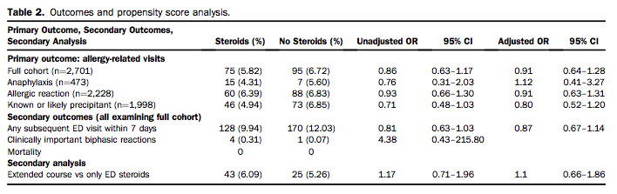
STEROIDS
Steroids have no role in acute management of anaphylaxis
No strong evidence for decrease of biphasic or prolonged reactions
Patients who have complete resolution of symptoms after treatment with epinephrine do not need steroids
  Consider if history of asthma and respiratory symptoms
Cochrane review in 2012 found no studies that satisfied inclusion criteria
Choo, Cochrane Database Syst Rev 2012.
Shaker MS et al, J All Clin Immunol 2020.
Grunau, Ann Emerg Med 2015.

Slide 15
BETA BLOCKERS AND GLUCAGON
Beta blockers can reduce compensatory cardiovascular response and response to epinephrine –> Concern for increased risk of severe anaphylaxis
  Given benefit of beta blockers, not a contraindication in patients at risk for anaphylaxis (risk of stopping exceeds risk of more severe anaphylaxis)
  Hold if beta blocker can be safely interrupted
If patient remains hypotensive despite epinephrine and is on beta-blocker, give glucagon
  Recommended dose is 1-5mg IV over 5 minutes followed by infusion of 5-15ug/min
  If IV not available, can give 1mg IM
  Risk of emesis and aspiration so important to protect airway
IM epinephrine is first-line therapy regardless of beta-blocker use.
Consider glucacon if patient on beta blocker with refractory hypotension despite epinephrine and adequate fluid resuscitation.
Lieberman P et al, Ann Allergy Asthma Immunol 2015.
Shaker MS et al, J All Clin Immunol 2020.

Slide 16
STEROIDS
Steroids have no role in acute management of anaphylaxis
No strong evidence for decrease of biphasic or prolonged reactions
Patients who have complete resolution of symptoms after treatment with epinephrine do not need steroids
  Consider if history of asthma and respiratory symptoms
Cochrane review in 2012 found no studies that satisfied inclusion criteria
Choo, Cochrane Database Syst Rev 2012.
Shaker MS et al, J All Clin Immunol 2020.
Grunau, Ann Emerg Med 2015.

Slide 17
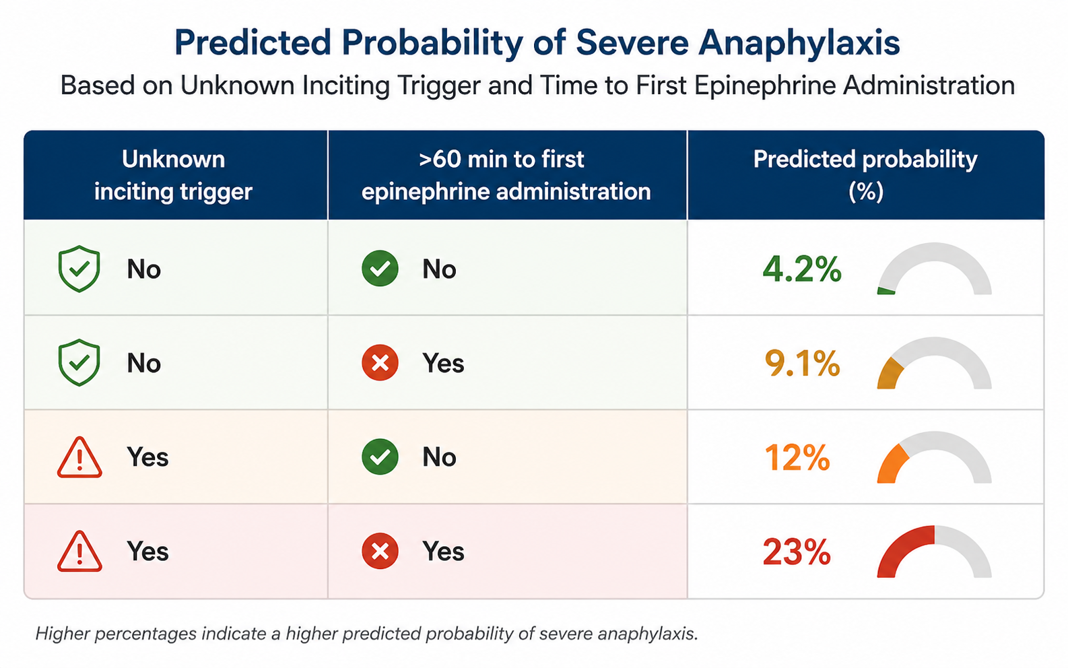
BIPHASIC REACTIONS
Defined as return of symptoms after at least 1 hour of resolution and occurring within 48 hours without re-exposure to the trigger
Occurs in 5-7% of reactions
Median interval between resolution of the initial episode and the biphasic reaction is approximately 10.5 hours (range 1.75–17 hours)
Risk Factors
Severe initial reaction
Delayed epinephrine: >30 minutes
Multiple epinephrine doses
Popa, Ann Allergy 1984.
Lee, Pediatrics 2000.
Ellis, Ann Allergy Asthma Immunol 2007.
Lee, J Allergy Clin Immunol Pract 2017.

Slide 18
TRYPTASE
In patients with recurrent, idiopathic, or severe anaphylaxis (particularly if hypotension present), check serum tryptase
Acute should be drawn within 2 hours of symptom onset
If elevated, baseline tryptase should be obtained for comparison
If baseline is elevated, refer for evaluation
Popa, Ann Allergy 1984.
Lee, Pediatrics 2000.
Ellis, Ann Allergy Asthma Immunol 2007.
Lee, J Allergy Clin Immunol Pract 2017.

