Slide 1
Allergy Documentation and Patient Safety
Dave Khan, MD
Jacqueline Squire, MD
Anna Wolfson, MD

Slide 2
Outline
How should an allergy history be taken and documented?
How should an allergy be removed?
What goes in the allergy module- areas of controversy such as environmental and contact allergens?
What do we know about documentation currently and how to improve it?
What gets transferred between systems and what does not?
What reactions are important for you to have coded and not in free text?
Should you document the drug or drug class and how do you make that decision?

Slide 3
Case: Penicillin Allergy Presentation
52-year-old female presents to discuss her history of penicillin allergy. She is planned for liver transplant and her team would like to be able to use penicillins during the surgery and post-operative course.
She reports that she took a penicillin when she was a child. It may have been amoxicillin. She had a rash. Her mother said it was itchy and red. She has been avoiding it since. It was prescribed at the time for strep throat. She did not seek emergency care and the rash resolved within a few days. No systemic symptoms as part of the reaction.

Slide 4
Drug Allergy History
Approximate date of reaction
Drug, dose, and route
Reaction details
    Doses/days into course
    Co-administered drugs
    Coincident infections
    Symptoms, exam, labs (tryptase, complement, CMP, CBC/d), pathology, photos, EHR review
    Treatment
      Home, office visit, ED, hospitalization
      Epinephrine, steroids, antihistamines
Exposures since
Notes:
Patient evaluation
What medication caused the reaction? What route did you take it?
What was it prescribed for?
What was the reaction?
Specifics – skin, respiratory, cardiovascular, GI, blistering
How long ago was the reaction?
Describe the reaction:
How long did it take for reaction to onset?
How long did it last? How long did it take to resolve?
How was the reaction managed? What medications were given?
Were you taking any other medications/OTCs at the same time?
Have they had the SAME medicine again? SIMILAR medicine?
Have they had the same reaction to other medications?

Slide 5
Question 1
A 45-year-old woman comes to your clinic to discuss her drug allergies. She has 40 listed allergies, from a variety of drug classes. The listed reaction is “hives” or “rashes” for the majority of medications. When obtaining her history, which of the following should be the focus:
Whether she also vomited during her reactions
The location on her body of the rashes/hives
A history of hives unrelated to medications
Whether she has also had angioedema
Notes:
C

Slide 6
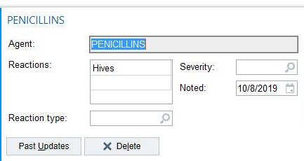
Drug Allergy History: Documentation
In the note: all the details
In the listing: symptoms (coded), date (coded)

Slide 7
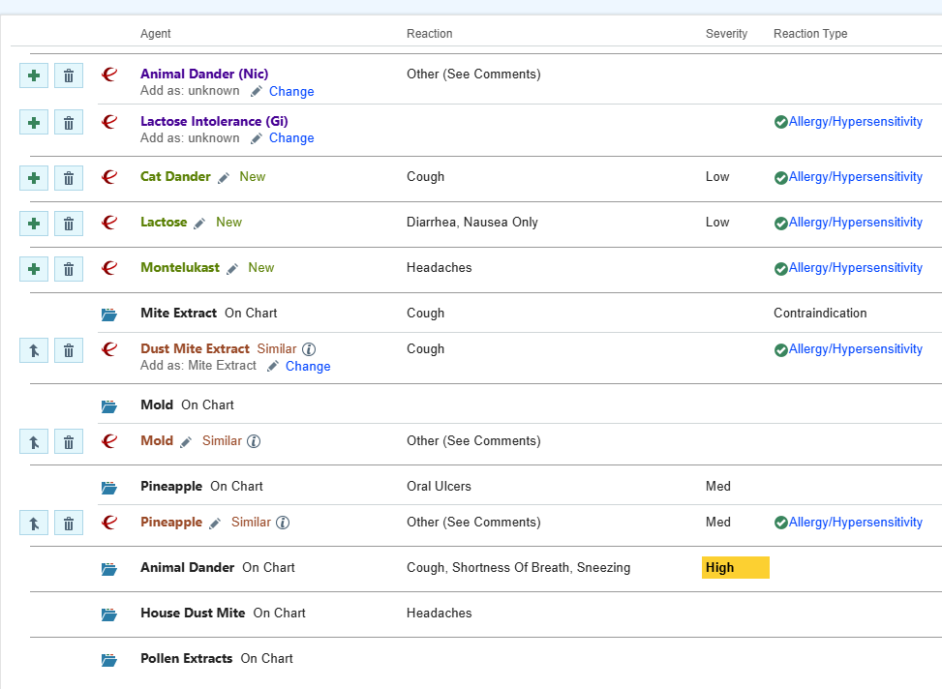
What should be in the Allergy Listing in the EMR?
65 year old new patient presents to discuss allergic rhinitis.
This is his allergy listing.
What should be deleted?
What never should have been added?

Slide 8
Question 2
What should be deleted from the allergy listing?
Animal dander, cat dander, dust mite, mold, pollen
Lactose intolerance
Montelukast
Pineapple
Notes:
A

Slide 9
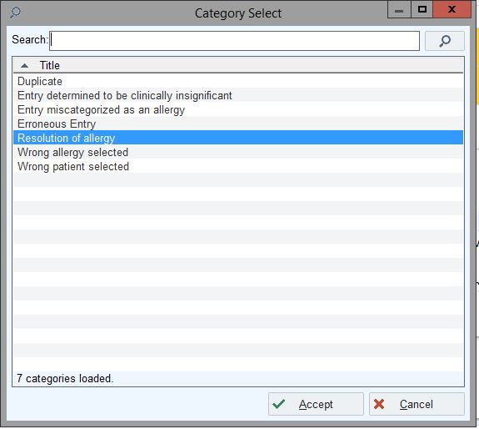
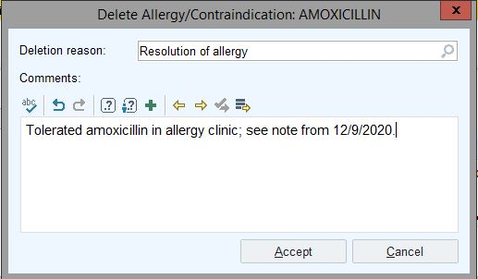
Delete Allergies from the EHR
Make a comment in the box about rationale for deletion:
  Duplicate
  Environmental allergen
  Tolerated drug or food
Make comments about pertinent related allergens,
  E.g. Penicillin-allergic
  patient, add “tolerated cephalexin”

Slide 10
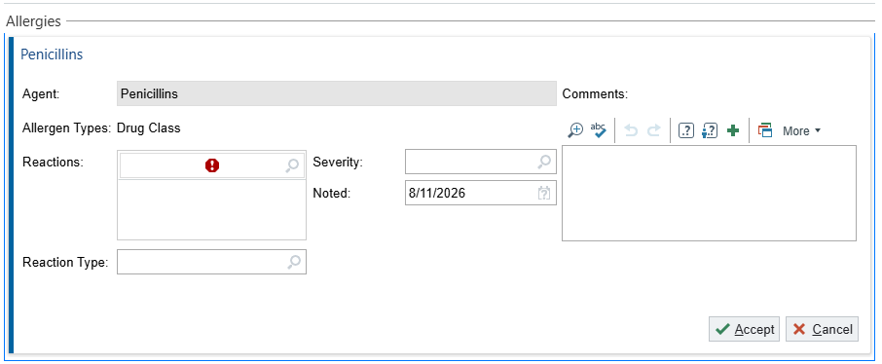
Current EHR Documentation
4 Coded EHR Domains
  Reactions: drop down options
    Often >70-90 options
  Reaction Type
    Allergy/Hypersensitivity
    Intolerance
    Adverse Effects
    Contraindication
    Unspecified
  Severity
    Low
    Medium
    High
  Date Noted
Free Text Comment
Notes:
“Optimal Quality Documentation” includes all 4 EHR Domains PLUS Free text

Slide 11
What is Transferred Between EMRs?
Coded domains
  Free Text does not generally transfer
Delabeling is NOT reliably transferred
  Primarily relies on patient-facilitated communications

Slide 12
How to Improve Documentation?
Automatization of Allergy category
  Anaphylaxis = high severity, GI upset = low severity
Addition of Free Text
  Interval drug class tolerance
  Testing results
Drug allergy history tool (DAHT)
  Standardized patient-facing instrument developed by the US Drug Allergy Registry Consortium
Rename EHR section from “Allergies” to “Alerts”
  AAAAI Position Statement published December 2024
  Recommended to not include pollen, dander, mold allergies in EHR
Notes:
DAHT: for each medication asks med/class, reaction history (timing, years since rxn, etc), Detailed info on symptoms (with images)
Environmental allergies in Problem List

Slide 13
Relabeling
Relabeling rates reportedly range from 5% to over 50%
  US multi-hospital system reported 36% redocumented allergy within 1 year
  Israeli ambulatory cohort reported 51% still carried label after negative challenge within 56 months
Often attributed to charting error or limits in updating EHRs
Recent study by Shi et al: 17% relabeled, with 100% of those deemed inappropriate
  No subsequent reactions within median relabeling time of 154 days
  Occurred despite document negative DPT, formal delabeling in unified EHR, individualized nurse counseling, and written reference letter for future care
Rimawi RH, J Hosp Med, 2013
Lachover-Roth I, JACI In Pract 2019
Shi W, Ann Allergy Asthma, 2026
Notes:
Shi study: Hong Kong wide, territory-wide unified EHR
Beyond EMR, also patient education and clinician awareness
Rimawi RH, J Hosp Med, 2013
Lachover-Roth I, JACI In Pract 2019
Shi W, Ann Allergy Asthma, 2026

Slide 14

When should you label an entire class of drugs as an allergy?

Slide 15
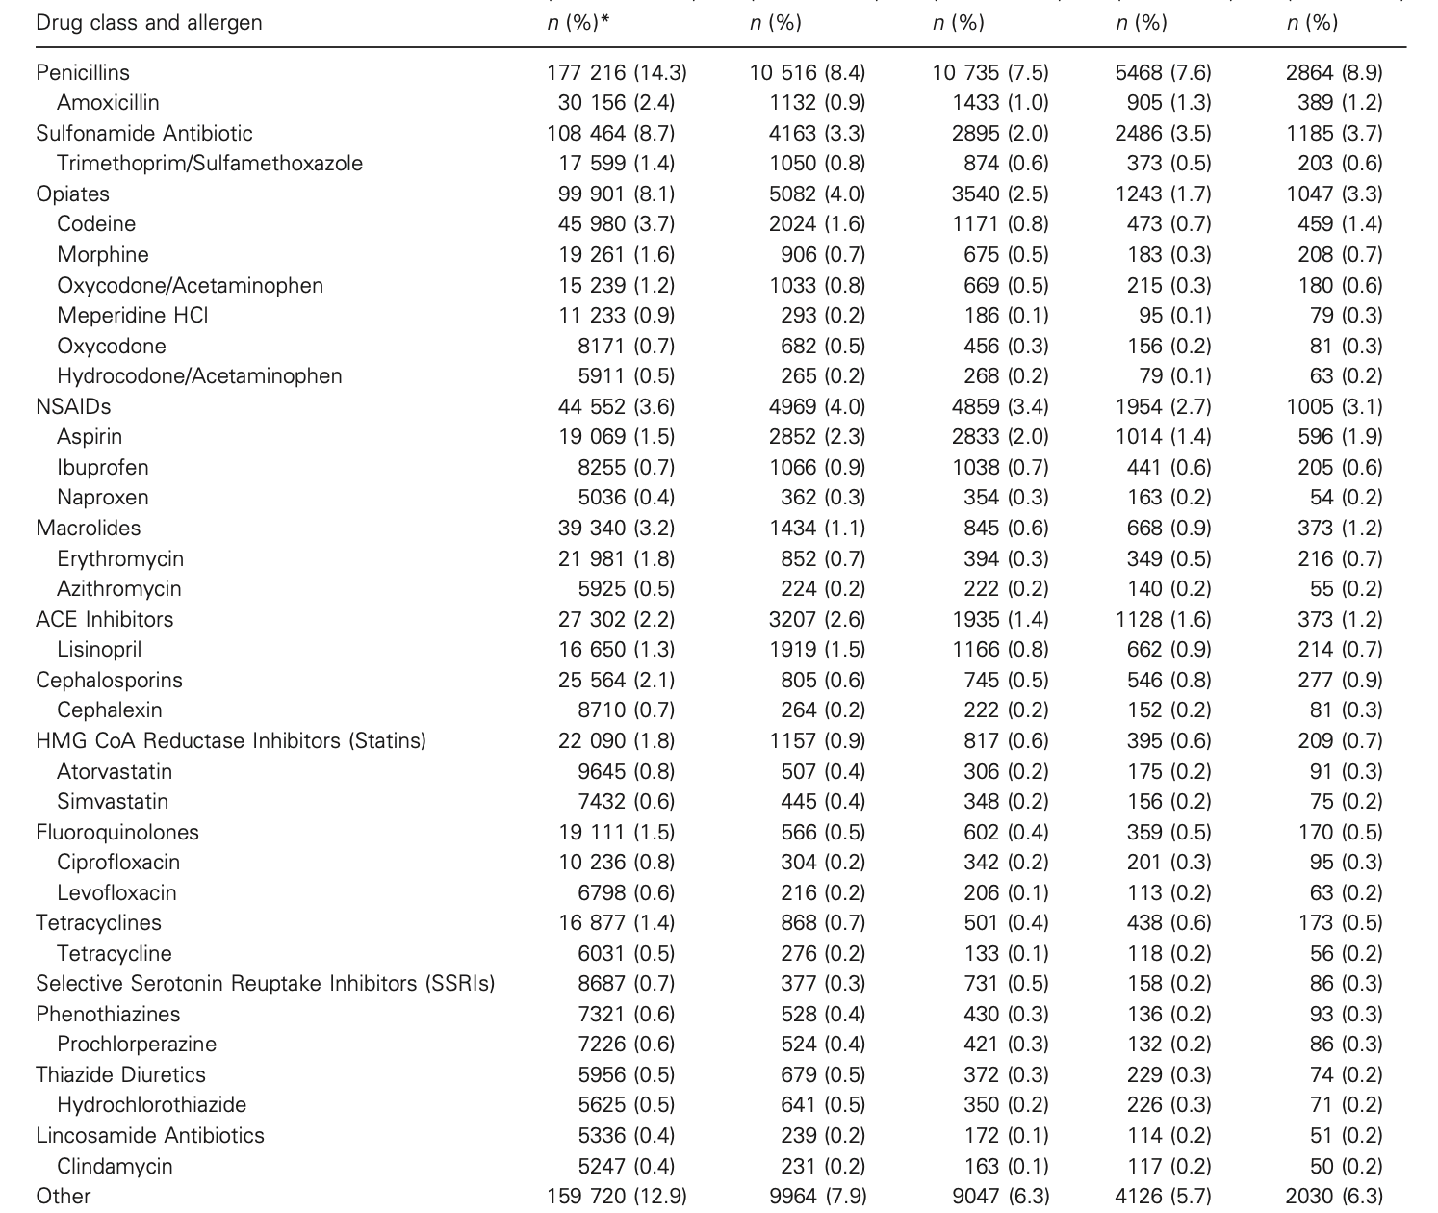
Antibiotics and a Few Classes of Other Medications Are the Most Common Reported Drug Allergies

Slide 16
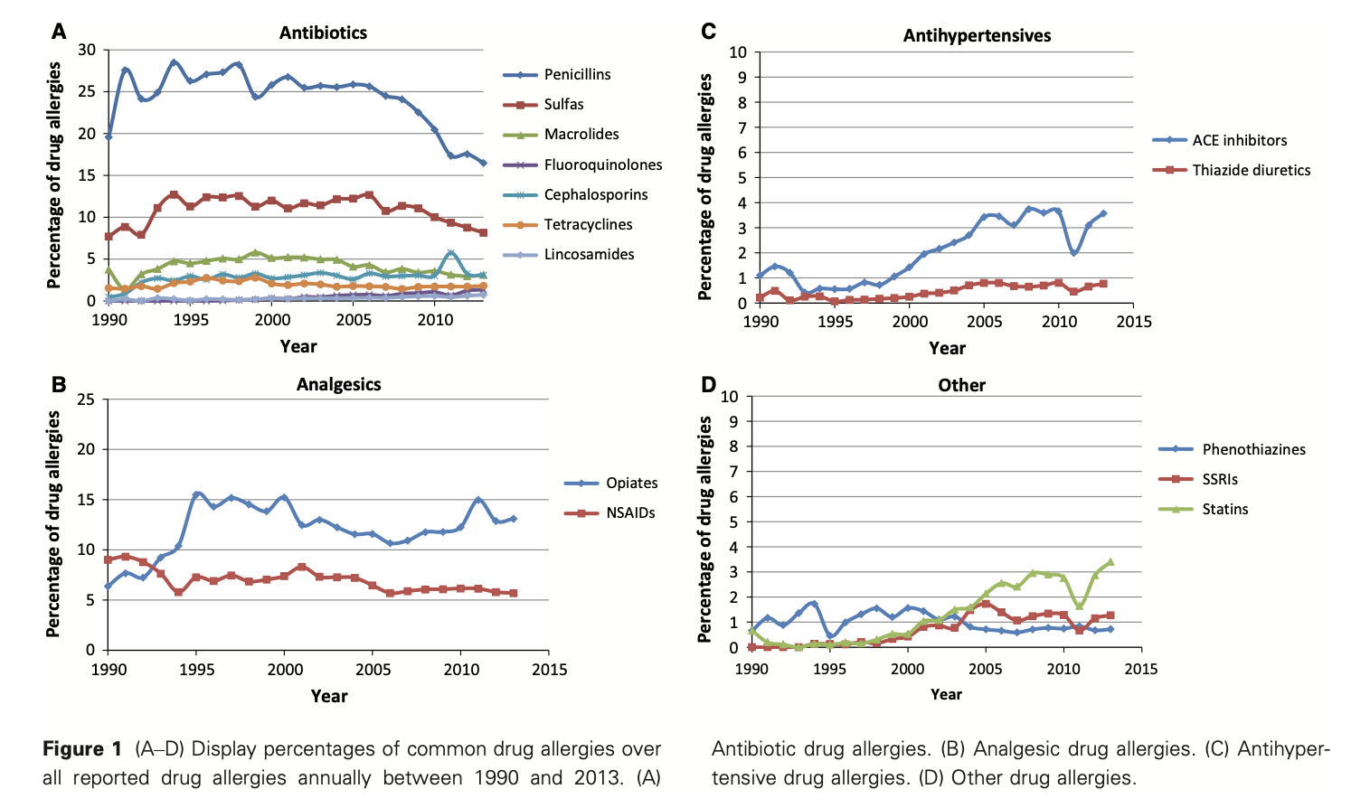
Drug Allergy Heavy Hitters

Slide 17
Most Drug Allergy Labels Should be Drug Specific
Few Exceptions

Slide 18
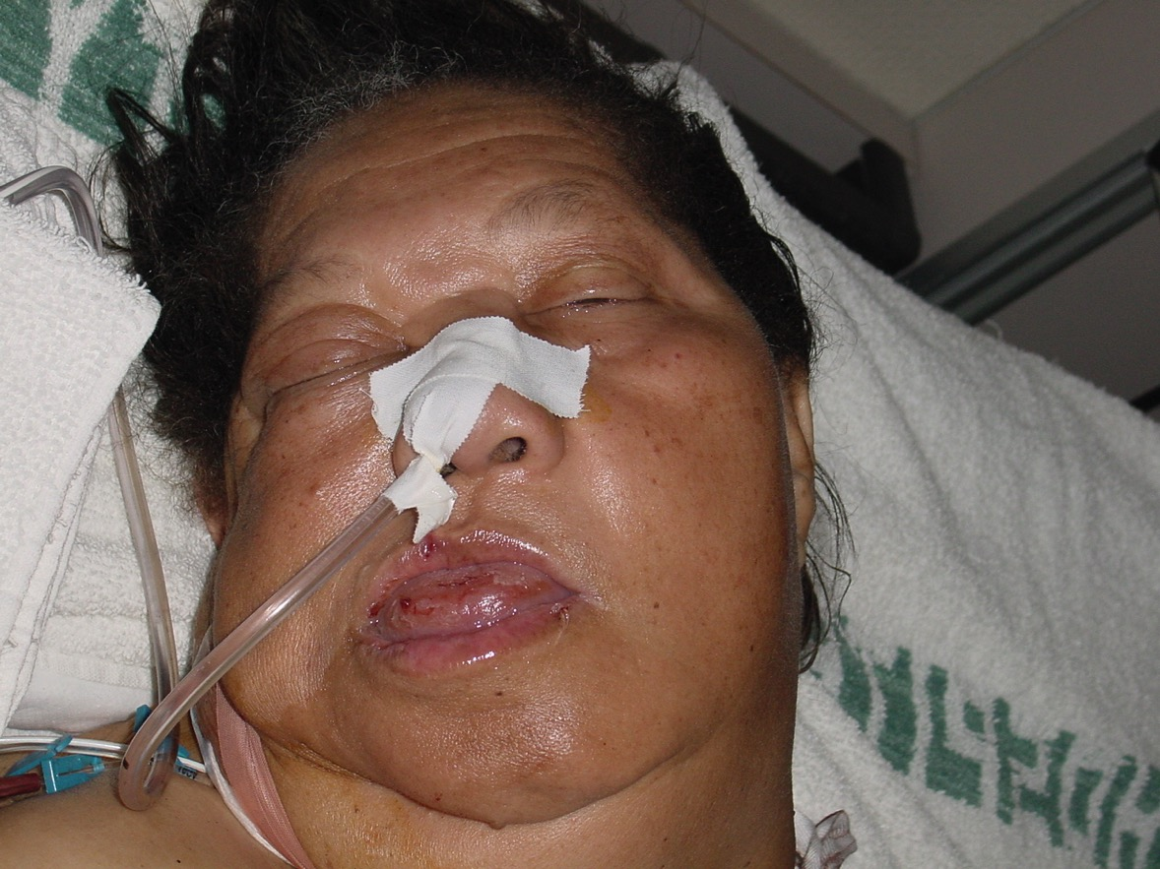
ACE-I-induced Angioedema
Important drug class allergy label phenotype

Slide 19
ACE-I Angioedema
Not drug-specific
Occurs in 0.1-0.7%
  more common in African-Americans
Angioedema above neck most common
  Rarely associated with urticaria
Usually delayed in onset
  Mean 1.8 yrs (Malde 2007)
Likely des-Arg bradykinin induced
  ACE (kinase II) activates bradykinin and angiotensin I
Usually tolerate ARBs

Slide 20
NSAID Allergy
Phenotype Indicates a Class Allergy Label

Slide 21
Aspirin/NSAID Hypersensitivity Phenotypes
Hypersensitivity Reaction | Cross-Reactivity | Onset | Clinical Features | Underlying Disease Exacerbated=Y Induced=N | Mechanism
Aspirin/NSAID Exacerbated Respiratory Disease (AERD/NERD) | Yes | Immediate | Naso-ocular Respiratory (GI, skin less often) | Asthma, nasal polyps | COX-1 Inhibition
Aspirin/NSAID Exacerbated Cutaneous Disease (AECD/NECD) | Yes | Immediate | Urticaria/Angioedema | Chronic urticaria | COX-1 Inhibition
NSAID-Induced Urticaria/AE | Yes | Immediate | Urticaria/Angioedema | None | COX-1 Inhibition ?
Single NSAID Induced Urticaria/AE/Anaphylaxis | No | Immediate | Urticaria/Angioedema Anaphylaxis | None | IgE mediated ?
Variable | Usually No | Delayed | FDE, SJS/TEN, MP exanthem, HP, aseptic meningitis | None | T cell mediated ?
Notes:
Exacerbated means underlying disease. Inducible means no underlying disease

Slide 22
Aspirin/NSAID Hypersensitivity Phenotypes
Hypersensitivity Reaction | Cross-Reactivity | Onset | Clinical Features | Underlying Disease Exacerbated=Y Induced=N | Mechanism
Aspirin/NSAID Exacerbated Respiratory Disease (AERD/NERD) | Yes | Immediate | Naso-ocular Respiratory (GI, skin less often) | Asthma, nasal polyps | COX-1 Inhibition
Aspirin/NSAID Exacerbated Cutaneous Disease (AECD/NECD) | Yes | Immediate | Urticaria/Angioedema | Chronic urticaria | COX-1 Inhibition
NSAID-Induced Urticaria/AE | Yes | Immediate | Urticaria/Angioedema | None | COX-1 Inhibition ?
Single NSAID Induced Urticaria/AE/Anaphylaxis | No | Immediate | Urticaria/Angioedema Anaphylaxis | None | IgE mediated ?
Variable | Usually No | Delayed | FDE, SJS/TEN, MP exanthem, HP, aseptic meningitis | None | T cell mediated ?
Caveat: when disease goes away, can tolerate NSAIDs
Notes:
Exacerbated means underlying disease. Inducible means no underlying disease

Slide 23
Aspirin/NSAID Hypersensitivity Phenotypes
Hypersensitivity Reaction | Cross-Reactivity | Onset | Clinical Features | Underlying Disease Exacerbated=Y Induced=N | Mechanism
Aspirin/NSAID Exacerbated Respiratory Disease (AERD/NERD) | Yes | Immediate | Naso-ocular Respiratory (GI, skin less often) | Asthma, nasal polyps | COX-1 Inhibition
Aspirin/NSAID Exacerbated Cutaneous Disease (AECD/NECD) | Yes | Immediate | Urticaria/Angioedema | Chronic urticaria | COX-1 Inhibition
NSAID-Induced Urticaria/AE | Yes | Immediate | Urticaria/Angioedema | None | COX-1 Inhibition ?
Single NSAID Induced Urticaria/AE/Anaphylaxis | No | Immediate | Urticaria/Angioedema Anaphylaxis | None | IgE mediated ?
Variable | Usually No | Delayed | FDE, SJS/TEN, MP exanthem, HP, aseptic meningitis | None | T cell mediated ?
Notes:
Exacerbated means underlying disease. Inducible means no underlying disease

Slide 24
Free Text and Drug Allergy Documentation

Slide 25
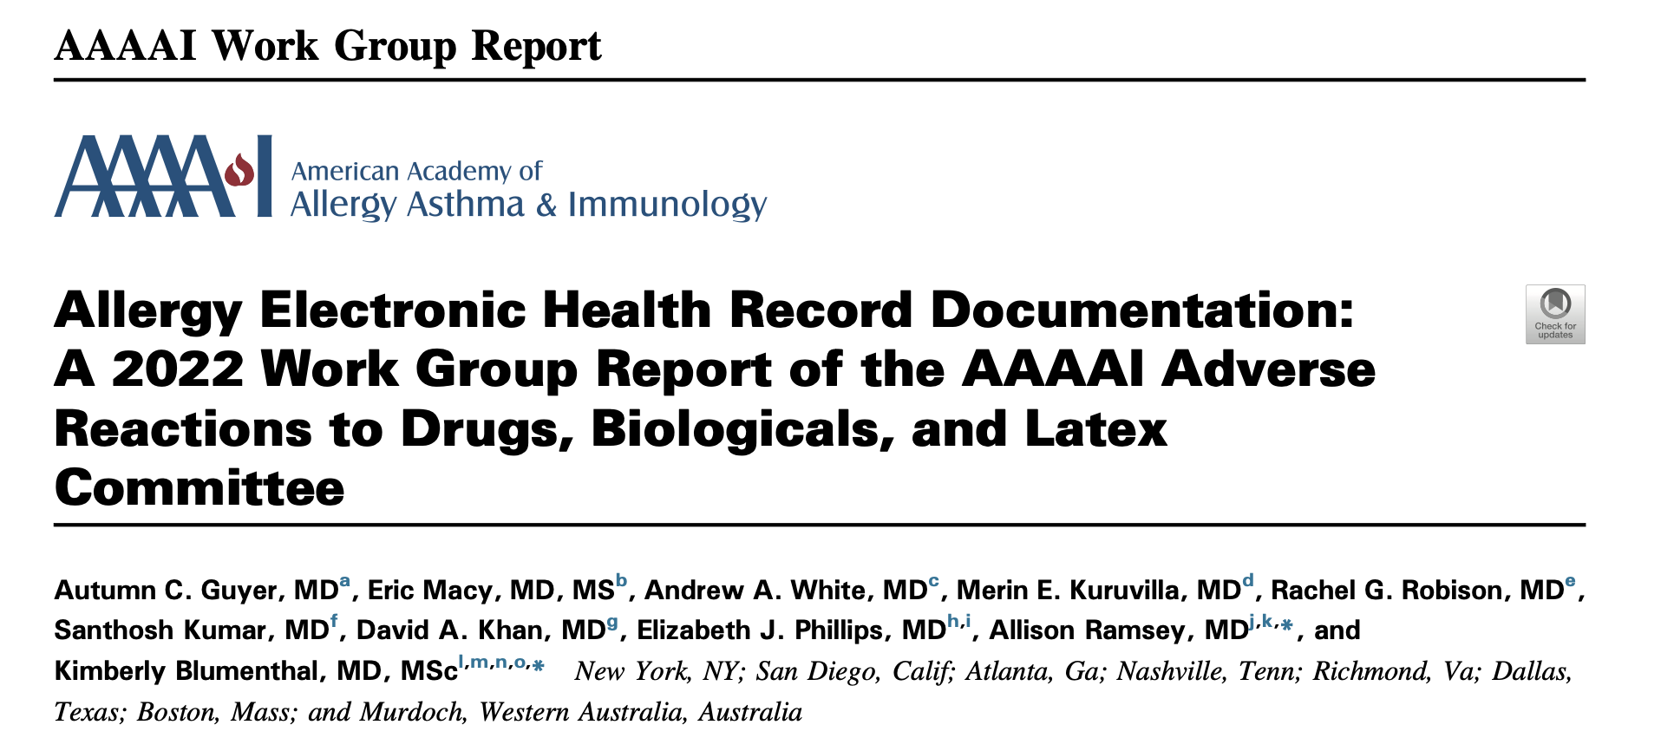
J Allergy Clin Immunol Pract. 2022;10(11):2854–67.

Slide 26
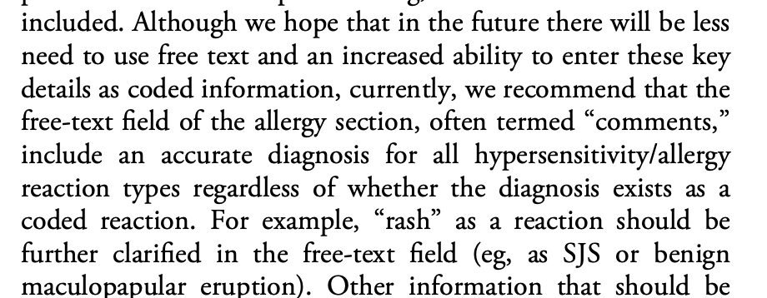
J Allergy Clin Immunol Pract. 2022;10(11):2854–67.

Slide 27
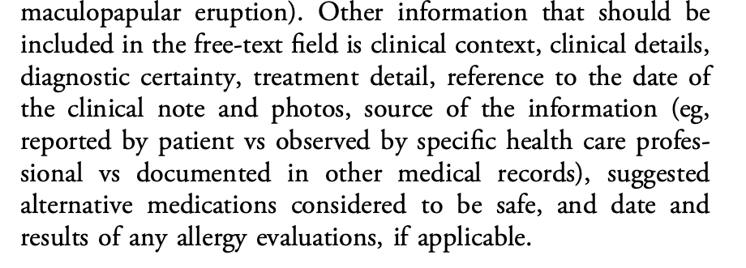
J Allergy Clin Immunol Pract. 2022;10(11):2854–67.

Slide 28
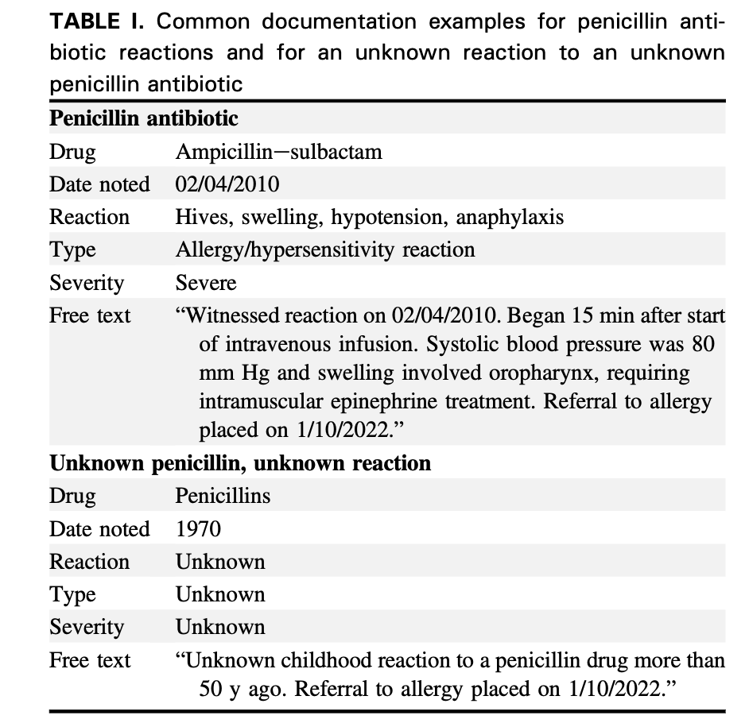
High Risk vs Unknown Allergy Labels
J Allergy Clin Immunol Pract. 2022;10(11):2854–67.

Slide 29
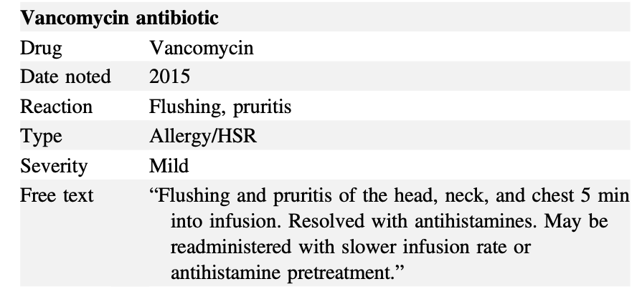
Free Text with Administration Guidance for Vancomycin Infusion Reaction
J Allergy Clin Immunol Pract. 2022;10(11):2854–67.

Slide 30
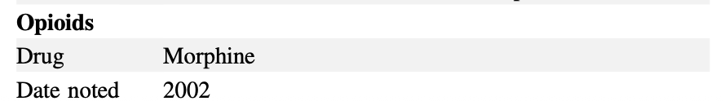
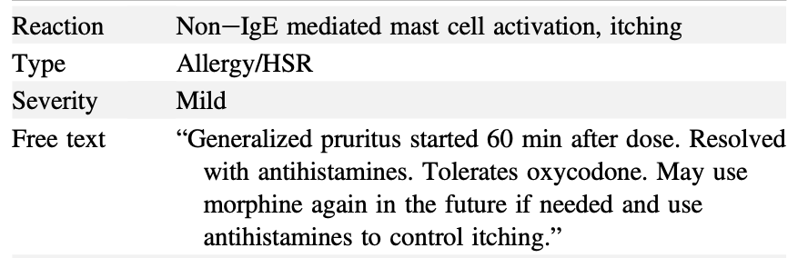
Free Text with Administration Guidance for Opiates
J Allergy Clin Immunol Pract. 2022;10(11):2854–67.

Slide 31
Questions and Discussion

