Slide 1
Case #1: Cephalosporin allergy
What questions are important to ask?
55 yo M with PMHx of ESRD on HD undergoing kidney transplant who reports a history of allergy to cephalexin. He recalls a rash after taking this drug 6 years ago; he took Benadryl at home for this.
He believes he has avoided all cephalosporins since then.

Slide 2
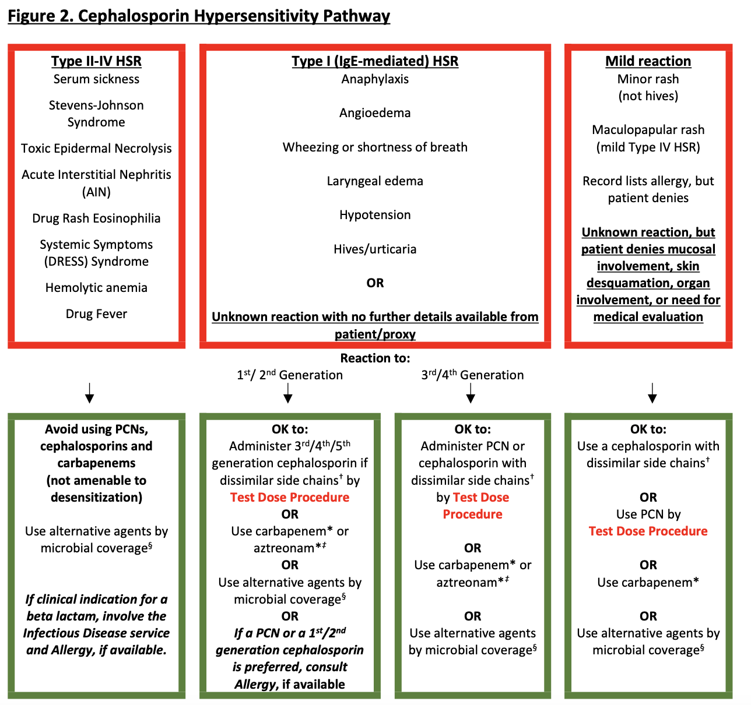

Slide 3
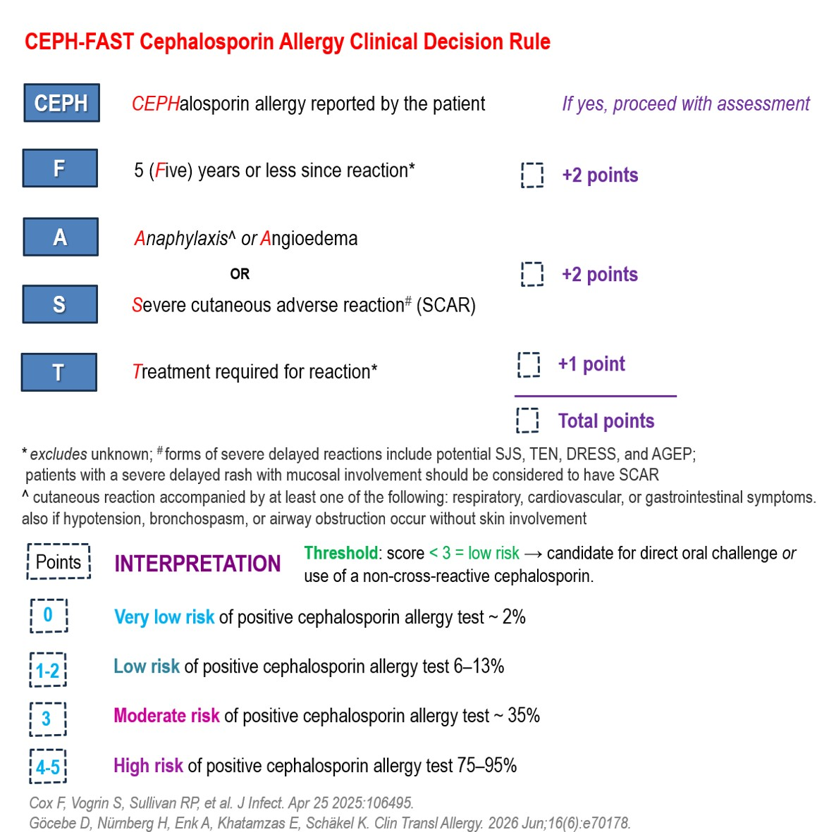
Notes:
Based on risk assessment, this patient would be low risk (“mild” reaction or CEPH-FAST score 1 for treatment) and could undergo a direct oral challenge.

Slide 4
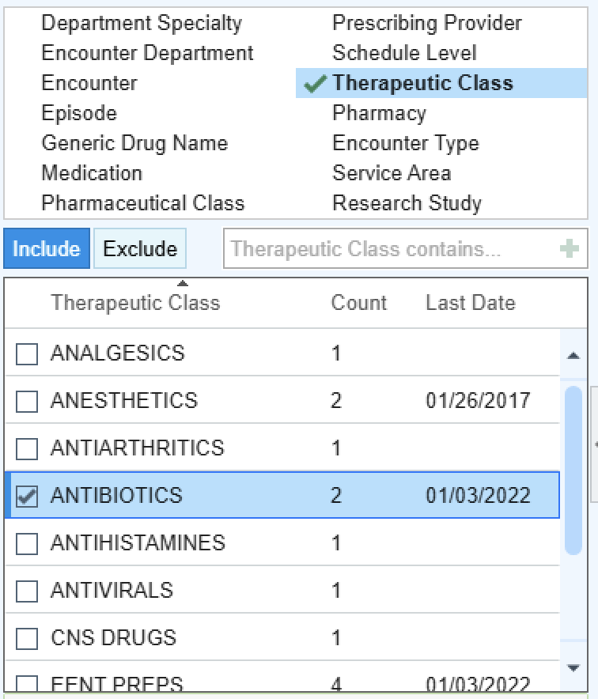
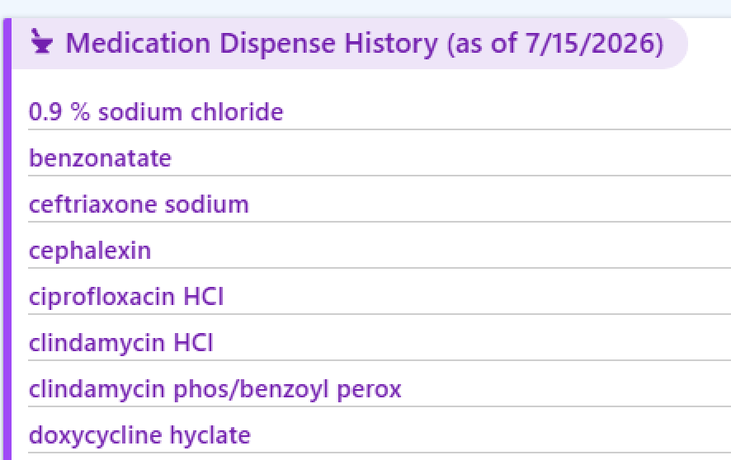
What questions are important to ask?
55 yo M who is undergoing kidney transplant reports a history of allergy to cephalexin. He recalls a rash after taking this drug 6 years ago. He believes he has avoided all cephalosporins since then.
Notes:
You review his medication records and can see the dispensed cephalexin prescription from 6 years ago. His treatment has been complicated by a central-line associated bloodstream infection (CLABSI) and the primary team wish to give Ceftriaxone.

Slide 5
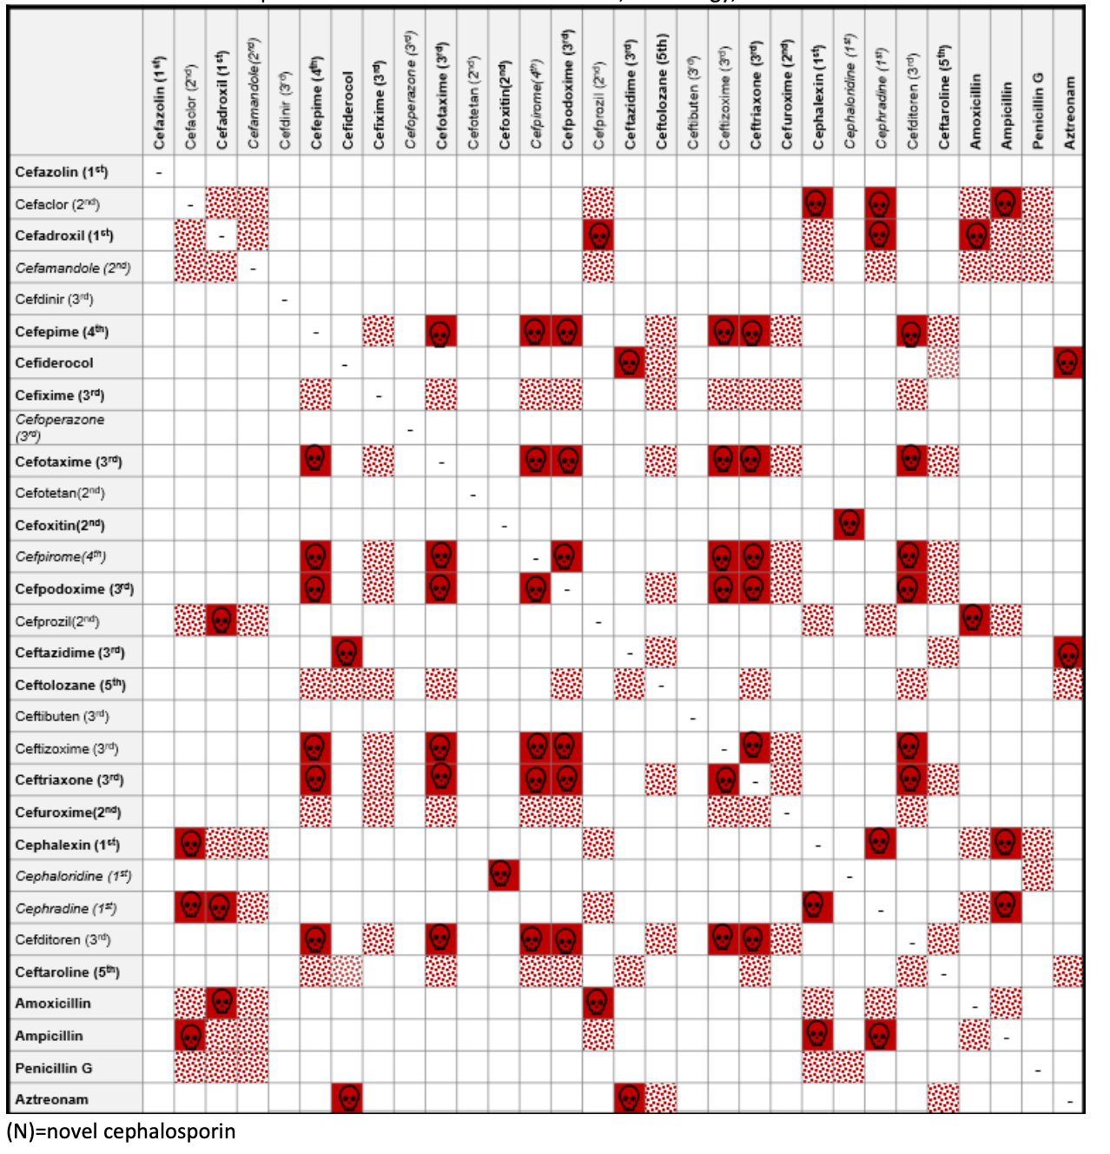
Notes:
Brief discussion of cross-reactivity

Slide 6
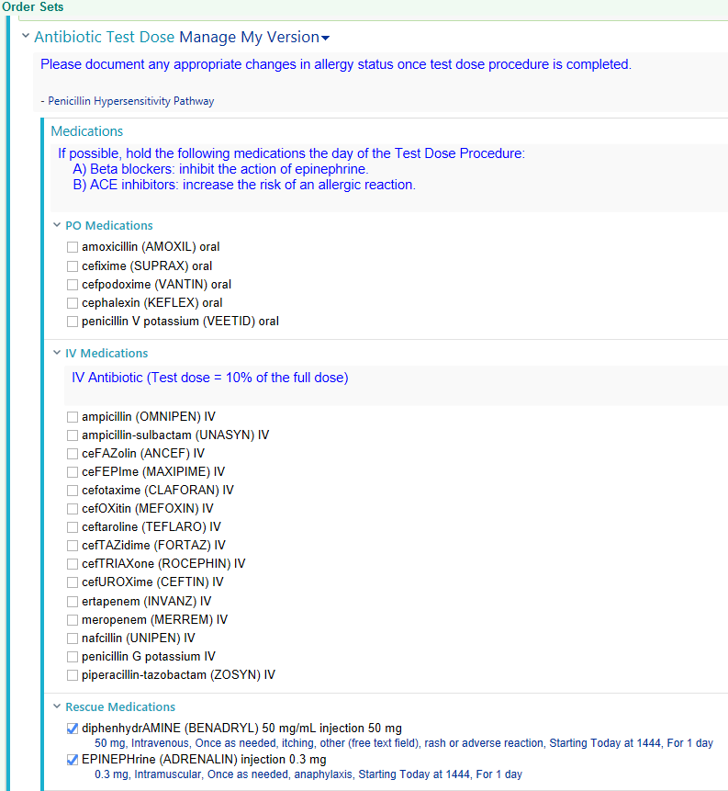
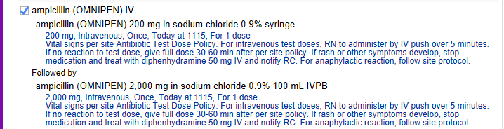
EHR: Test Dose Order Set for IV formulations
Links to computerized guideline/app
Notes:
An IV challenge would be considered, and may be performed inpatient with many outpatient centers also conducting these.
Here is an example of a “test dose” or IV drug challenge protocol
- 10% of full dose is administered via IV with 30-60 minutes of observation
- if initial dose is tolerated, then full dose may be administered with additional 30-60 minutes of observation. *Note: some versions include 90% challenge with second dose, so that the total dose adds to a full desired medication dose

Slide 7
Case #2: ”sulfa” allergy
What questions are important to ask?
22 yo F with history of leukemia undergoing evaluation for BMT, with a history of ”sulfa” allergy (rash 3 days after taking Bactrim for tx of UTI 4 years ago).
she recalls this rash self-resolved after a few days and did not require treatment
Notes:
Transplant patient, Bactrim allergy

Slide 8
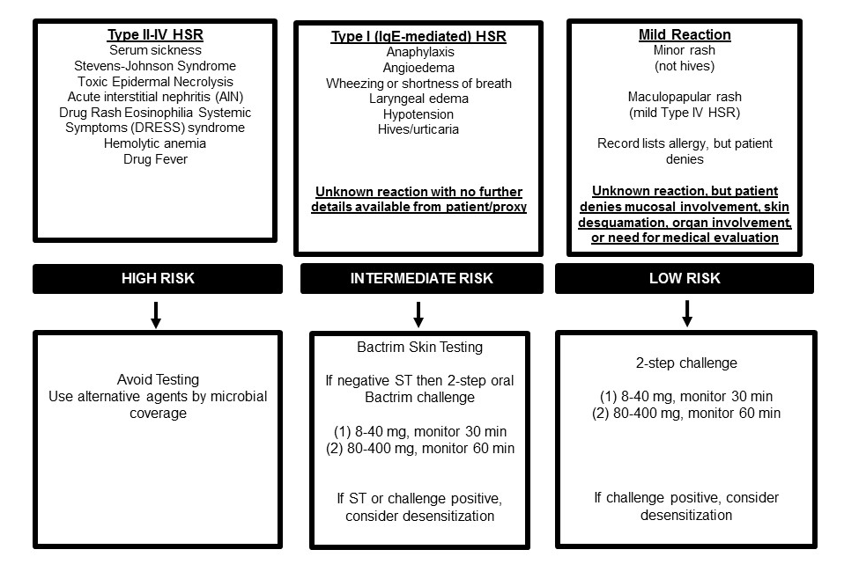
Notes:
She would be classified as mild

Slide 9
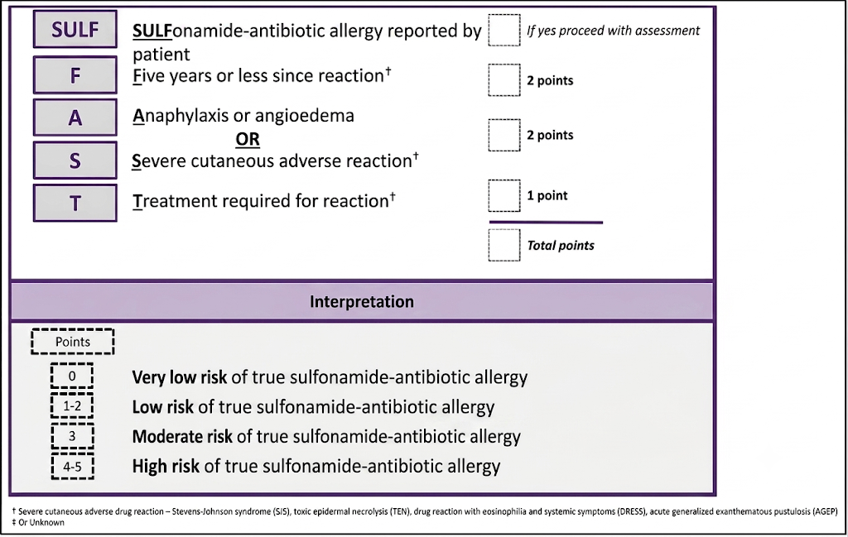
Waldron, et al
PMID 37273210
Notes:
She would be classified as low risk, score of 2 as this occurred within the last 5 years

Slide 10
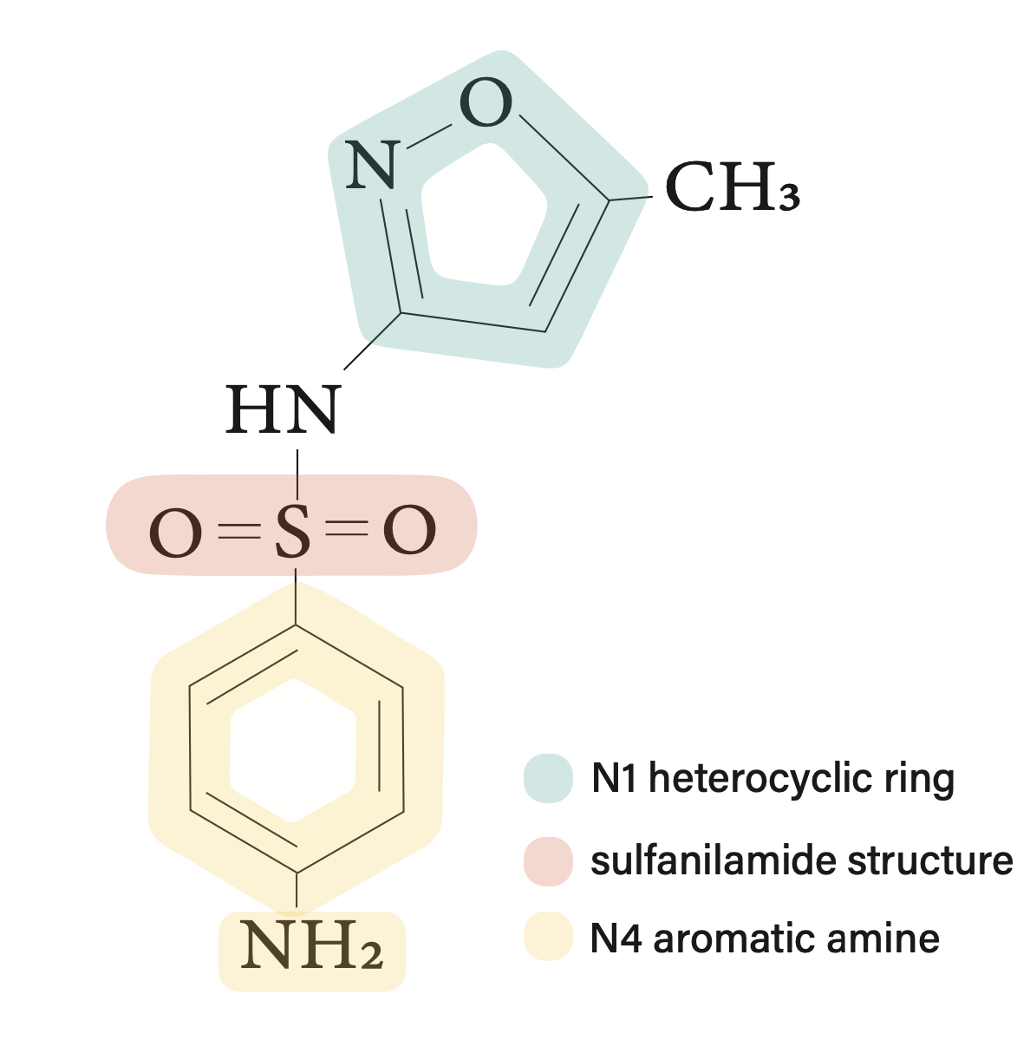
Treatment is complicated by fluid overload; the primary team would like to give Lasix, but are avoiding this due to her “sulfa” allergy.
Can she receive medications that contain ‘sulfa’ components?
Waldron, et al
PMID 42103429
Notes:
Although cross-reactivity between nonantimicrobial sulfonamides and sulfonamide antimicrobials has been disproven in both in vitro and clinical studies, confusion persists due to the term “sulfa allergy.” 6 There are many compounds that contain sulfur, sulfite, or sulfate salts, including penicillins, cephalosporins, omeprazole, ranitidine, furosemide, clopidogrel, captopril, albuterol sulfate, ferrous sulfate, magnesium sulfate as well as sulfite preservatives in food and wine that could be misconstrued as risky for the sulfonamide antimicrobial allergic individual. There is no risk of cross-sensitivity between medications that contain sulfur but not the SO 2 NH 2 moiety. 5,17,43 When diagnosing an individual with sulfonamide antimicrobial allergy, we discourage the term sulfa allergy because it falsely implies a more broad hypersensitivity. Instead, the authors suggest using the term sulfonamide antimicrobial allergy.

Slide 11
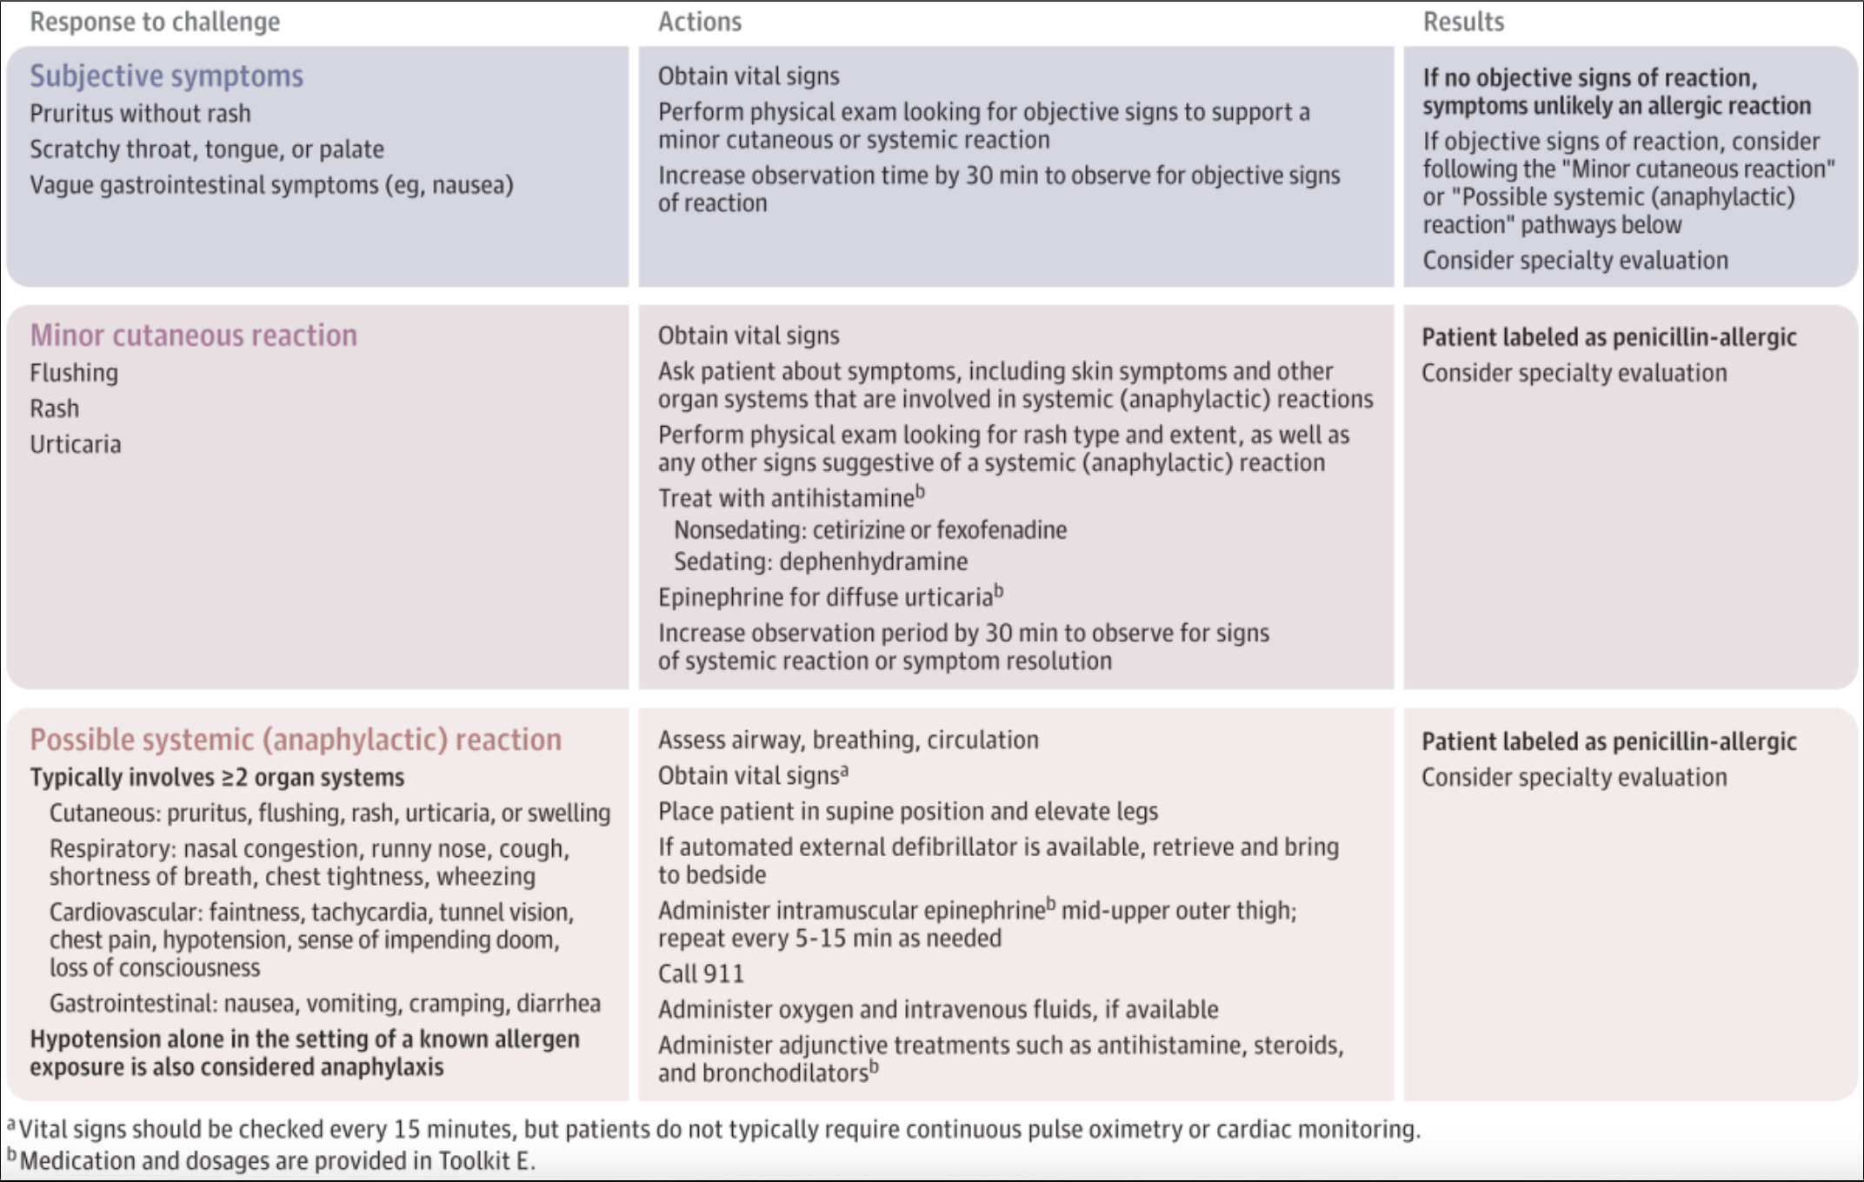
Notes:
Shenoy ES, Macy E, Rowe T, Blumenthal KG. Evaluation and Management of Penicillin Allergy: A Review. JAMA. 2019 Jan 15;321(2):188-199. doi: 10.1001/jama.2018.19283. PMID: 30644987.

Slide 12
Pediatric Case #1
What questions are important to ask?
2.5 year-old male presents for a reaction to amoxicillin. His parents report that he experienced a rash with amoxicillin around 1 year ago while on this for an episode of otitis media.
He had a slightly bumpy, diffuse red rash without any oral / ocular / genital involvement. He was not particularly itchy and did not need urgent medical attention.

Slide 13
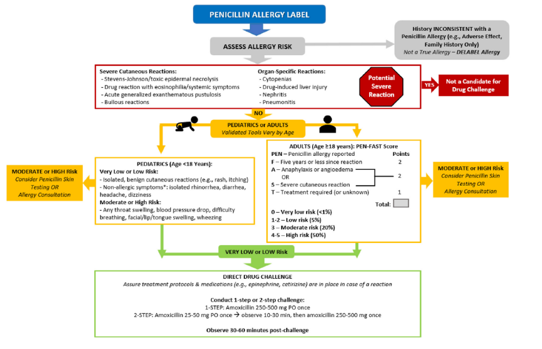
Non-Allergist Challenges
J Allergy Clin Immunol Pract 2025;13:1011-7

Slide 14
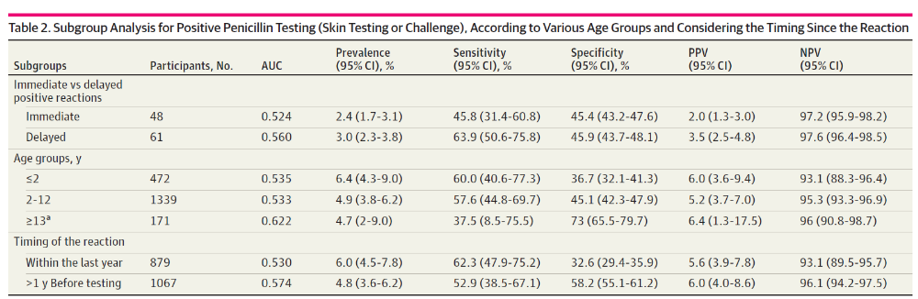
PEN-FAST Doesn’t Work in Pediatrics
Poor predictive values in 2028 children
JAMA Network Open. 2022;5(9):e2233703.

Slide 15
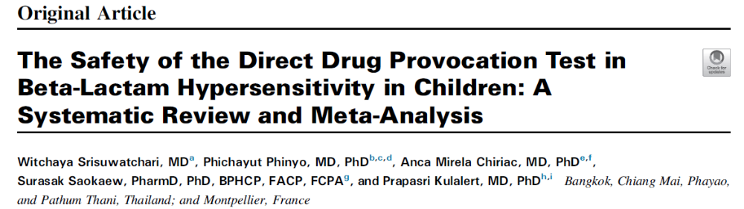
Beta-lactam Challenge Meta-Analysis
8334 patients total, 28 studies
Type of reaction | % Reaction | Severe Reaction
Non-immediate | 5.23% | 2 (1 SSLR, 1 DILI)
Immediate | 0.08% | 1 (anaphylaxis)
***Severe reaction risk = 0.0004%***
J Allergy Clin Immunol Pract 2023;11:506-18

Slide 16
Pediatric Case #2
What questions are important to ask?
Upon further questioning, the patient was referred because he had a similar reaction to cefdinir about 6 months ago. His parents show you pictures that are consistent with urticaria.
He did not have any other symptoms. He was seen at his pediatrician and was treated with cetirizine. The urticaria lasted about 2 weeks.

Slide 17
Non-Allergist Challenges
J Allergy Clin Immunol Pract 2025;13:1011-7

Slide 18
Cephalosporin Challenges
Demographics
128 patients
IR Age
Offending Agents
Cefixime (45.3%)
Cefdinir (25.8%)
Challenge Outcomes
5 failed challenges (3.9%)
All urticaria
Challenge Age
Time between rxn and challenge
Cefuroxime (18%)
Cefpodoxime (3.9%)
4.6 yrs (median)
5.7 yrs (median)
4 mos (median)
Cefprozil (3.9%)
Cephalexin (1.5%)
Cefaclor (0.8%)
Cefoxitin (0.8%)
All index reactions occurred on first day, 1-8 hours after dose
Allergy, Asthma Proc. 2025. 46: 235-239. .

Slide 19
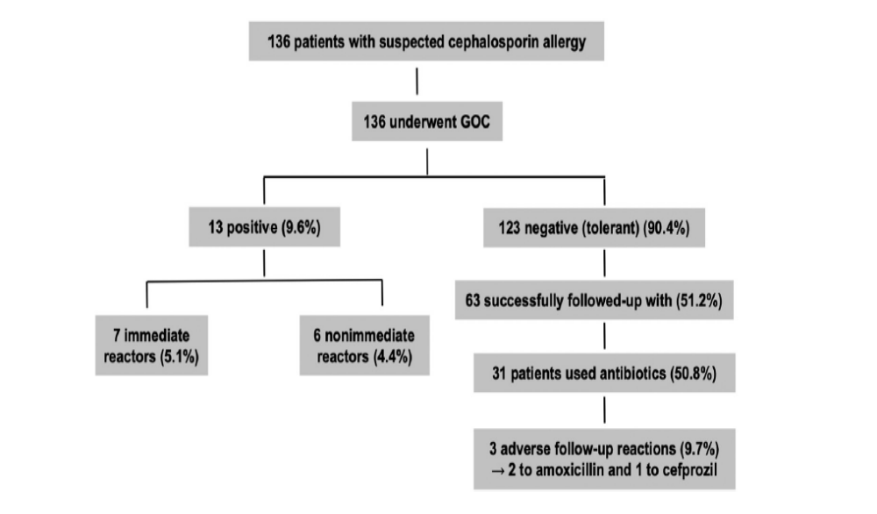
Cephalosporin Challenges
Predictor of positive immediate challenge
Older age
Predictors of positive delayed challenges
Older age, longer time elapsed
J Allergy Clin Immunol Pract 2024;12:156-64
Notes:
Canadian study
Median age of index reaction 2, median age of GC time 4.9

Slide 20
Pediatric Case #3
What questions are important to ask?
A 15 yo wrestler comes in with a suspected MRSA infection. He has a history of “a red rash” with trimethoprim/sulfamethoxazole around 3 years ago while on it for the same reason.
He did not have any other symptoms. His symptoms resolved over a few days.

Slide 21
Other Antibiotic Epidemiology
Macrolides
Rare, 0.3-0.8% prevalence
Sulfamethoxazole
0.5-2.7% prevalence
Clindamycin
Fluoroquinolones
Tetracyclines
Limited data
0.004-0.04% prevalence
0-0.3% prevalence
Immunol Allergy Clin N Am 42 (2022) 433–452

Slide 22
Other Antibiotic Reaction Presentations
Macrolides
Cutaneous symptoms, anaphylaxis rare
Sulfamethoxazole
Delayed maculopapular exanthem, fixed drug eruption
Clindamycin
Fluoroquinolones
Tetracyclines
Limited data
Usually occurs in context of chronic illness
Usually occur in context of chronic illness
Unlikely to cross react
No cross reactivity with non-antibiotic sulfonamides
Possible cross reactivity
Immunol Allergy Clin N Am 42 (2022) 433–452
Notes:
Deciding about challenges is a risk / benefit analysis depending on clinical context
Case reports of desenstiziations

Slide 23
Case #4
How to proceed?
A 57 yo female presents with 23 listed drug allergies in her allergy field. She needs upcoming dental work for which her dentist would like to use either amoxicillin or cephalexin.
She reports the following ALL cause “hives, itching, and nausea”
All cephalosporins
All penicillins
Clindamycin
Azithromycin
Sulfa
Her other non-antibiotic listed allergies cause similar symptoms.

Slide 24
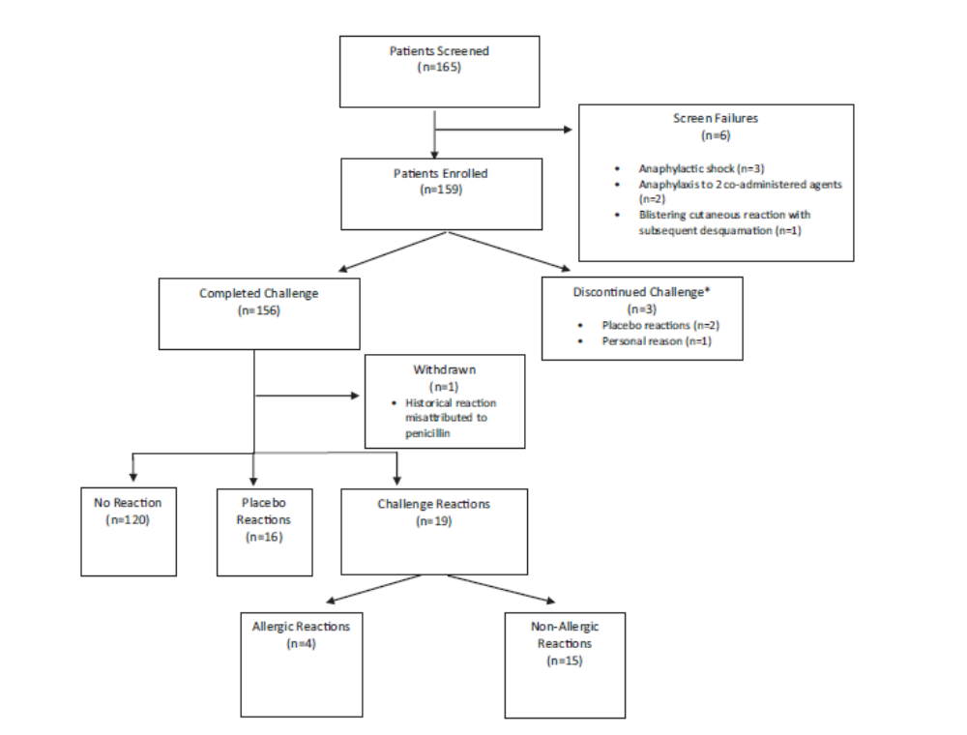
J Allergy Clin Immunol Pract 2019;7:236-43

