Slide 1


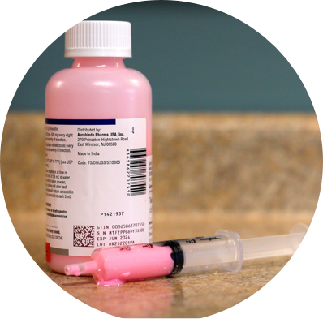



Discussing
Penicillin Allergy with Patients, Families, & the Public
Farah Khan, MD
Allergist/Immunologist
Assistant Professor of Pediatrics
September 28, 2026
Notes:
4 pm – 4:45 pm

Slide 2
Penicillin allergy delabeling is not just an allergy problem.
It's a communication problem, a systems problem, a health literacy challenge, a medicolegal risk issue, and a trust and confidence problem.

Slide 3
Objectives
How do we get everyone to care about a penicillin allergy?
1
Inspire more confidence with drug allergy de-labeling
2
No relevant financial disclosures.
Notes:
Take the easy wins where you can, And potentially even encouraging a pause before labeling a patient with this allergy label

Slide 4
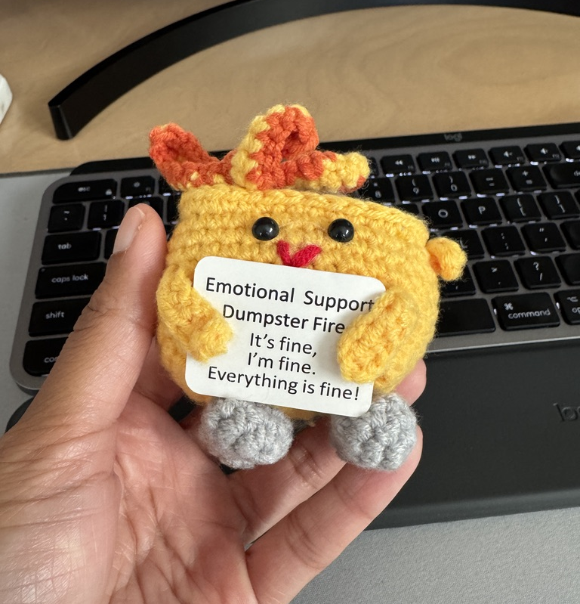
It’s 2026
We have more data.
We’re smarter.
We’re stretched.
And healthcare in America is…
Notes:
We’ve come a long way with PCN allergy, we have more data even within pediatrics
Often if feels like we’re asked to do more with less resources

Slide 5
Let’s start with the numbers
= 33,000,000
Americans
10% PCN allergic
>330,000,000
Americans
10% of the general population carries a penicillin allergy label
95% of these labels do not reflect a true allergy
5% truly PCN allergic
= 1,650,000
Americans
Blumenthal et al., Lancet 2019;393:183-98.
Notes:
By EMR documentation, have 10% stat In the general population, ~10% carry a penicillin allergy label
In the pediatric population, true prevalence ranges from 5-15%, but again, how many scoops is that? It’s about 10% of kids
https://jamanetwork.com/journals/jamapediatrics/fullarticle/2814316?__cf_chl_tk=iKnclqCGh92C9XVyXgLzTJsTPekNWP3GltllO00nOn4-1787428853-1.0.1.1-H2aO81rrUqbbf1Gn_QD3.PupWPheehhNVsS.0oeVpqA
Interesting paper to include? https://pmc.ncbi.nlm.nih.gov/articles/PMC13162243/pdf/CEA-56-979.pdf

Slide 6
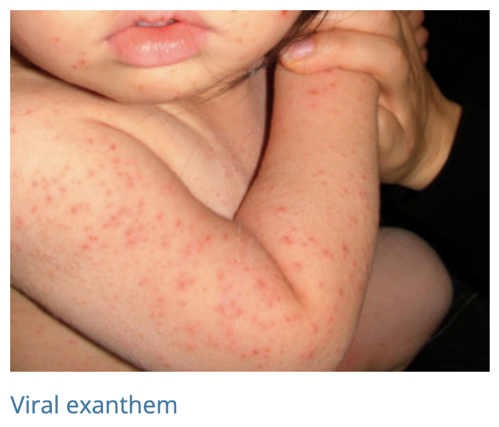
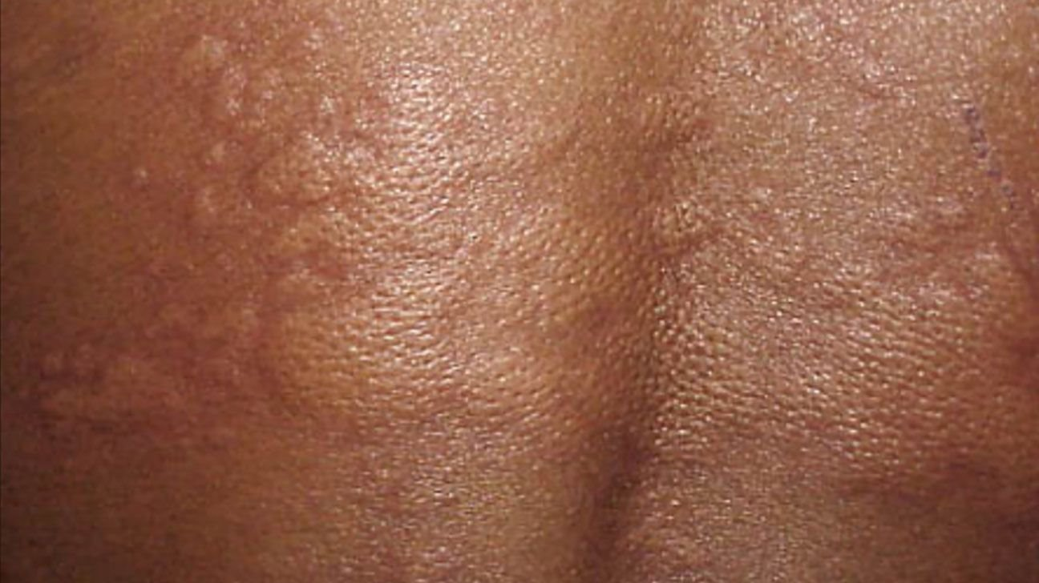
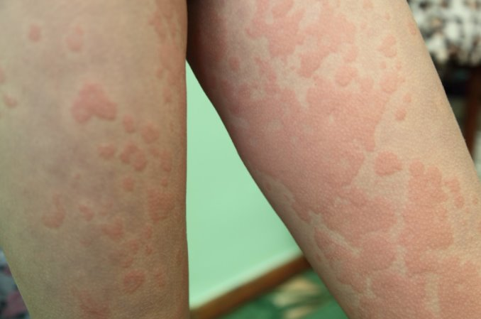
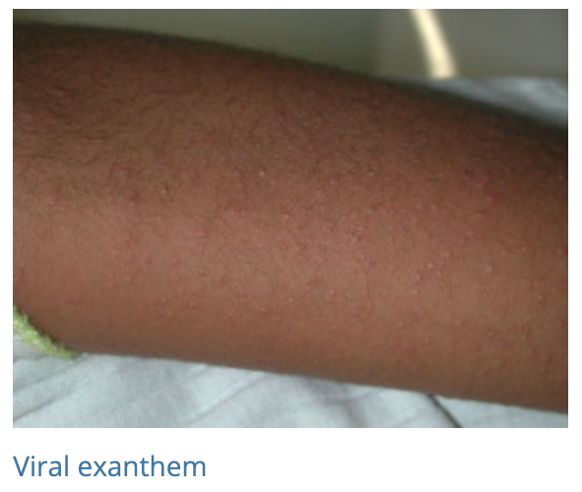
Common cause of a PCN allergy label:
H
A
https://dermnetnz.org/topics/exanthems
MedicalNewsToday
R
S

Slide 7
Amoxicillin
Most commonly prescribed abx to pediatric patients (specifically kids 2 years and younger)
BUT
75% receive a PCN allergy label by age 3
Notes:
https://www.cdc.gov/antibiotic-use/hcp/clinical-care/pediatric-outpatient.html

Slide 8
Amoxicillin & Augmentin
The most common cause of drug-induced delayed rashes and drug-viral interactions
  But infrequent culprits in true IgE-mediated reactions

Slide 9
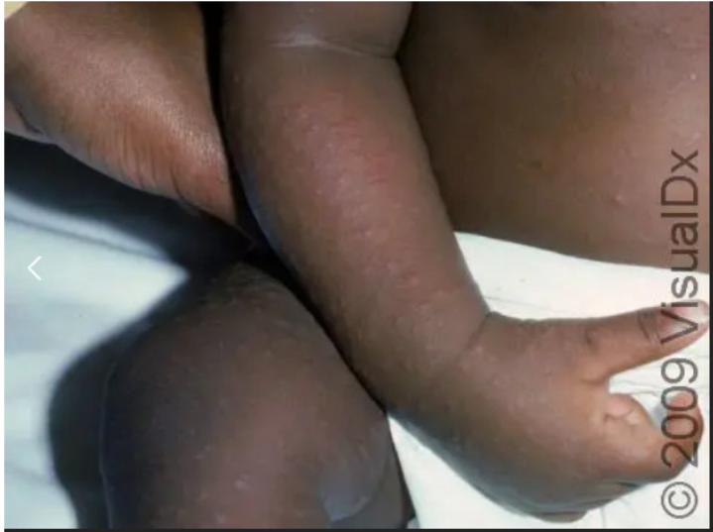
Virus
Cell mediated response
+
=
Drug-infection interaction
Immunologic versus non-immunologic event
Short story: Still don’t understand this completely
Tsabouri, S et al., PAI 2021:32(5):824-834.
Image: https://skinsight.com/skin-conditions/viral-exanthem/infant/
Notes:
The skin manifestation may result from an immune response (indirect or parainfectious exanthema) between the virus and the antibody or a cell mediated response to the virus. Well established assumption that concurrent use of certain drugs during certain infections increases the occurrence of drug induced exanthem. Or viral infections could be a co-factor for activating drug specific T cells which would otherwise undergo apoptosis and a long lasting delayed hypersensitivity reaction would not develop.

Slide 10
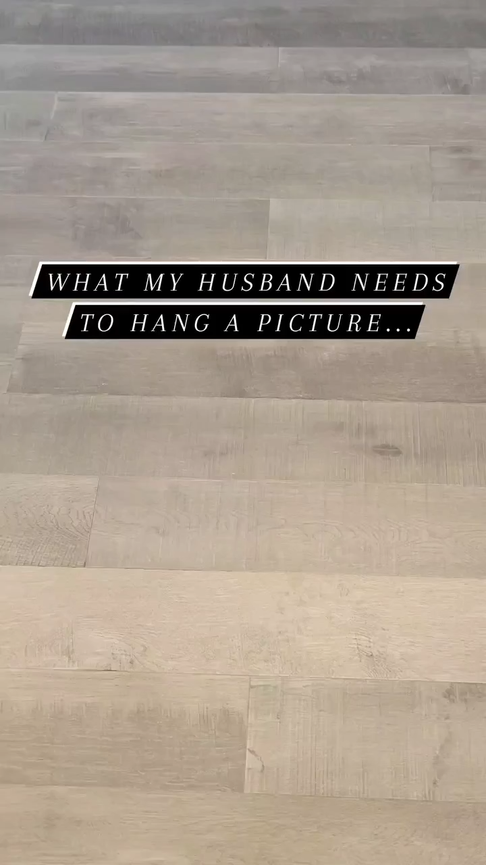
From Instagram: @lulibebe.team
Notes:
Story time again but this time I’m showing a reel from IG

Slide 11
Where the magic tries to happen
Clinical history
  When did the reaction occur
  Timing of rash development in relation to last dose
  Concomitant symptoms
  Rash description (photos!)
  Duration of symptoms
  Treatment of reaction
  Has the patient tolerated penicillin or related antibiotics since?
Notes:
Rash description/photos, timing of reaction, timing since reaction, treatment of reaction
Social circumstances can make this complicated
Relying on documentation in EHR to fill in gaps

Slide 12
Validate → clarify → educate → offer a path forward
“Here’s what we know.”
“Here’s what I’m still unsure about.”
“Here’s the safest way to answer that question.”
Notes:
1. Start by validating the experience.
“I believe you had a reaction.”
Avoid: “You’re not allergic; it was just a rash.”
The goal is to distinguish what happened from what we call it.

Slide 13
The conversation is part of the intervention.
It’s not just a test.
It's a communication process.

Slide 14
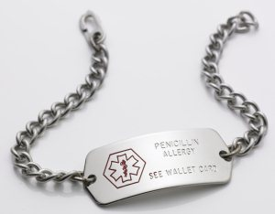
Evaluate the label
Effective penicillin-allergy counseling isn't about convincing someone they're not allergic.
It's about replacing an uncertain label with an evidence-based answer.
Sometimes this takes more than one conversation.
Image: https://www.aaaai.org/tools-for-the-public/conditions-library/allergies/penicillin-allergy
Notes:
Don’t just carry the label.

Slide 15
Explaining risk
This:
Rather than:
“Your history suggests a very low likelihood of a dangerous reaction to penicillin today.”
“Your pretest probability of an IgE-mediated hypersensitivity reaction is low.”
Notes:
Explain risk in language patients can understand
The communication piece is actually part of successful delabeling.
The goal isn’t simply to prove that someone isn’t allergic - it’s to help patients understand what their reaction means, what their testing means, and what they should do differently in the future.

Slide 16
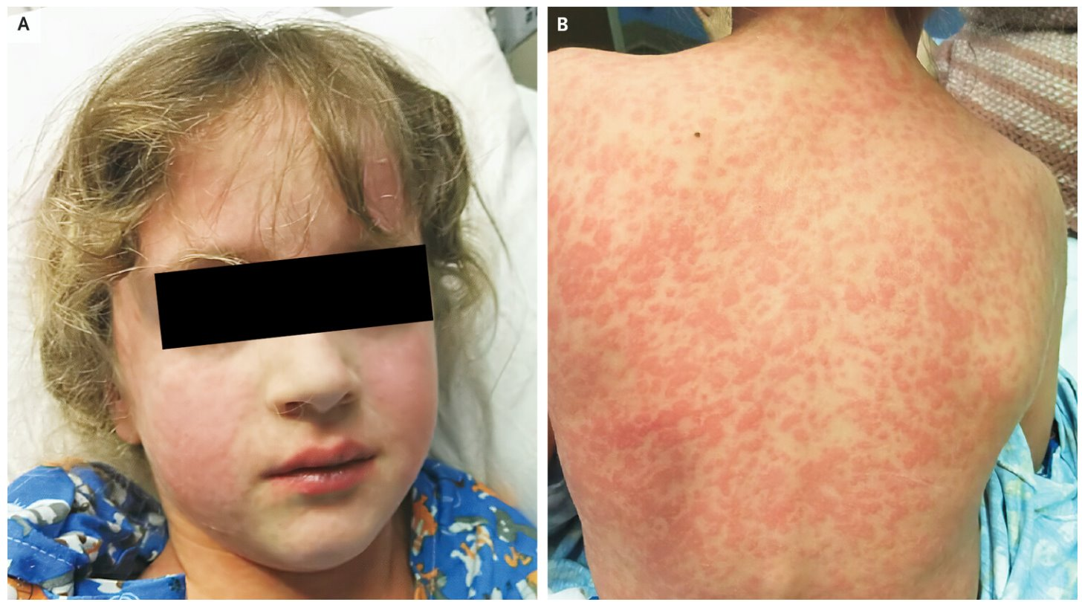
Rashes happen
Even after an IgE mediated reaction is excluded, ~3% of adult patients and up to 10% of pediatric patients could have a benign, delayed, possibly T cell mediated eruption to the drug.
Oral drug challenge doesn’t help predict if it will happen again.
NEJM, rash after Amox in child with EBV
Blumenthal et al., Lancet 2019;393:183-98.
Mill et al., JAMA Pediatrics 2016; 170(6):e16003

Slide 17
Encouraging piece of news
Benign cutaneous T cell mediated reactions do not reliably occur with subsequent challenges
Rechallenge
Penicillin ✅
Blumenthal et al., Lancet 2019;393:183-98.
Notes:
Either these rxns aren’t representative of adaptive immune responses or were immune responses that were lost over time once no longer exposed to the drug

Slide 18
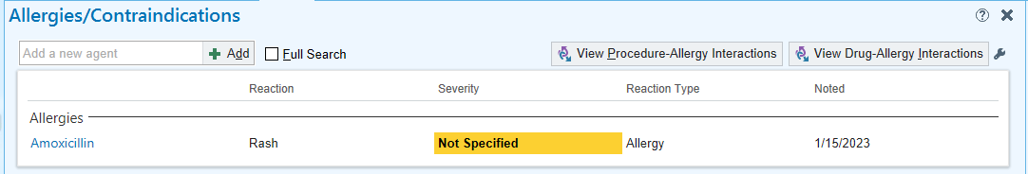
Electronic Health Records
The drug allergy section is not perfect.
It’s clunky.
It’s incomplete.
It’s inconsistent.
Notes:
Shift gears a bit here

Slide 19
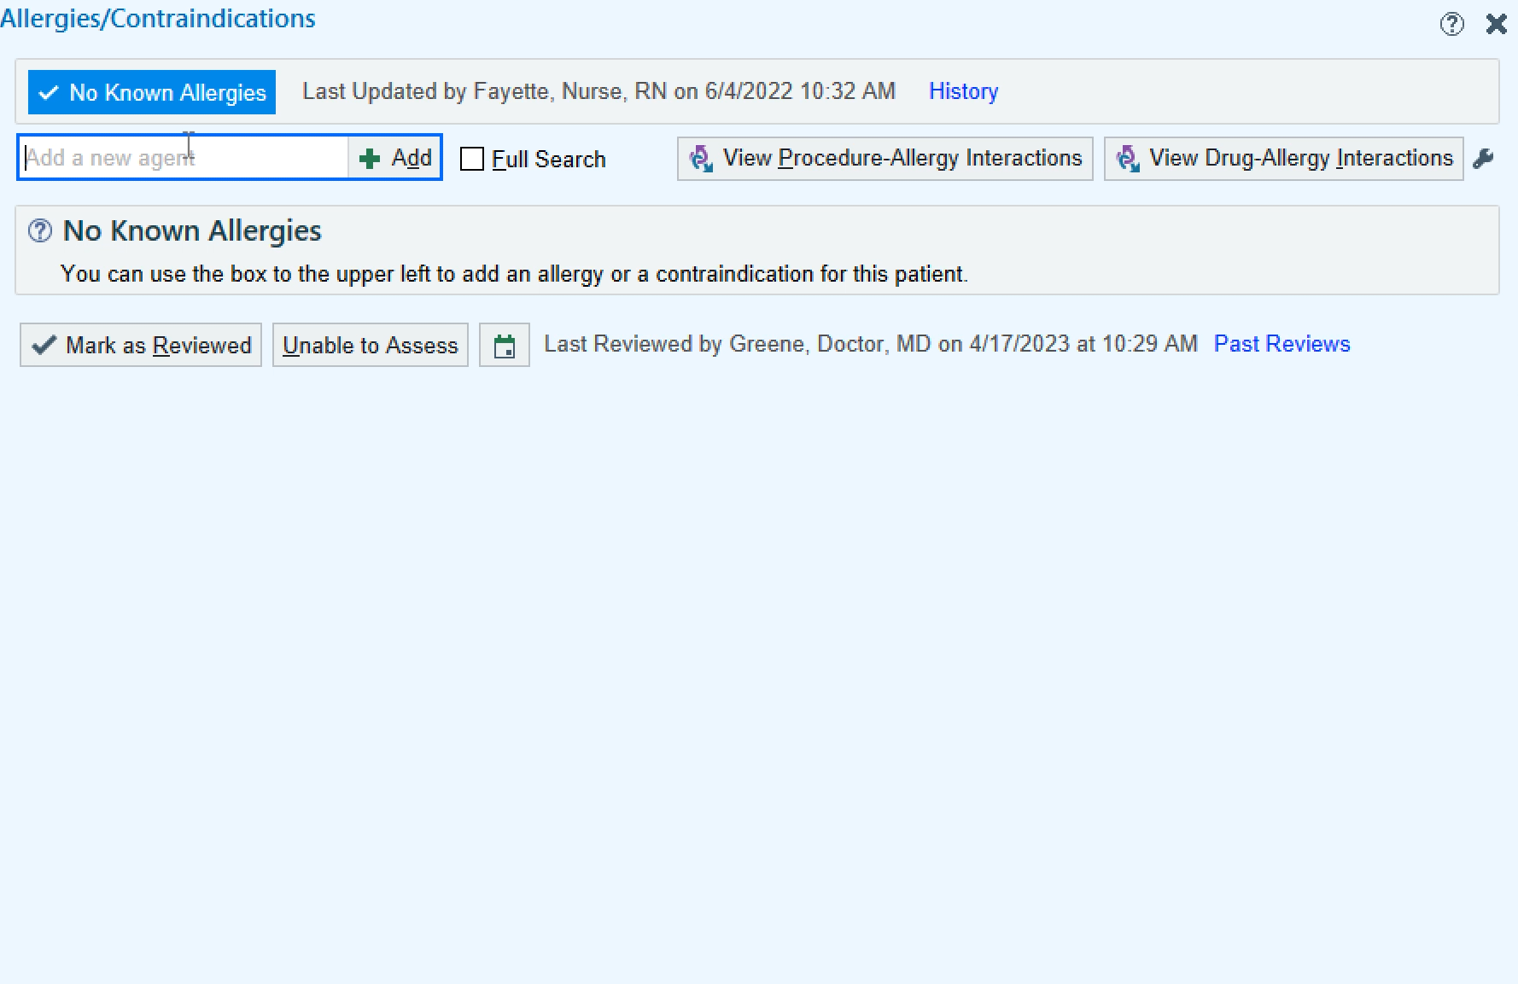
Adding a drug allergy label
Easy peasy!
4 clicks. Boom. Done.

Slide 20

But…
Dozens to even thousands of staff members have access to this part of the chart
Notes:
12,000 at NCH to be able to put drug allergy
No consensus guidelines on how to train or who to train to enter drug allergies, various EHR vendors ➔ lack of standardization

Slide 21

Undoing an allergy label
Much more challenging
  Liability
  Fear
  Time
Notes:
14 of us in our division
What this represents for the general population as well, not enough allergists, need to work with other specialties like primary care, pharmacists and ID

Slide 22
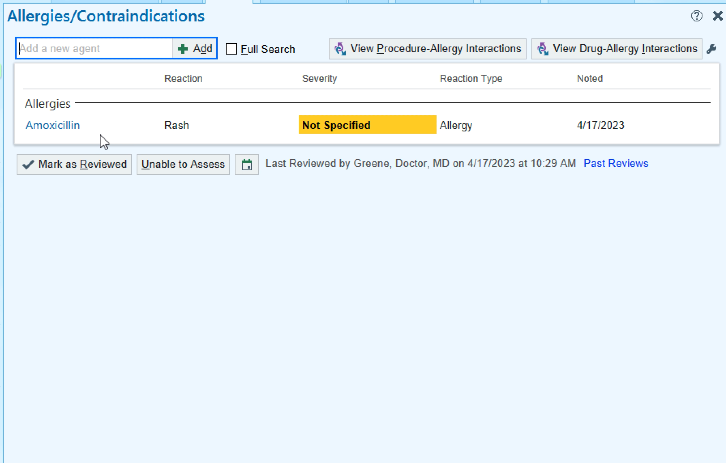
The more details the better
Notes:
The more details the better

Slide 23

Even if you undo the allergy label
Patients can get relabeled
  Personal discomfort
  Lack of understanding
  Incomplete chart review
  No EHR crosstalk
Notes:
Close the loop and document in Epic, send notes to PCP, provide clearly written d/c instructions to patients

Slide 24
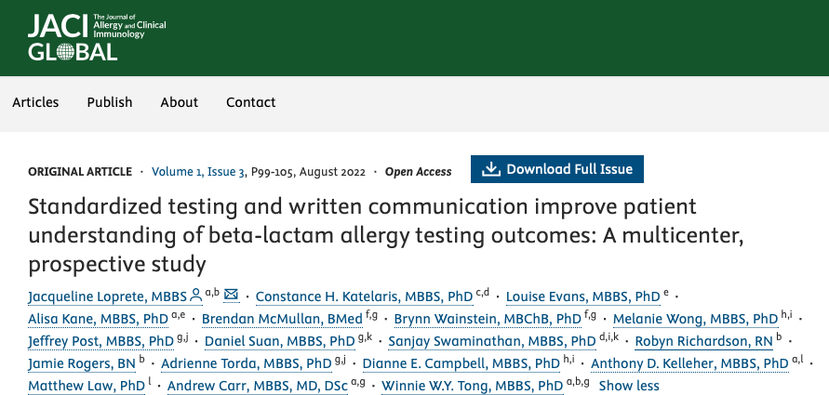
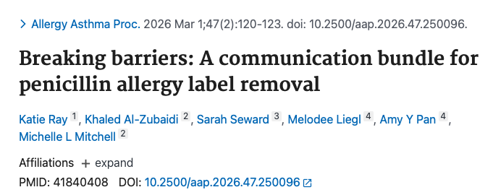
When is delabeling complete?
Standardized testing and communication improves patients’ understanding of their beta lactam allergy status
A multicenter prospective study across 7 adult and pediatric centers
What we tell patients after testing matters, not just the testing itself.
After successful oral challenges in children, direct communication with pharmacies and outside primary care providers reduced the presence of the penicillin allergy label in pharmacy records from 32% to 12%.

Slide 25
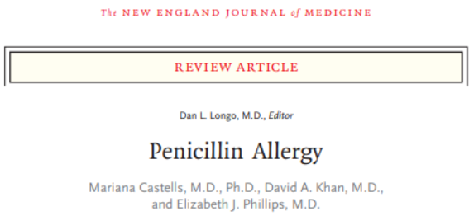
Why do we care about penicillin allergies?
Surgical site infections
Antibiotic resistance
MRSA
C.Diff
Treatment failures
Increased mortality
Castells, M et al. NEJM 2019; 381:2338-2351.
Trubiano JA, et al. JAMA. 2017;318(1):82-83
Notes:
There are serious implications with a PCN allergy label, review article from NEJM
“Use of alternate antibiotics that are less effective, more toxic and expensive, and that have inappropriately broader coverage than penicillin”

Slide 26



Why do we care?
Many patients get diagnosed in childhood and carry that label into adulthood where things get more complicated
January 2017: Joint Commission mandated that all hospitals have an antibiotic stewardship program
Notes:
but if we can proactively de-label or prevent PCN allergy labels to go in the first place, that would change how we deliver this part of healthcare

Slide 27
If we communicate at a level our patients can't understand, that's not a patient failure.
That's a communication failure.
Health literacy ≠ intelligence
Health literacy ≠ education level
It is the ability to find, understand, and use health information.

Slide 28
Health literacy
Average U.S. adult reading level ~8th-9th grade
~20% read at a 5th-grade level or below
Traditionally, patient-facing material aim for ≤ 6th-grade reading level or below
Notes:
https://www.ahrq.gov/health-literacy/improve/precautions/tool11.html
https://www.epa.gov/choose-fish-and-shellfish-wisely/readability-developing-and-pretesting-concepts-messages-materials

Slide 29

Why do our patients care?
To be honest, sometimes they don’t
Alternative antibiotics availability
Nobody plans on getting sick
*To be honest, sometimes I don’t have time to cover a PCN allergy in a visit either.
Notes:
Image: https://www.google.com/url?sa=t&source=web&rct=j&url=https%3A%2F%2Fchestbrew.com%2F5-things-stop-caring-right-now%2F&ved=0CBoQ3YkBahcKEwjQptzEk7WWAxUAAAAAHQAAAAAQOA&opi=89978449

Slide 30
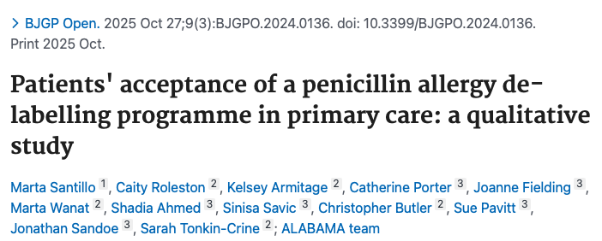
Patient beliefs & understanding
A qualitative study of patients participating in a primary-care penicillin allergy program found that patients were more accepting when:
  patients identified themselves as low risk before the test
  penicillin testing being perceived as trustworthy and safe
  patients’ previous experience of penicillin allergy and reactions
  patients’ understanding of penicillin reactions
  clear communication after de-labelling
Notes:
Attitudes will also influence whether patients are willing to undergo testing and accept delabeling.

Slide 31

Let’s talk about risk
Low risk patient
  Example: My grandmother had anaphylaxis to penicillin so everyone in the family avoids it.
Drug allergies
are hereditary
Notes:
Toddler patient last week who had maternal grandmother who had fatal anaphylaxis due to PCN in 1950s and everyone avoids it since, drug allergies are not hereditary

Slide 32
Let’s talk about risk
High risk patient
  Example: When I took Augmentin a few years ago, I immediately started to break out in itchy welts and my face got really swollen right after my morning dose and I had to go to the ER. Oh, by the way, I’ve been struggling with my asthma control recently.
Notes:
More immediate symptoms consistent with possible IgE rxn… need to address comorbid condition first

Slide 33

Allergic reaction rates
Fatal anaphylaxis is rare
0.001% with parenteral exposures
0.0005% with oral exposures
Blumenthal et al., Lancet 2019;393:183-98.
This Photo by Unknown Author is licensed under CC BY-NC-ND
Notes:
What’s the most commonly associated word with allergic reactions online? Death, mortality, fatality, dying *according to my own observation
One fatal Amoxicillin reaction in the UK from 1972 – 2007 from 100 million Amox Rx

Slide 34
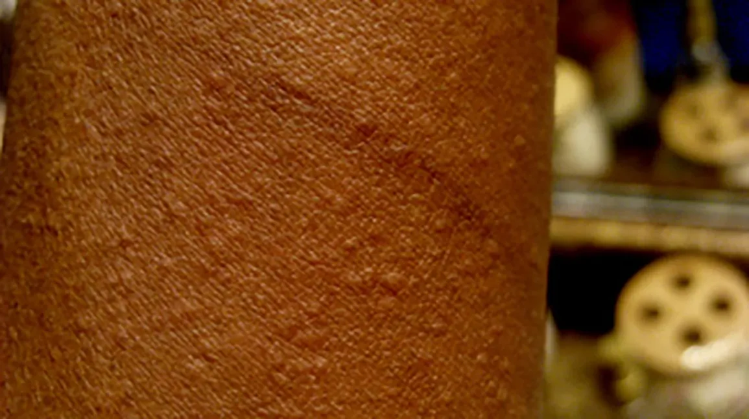
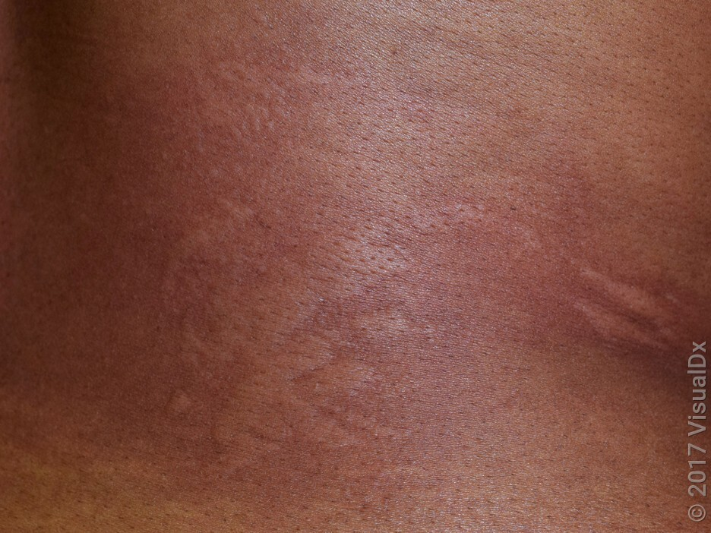
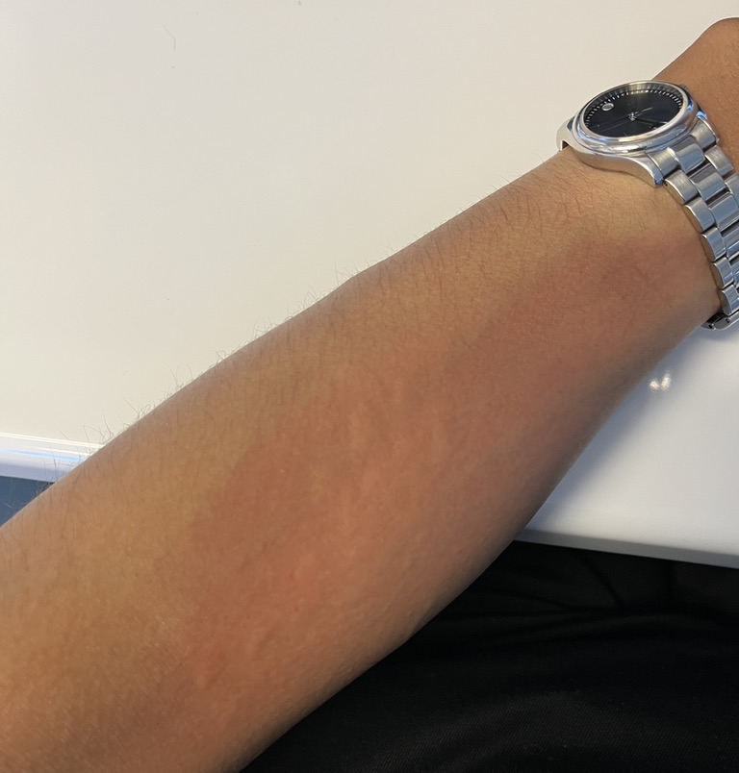
#1 cause of hives in young kids:
MedicalNewsToday
Viral illnesses and infections!
https://www.medicalnewstoday.com/articles/hives-on-black-skin

Slide 35
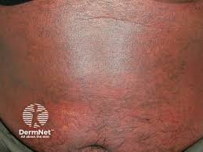
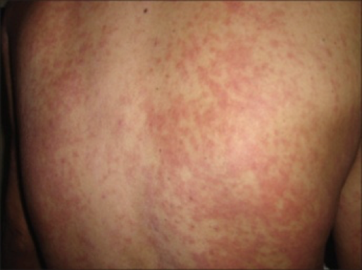
Delayed rashes
Infamous maculopapular rash
AAAAI Drug Allergy Slides
Notes:
But clinical presentation can be dynamic and evolves and always important to put the rash in clinical context

Slide 36
Treating through the rash
We still don’t have any objective data on outcomes and complications
Medical-legal risk
Prednisone
https://dermnetnz.org/topics/exanthems
Notes:
but there are nuances, no two patients will be alike and there will be two camps: treat through (because when you send them to the allergist we’re going to rechallenge them) versus stop and switch because you can’t predict how the patient will evolve
Shared decision making

Slide 37
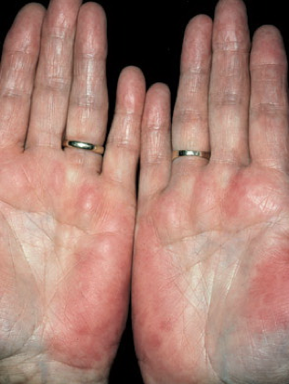
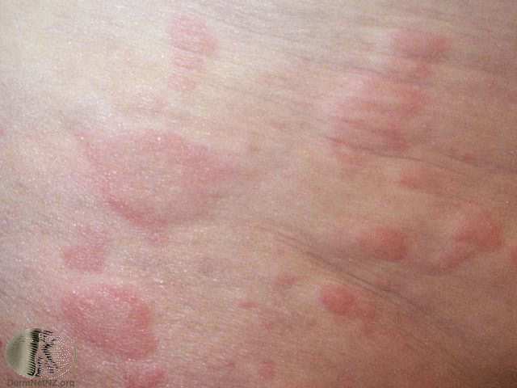
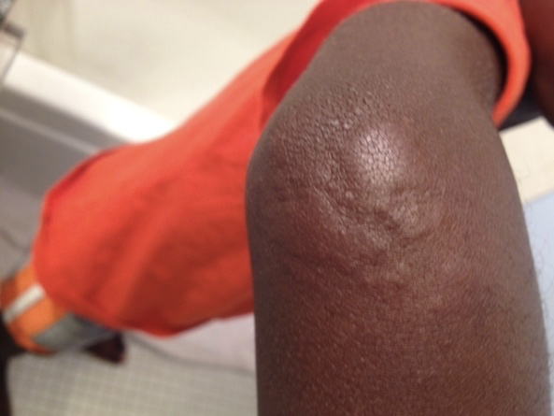
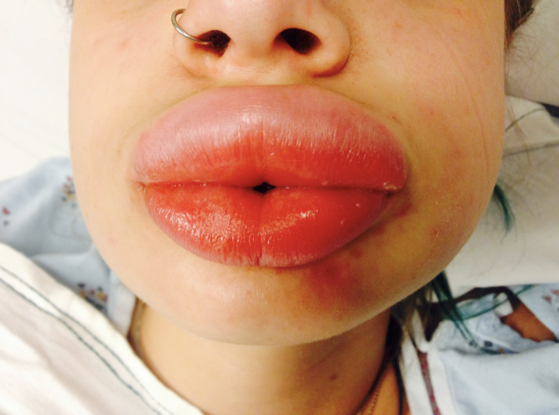
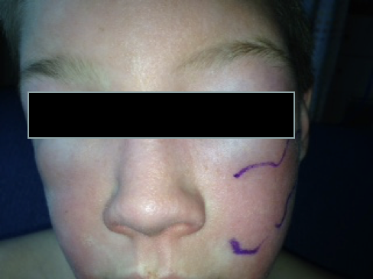
IgE mediated symptoms
AAAAI Drug Allergy Slides
Notes:
Need a sensitizing event, need to learn that you’re allergic and then on second exposure, usually first dose causes the sxs
Sxs usually occur within a couple of hours, but can happen up to 6 hours
If rash lasts > 24 hours, also less likely to be IgE mediated

Slide 38
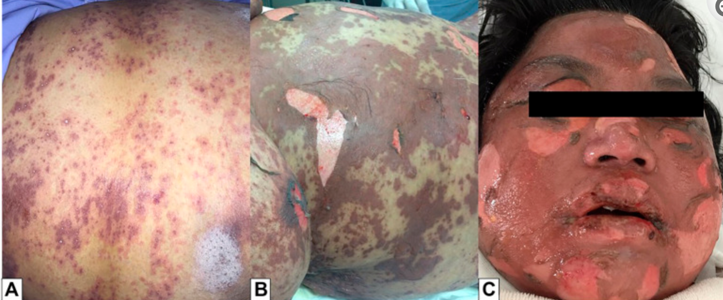
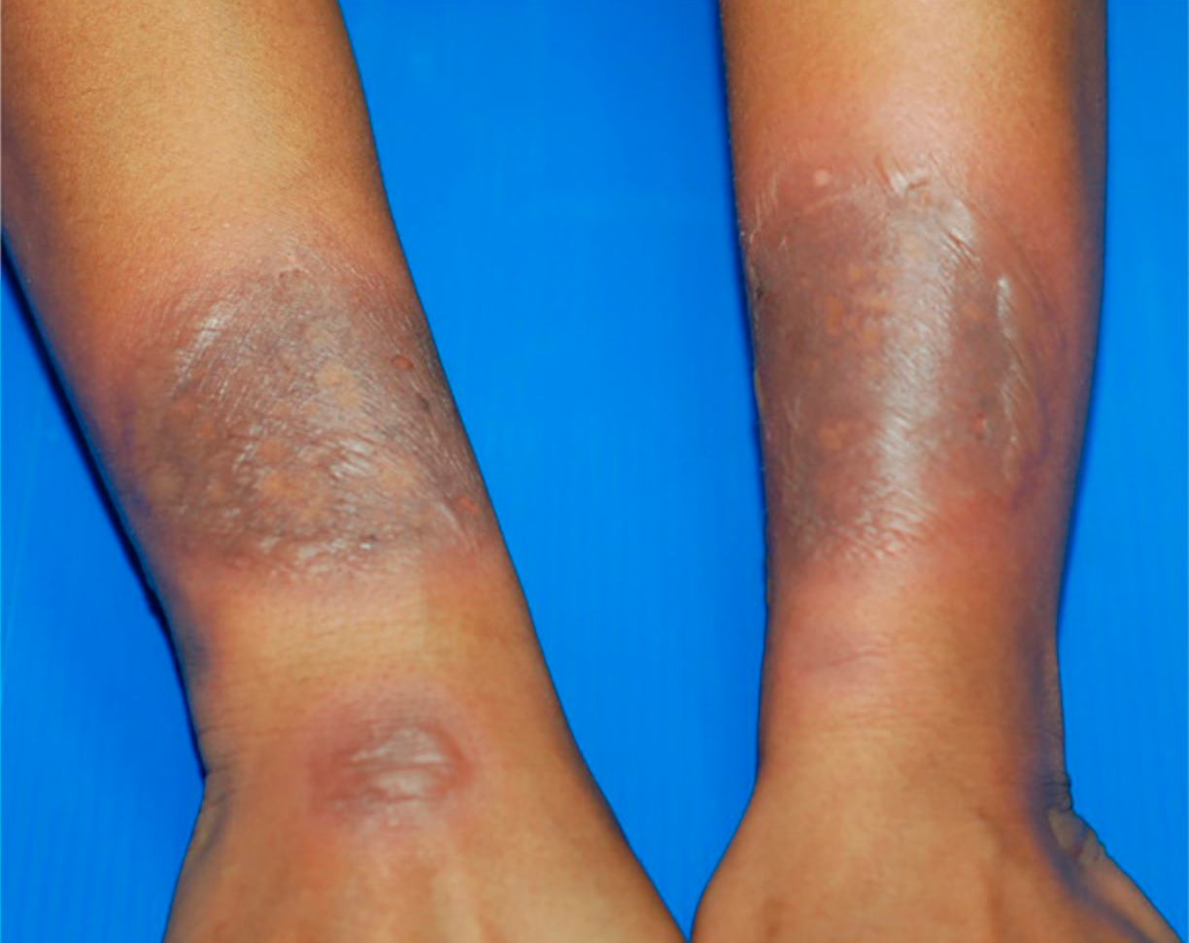
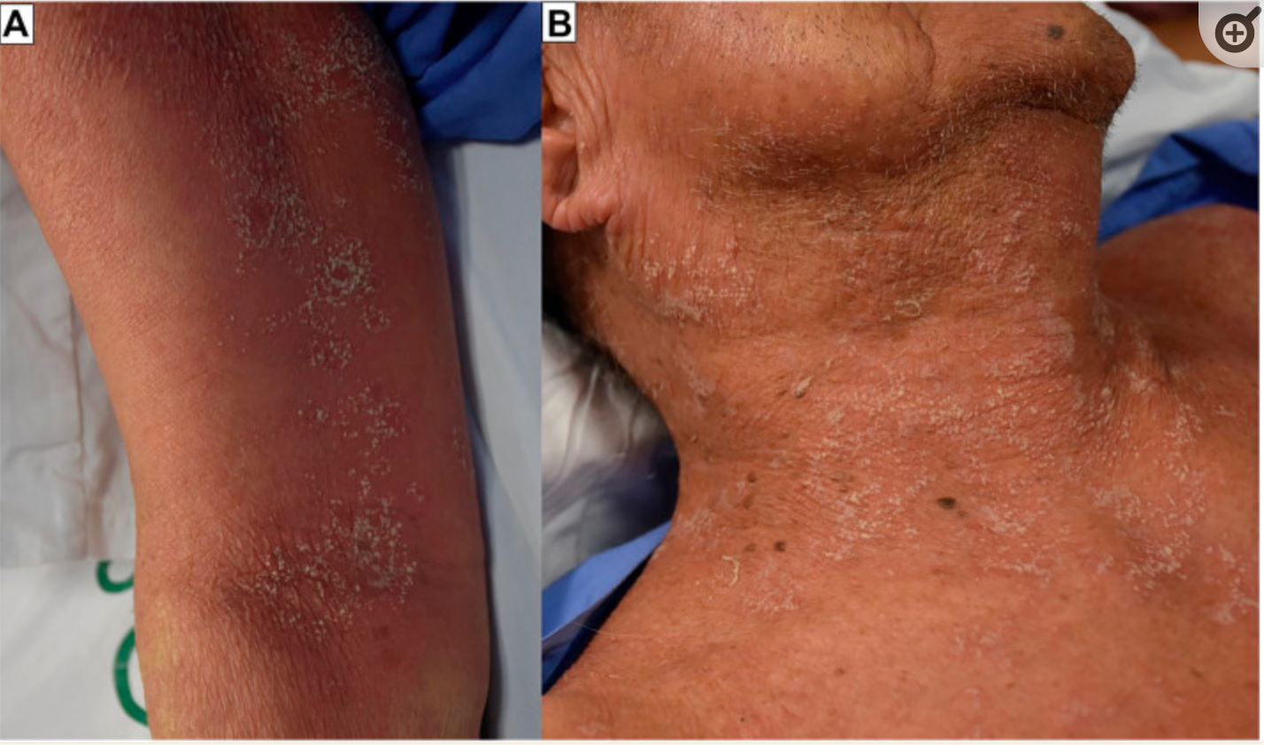
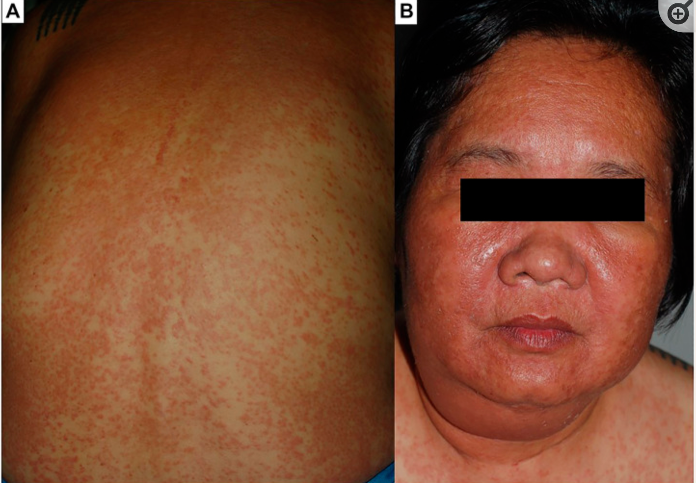
Penicillins + severe cutaneous adverse reactions
Fixed drug eruption
TEN
DRESS
AGEP
Images: Tempkar, T et al. Front Pharmcol. 2022; 13: 832048.
Notes:
Can cause AGEP, DRESS, SJS, TEN, yes this can absolutely happen
Short story: SCARs are even rarer than IgE mediated events (1-5 cases/1 million people/year)
No good testing for delayed drug reactions

Slide 39
But what if it was a true PCN reaction?
Short story: PCN allergy can wane over time
No longer allergic
No longer allergic
No longer allergic
30% lose sensitivity within 1 year
60% within 5 years
80% within 10 years
Blanca M, et al. J Allergy Clin Immunol. 1999;103:918-924
W Covington et al. Pharmacy. 2019;7(2):69.
Trubiano JA, et al. JAMA. 2017;318(1):82-83
Notes:
“The longer the interval between the reaction and the skin test, the greater the likelihood of having a negative result.
“it is important to note that this phenomenon is limited to penicillin-specific IgE antibodies, and does apply to non-IgE mediated reactions.”
Up to 30% of patients can lose sensitivity and have a negative skin testing within 1 year
Up to 60% within 5 years
Up to 80% within 10 years
Less than 1% after 20 years (“Broyels, A et al. JACI: IP 2020; XX Practical Guidance for the Evaluation and Management of Drug Hypersensitivity: Specific Drugs”)

Slide 40
Gold standard = oral challenge
Many variations in how PCN drug challenges are performed
Generally 2-step
  10% of therapeutic dose
    Wait 10-30 minutes
  Remaining 90% of dose
    Observe 60-120 minutes
Notes:
Working with our PCP offices to also help assess and catch these kids
Time is a huge rate limiting step, comfort #2

Slide 41
Discharge instructions
Explicitly communicate to patient and family once they have passed the oral challenge, that today marks a clean slate from an allergy standpoint.
Do you have any
known drug allergies?
Noooope!
Notes:
Physicians talk too much because we’re trying to explain the gray area and the nuance, but I need them to hear me clearly and so I paint a black and white picture, we walk through this hypothetical scenario, you end up in the urgent care for a sprained ankle

Slide 42
After the intervention
Make the plan explicit. Patients should leave knowing:
  Whether the allergy label was removed
  Whether penicillin can be used in the future
  Which antibiotics remain contraindicated, if any
  What to do if a future reaction occurs
Notes:
The communication piece is actually part of successful delabeling.
The goal isn’t simply to prove that someone isn’t allergic - it’s to help patients understand what their reaction means, what their testing means, and what they should do differently in the future.

Slide 43
Case
16-month-old male previously healthy
Diagnosed with first ear infection after starting daycare
NKDA, started on Amoxicillin
No previous antibiotic use
Day 4, parent calls your office and reports a “bumpy red rash”, no other symptoms
Morning dose given 5 hours ago
Now what?
https://dermnetnz.org/topics/exanthems

Slide 44
Case
16-month-old male previously healthy
Diagnosed with first ear infection after starting daycare
NKDA, started on Amoxicillin
No previous antibiotic use
Day 4, parent calls your office and reports a “bumpy red rash”, no other symptoms
Morning dose given 5 hours ago, had slept fine the night before
Now what?
https://dermnetnz.org/topics/exanthems

Slide 45
What’s your next step?
Stop and switch to Cefdinir.
Treat through the rash.
Don’t ask me about rashes.
https://dermnetnz.org/topics/exanthems
Notes:
Risk assessment and tolerance will vary widely from clinician to clinician and that’s ok

Slide 46
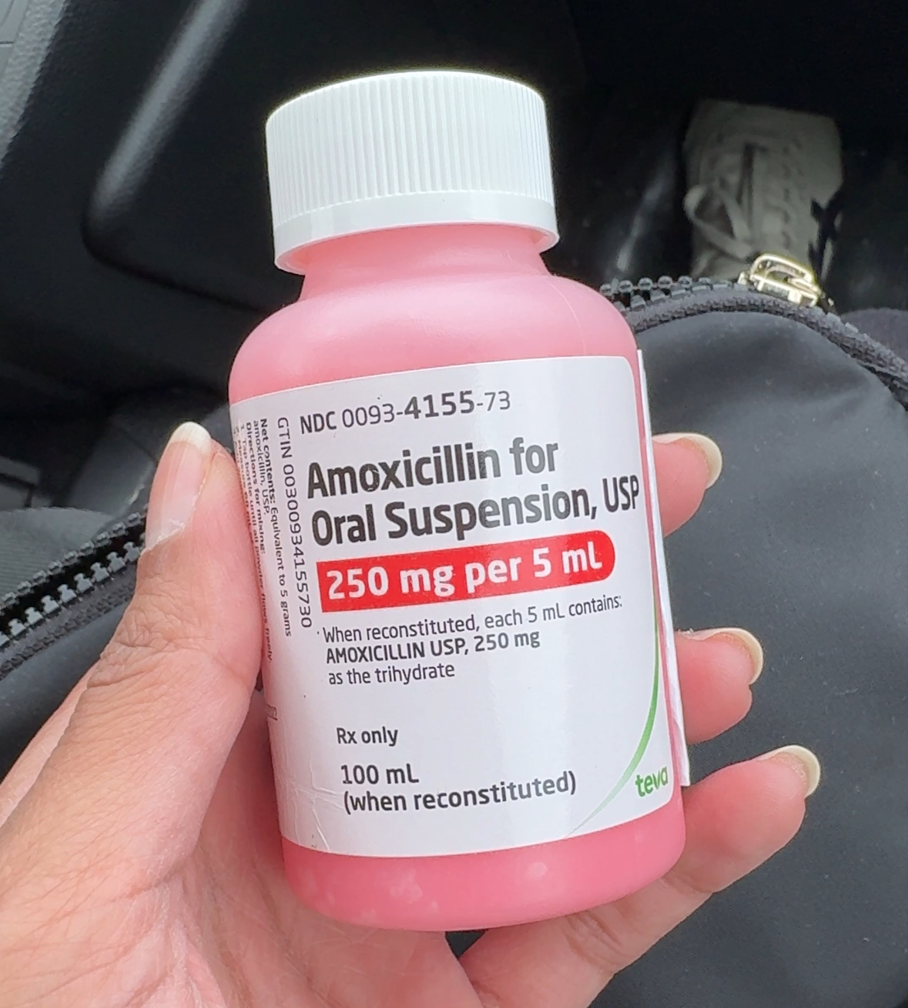
Take home points
Clinical histories are the most important part of any drug allergy evaluation.
Oral Amoxicillin challenges are safe.
Don’t shoot yourself in the foot by jumping to a drug allergy label.
Drug-infection interaction very likely to be cause of delayed benign rash in young kids.
ALLERGY

Slide 47
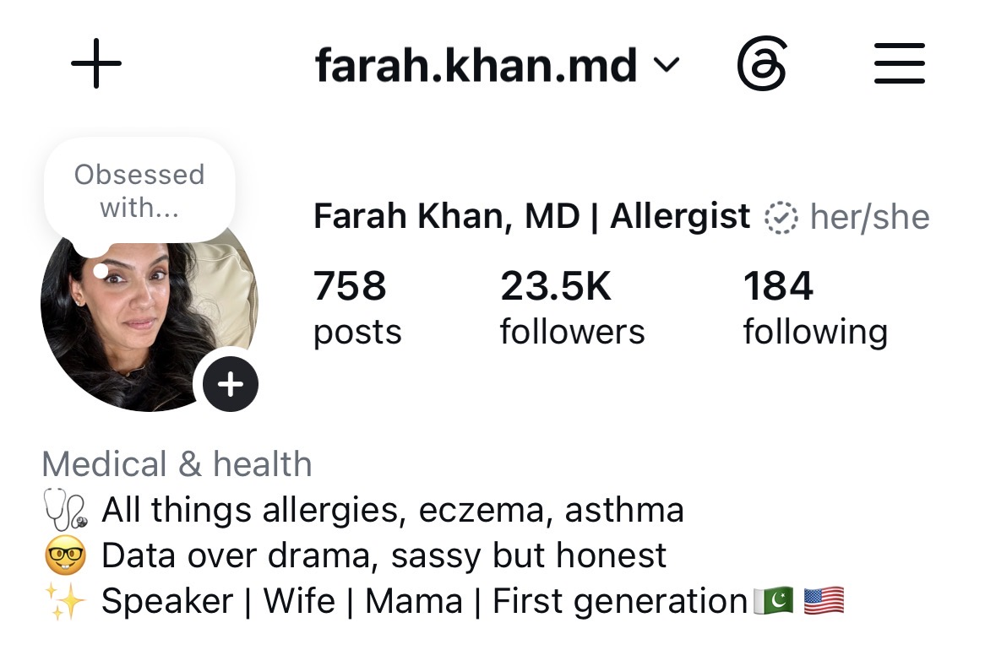
Thank you!
farah.khan@nationwidechildrens.org

Slide 48
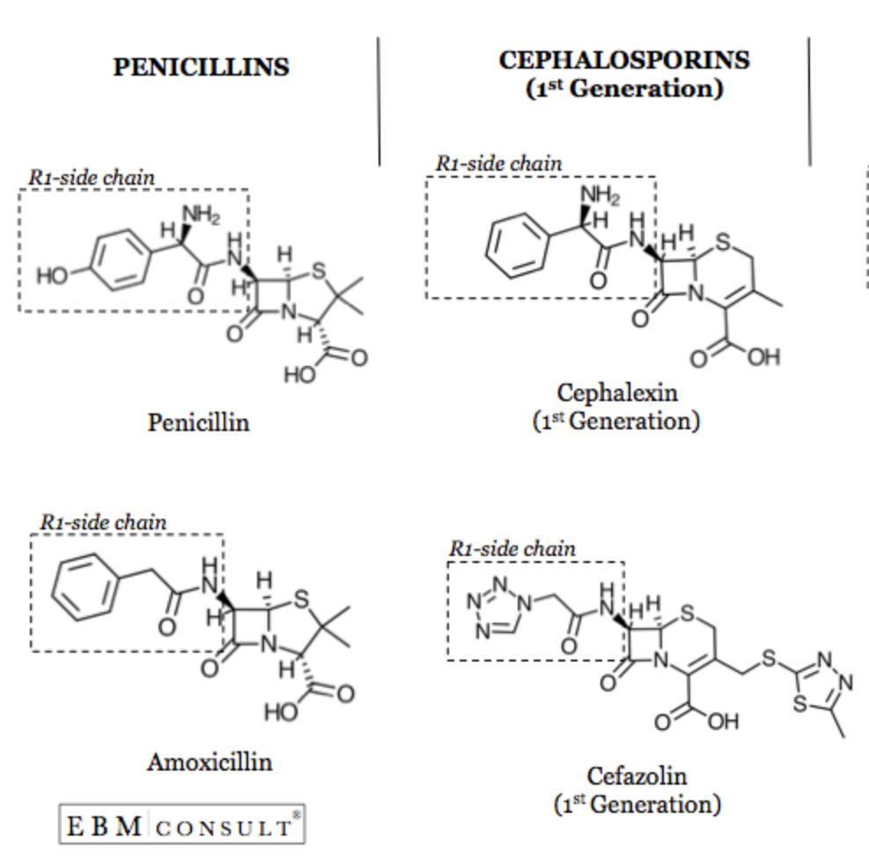
PCN cross reactivity with cephalosporins
Short story: Very low risk. Do not avoid.
First generation (Cefaclor, Cephalexin) does have slightly higher cross reactivity with R1 side chain
Broyels, A et al. JACI: IP 2020; Oct;8(9S):S16-S116.
Notes:
Consensus based statement “experts of experts”
True cephalosporin allergy 1-3% of general pop
Additional data suggests cephalosporin-induced anaphylaxis to be 0.0001–0.1%, with differing rates based on the R1 side chain [4,68].
Negligible risk with 2nd generation and higher

Slide 49

But let’s break it down
Notes:
Penicillin-hapten carrier complex which is presented by APC to a naïve T cell which then goes through Th2 pathway to stimulate B cells to turn into plasma cells and generate IgE Ab which then sensitize mast cells. This applies to foods, drugs, venom. You have to have a sensitizing event.
On reexposure, the sensitized mast cells sees the allergen bind to the IgE Ab and cross linking occurs between 2 IgE Abs which then leads to degranulation and release of chemicals like histamine, and various other proteases that lead to allergic reaction symptoms

Slide 50
After the intervention
Communicate the result beyond the allergy clinic: The allergy label lives in multiple places like EHRs, pharmacies, primary care records, school/daycare records, and family memory.
  A negative challenge that isn't communicated effectively can eventually become another allergy label.
The goal is confidence, not just a negative test.
Notes:
The communication piece is actually part of successful delabeling.
The goal isn’t simply to prove that someone isn’t allergic - it’s to help patients understand what their reaction means, what their testing means, and what they should do differently in the future.

