Slide 1


Penicillin Allergy Labels and the Approach to Evaluation
David A. Khan, MD
Professor of Medicine and Pediatrics
Allergy & Immunology Program Director
Notes:
25 minutes

Slide 2
Learning Objectives
Discuss the history of penicillin
Discuss phenotypes of penicillin allergy
Discuss strategies for penicillin allergy delabeling

Slide 3
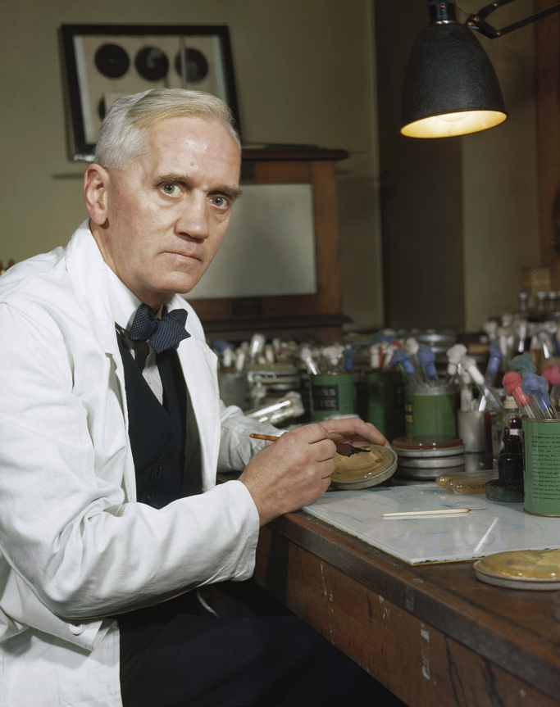
The Discovery of Penicillin
September 28, 1928
Sir Alexander Fleming

Slide 4
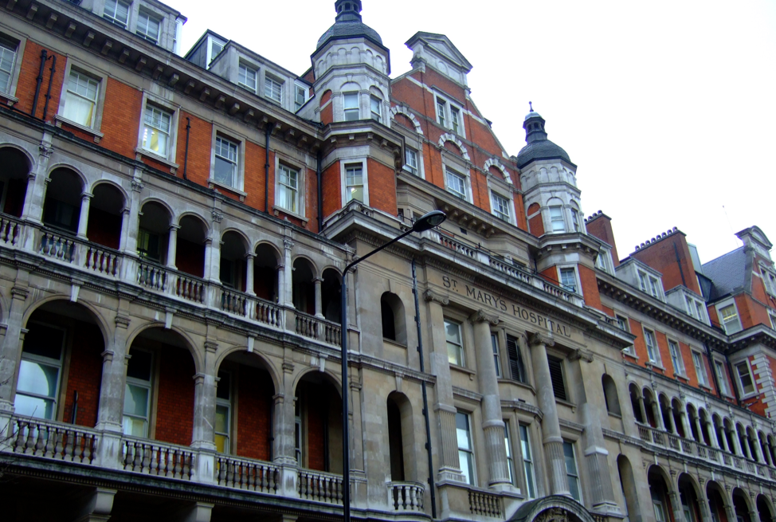
Alexander Fleming 1881-1955
Born in Scotland
Initially worked in a shipping office but after inheriting money from an uncle pursued his medical education at St Mary’s Hospital in London and graduated in 1906

Slide 5
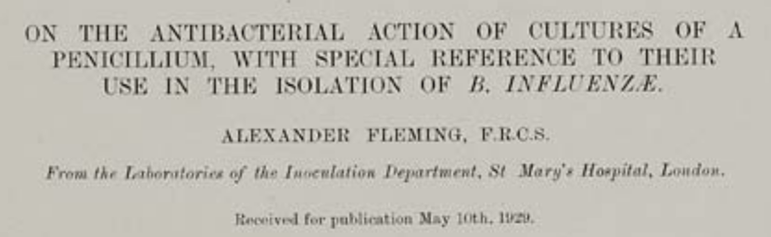
Br J Exp Pathol. 1929;10:226-36.

Slide 6
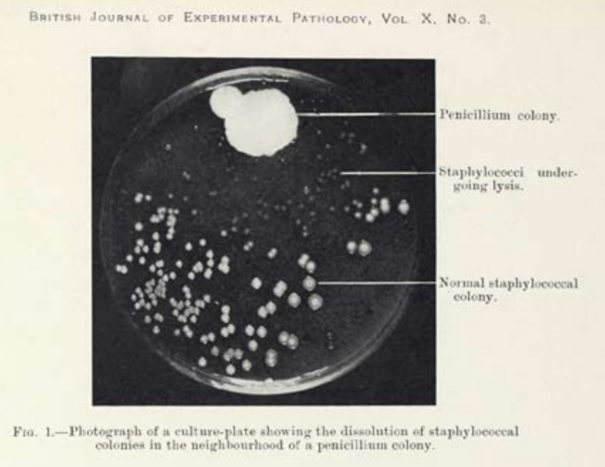

Slide 7
The “juice” of Penicillium
“I have been frequently asked why I invented the name penicillin. I simply followed perfectly orthodox lines and coined the word which explained that the substance penicillin was derived from the plant of the genus Penicillium just as many years ago the word ‘Digitalin’ was invented for a substance derived from the plant Digitalis.”

Slide 8
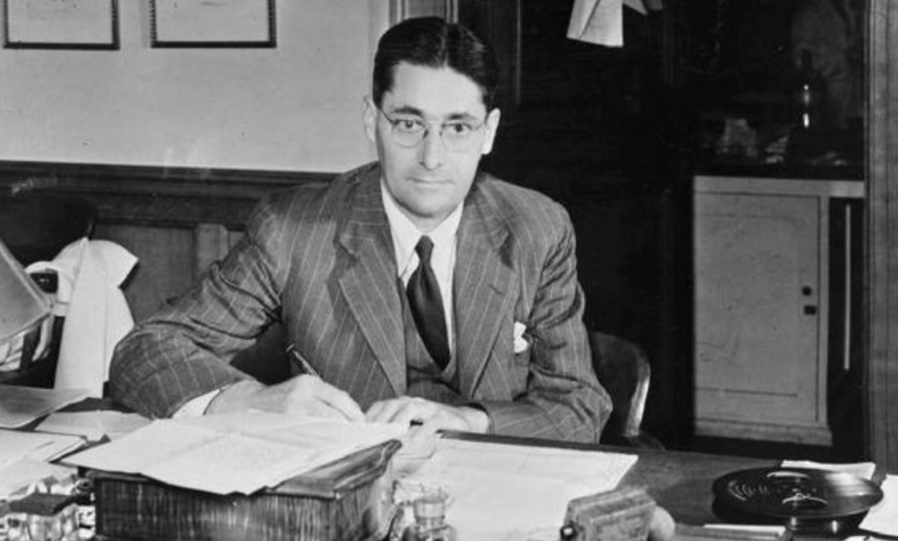
Sir Howard Florey
Australian pathologist at Oxford who assembled the team to test and develop penicillin

Slide 9
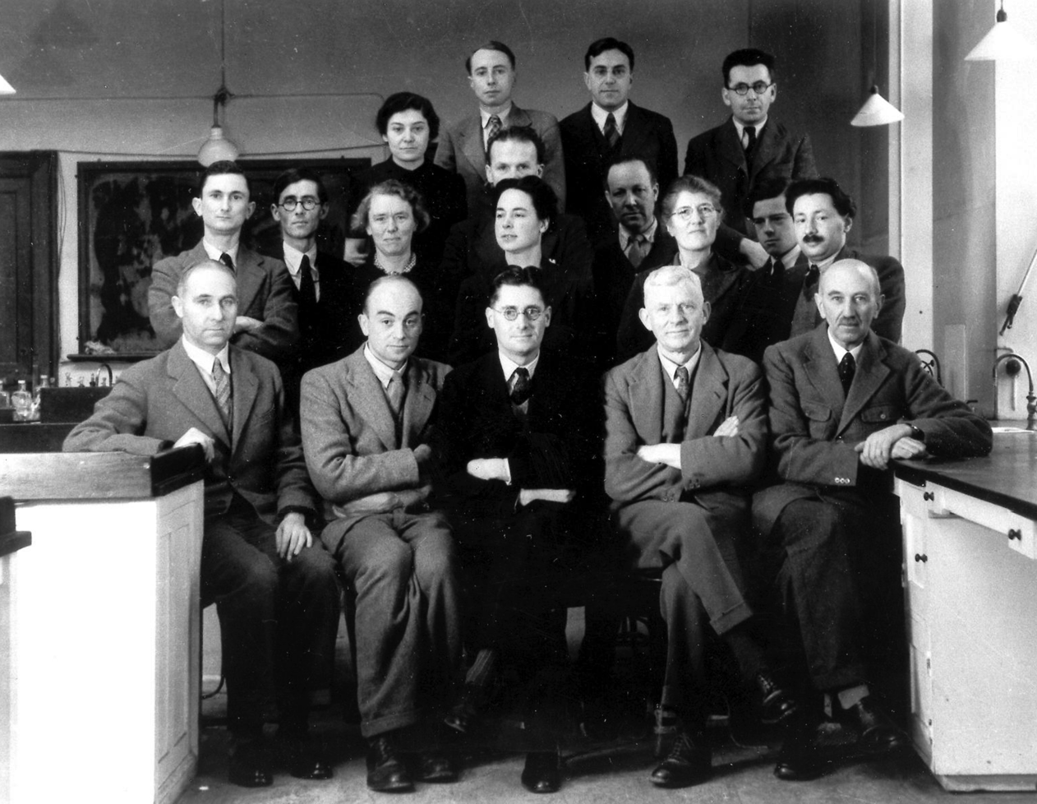
“Developing penicillin was a team effort as these things tend to be”
Notes:
Oxford Research Team 1940, Florey in middle, Chain 2nd row on Right, Heatley2nd row left(?)

Slide 10
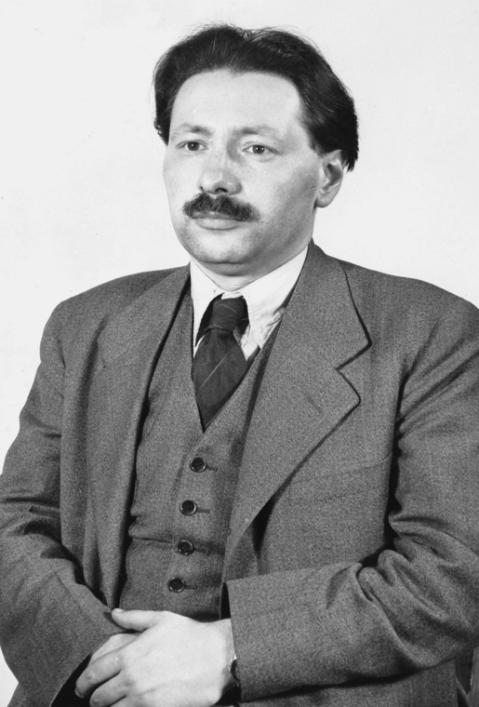
Isolation and Chemical Structure of Penicillin
Ernst Chain was a German-born biochemist who fled Germany and in 1935 came to the University of Oxford
Notes:
Chain found Flemings 1929 article on penicillin and proposed to his supervisor Florey that he try to isolate the compound

Slide 11
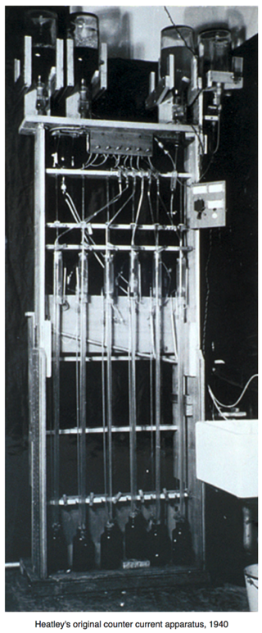
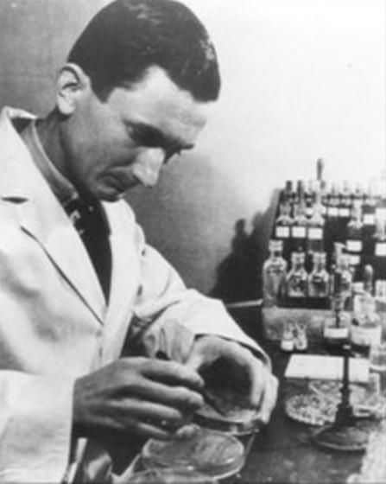
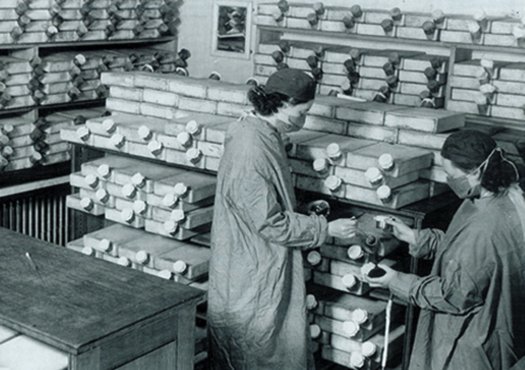
Producing Penicillin
Norman Heatley Ph.D. Oxford Biochemist
Notes:
Counter current apparatus

Slide 12
“It Looks Like a Miracle”
Saturday, May 25, 1940
11 AM: Florey and Kent injected 8 mice with a lethal dose of streptococci
Noon: Mice 1&2 received 5 ml penicillin solution, Mice 3&4 received 10 ml
  Mice 1&2 received penicillin at 4:15, 6:20 and 10PM
6:30 PM: Mice 5-8: “look quite sick. No attempt to eat. Eyes permanently closed…Breathing laboured”
Midnight: 1 control mouse died
1:30 AM: 2 controls died
3:28 AM: Last control died
Treated mice survived 2, 6, 13 days, and “indefinitely”
Notes:
Penicillin they used was only 0.5% pure

Slide 13
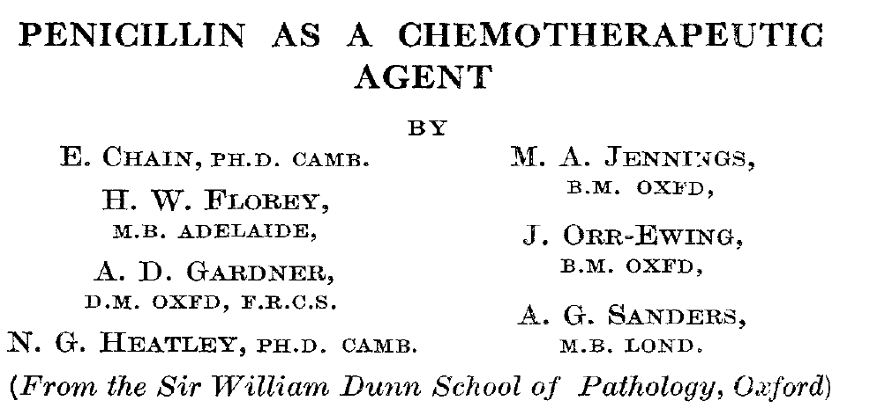
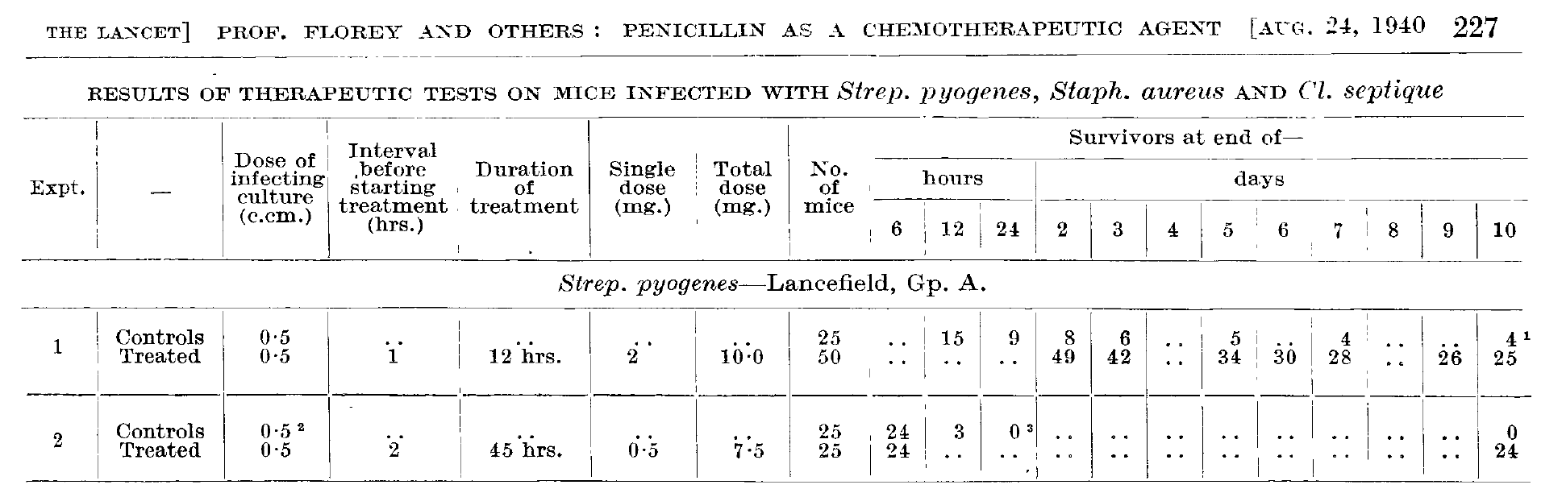
Lancet. 1940;1940(236):226-8.

Slide 14
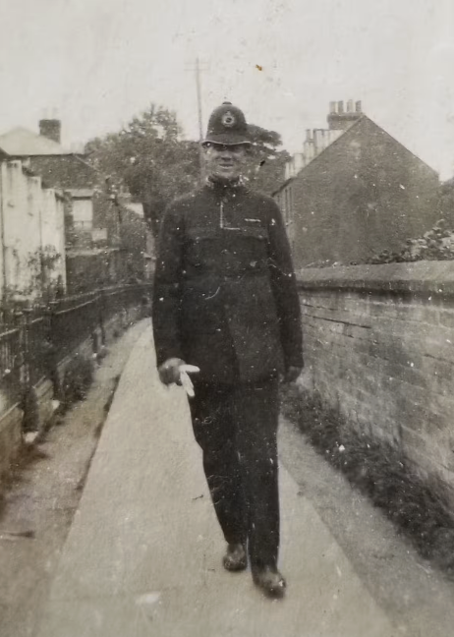
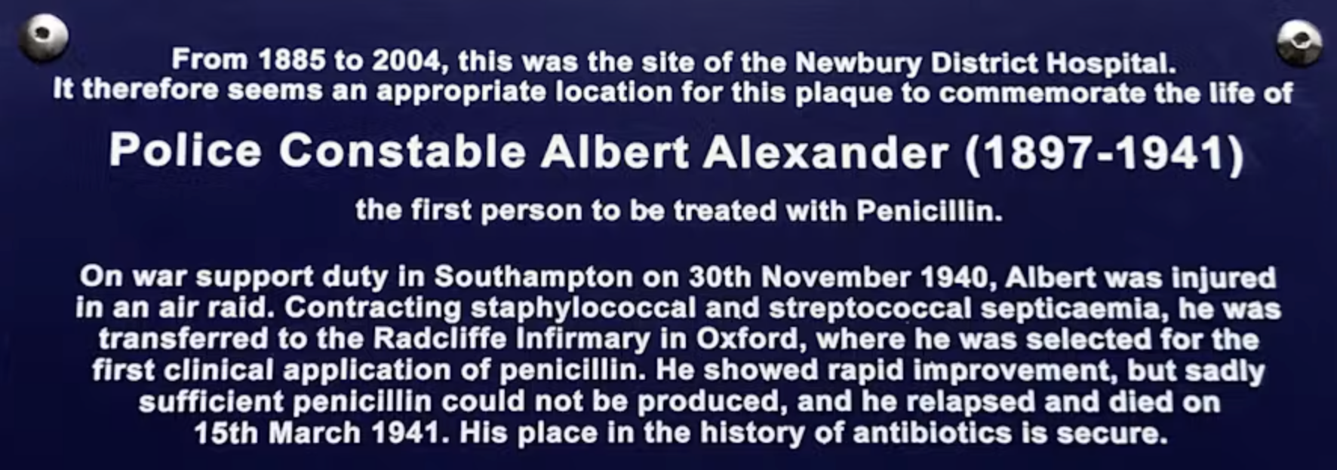
Albert Alexander a 43 yo Oxford constable had numerous staph and strep abscesses skin, lungs, joints (after shrapnel from a German bomb)
Heatley: “He was oozing pus everywhere”
Feb 12, 1941 he was treated with a total of 500 mg penicillin over 12 hours
Within 24 hrs he was afebrile with less pus, reduced swelling and was stable for 10 days
All penicillin supplies were exhausted and he died 1 month later

Slide 15
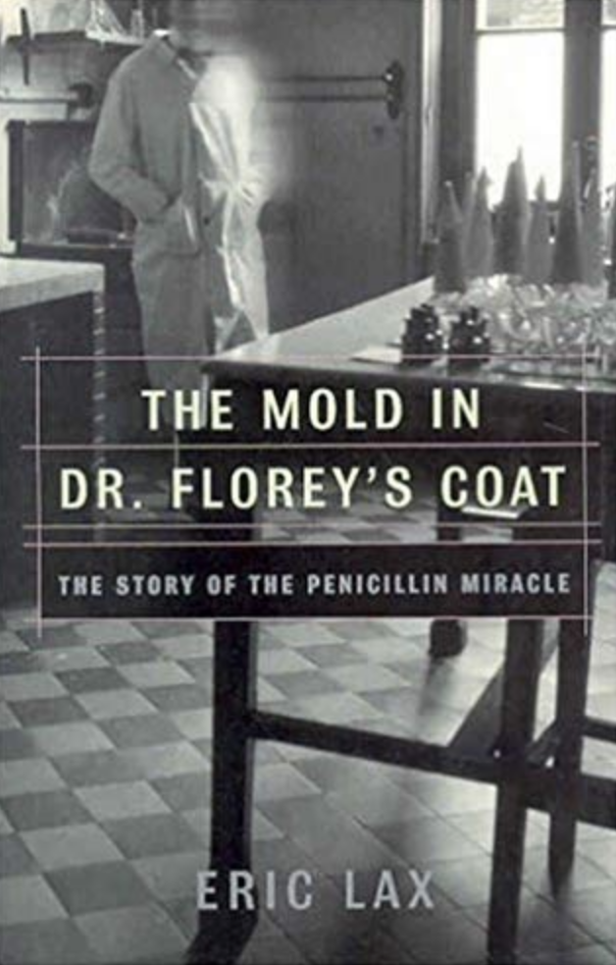
In the summer of 1941, due to concerns that they may have to destroy their research that could help the Nazis, Heatley suggested they rub mold spores in their coats that could be preserved for years
Florey, Heatley, Chain and 2 others did this

Slide 16
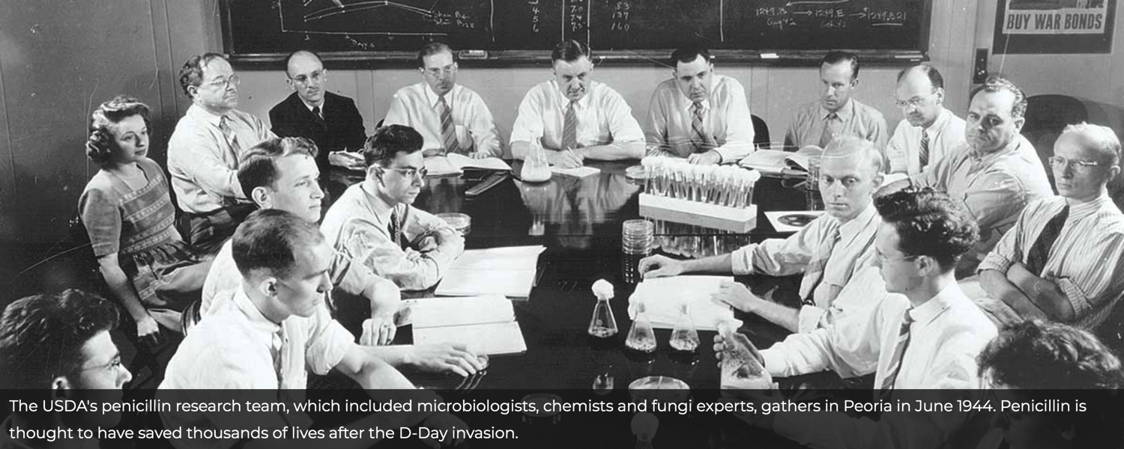
USDA Regional Research Laboratory Peoria IL
How to Manufacture Penicillin in Bulk
July 14, 1941 Florey and Heatley go to Peoria to meet with fermentation lab experts

Slide 17
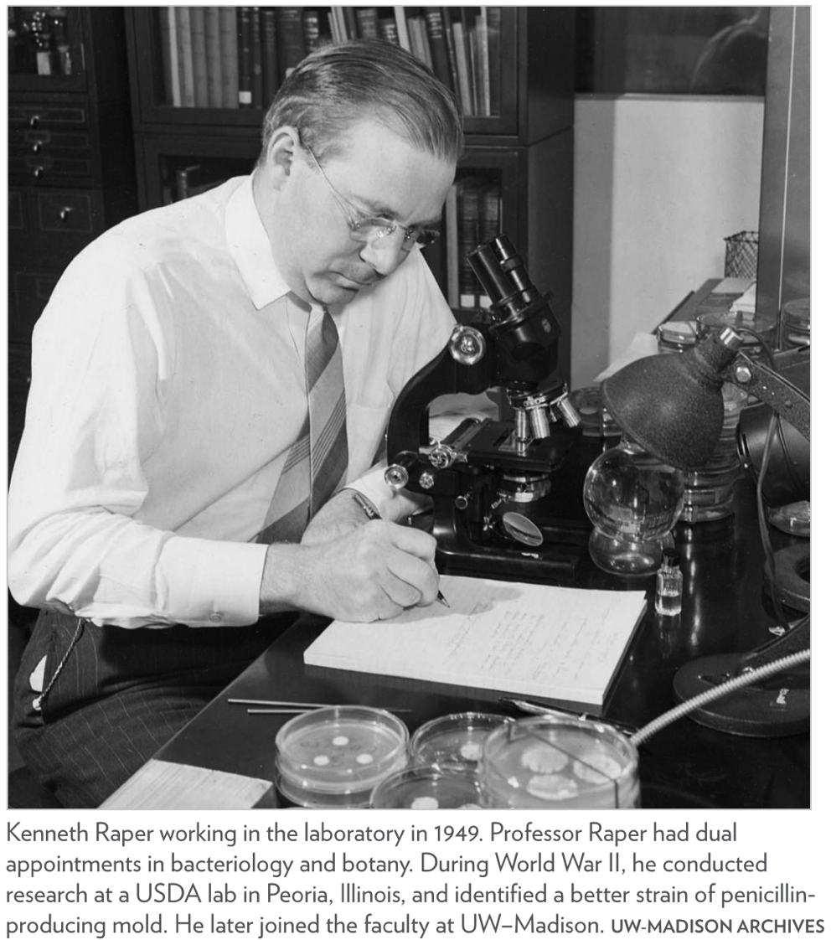
Raper’s assistant “Moldy Mary” searched numerous sources of mold and found the most potent on an overripe cantaloupe at a Peoria grocery store

Slide 18
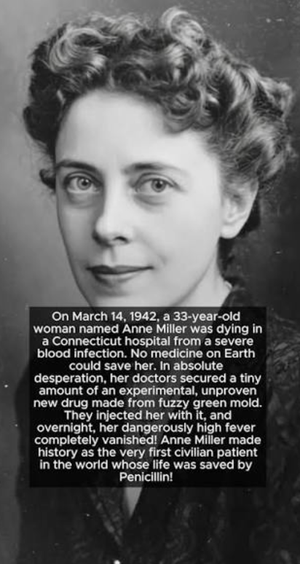
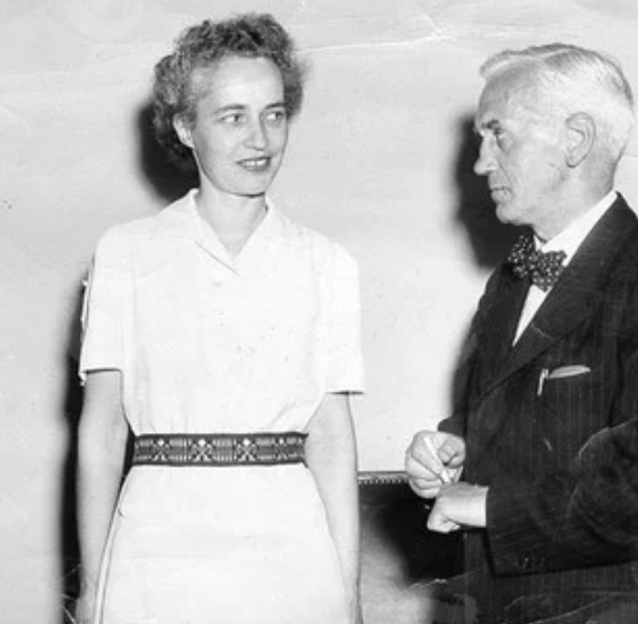
US Penicillin Production
Florey and Heatley convinced Merck, ER Squibb and Sons, Pfizer and Lederle Labs to produce penicillin
March 1942, Anne Miller was first patient saved by penicillin at Yale
  Exhausted the entire U.S. supply of penicillin

Slide 19
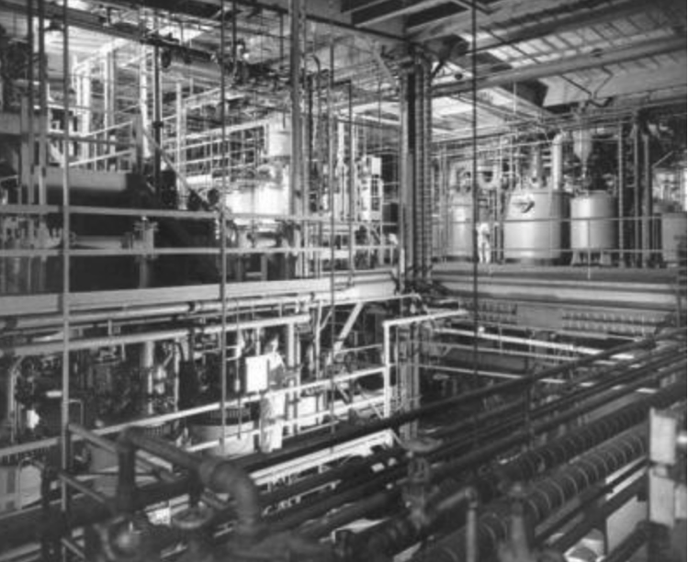
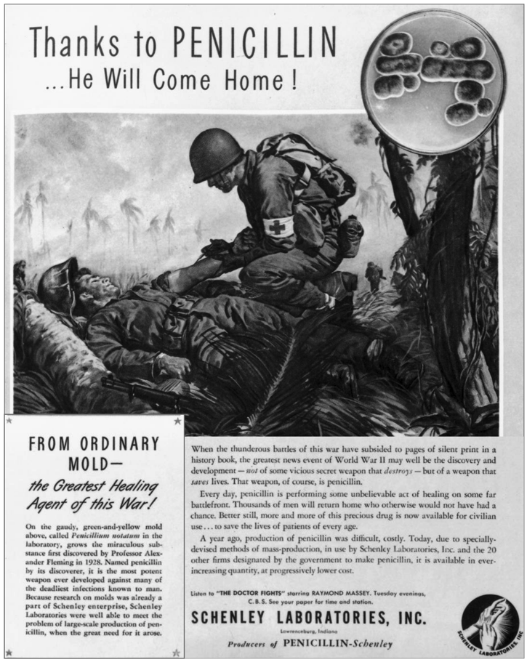
Fermentation tanks to make penicillin at Pfizer during WWII
By D-Day (1944), 21 US Companies produced 2.3 million doses

Slide 20
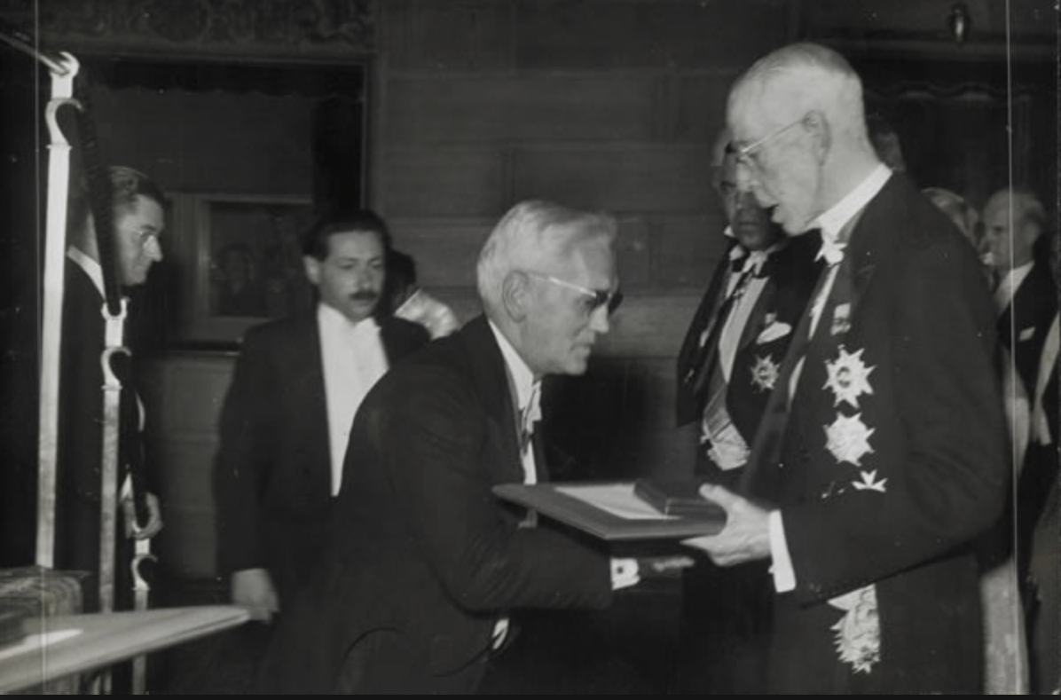
Fleming, Chain and Florey Receiving Nobel Prize
1945

Slide 21
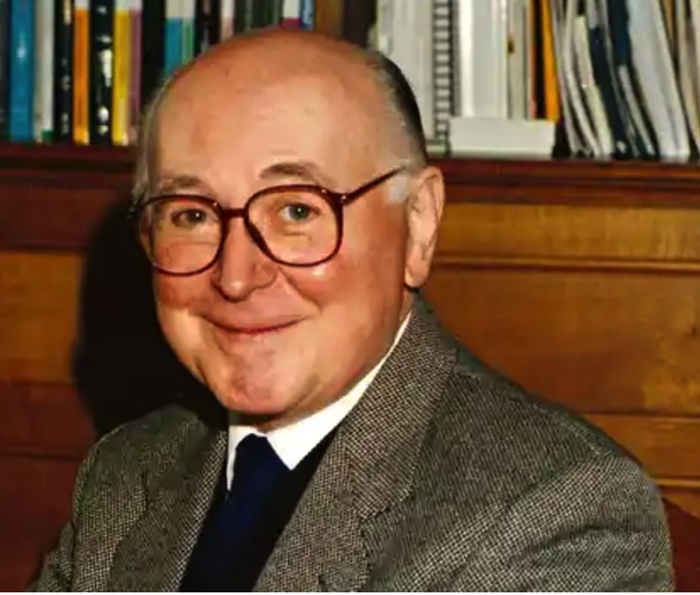
“..without Fleming, no Florey or Chain, without Chain no Florey, without Florey no Heatley, without Heatley no penicillin.”
Sir Henry Harris who succeeded Florey as Oxford’s Chair of Pathology
Norman Heatley received an honorary Doctorate of Medicine from Oxford in 1990, the 1st in 800 years

Slide 22
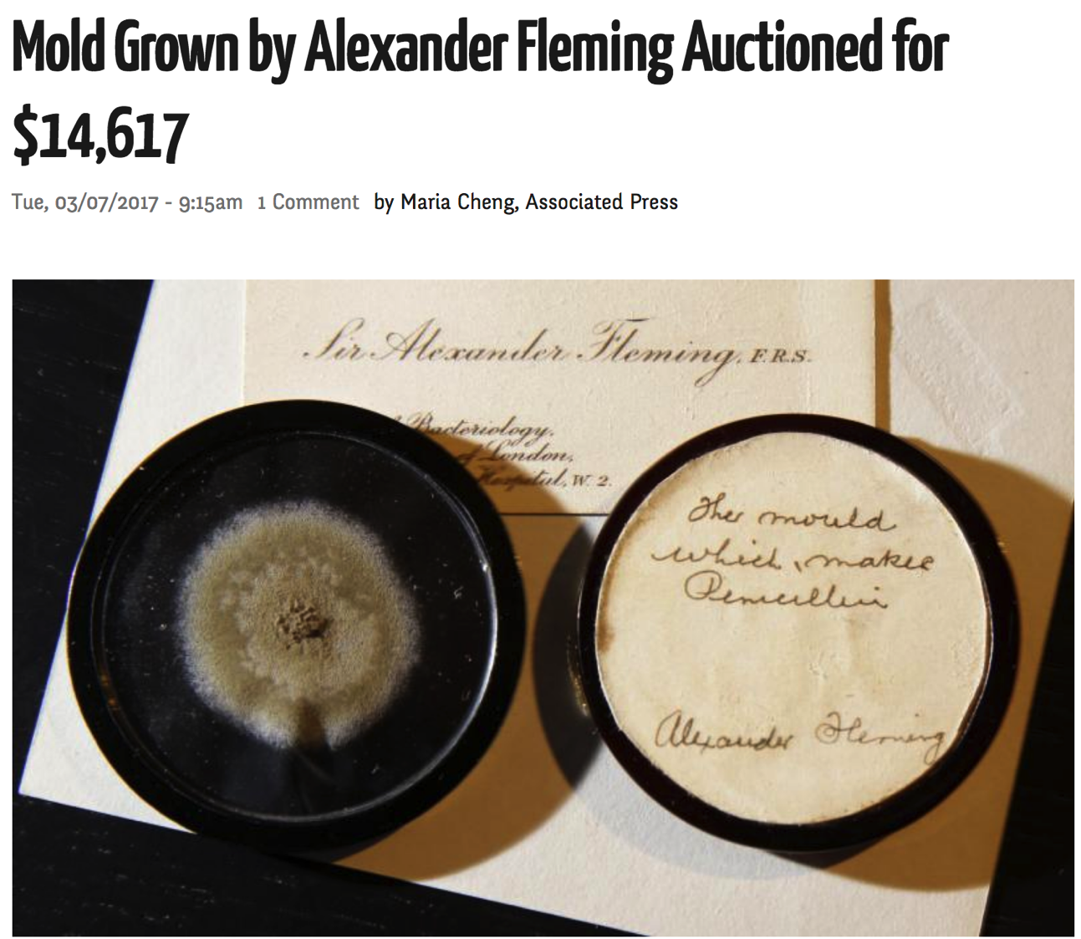
Notes:
Penicillin medallion

Slide 23
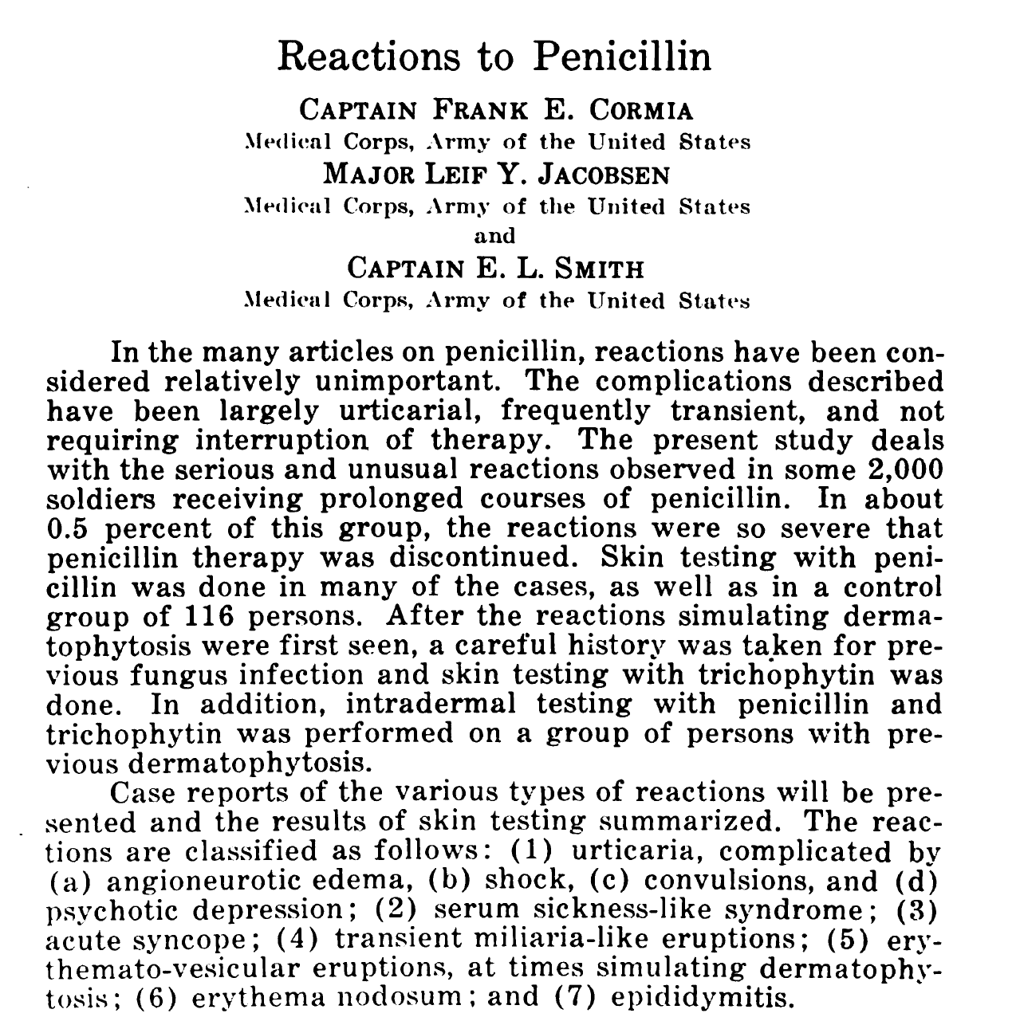
Bull U S Army Med Dep. 1945;4:694-702.

Slide 24
Phenotypes of Penicillin Allergic Reactions

Slide 25
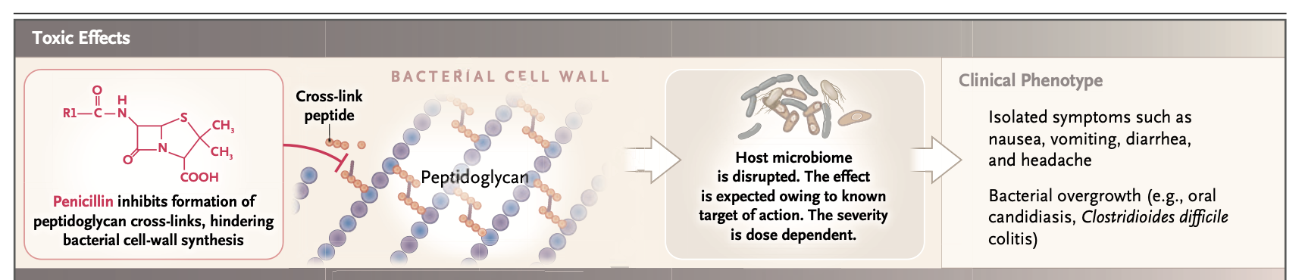
Toxic Effects
Castells MC, Khan DA, Phillips EC. N Engl J Med 2019;381:2338-51.

Slide 26
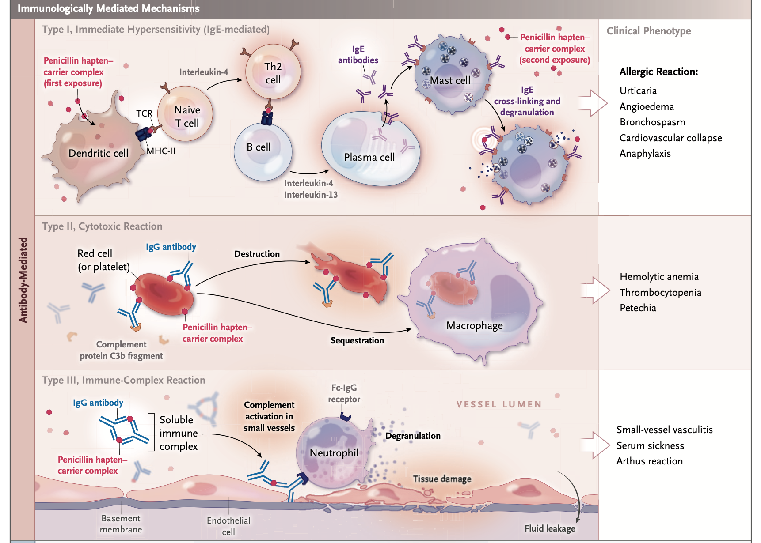
Toxic Effects
Castells MC, Khan DA, Phillips EC. N Engl J Med 2019;381:2338-51.

Slide 27
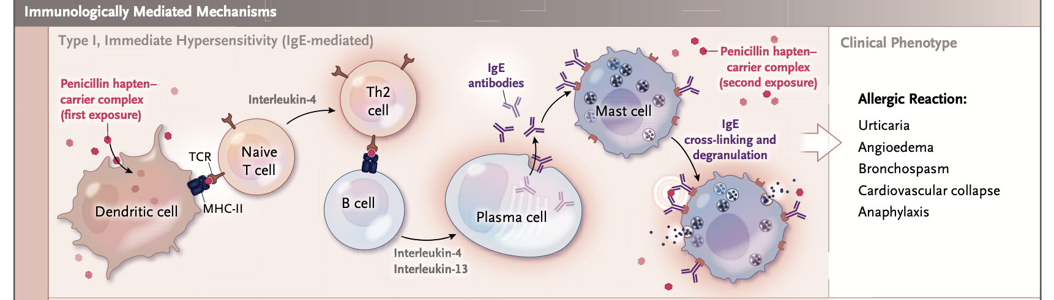
Immediate: IgE-mediated
Castells MC, Khan DA, Phillips EC. N Engl J Med 2019;381:2338-51.

Slide 28
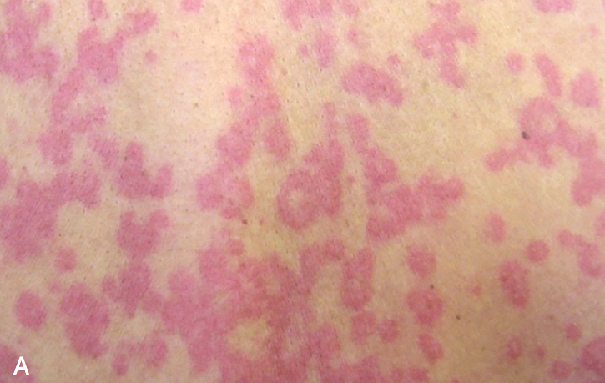
Drug-Induced
Urticaria & Angioedema
Urticaria
Multiple mechanisms: IgE, pseudoallergic, serum sickness, bradykinin
Angioedema
Joshi SR, Khan DA. Pediatric Allergy: Principles and Practice. 4th ed. 2021

Slide 29
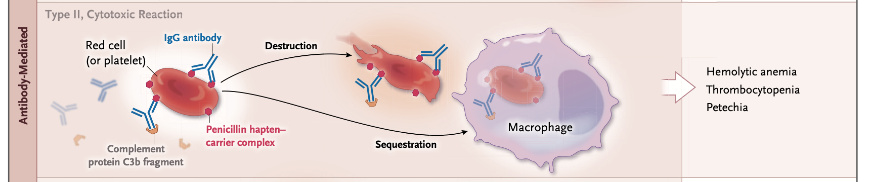
Antibody-Dependent Cytotoxicity
Castells MC, Khan DA, Phillips EC. N Engl J Med 2019;381:2338-51.

Slide 30
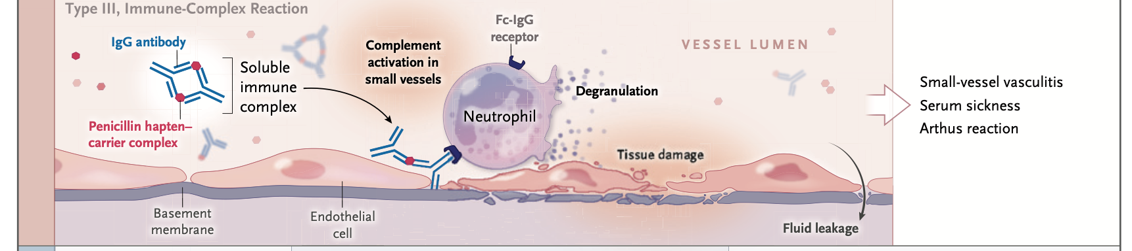
Immune-Complex Reactions
Castells MC, Khan DA, Phillips EC. N Engl J Med 2019;381:2338-51.

Slide 31
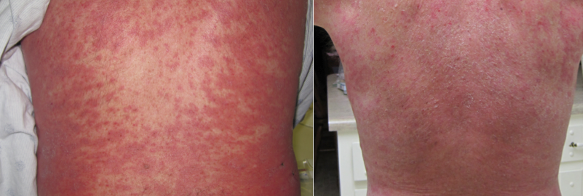
Morbilliform Drug Eruption
Most Common Delayed Hypersensitivity Reaction
Acute (Hospital)
Days Later (Home)
31

Slide 32
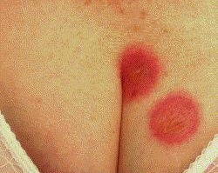
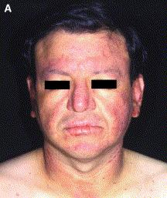
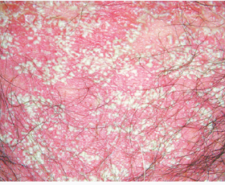
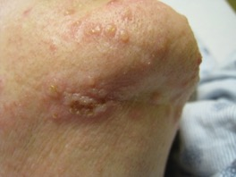
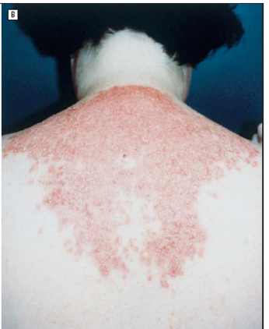
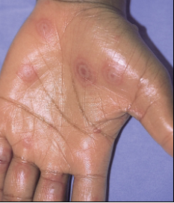
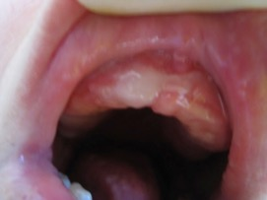
Delayed
Cutaneous Drug Eruptions
32

Slide 33
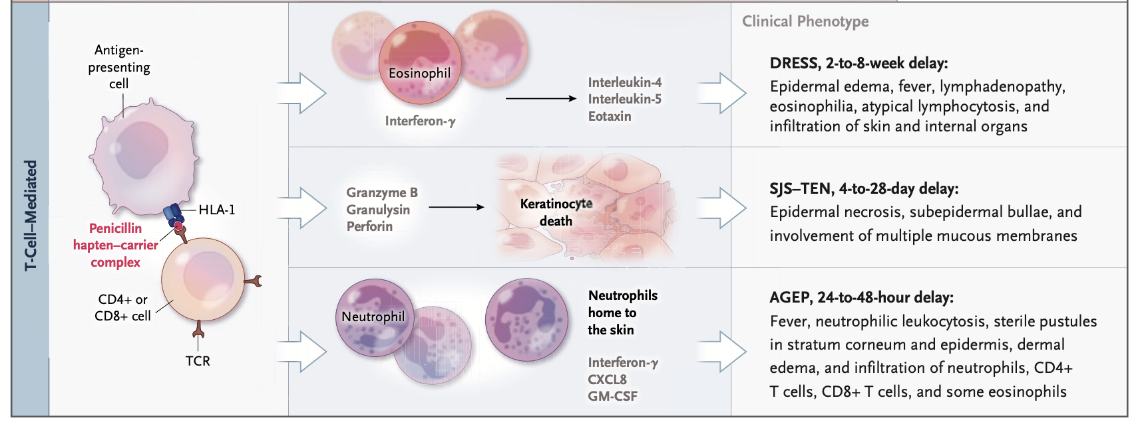
Severe Cutaneous Adverse Reactions
SCAR
Castells MC, Khan DA, Phillips EC. N Engl J Med 2019;381:2338-51.

Slide 34
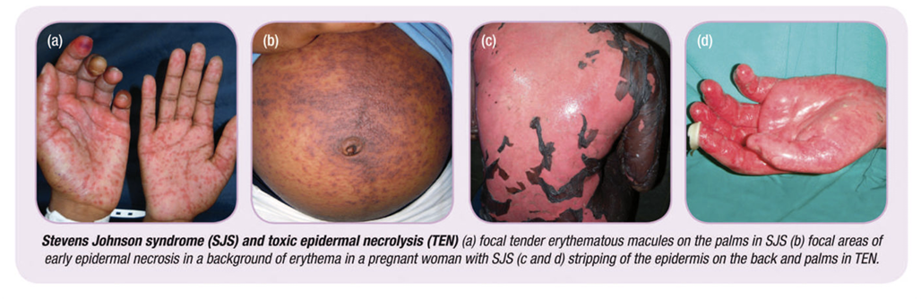
SJS/TEN, DRESS, AGEP
Patients are ill
  Fever, other systemic symptoms
Mortality 5 to >30%
Require multidisciplinary care
Severe Cutaneous Adverse Drug Reactions (SCAR)
Peter JG et al. J Allergy Clin Immunol Pract. 2017;5(3):547–63.
34

Slide 35
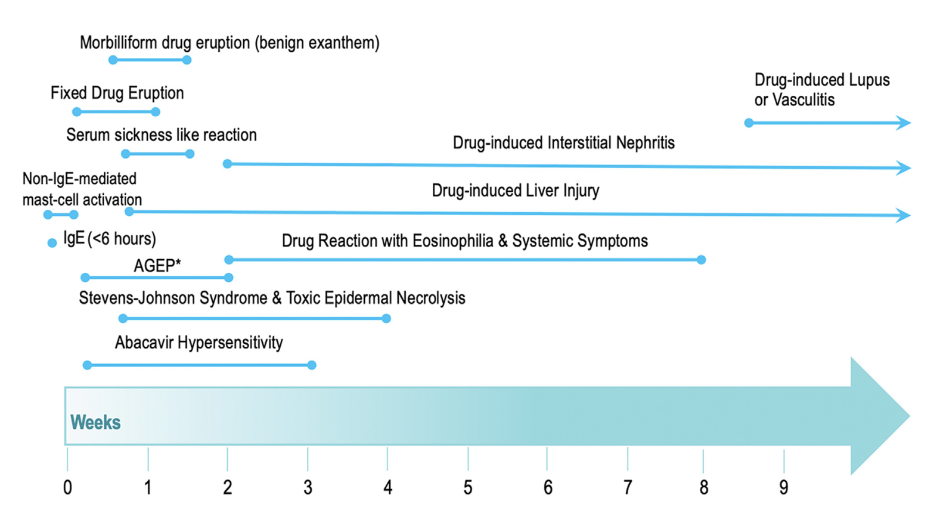
Khan DA et al. J Allergy Clin Immunol 2022;150(6):1333-93.

Slide 36
Why Penicillin Allergy Labels Matter
Castells MC, Khan DA, Phillips EC. NEJM 2019;381:2338-51
Notes:
Figure showing associated Personal and Public Health Burdens of a Penicillin Allergy.

Slide 37
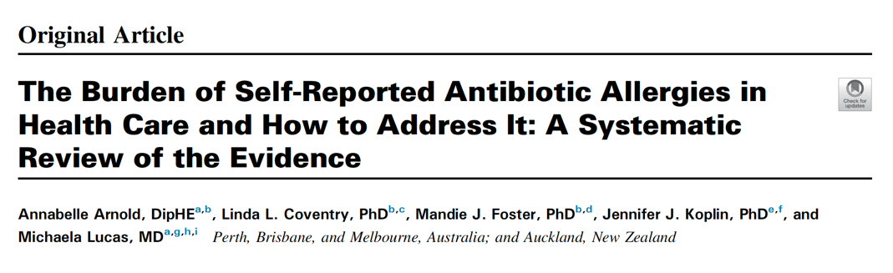
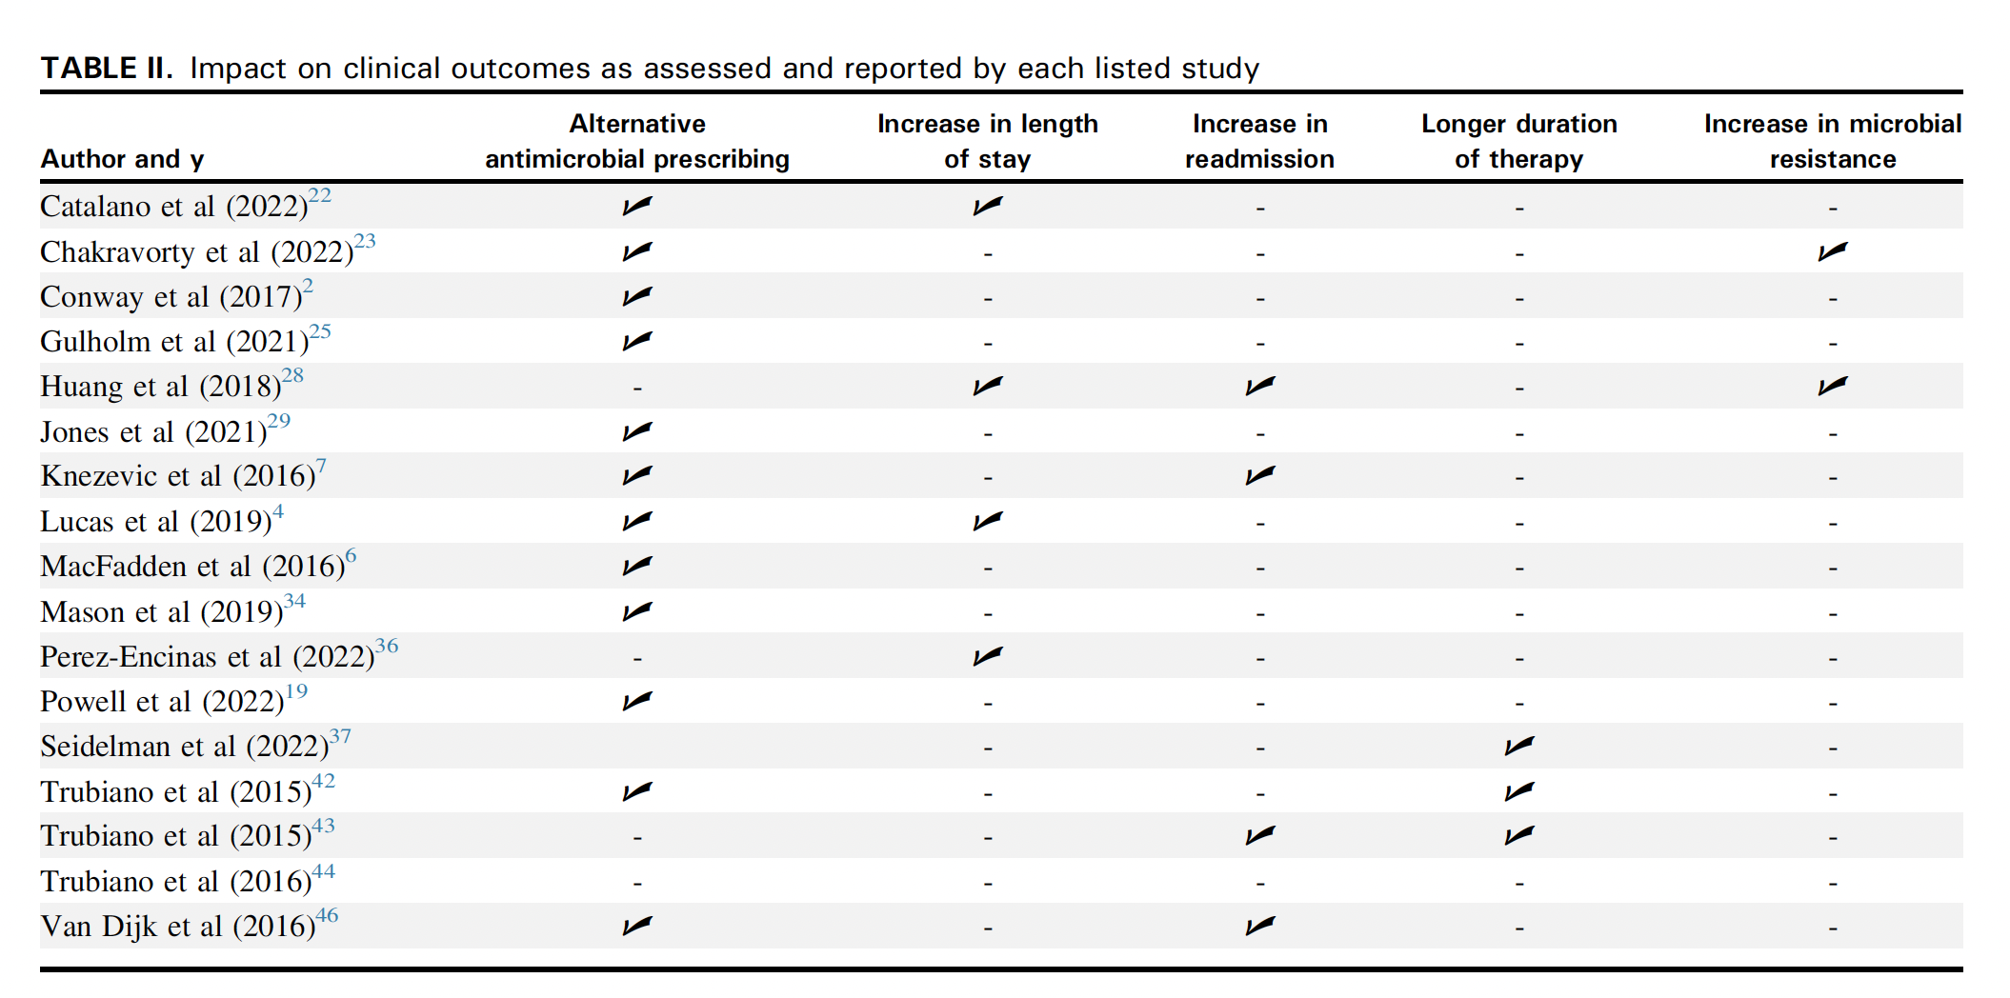
Arnold A et al. J Allergy Clin Immunol Pract. 2023;11(10):3133-45.

Slide 38
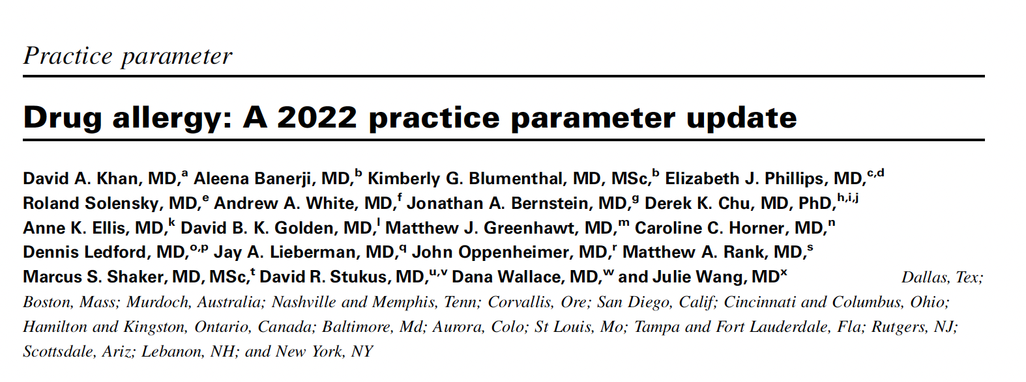
Khan DA et al. J Allergy Clin Immunol 2022;150(6):1333-93.

Slide 39

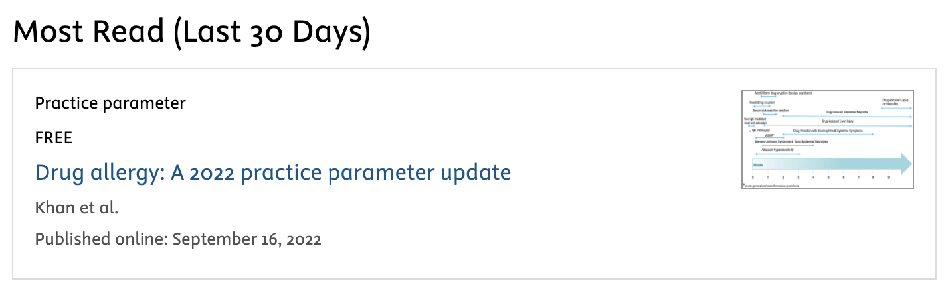

Slide 40

Notes:
Romeo and Juliet

Slide 41
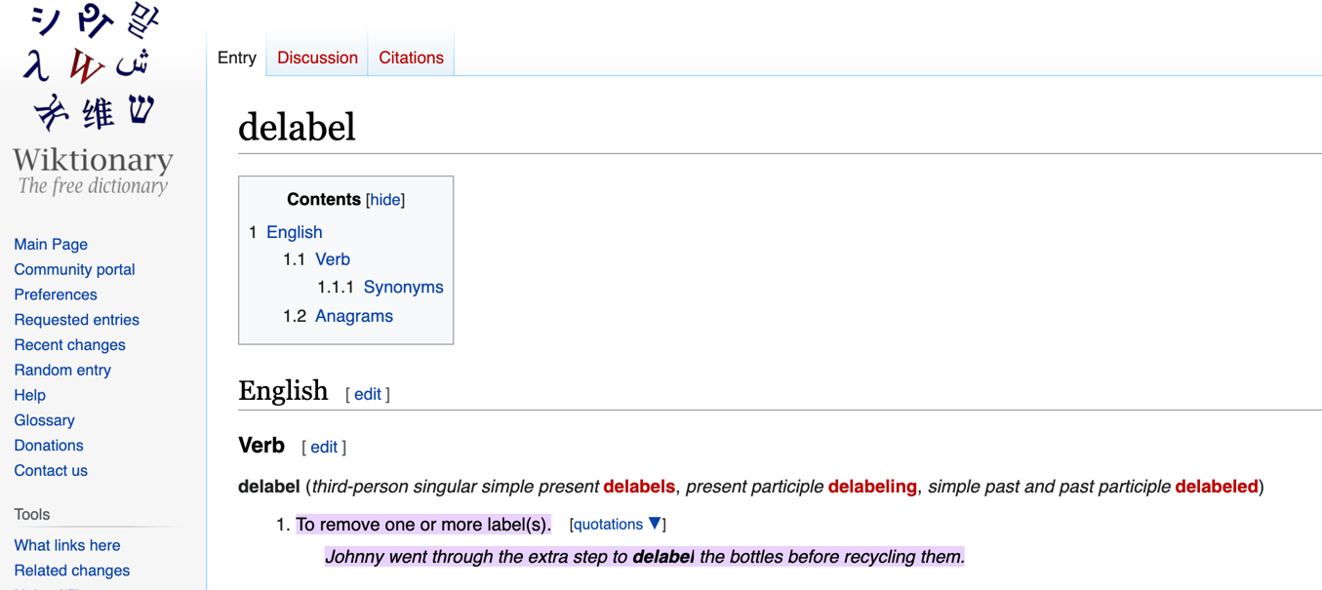
What is delabeling?
To remove one or more labels

Slide 42
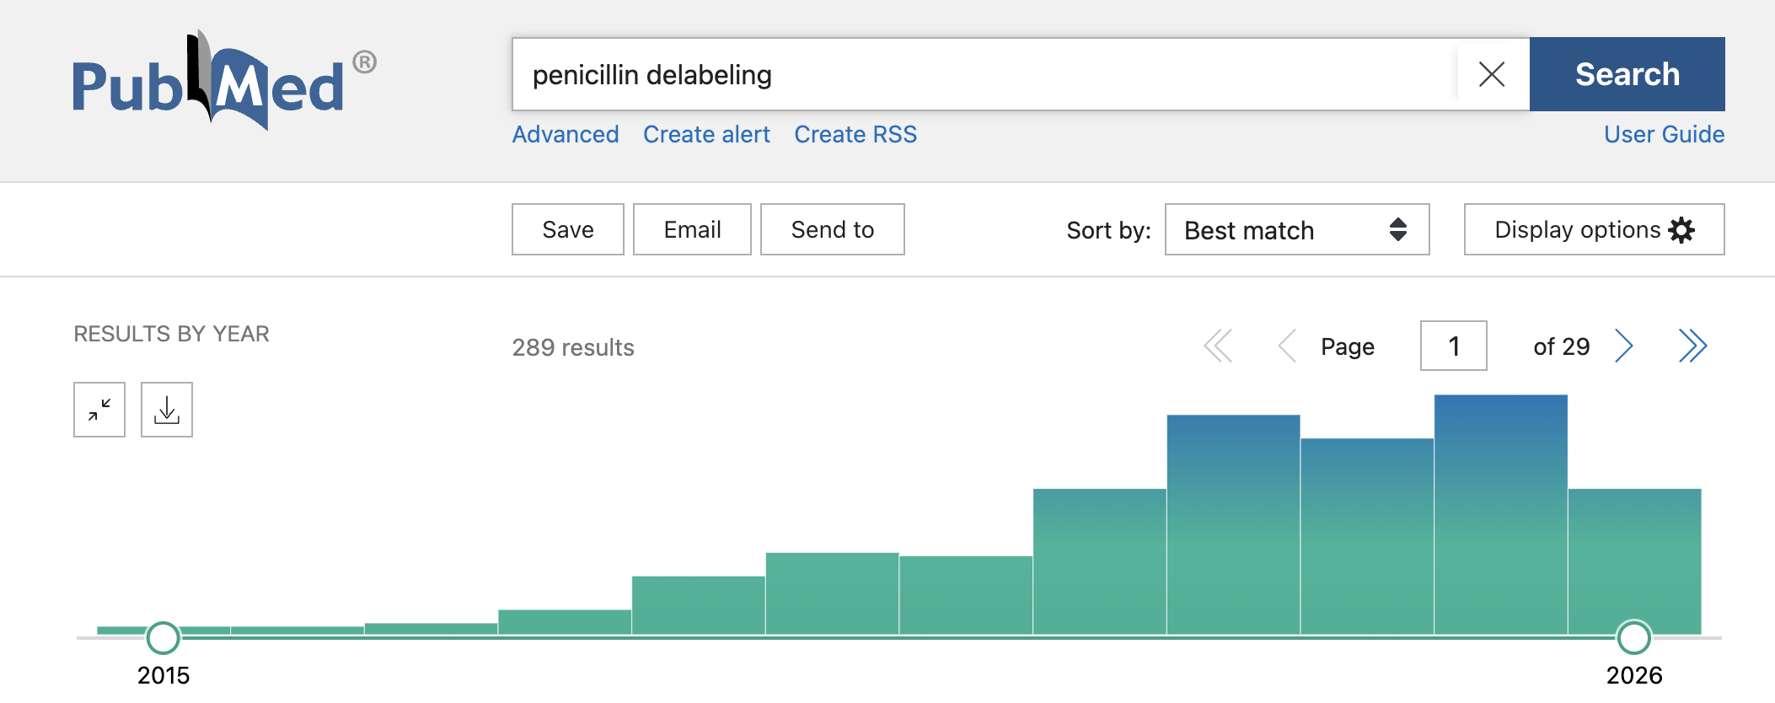

Slide 43
Proactive Penicillin Allergy Delabeling
PARADIGM SHIFT
Consensus Based Statement
We recommend that a proactive effort should be made to delabel a penicillin allergy, if appropriate.
Strength of Recommendation
Strong
Certainty of Evidence
Moderate

Slide 44
Paradigm Shifts in Penicillin Allergy Testing

Slide 45
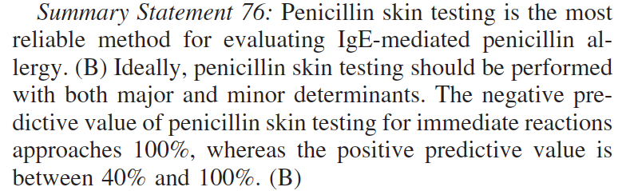
2010 RECOMMENDATIONS
Ann Allergy Asthma Immunol. 2010;105(4):259-73.

Slide 46
Is Penicillin Skin Testing Always Needed?

Slide 47
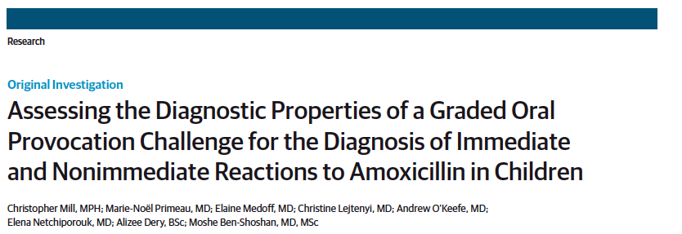
Delabeling via Direct Challenge
Without Skin Testing
818 children direct challenged
94% passed
Mill C, et al. JAMA Pediatr. 2016;170(6):e160033.

Slide 48
Direct Challenges in Children with Amoxicillin Allergy
1914 children underwent direct challenges
94.6% passed
Median age 1.7 yrs
Median time from reaction 1.1 yrs
J Allergy Clin Immunol Pract 2021;9(11):4060-6.
Notes:
Cephalexin has similar but not identical R1 group as amoxicillin

Slide 49

Srisuwatchari W et al. J Allergy Clin Immunol Pract. 2023;11(2):506-18.

Slide 50

Risk of anaphylaxis with Direct Challenge is 1/8000

Slide 51
Penicillin Skin Testing Not Required for Most Children
PARADIGM SHIFT
Consensus Based Statement
We recommend against penicillin skin testing prior to direct amoxicillin challenge in pediatric patients with a history of benign cutaneous reaction (such as morbilliform drug eruptions and urticaria).
Strength of Recommendation
Strong
Certainty of Evidence
Moderate

Slide 52
Penicillin Delabeling in Adults

Slide 53
Direct Amoxicillin Challenge May Be Considered for
Low Risk Patients Labeled with Penicillin Allergy
PARADIGM SHIFT
Consensus Based Statement
We suggest that direct amoxicillin challenge be considered in adults with a history of distant and benign cutaneous reactions (such as morbilliform drug eruptions and urticaria).
Strength of Recommendation
Conditional
Certainty of Evidence
Low

Slide 54

Defining Low Risk in Adults

Slide 55
Eligible for RCT: benign cutaneous only reactions
Age 5-17: reaction > 1 yr ago
Age ≥18: reaction > 10 yrs ago
J Allergy Clin Immunol Pract 2019;7(7):2163–70.

Slide 56
3 reactions with challenge: benign rashes treated with antihistamines
J Allergy Clin Immunol Pract 2019;7(7):2163–70.

Slide 57
PEN-FAST Score=0, NPV of 99.4%
PEN-FAST Score=3, NPV of 96.3%
PEN-FAST Score < 3 excluded severe allergies
JAMA Intern Med. 2020;180(5):745-52.

Slide 58
Duration of Hives May Predict Allergy
Urticaria
  Hives of brief duration: Higher risk
  1-1-1 Rule
    Hives with 1st dose
    Within 1 hour
    Last < 1 day
  Hives of longer duration: low risk
    Hives lasting longer than 1 day
    0/151 studied patients confirmed allergic
Sabato V et al. J Allergy Clin Immunol Pract. 2021;9(10):3697–704.
Romano A et al. J Allergy Clin Immunol Pract. 2025;13(8):2103–14.

Slide 59


Duration of Morbilliform Rash May Predict Allergy
Morbilliform rashes lasting > 4 days
  Higher likelihood of being allergic on testing
  The longer the rash, the more likely allergic
Romano A et al. J Allergy Clin Immunol Pract. 2025;13(8):2103–14.

Slide 60

JAMA Intern Med. 2023;183(9):944-52.

Slide 61

PEN-FAST Score of 0 or 1
JAMA Intern Med. 2023;183(9):944-52.

Slide 62


56 studies of 9225 participants
2053 adults
2.2% of adult challenges had positive challenges
No severe reactions to challenges in adults
Positive challenges lower in inpatients (2.3%) than in outpatients (4.2%)
PEN-FAST used in <8% of challenges
Reactions lower in N America
  different risk stratification?
JAMA Intern Med. 2024;184(11):1374-83.

Slide 63
Other Populations to Delabel
ICU patients
Pregnant patients
Koo G et al. J Allergy Clin Immunol Pract. 2022 Jun;10(6):1660-3 e2.
Mak R et al. J Allergy Clin Immunol Pract 2022 Vol. 10 Issue 7 Pages 1919-1921 e1

Slide 64


ICU patients with PEN FAST < 3 randomized to single dose amoxicillin 250 mg challenge
40 challenged
  No immediate reactions
  1 delayed morbilliform rash
Increased use of penicillin antibiotics in intervention group (OR 4.3)
Intensive Care Med. 2024;50(6):913-21.

Slide 65


Exclusion: < 5 year reaction, angioedema, non-cutaneous symptoms, SCAR
J Allergy Clin Immunol Pract 2025;13:2405-10.

Slide 66

J Allergy Clin Immunol Pract. 2026;14(4):805–15

Slide 67


Slide 68










Videos for Adult Inpatient Delabeling
How to Conduct a Penicillin Challenge in the Hospital
Videos for Pediatric Outpatient Delabeling
Videos for Delabeling in Pregnant Patients

Slide 69


Slide 70


RCT of PCN assessment pathway using risk stratification, skin testing and direct challenge in PCP clinics in the UK
823 patients randomized
7% had reaction within 3 days of test
Lancet Primary Care. 2025;1(1)

Slide 71
Penicillin Skin Testing

Slide 72
When Is Penicillin Skin Testing Indicated?
PARADIGM SHIFT
Consensus Based Statement
We suggest penicillin skin testing for patients with a history of anaphylaxis or a recent
reaction suspected to be IgE-mediated
Strength of Recommendation
Conditional
Certainty of Evidence
Low

Slide 73
Penicillin Skin Testing Reagents
Penicilloyl-polylysine (PPL) is available commercially as PRE-PEN
The only commercially available minor determinant is penicillin G
Value of additional testing with other minor determinants including penicilloate and/or penilloate is unknown

Slide 74

Selective Reactions to
Piperacillin-Tazobactam (TZP)
41 patients with immediate reactions
TZP ST positive in 25/41 (61%)
44% with SPT
66% selectively sensitized to TZP
70% of nonimmediate reactions selectively sensitized
Testing Implications
typical penicillin skin test reagents and/or amoxicillin challenge will miss these patients
J Allergy Clin Immunol Pract. 2021;9(5):2001-9.

Slide 75
Summary
Proactive penicillin allergy delabeling is a priority
Children with non-anaphylactic reactions to penicillins can be delabeled via direct oral challenge
Adults with low-risk histories of penicillin allergy can also be delabeled with direct oral challenges, even by PCPs
RCTs in drug allergy will yield more robust evidence

