Slide 1

Prescription as Prevention
The Essential Role of Penicillin Allergy Evaluation in Reducing Risk of Healthcare-Associated Infections and Antimicrobial Resistance
Erica S. Shenoy, MD, PhD
Chief of Infection Control, Mass General Brigham
Physician, Infectious Diseases, Mass General Brigham
Associate Professor, Harvard Medical School
September 2026

Slide 2
Roadmap
The relationship between penicillin allergy and healthcare associated infection
How penicillin allergy contributes to risk of Clostridioides difficile infection and antimicrobial resistance
How addressing penicillin allergies can improve patient care

Slide 3
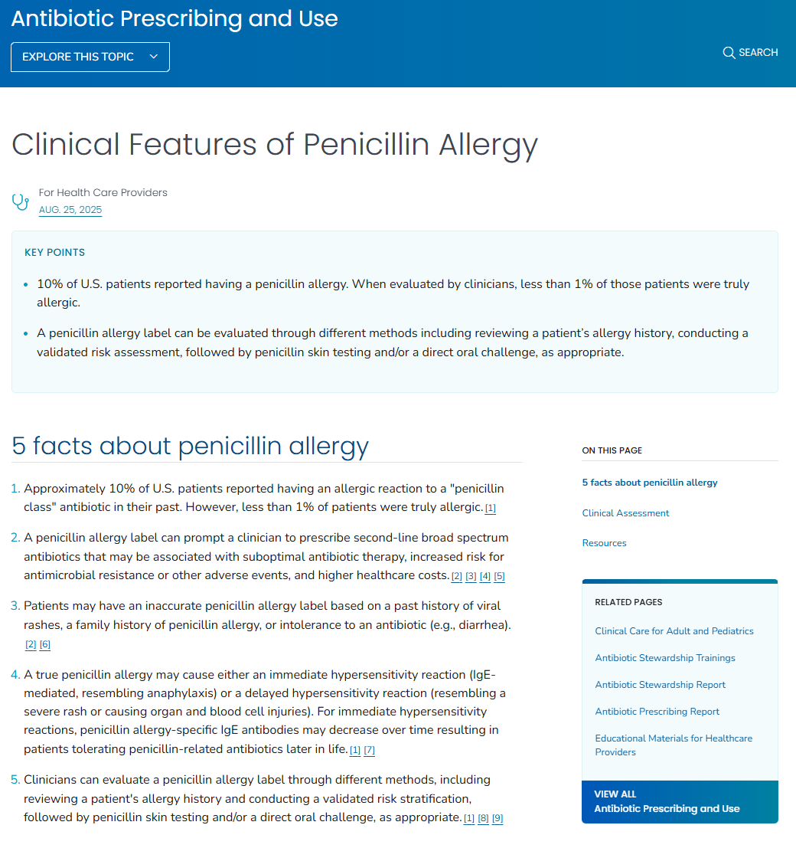
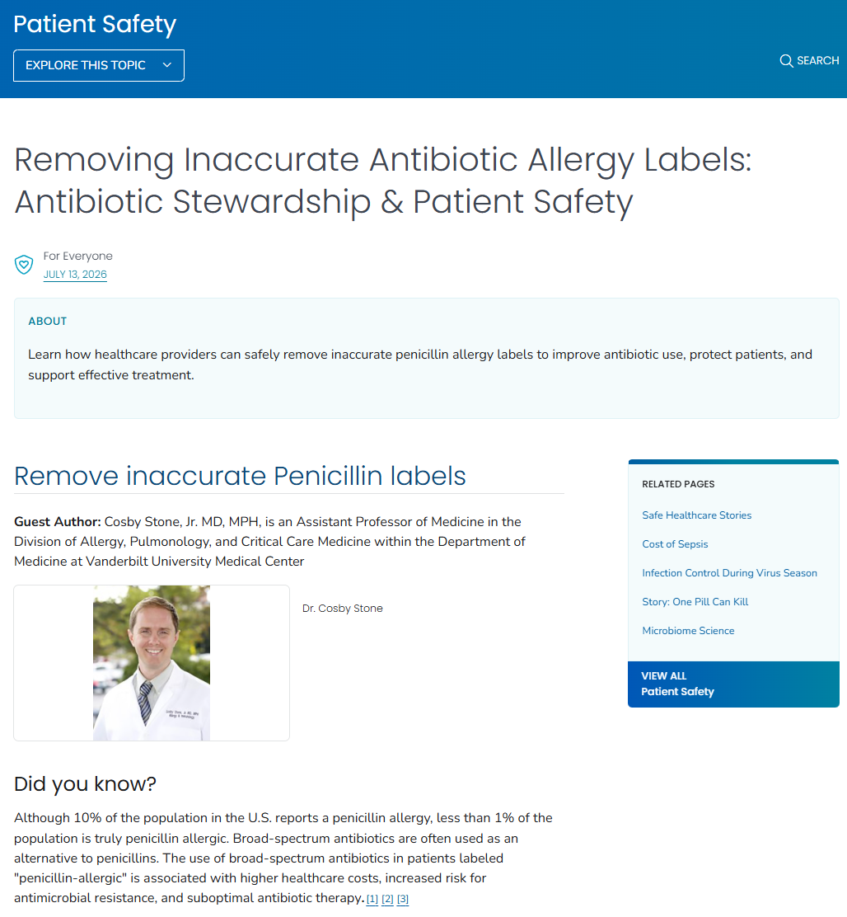
A core concept in Antibiotic Stewardship with Implications for Infection Prevention
Choose the right antimicrobial, for the right patient, and administer at the right time, for right duration
https://www.cdc.gov/antibiotic-use/hcp/clinical-signs/index.html; https://www.cdc.gov/patient-safety/stories/antibiotic-stewardship-and-allergy-labels.html

Slide 4
A story

Slide 5
This could be your patient, your family member or loved one
78F admitted for CABG
Labeled as allergic to cephalexin “unspecified”
Receives vancomycin and ciprofloxacin for procedural prophylaxis and develops SSI

Slide 6
Penicillin allergy and risk of healthcare associated infections

Slide 7
ß-lactam antibiotics are workhorses in infection prevention and treatment of a wide range of infectious diseases
Prevention
Treatment
Peri-operative antibiotic prophylaxis to prevent surgical site infections (SSIs)
Prophylaxis prior to dental procedures for select patient populations to prevent infective endocarditis
Streptococcus spp
Listeria monocytogenes
Actinomyces spp
Cutibacterium acnes
Staphylococcus aureus
Pasteurella multocida
Neisseria gonorrhea
Neisseria meningitidis
Treponema pallidum (syphilis)
Patients with penicillin allergy label are more likely to be prescribed alternative, non-ß lactam antibiotics which are inferior to first-line antibiotic choice

Slide 8


What is the burden of SSIs in the United States?
> 100,000 patients per year develop an SSI
Increased risk of death; varies by procedure, type of SSI (deep vs superficial), age and other factors
Costly
  Higher total medical costs
  Range from $6,500-$49,385 (weighted average of $29,414)
  Patients who develop SSIs have higher out of pocket costs as well
Major driver: Length of stay and readmission
  Average 5-17 days extended LOS if SSI diagnosed on index admission
  Majority of patients who develop SSI require readmission
Chea N, Li R, Eure T, Alkis Ramirez R, Nadle J, Lee JE, Lehmann M, Sardenga L, Czaja CA, Johnston H, Kellogg M, Emanuel C, Cilwick A, Correa MA, Maloney M, Ray SM, Howard-Anderson J, Carswell S, Wilson LE, Perlmutter R, Marceaux-Galli K, Mahoehney JP, Lynfield R, Sievers M, Cline C, Judson M, Dumyati G, Hurley C, Keller E, Walsh M, Licherdell E, Tellerman J, Pierce R, Ocampo VLS, Samper ME, Hires KA, Adrian LT, Tammer RP, Zhang A, Hiratzka S, Dusko A, Wilson C, Harriott M, Smith H, Russo V, Boswell L, Godfrey D, Leaptrot D, McMeen M, Otis M, Watkins J, Taylor A, Allen R, Thompson ND, Edwards JR, Magill SS, Grigg CT. Health Care-Associated Infections in U.S. Hospitals, 2023 versus 2015. N Engl J Med. 2026 Jul 16;395(3):255-266. doi: 10.1056/NEJMoa2510881. PMID: 42456137; PMCID: PMC13374708; Shambhu S, Gordon AS, Liu Y, Pany M, Padula WV, Pronovost PJ, Hsu E. The Burden of Health Care Utilization, Cost, and Mortality Associated with Select Surgical Site Infections. Jt Comm J Qual Patient Saf. 2024 Dec;50(12):857-866. doi: 10.1016/j.jcjq.2024.08.005. Epub 2024 Aug 24. PMID: 39384467.

Slide 9
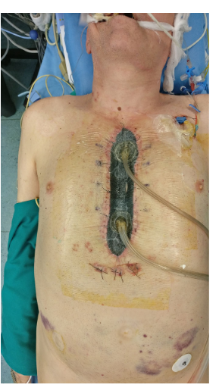
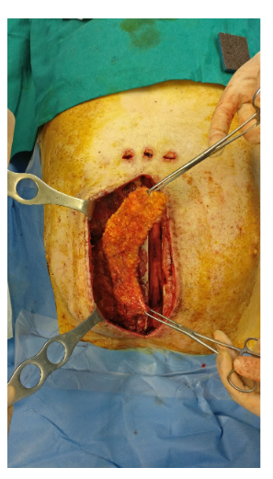
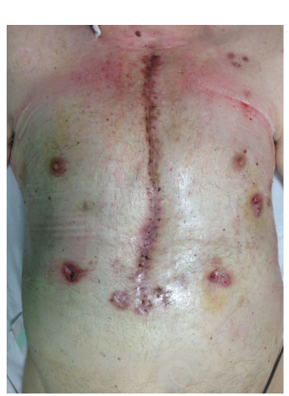
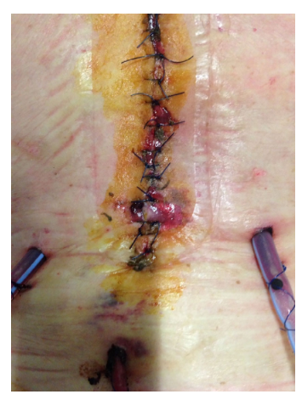
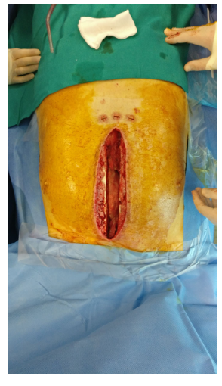
SSI after Cardiac Surgery
Sternal wound infection
30 days after surgery
Surgical debridement
VAC therapy
Wound closure with muscle flap
Lo Torto F, Turriziani G, Donato C, Marcasciano M, Redi U, Greco M, Miraldi F, Ribuffo D. Deep sternal wound infection following cardiac surgery: A comparison of the monolateral with the bilateral pectoralis major flaps. Int Wound J. 2020 Jun;17(3):683-691. doi: 10.1111/iwj.13324. Epub 2020 Feb 17. PMID: 32065728; PMCID: PMC7948840.
Notes:
Costs include extended hospitalization, antibiotic therapy (often with PICC line, extended IV course), re-operations/additional procedures, VAC. IN ADDITION to lost patient productivity, etc.

Slide 10


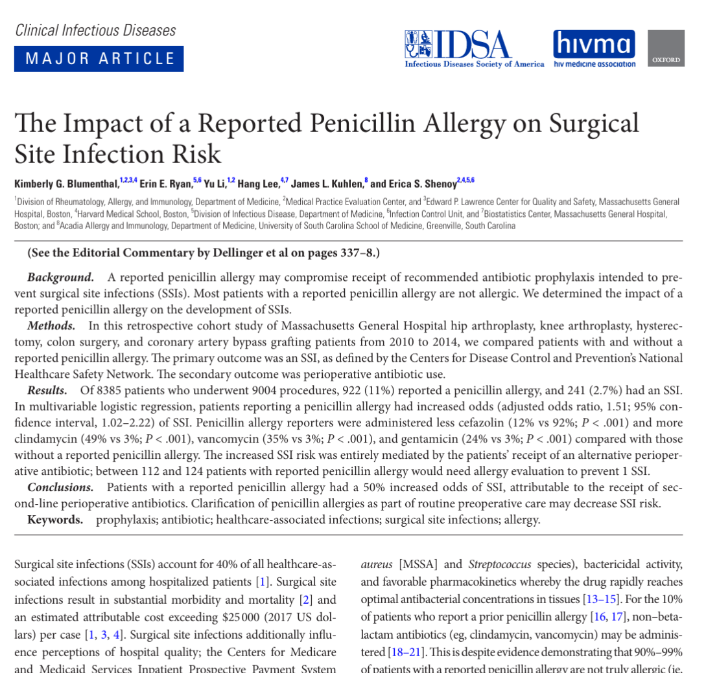
Why a history of ß-lactam allergy matters: prevention of SSIs
β-Lactam antibiotics are among the safest and most effective antibiotics
  About 10% of patients have a penicillin (PCN) allergy noted in their medical record, however, 95% do not have a true Type 1 allergy (urticaria, angioedema, anaphylaxis)
The β-Lactam antibiotic cefazolin is a workhorse for perioperative antibiotic prophylaxis
  Patients with reported PCN allergy have a 50% increased risk of SSI, mediated through use of alternatives to cefazolin (e.g., vancomycin, clindamycin)
Use of alternatives to cefazolin also increases risk of antimicrobial resistance and C diff
Shenoy ES, Macy E, Rowe T, Blumenthal KG. Evaluation and Management of Penicillin Allergy: A Review. JAMA. 2019 Jan 15;321(2):188-199. doi: 10.1001/jama.2018.19283. PMID: 30644987; Blumenthal KG, Ryan EE, Li Y, Lee H, Kuhlen JL, Shenoy ES. The Impact of a Reported Penicillin Allergy on Surgical Site Infection Risk. Clin Infect Dis. 2018 Jan 18;66(3):329-336. doi: 10.1093/cid/cix794. PMID: 29361015; PMCID: PMC5850334.
Notes:
Study of ~9000 surgical procedures performed at MGH found that patients with reported pcn allergy had 50% increased risk of SSI

Slide 11

Thank you
I used AI.

Slide 12

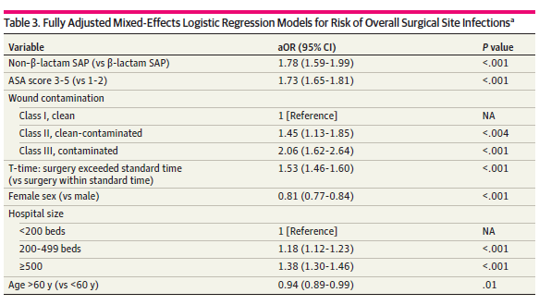
Non ß-lactam use for surgical prophylaxis is associated with increased SSI incidence
Methods
  Cohort study including 175 Swiss hospitals including patients who underwent procedures from 2009-2020
  Primary outcome: NHSN defined SSI
Results
  Among 538,976 patients, 98.3% received ß-lactam antibiotic prophylaxis
  2.8% of patients who received ß-lactam antibiotics developed SSIs compared to 6.1% who received non ß-lactam antibiotics
  Non ß-lactam antibiotic use associated with higher SSI rate: aOR 1.78
Largiadèr S, Berthod D, Widmer A, Troillet N, Jackson H, Perdrieu C, Harbarth S, Sommerstein R; Swissnoso Group. β-Lactam vs Non-β-Lactam Antimicrobial Prophylaxis and Surgical Site Infection. JAMA Netw Open. 2025 Oct 1;8(10):e2540809. doi: 10.1001/jamanetworkopen.2025.40809. PMID: 41171274; PMCID: PMC12579348.

Slide 13

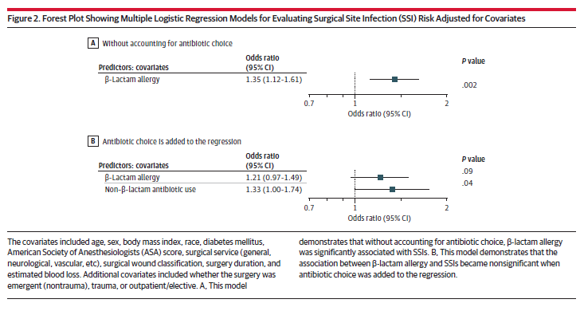
Increased SSI incidence in patients with ß-lactam allergy is partially mediated through use of non ß-lactam antibiotics
Methods
  Retrospective analysis of surgical procedures and infections as defined by the National Healthcare Safety Network (NHSN) between 2021-2024 at two hospitals at UPMC
  A ß-lactam allergy evaluation and management guideline was implemented (9/2022)
  Primary outcome: SSI
Results
  Among 49,279 procedures and 41,1000 patients, 7,177 had documented ß-lactam allergy; 36% received a non ß-lactam
  Procedures with non-ß-lactam use had higher incidence of SSI
  Procedures in patients with reported ß-lactam allergy had higher incidence of SSI
  Mediation analysis found the indirect effect was significant but direct effect was not
    37% of observed association between the allergy label and SSI is due to use of non- ß-lactam antibiotics
Agarwal P, Kumar RP, Oleksiuk LM, Crall V, Petrov AA, McCreary EK, Holder-Murray J, Chang YF, Agarwal N, Hamilton DK, Friedlander RM. Non-β-Lactam Antibiotic Use, β-Lactam Allergy, and Surgical Site Infections. JAMA Surg. 2025 Nov 1;160(11):1260-1267. doi: 10.1001/jamasurg.2025.3789. PMID: 41032329; PMCID: PMC12489799.

Slide 14

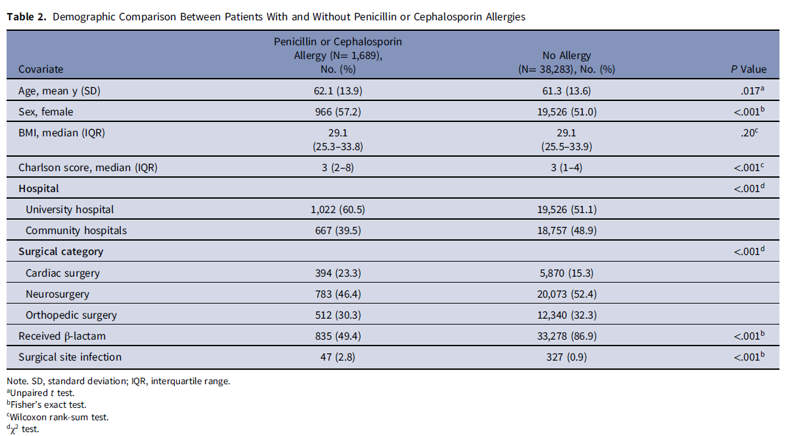
The association between ß-lactam allergy and SSI is not completely mediated through antibiotic prophylaxis
Methods
  Retrospective cohort analysis of patients undergoing procedures at three hospitals from 2013-2017
  Multivariate regression analysis to calculate adjusted OR of SSI in patients with and without a reported penicillin or cephalosporin allergy
  Used effect measure modification (EMM) to assess if choice of surgical prophylaxis affected associated between PCN allergy and SSI
Results
  Among 39,972 procedures, 1,689 had a documented allergy
  374 developed an SSI: 47 (2.8%) had documented allergy and 327 (0.85%) did not have documented allergy; aOR 3.26
  Antibiotic class used for surgical prophylaxis did not have significant EMM on the association of allergy with SSI; authors conclude that reported allergy may be a surrogate marker for unmeasured, confounding factors that predict SSI (e.g., healthcare exposure, patient complexity, socio-economic status)
Seidelman JL, Moehring RW, Weber DJ, Anderson DJ, Lewis SS. The impact of patient-reported penicillin or cephalosporin allergy on surgical site infections. Infect Control Hosp Epidemiol. 2022 Jul;43(7):829-833. doi: 10.1017/ice.2021.232. Epub 2021 Jun 9. PMID: 34105449.
Notes:
48% of patients with beta lactam allergy received cephalosporin in this study

Slide 15

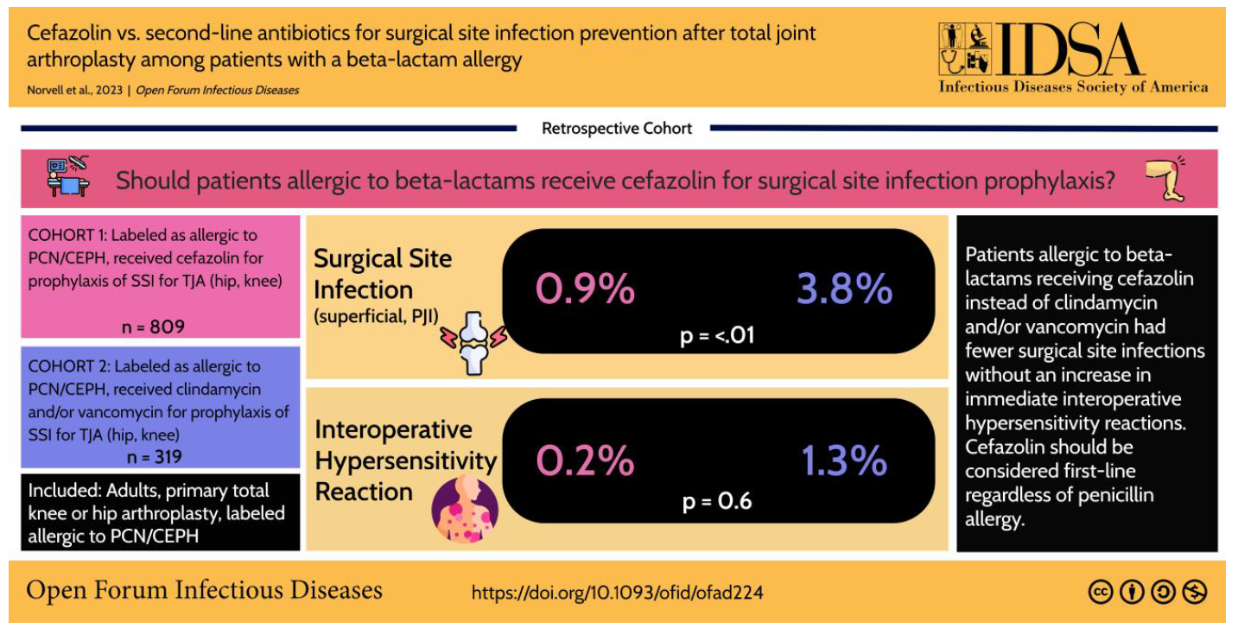
Increased SSI incidence in patients undergoing TJA who received non ß-lactam non ß-lactam antibiotics
Methods
  Retrospective cohort analysis of patients undergoing TJA who had a PCN or cephalosporin allergy label
  Assessed risk of SSI among those who received cefazolin vs those who received alternative antibiotic (clindamycin, vancomycin)
Results
  1128 procedures from 1047 patients included
      809 (71.7%) received cefazolin
      319 (28.3%) received clindamycin or vancomycin or combination
  SSI incidence was 0.9% vs 3.8No differences in hypersensitivity reaction: 0.2% in cefazolin vs 1.3% in clindamycin/vancomycin (p=0.06)
  More gram negative infections in the clindamycin/vancomycin group
Norvell MR, Porter M, Ricco MH, Koonce RC, Hogan CA, Basler E, Wong M, Jeffres MN. Cefazolin vs Second-line Antibiotics for Surgical Site Infection Prevention After Total Joint Arthroplasty Among Patients With a Beta-lactam Allergy. Open Forum Infect Dis. 2023 Apr 24;10(6):ofad224. doi: 10.1093/ofid/ofad224. PMID: 37363051; PMCID: PMC10289809.

Slide 16

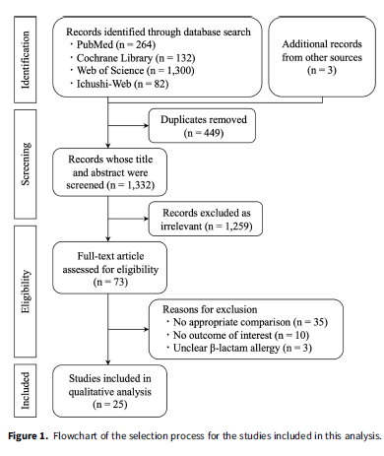
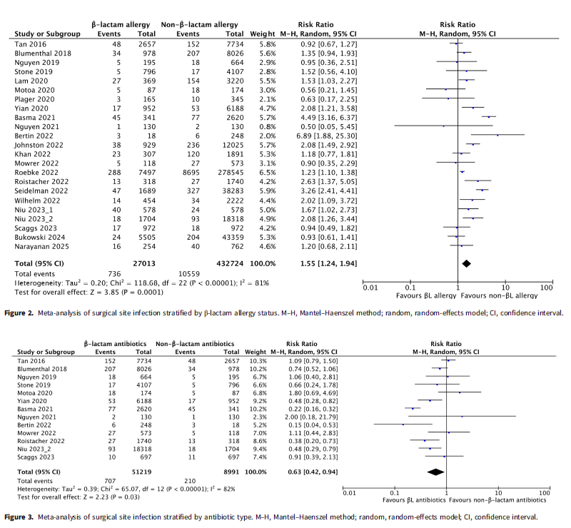
Reported β-lactam allergy is associated with an increased risk of SSI: systematic review and meta-analysis
Hanai Y, Hirai J, Matsuo K, Kouzu K, Shinkawa H, Shinji S, Kobayashi M, Kitagawa Y, Yamashita C, Mohri Y, Nobuhara H, Suzuki K, Shimizu J, Uchino M, Haji S, Yoshida M, Mizuguchi T, Mayumi T, Kitagawa Y, Ohge H. Consequences of reported β-lactam allergy on perioperative outcomes: a systematic review and meta-analysis of surgical site infection risk. Infect Control Hosp Epidemiol. 2025 Nov;46(11):1140-1150. doi: 10.1017/ice.2025.10294. Epub 2025 Sep 10. PMID: 40928127.
Notes:
2000-2025

Slide 17
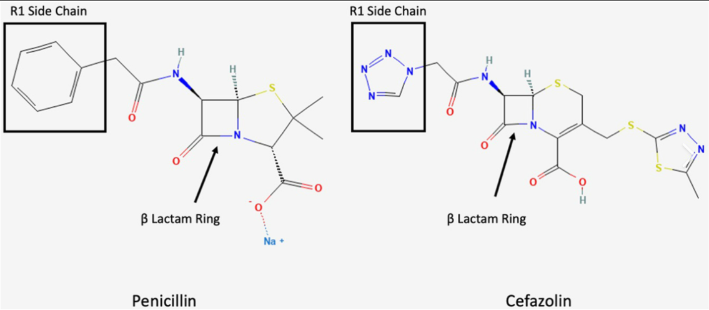
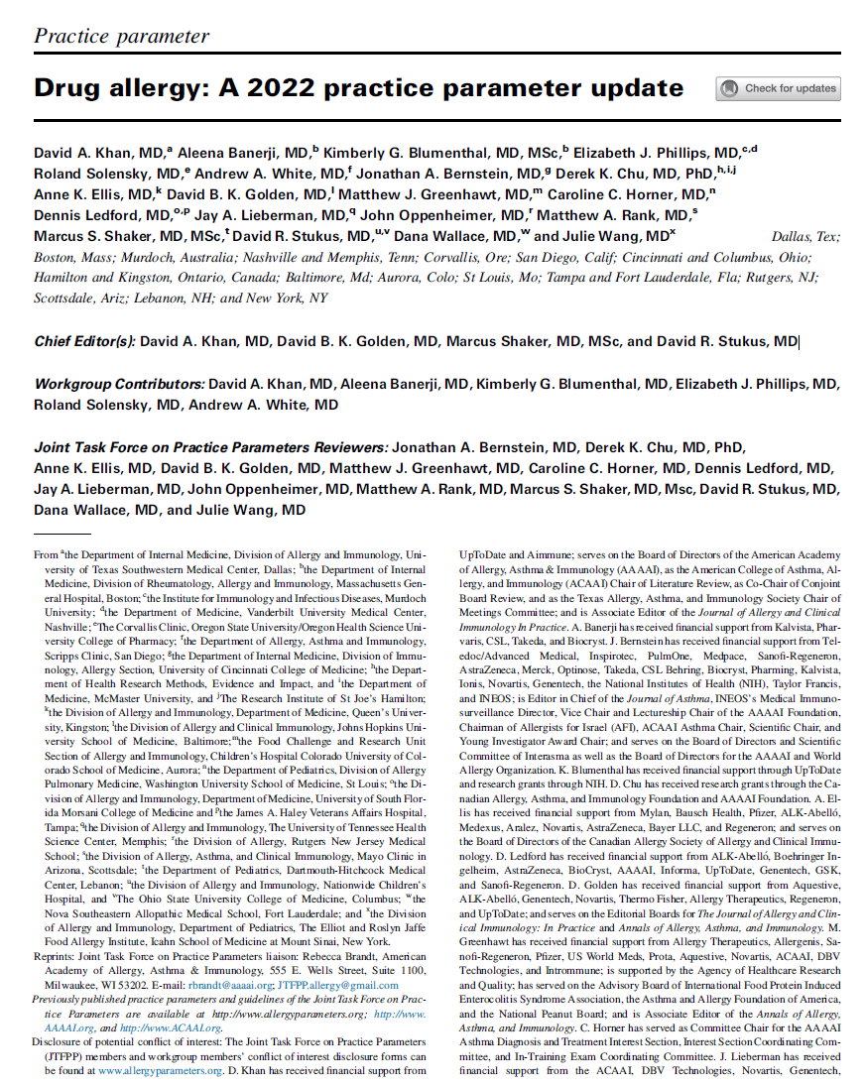
Cefazolin has a unique side chain with very low cross-reactivity with penicillins
Cefazolin has a unique side chain and appears to have very low cross-reactivity with penicillin
  Risk of reaction is rare, even rarer if no history of anaphylaxis with penicillins
  At MGB, we emphasize cefazolin as the primary choice for patients with Type I penicillin hypersensitivity without anaphylaxis history
  If history of PCN anaphylaxis, MGB guideline recommends test dose procedure
This is more conservative than the 2022 AAAAI/ACAAI Joint Task Force Drug Allergy Practice Parameter: “for those rare patients with a history of anaphylaxis to penicillin, a non–cross-reactive cephalosporin (eg, cefazolin) can be administered routinely without prior testing.”
Sousa-Pinto B, Blumenthal KG, Courtney L, Mancini CM, Jeffres MN. Assessment of the Frequency of Dual Allergy to Penicillins and Cefazolin: A Systematic Review and Meta-analysis. JAMA Surg. 2021 Apr 1;156(4):e210021. doi: 10.1001/jamasurg.2021.0021. Epub 2021 Apr 14. PMID: 33729459; PMCID: PMC7970387; Khan DA, Banerji A, Blumenthal KG, Phillips EJ, Solensky R, White AA, Bernstein JA, Chu DK, Ellis AK, Golden DBK, Greenhawt MJ, Horner CC, Ledford D, Lieberman JA, Oppenheimer J, Rank MA, Shaker MS, Stukus DR, Wallace D, Wang J; Chief Editor(s):; Khan DA, Golden DBK, Shaker M, Stukus DR; Workgroup Contributors:; Khan DA, Banerji A, Blumenthal KG, Phillips EJ, Solensky R, White AA; Joint Task Force on Practice Parameters Reviewers:; Bernstein JA, Chu DK, Ellis AK, Golden DBK, Greenhawt MJ, Horner CC, Ledford D, Lieberman JA, Oppenheimer J, Rank MA, Shaker MS, Stukus DR, Wallace D, Wang J. Drug allergy: A 2022 practice parameter update. J Allergy Clin Immunol. 2022 Dec;150(6):1333-1393. doi: 10.1016/j.jaci.2022.08.028. Epub 2022 Sep 17. PMID: 36122788.

Slide 18
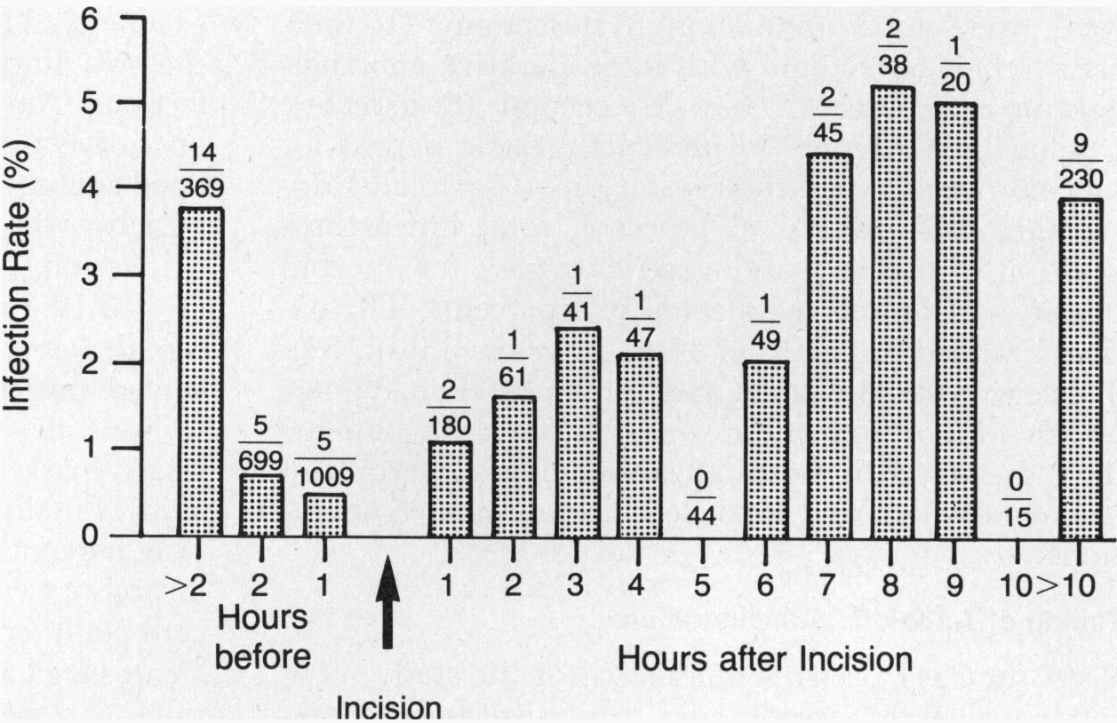
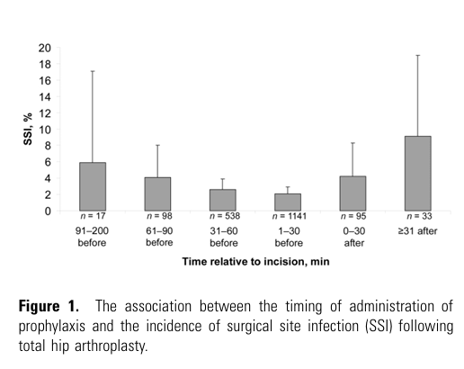
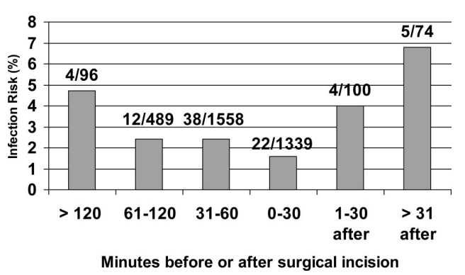
Another advantage of cefazolin…timing
Classen, 1992: 2,847 surgical cases
Van Kasteren, 2007: 1,922 cases
Steinberg 2009: 4,472 surgical cases
Classen DC, Evans RS, Pestotnik SL, Horn SD, Menlove RL, Burke JP. The timing of prophylactic administration of antibiotics and the risk of surgical-wound infection. N Engl J Med. 1992 Jan 30;326(5):281-6. doi: 10.1056/NEJM199201303260501. PMID: 1728731; van Kasteren ME, Manniën J, Ott A, Kullberg BJ, de Boer AS, Gyssens IC. Antibiotic prophylaxis and the risk of surgical site infections following total hip arthroplasty: timely administration is the most important factor. Clin Infect Dis. 2007 Apr 1;44(7):921-7. doi: 10.1086/512192. Epub 2007 Feb 14. PMID: 17342642; Steinberg JP, Braun BI, Hellinger WC, Kusek L, Bozikis MR, Bush AJ, Dellinger EP, Burke JP, Simmons B, Kritchevsky SB; Trial to Reduce Antimicrobial Prophylaxis Errors (TRAPE) Study Group. Timing of antimicrobial prophylaxis and the risk of surgical site infections: results from the Trial to Reduce Antimicrobial Prophylaxis Errors. Ann Surg. 2009 Jul;250(1):10-6. doi: 10.1097/SLA.0b013e3181ad5fca. PMID: 19561486.

Slide 19
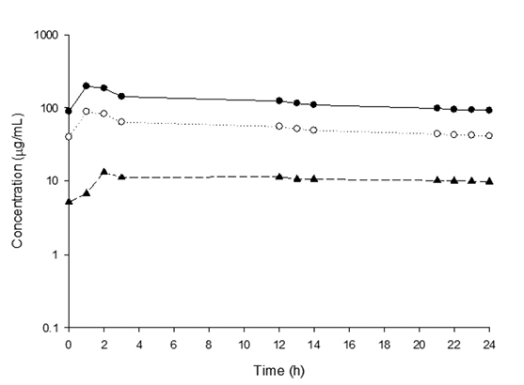
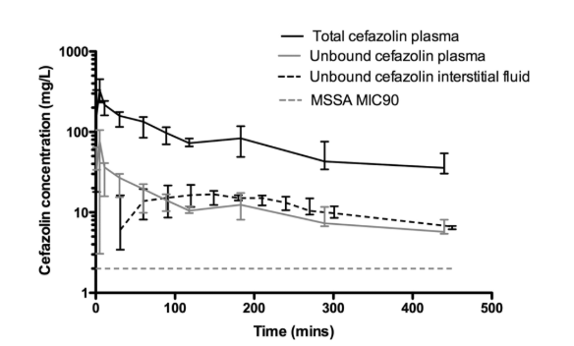
Tissue concentration peak lags behind serum
Exposure profile of cefazolin in serum and tissue in patients with lower limb infections; tissue peaks after serum
Plasma and subcutaneous interstitial fluid concentrations in patients undergoing AAA open repair surgery; cefazolin administered 30 minutes prior
total/free serum
tissue
interstitial fluid
Bhalodi AA, Papasavas PK, Tishler DS, Nicolau DP, Kuti JL. Pharmacokinetics of intravenous linezolid in moderately to morbidly obese adults. Antimicrob Agents Chemother. 2013 Mar;57(3):1144-9. doi: 10.1128/AAC.01453-12. Epub 2012 Dec 17. PMID: 23254421; PMCID: PMC3591894; Douglas A, Udy AA, Wallis SC, Jarrett P, Stuart J, Lassig-Smith M, Deans R, Roberts MS, Taraporewalla K, Jenkins J, Medley G, Lipman J, Roberts JA. Plasma and tissue pharmacokinetics of cefazolin in patients undergoing elective and semielective abdominal aortic aneurysm open repair surgery. Antimicrob Agents Chemother. 2011 Nov;55(11):5238-42. doi: 10.1128/AAC.05033-11. Epub 2011 Aug 22. PMID: 21859939; PMCID: PMC3195052.

Slide 20
Alternative antibiotics have a timing problem.
Evidence supports ß-lactam infusion window within 60 mins prior to incision
SSI is minimized if given within 30 mins prior to incision
Tissue concentrations maximized if infusion is completed ~15-30mins prior to incision
Cefazolin can be pushed over 5 minutes, a large advantage to OR workflows and to achieving ideal timing of antibiotic administration
Alternative antibiotic such as vancomycin and fluoroquinolones require a longer infusion window
Can lead to sub-optimal tissue concentrations→ increased risk of SSI

Slide 21
Penicillin allergy and risk of C diff and Antimicrobial Resistance

Slide 22
What is the burden of Clostridioides difficile infection in the United States?
>500,000 cases/year; of which slightly more than half are healthcare-associated
Morbid
  Increased risk of death from C diff (OR 1.77)
  Increased attributable mortality 10.9%
  Increased risk of readmission at 30 days, 90 days, and 1 year
Costly
  Hospital onset C diff had increased attributable costs that continue for years after initial diagnosis:
      At 1 year $14K, at 3 years $18K, at 5 years $21K (2017 USD)
CDC, 2024, https://www.cdc.gov/healthcare-associated-infections/media/pdfs/2024-CDI-Report-508.pdf; Olsen MA, Stwalley D, Demont C, Dubberke ER. Clostridium difficile infection increases acute and chronic morbidity and mortality. Infect Control Hosp Epidemiol. 2019 Jan;40(1):65-71. doi: 10.1017/ice.2018.280. Epub 2018 Nov 9. PMID: 30409240; PMCID: PMC6624072; Sahrmann JM, Olsen MA, Stwalley D, Yu H, Dubberke ER. Costs Attributable to Clostridioides difficile Infection Based on the Setting of Onset. Clin Infect Dis. 2023 Mar 4;76(5):809-815. doi: 10.1093/cid/ciac841. PMID: 36285546; PMCID: PMC10226732.

Slide 23
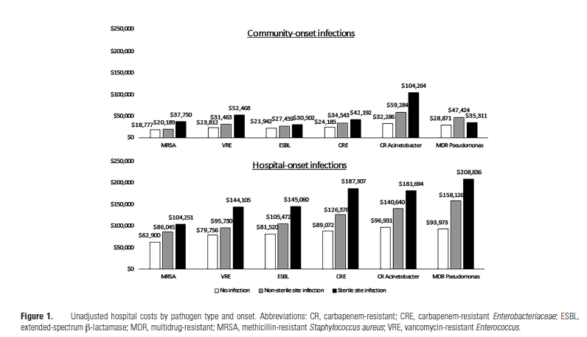
What is the burden of antimicrobial resistance?
> 2.8 million antimicrobial-resistant infections occur each year
> 35,000 deaths
Estimated national cost to treat 6 types of AMR infections > $4.6 Billion/year (2017 USD)
CDC, https://www.cdc.gov/antimicrobial-resistance/data-research/facts-stats/index.html; Nelson RE, Hatfield KM, Wolford H, Samore MH, Scott RD, Reddy SC, Olubajo B, Paul P, Jernigan JA, Baggs J. National Estimates of Healthcare Costs Associated With Multidrug-Resistant Bacterial Infections Among Hospitalized Patients in the United States. Clin Infect Dis. 2021 Jan 29;72(Suppl 1):S17-S26. doi: 10.1093/cid/ciaa1581. PMID: 33512523; PMCID: PMC11864165.

Slide 24

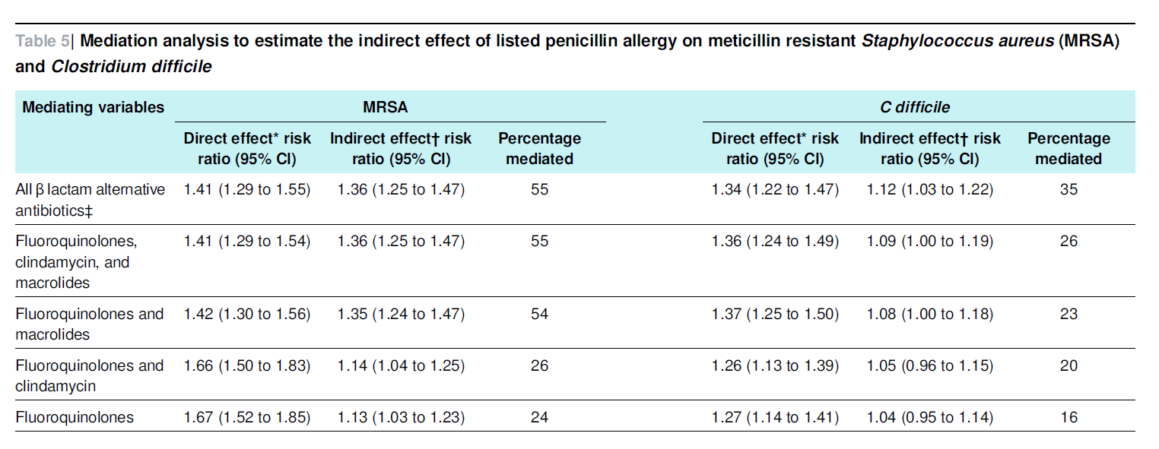
PCN Allergy Associated with Increased Risk of MRSA and C diff due to use of alternatives to ß-lactam antibiotics
Methods
  Population based matched cohort study using NHS data from 1995-2015
  Individuals without prior MRSA or C diff were matched to comparators
  Primary outcome: incident MRSA and C diff
Results
  64,141 with PCN allergy and 237,258 matched comparators
      1365 developed MRSA (442 with PCN allergy, 923 comparators)
      1688 developed C diff (442 with PCN allergy and 1246 comparators)
  aOR MRSA: 1.69; aOR C diff: 1.26
  PCN allergy patients had increased use of macrolides, clindamycin and fluoroquinolones
Increased ß lactam alternative antibiotics accounted for 55% increased risk of MRSA and 35% increased risk of C diff
Blumenthal KG, Lu N, Zhang Y, Li Y, Walensky RP, Choi HK. Risk of meticillin resistant Staphylococcus aureus and Clostridium difficile in patients with a documented penicillin allergy: population based matched cohort study. BMJ. 2018 Jun 27;361:k2400. doi: 10.1136/bmj.k2400. PMID: 29950489; PMCID: PMC6019853.

Slide 25

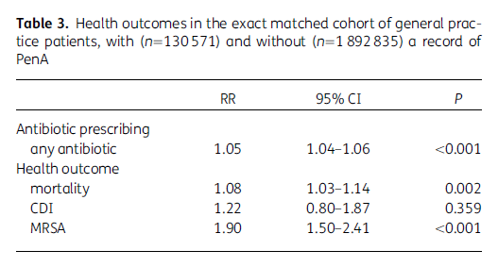
PCN allergy is associated with antibiotic prescribing patterns, MRSA, and mortality
Methods
  3 part study including cross-sectional study, and 2 retrospective cohort studies of patients in NHS general practices from 2013-2014
  Assessed prevalence of PCN allergy, antibiotic prescribing, mortality, MRSA infection/colonization and C diff infection
Results
  2.3 million adult patients, 5.9% with PCN allergy
      More overall antibiotics prescribed to those with PCN allergy
      PCN prescribed less frequently, received macrolides (RR 4.03), tetracyclines (RR 1.91) nitrofurantoin (RR 1.09), trimethoprim (RR 1.04), cephalosporins (RR 2.05), quinolones (RR 2.10), clindamycin (RR 5.47)
      PCN allergy patients had increased risk of death in subsequent year, increased risk of re-prescription of a new antibiotic class within 1 month, and MRSA infection/colonization
      No apparent impact on C diff, possibly due to follow up window
West RM, Smith CJ, Pavitt SH, Butler CC, Howard P, Bates C, Savic S, Wright JM, Hewison J, Sandoe JAT. 'Warning: allergic to penicillin': association between penicillin allergy status in 2.3 million NHS general practice electronic health records, antibiotic prescribing and health outcomes. J Antimicrob Chemother. 2019 Jul 1;74(7):2075-2082. doi: 10.1093/jac/dkz127. PMID: 31225607.
Notes:
Part 1
A cross-sectional study of adult patients in ResearchOne based on their
electronic health records on 1 April 2013. The aim was to identify factors
associated with the record of a PenA, allowing for clustering within practice.
Part 2
A retrospective cohort study with patients matched by the factors identified
in Part 1. Patients were followed for 1 year until 31 March 2014 to establish
the associated impact of a PenA record on several health outcomes.
Part 3
A retrospective cohort study that included only patients prescribed at least
one antibiotic during the study year 1 April 2013 to 31 March 2014. Patient
cohorts with and without a PenA record were matched by the factors identified
in Part 1.

Slide 26

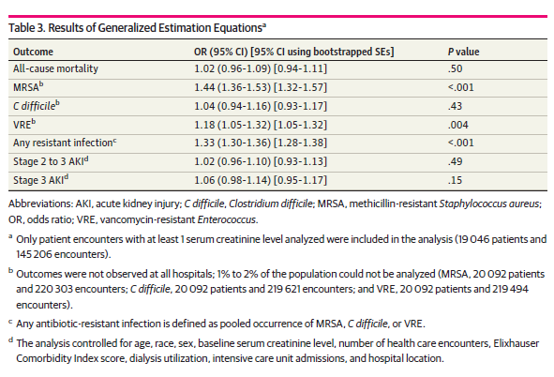
ß-lactam allergies are associated with risk of antimicrobial resistant infections
Methods
  Longitudinal retrospective cohort study at a regional healthcare system in western Pennsylvania for patients with a diagnosis of sepsis, pneumonia, or UTI from 2007-2008, with follow up through 2018 or death
  Outcomes included all cause mortality, MRSA, C diff, VRE, acute kidney injury
Results
  20,092 patients; 4,211 with ß-lactam allergy
  Allergy was not associated with increased mortality, C diff, or AKI
  Allergy was associated with increase in MRSA, VRE, and AMR infections
Gray MP, Kellum JA, Kirisci L, Boyce RD, Kane-Gill SL. Long-Term Outcomes Associated With β-Lactam Allergies. JAMA Netw Open. 2024 May 1;7(5):e2412313. doi: 10.1001/jamanetworkopen.2024.12313. PMID: 38758551; PMCID: PMC11102016.

Slide 27

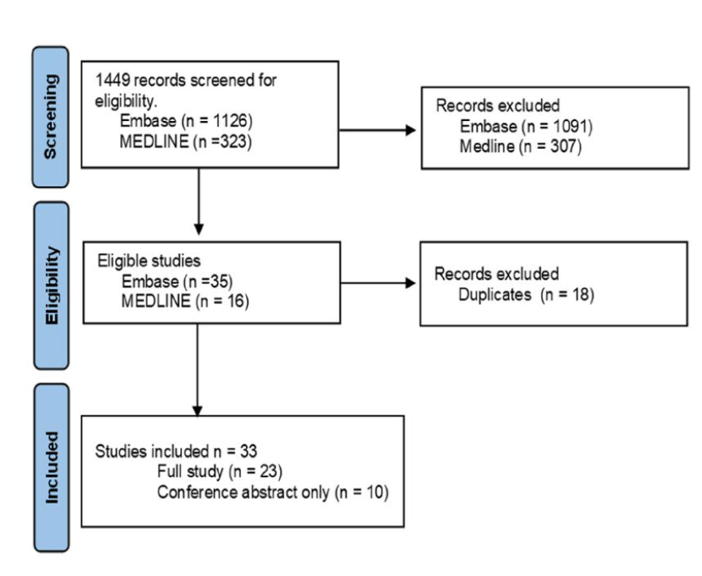
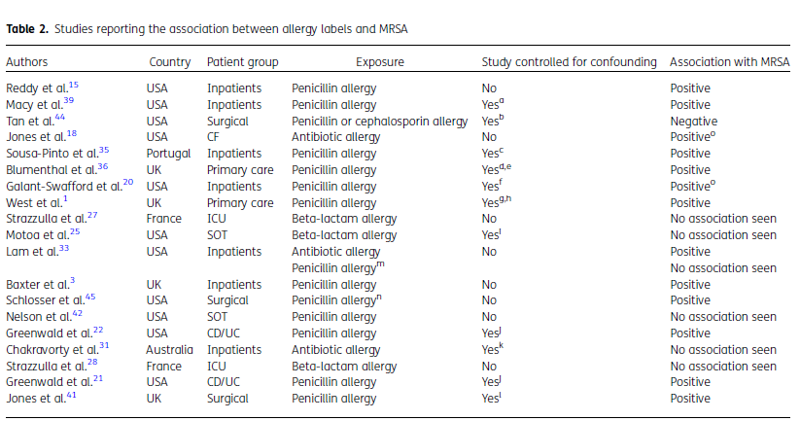
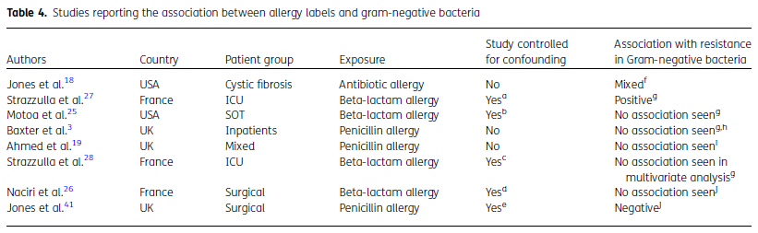
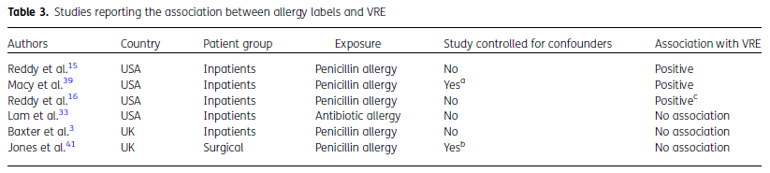
Reported PCN allergy is associated with an increased risk of AMR: systematic review of MRSA, VRE, and GN
Ahmed S, Sandoe JAT. A rapid literature review of the impact of penicillin allergy on antibiotic resistance. JAC Antimicrob Resist. 2025 Jan 21;7(1):dlaf002. doi: 10.1093/jacamr/dlaf002. PMID: 39840325; PMCID: PMC11747217.
Notes:
Conceptually: PCN label leads to increase abx use and increased exposure to broad spectrum abx → AMR
Other factors associated with label (e.g., healthcare exposure)

Slide 28
How addressing penicillin allergy labels can improve patient care

Slide 29
When, who and where, and how?
When
Ideally, before acute need for antibiotic.
Ideally, before acute need for antibiotic.
Who and Where
Many role groups: pharmacists, physicians, advanced practice providers; outpatient, emergency room, operating room, inpatient…
How
History
Test dose/graded challenge
Skin testing
Suppress allergy alerts

Slide 30

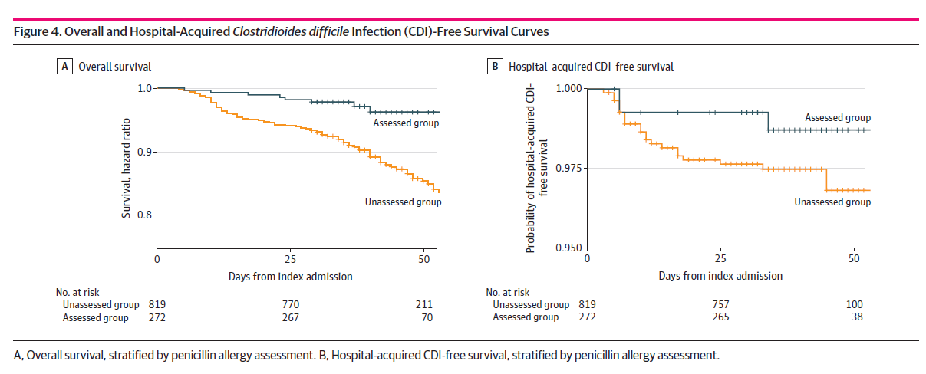
Pharmacist-led allergy assessments associated with reduced use of antibiotics with high risk for C diff
Methods
  Longitudinal cross-sectional study from 2014-2020 of a pharmacist-led allergy assessment program implemented in 2015 (allergy history) and 2016 (comprehensive assessment) at a single hospital; facility wide outcomes included antibiotic days of therapy/1000 PD and HO-C diff/10,000PD
  Case-control study of inpatients with reported PCN allergy in which cases underwent comprehensive allergy assessment and outcomes including antibiotic selection, survival, and C diff-free survival
Results
  Hospital-wide, allergy histories were associated with decreased use of non-PCN alternative antibiotics (RR 0.87) and high C diff-risk antibiotics (RR 0.91)
  PCN skin testing associated with lower hospital onset C diff (RR 0.61)
  Allergy-assessed patients were less likely to receive high C diff-risk antibiotics at discharge (OR 0.66)
  Reductions in mortality and hospital-onset C diff were not significant, however, there was a divergence in survival curves
Turner NA, Wrenn R, Sarubbi C, Kleris R, Lugar PL, Radojicic C, Moehring RW, Anderson DJ. Evaluation of a Pharmacist-Led Penicillin Allergy Assessment Program and Allergy Delabeling in a Tertiary Care Hospital. JAMA Netw Open. 2021 May 3;4(5):e219820. doi: 10.1001/jamanetworkopen.2021.9820. PMID: 33983399; PMCID: PMC8120333. Figure modified for presentation.

Slide 31

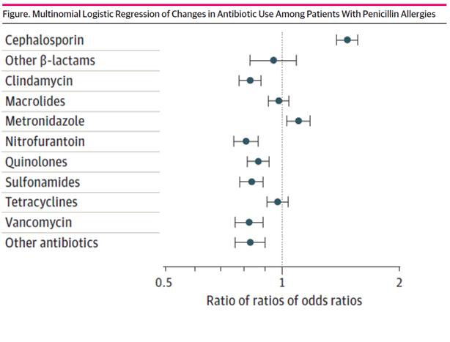
Removal of automated alert warning against cephalosporin use in patients with PCN allergy associated with increased use of cephalosporins
Methods
  Retrospective cohort of patients receiving antibiotics in inpatient or outpatient settings in 2 regions of a large integrated healthcare system in California between 2017-2018 during which an electronic health record alert warning against use of cephalosporins was removed
  Antibiotic dispensed or administered were assessed and the probability of an antibiotic course being a cephalosporin measured
Results
  Over 4 million patients and more than 10.5 million antibiotic courses
  Cephalosporins increased by 47% among patients with PCN allergy after removal of alert compared to patients without PCN allergy at the same site and those with PCN allergy at site where alert was retained.
  No differences in anaphylaxis, new allergies or treatment failures were identified
  No differences in all cause mortality, hospital LOS, new C diff, MRSA, or VRE
Macy E, McCormick TA, Adams JL, Crawford WW, Nguyen MT, Hoang L, Eng V, Davis AC, McGlynn EA. Association Between Removal of a Warning Against Cephalosporin Use in Patients With Penicillin Allergy and Antibiotic Prescribing. JAMA Netw Open. 2021 Apr 1;4(4):e218367. doi: 10.1001/jamanetworkopen.2021.8367. PMID: 33914051; PMCID: PMC8085727. Figure modified for presentation.

Slide 32

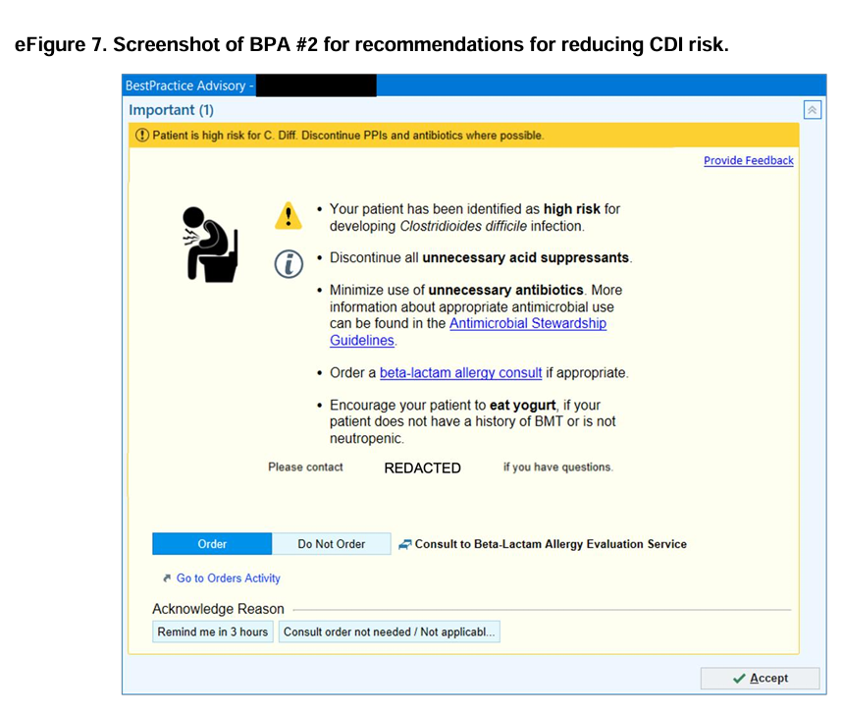
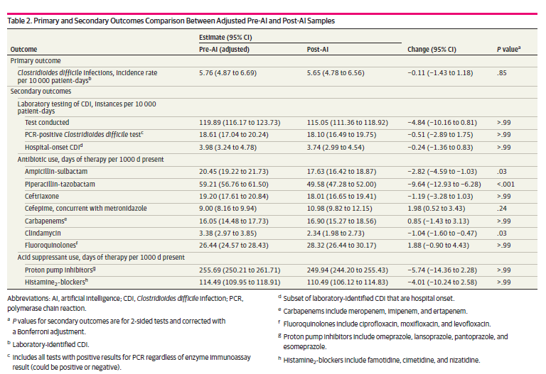
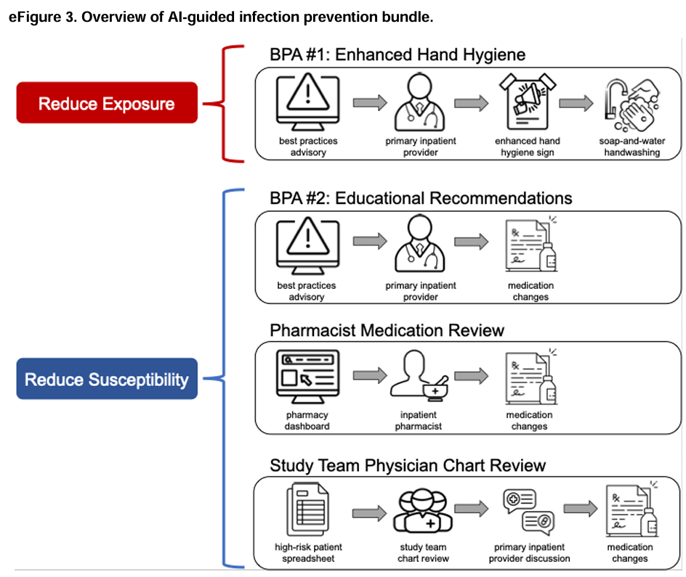
Integration of AI-generated risk score linked to allergy consult decreased antimicrobial use, but not C diff
Methods:
  Prospective single-center study between 2021-2023, assessing impact of implementation of previously validated model to predict risk of C diff infection was integrated into daily workflows
  Model score was used to guide interventions related to hand hygiene and antimicrobial stewardship (beta-lactam allergy consult, antimicrobial de-escalation, and yogurt recommendation)
  Outcomes included C diff incidence, antimicrobial use, and qualitative assessments of bundle implementation were reported
Results
  ~80,000 hospitalizations
  No significant difference in C diff incidence
  Greater than 10% reduction in pip-tazo and clindamycin
Tang S, Shepard S, Clark R, Ötles E, Udegbunam C, Tran J, Seiler M, Ortwine J, Waljee AK, Nagel J, Krein SL, Kurlander JE, Grant PJ, Baang J, Wasylyshyn A, Rao K, Wiens J. Guiding Clostridioides difficile Infection Prevention Efforts in a Hospital Setting With AI. JAMA Netw Open. 2025 Jun 2;8(6):e2515213. doi: 10.1001/jamanetworkopen.2025.15213. PMID: 40504526; PMCID: PMC12163649.

Slide 33
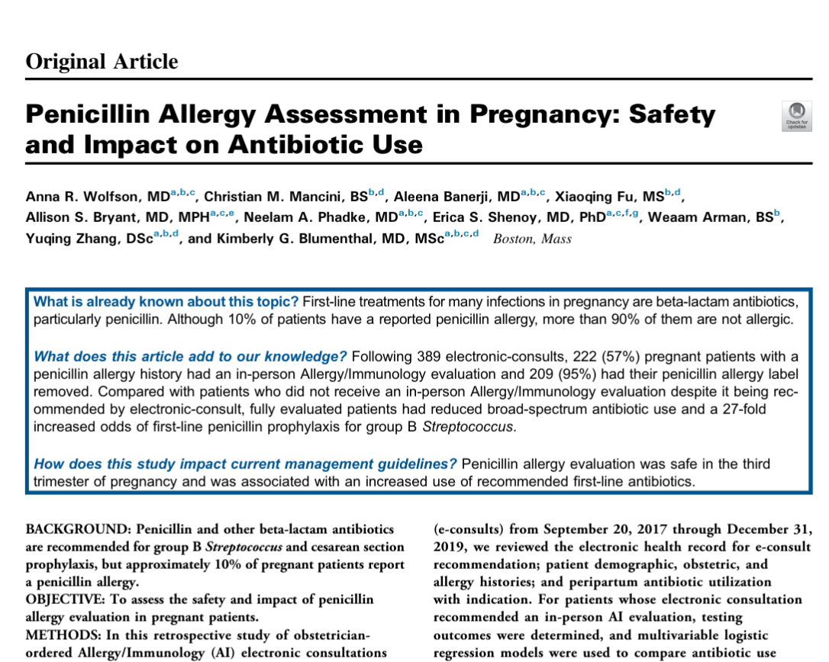
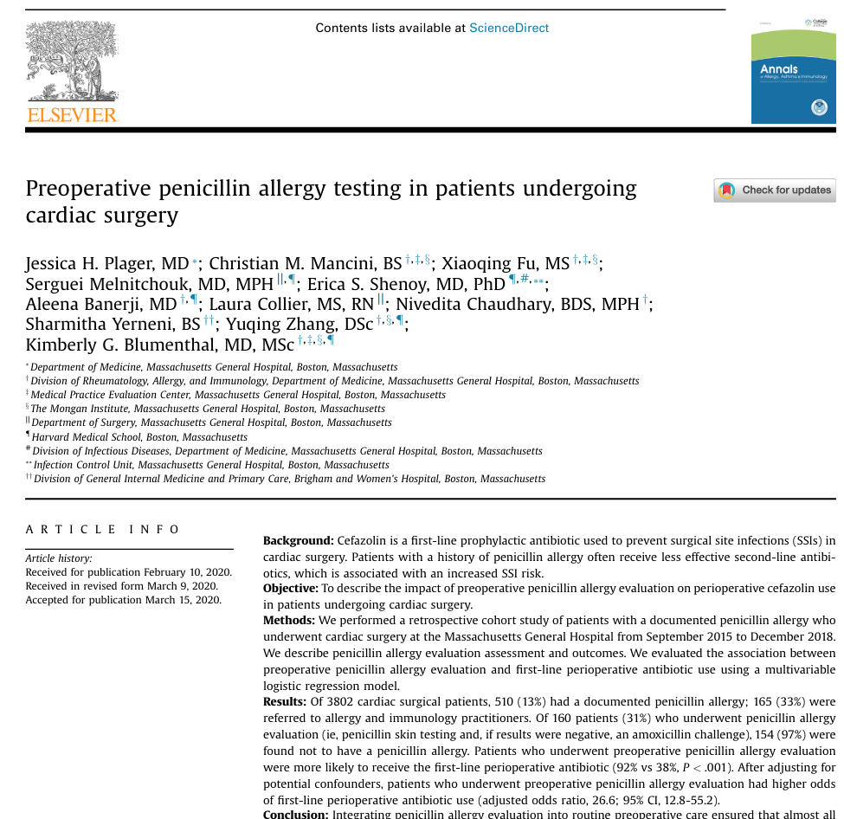
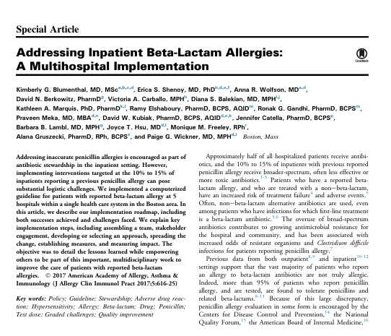
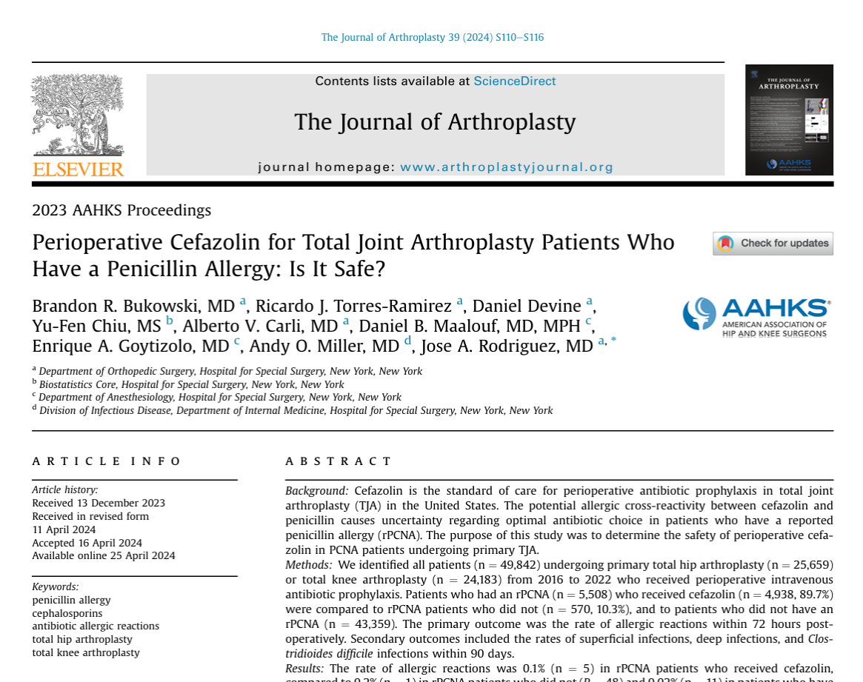
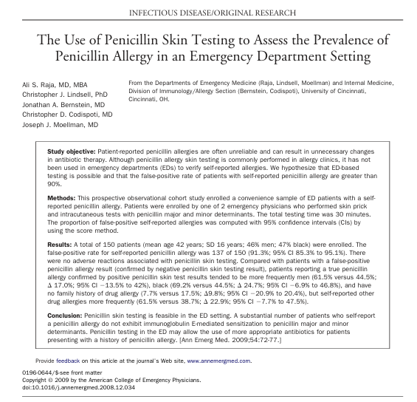
Many examples of implementation opportunities across the spectrum of care, patient populations, and role groups

Slide 34

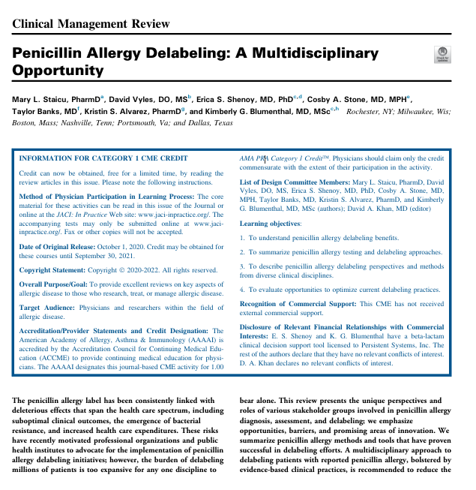
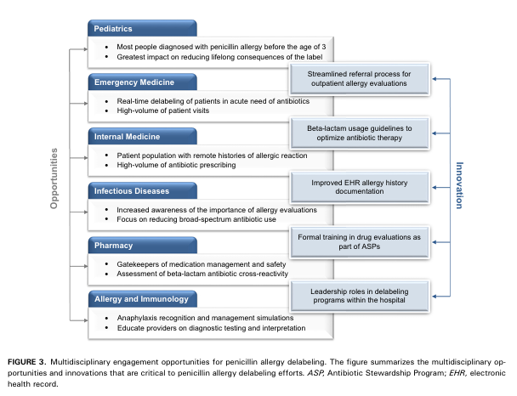
Whatever the method, collaboration and innovation are key
Staicu ML, Vyles D, Shenoy ES, Stone CA, Banks T, Alvarez KS, Blumenthal KG. Penicillin Allergy Delabeling: A Multidisciplinary Opportunity. J Allergy Clin Immunol Pract. 2020 Oct;8(9):2858-2868.e16. doi: 10.1016/j.jaip.2020.04.059. PMID: 33039010; PMCID: PMC8019188.

Slide 35
Summary

Slide 36
ß-lactam antibiotics are essential to safe patient care; when alternative agents are used…
Increased risk of prophylaxis failure
Increased risk of treatment failure
Exposure to broader spectrum antibiotics and increased risk of C diff and AMR
Preventable harm

Slide 37
Next steps
Collaboration across disciplines
Full integration of assessments into workflows across the healthcare continuum
More investigation on other factors linked to antibiotic allergy labels driving patient outcomes

Slide 38
Thank you.

