Slide 1

Penicillin Allergy Assessments Across Populations and Locations
Allison Ramsey, MD FAAAAI, FACAAI
PALM
September 28, 2026

Slide 2

Disclosures
Speaker’s bureau: Sanofi Regeneron, GSK, AstraZeneca, CSL Behring, Galderma, and Novartis
  Not relevant for our discussion

Slide 3
Overview
Pediatric Primary Care
Inpatient evaluations
ICU evaluations
Adult Primary Care
Outpatient Adult Evaluations
Immune Compromised
Pre-Operative
Pregnancy Evaluations

Slide 4

Penicillin Allergy
https://www.cdc.gov/antibiotic-use/community/pdfs/penicillin-factsheet.pdf

Slide 5




Why delabeling is important
Non-β-Lactam
Antibiotic Exposure
Untoward Effects
Clinical Outcomes
Expenditures
Healthcare Utilization
Resistant Infections
C.difficile Infection
Adverse Reactions
Clinical Failure
Surgical Site Infections
Increased Mortality
Direct and Indirect Antibiotic and Hospital Costs
Hospital Admissions and Readmissions
Outpatient visits
Slide courtesy of M. Staicu, PharmD
Sacco KA. Allergy. 2017;72:1288. Castells MC. NEJM. 2019;381:2338.

Slide 6
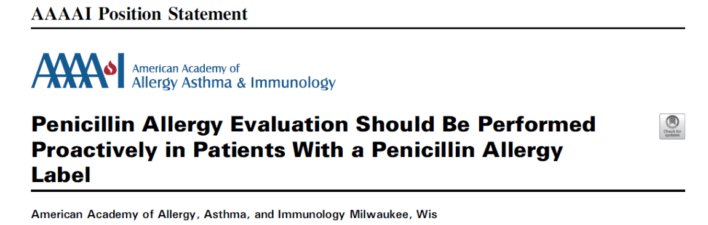

Slide 7
Inpatient Evaluations

Slide 8
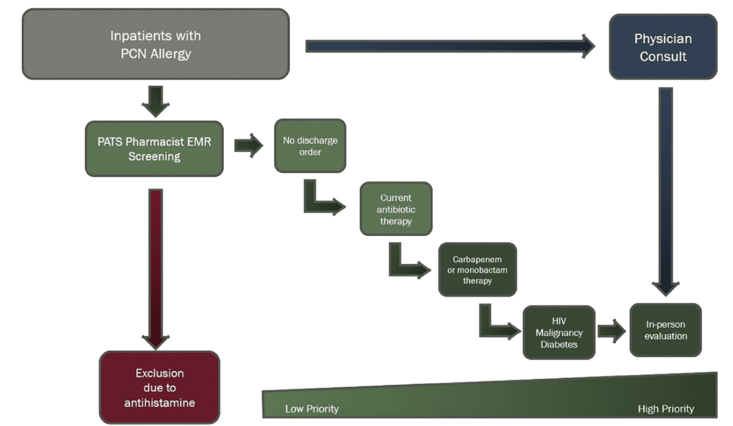
Inpatient Evaluations
J Allergy Clin Immunol Pract 2017;5:686-93

Slide 9
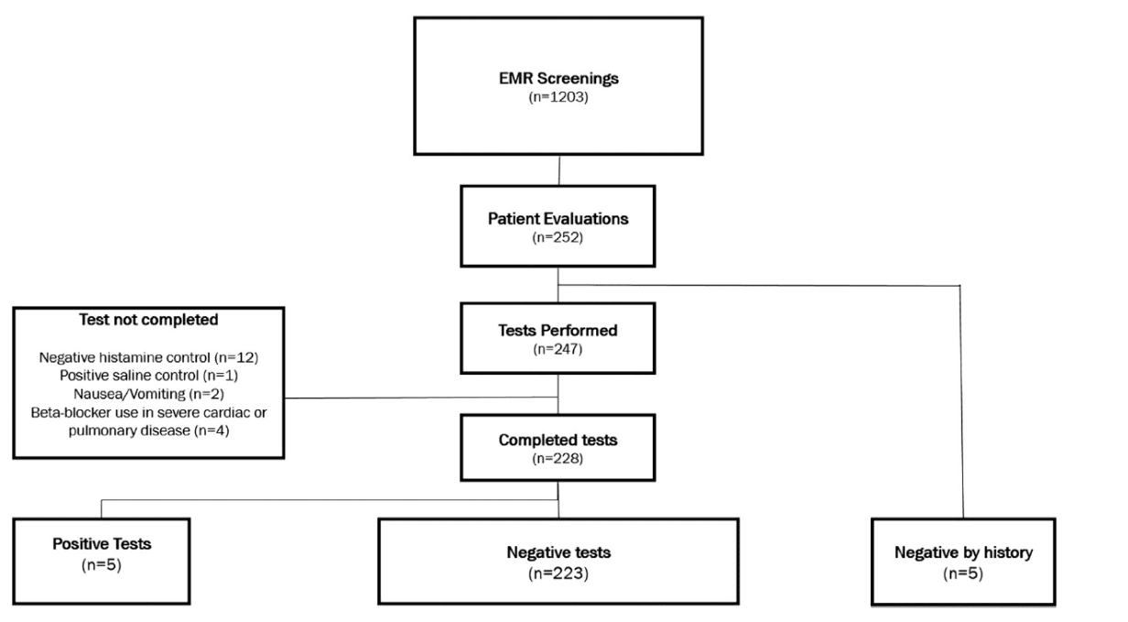
Inpatient Evaluations
J Allergy Clin Immunol Pract 2017;5:686-93

Slide 10
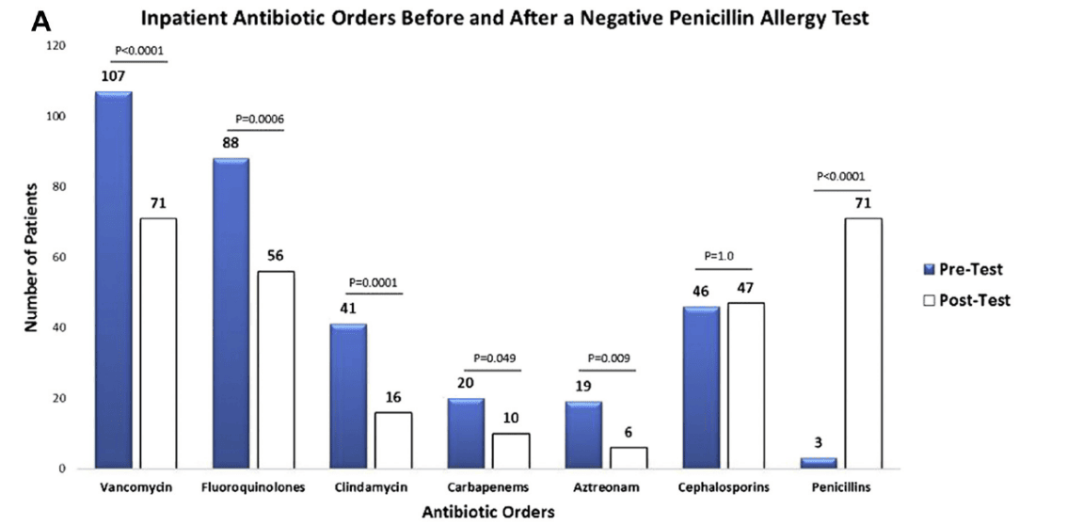
Inpatient Evaluations
J Allergy Clin Immunol Pract 2017;5:686-93

Slide 11
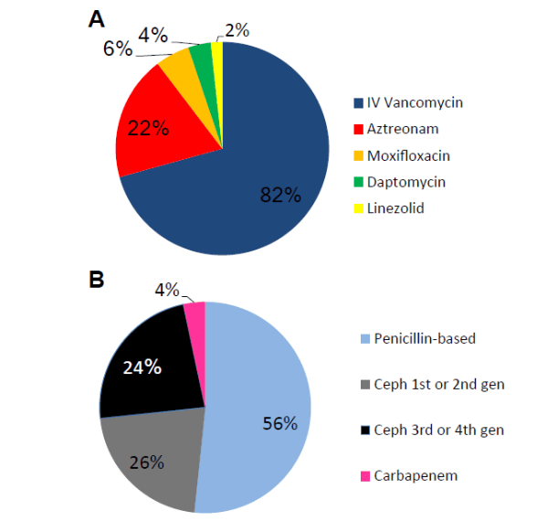
Inpatient Evaluations
Total number of pts | 50
Mean age, years (SD) | 66 (13)
Female n (%) | 27 (54)
Race n (%)
Caucasian | 42 (84)
Black | 3 (6)
Hispanic | 5 (10)
Historical Reaction, n (%)
Hives | 16 (32)
Angioedema | 15 (30)
Unknown | 6 (12)
Anaphylaxis | 6 (12)
Rash | 6 (12)
Shortness of breath | 1 (2)
J Allergy Clin Immunol Pract 2018;6:1349-55

Slide 12
Inpatient Evaluations
Days of Second Line Antibiotics Avoided
Targeted Antibiotic | Days Avoided
Aztreonam | 66
Daptomycin | 40
Moxifloxacin | 13
Vancomycin | 863
Total | 982
$3,500 direct cost savings (underestimate)
$56,000 savings in hospital days avoided
Ramsey and Staicu. J Allergy Clin Immunol Pract 2018;6:1349-55

Slide 13
Inpatient Evaluations – Direct Challenge
Patients, n | 52 | 48
Age (y), mean ± SD | 56.5 ± 16.3 | 65.2 ± 16.1
Sex: female, n (%) | 29 (55.8) | 34 (70.8)
White, n (%) | 42 (80.8) | 37 (77.1)
Black, n (%) | 5 (9.6) | 9 (18.8)
Hispanic, n (%) | 5 (9.6) | 2 (4.2)
Reaction history, n (%)
Hives and angioedema | 12 (23.1) | 0
Anaphylaxis | 10 (19.2) | 0
Angioedema | 7 (13.5) | 0
Rash | 6 (11.5) | 22 (45.8)
Hives | 5 (9.6) | 20 (41.7)
Unknown | 5 (9.6) | 4 (8.3)
Dyspnea | 4 (7.7) | 0
Itching | 2 (3.8) | 2 (4.2)
History of +PST | 1 (1.9) | 0
J Allergy Clin Immunol Pract 2020;8:2294-301

Slide 14
Inpatient Evaluations: Results
PCN allergy evaluation results | PST (followed by challenge) | DC (without skin testing)
Patients, n | 52 | 48
Positive PST result, n (%) | 6 (11.5) | NA
Negative PST result, n (%) | 44 (84.6) | NA
Blocked histamine/TND, n (%) | 2 (3.8) | NA
DC Fail immediate, n (%) | NA | 1 (2.1)
DC Fail delayed, n (%) | NA | 2 (4.2)
DC Pass, n (%) | NA | 45 (93.8)
J Allergy Clin Immunol Pract 2020;8:2294-301

Slide 15
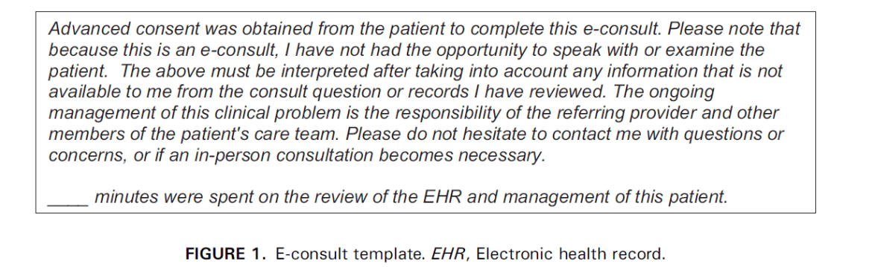
E-Consult Inpatient Evaluations
Demographics | E-consult | In-person consult
Patients, n (%) | 78 (72) | 31 (28)
Age (y) | 61 (range, 47–73) | 67 (range, 52–76)
Female, n (%) | 51 (65) | 17 (54)
Primary service, n (%)
Internal medicine | 58 (74) | 27 (87)
Surgery | 12 (15) | 2 (7)
Emergency medicine | 4 (5) | 1 (3)
Obstetrics and gynecology | 4 (5) | 1 (3)
Indication for consult, n (%)
Penicillin allergy | 53 (68) | 20 (64)
Nonpenicillin drug allergy | 12 (16) | 3 (12)
Anaphylaxis | 3 (4) | 0
IV contrast allergy | 2 (3) | 2 (6)
Urticaria | 3 (4) | 0
Stevens Johnson syndrome | 0 | 2 (6)
Eosinophilia | 0 | 2 (6)
Rash | 1 (1) | 1 (3)
Immunodeficiency | 1 (1) | 1 (3)
Asthma | 1 (1) | 0
Angioedema | 1 (1) | 0
Oral ulcers | 1 (1) | 0

Slide 16
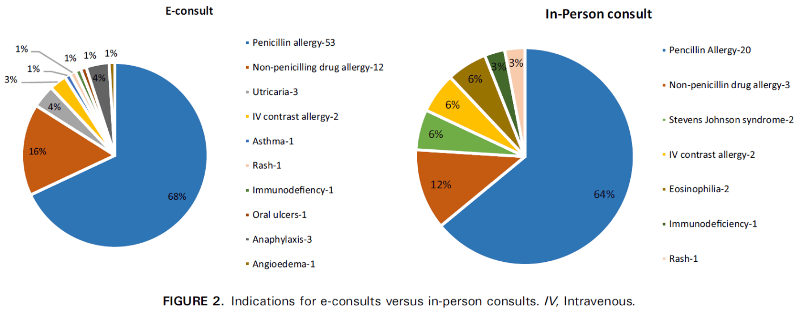
Inpatient e-consult vs in-person consult

Slide 17
Comparing e-consults to in-person consults
Variable | E-consult (n = 78) | In-person consult (n = 31) | P value
Age (y) | 61 (47–73) | 67 (52–76) | .479
Female, n (%) | 51 (65) | 17 (54) | .209
Time taken to complete* (min) | 15 (10–15) | 60 (45–60) | <.001
Turnaround time† (h) | 1 (0.5–2) | 7 (3–19) | <.001
Recommendations followed, n (%) | 69 (88) | 30 (96) | .162
Work relative value units | 0.7 (0.4–0.7) | 2.6 (1.9–3.8) | <.001
Physician reimbursement ($) | 42.05 (21.2–42) | 221.18 (163.4–327.4) | <.001

Slide 18
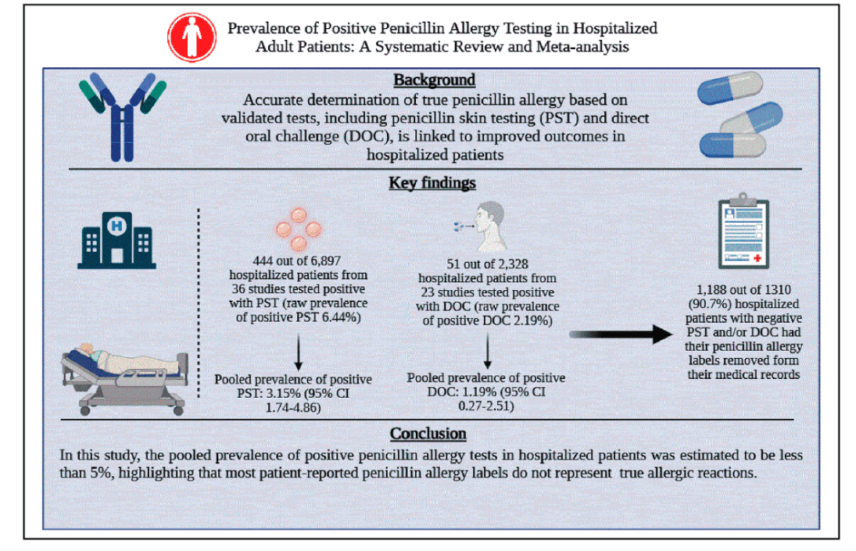
Inpatient Population Systematic Review / Meta-analysis
J Allergy Clin Immunol Pract 2025;13:2728-44

Slide 19
ICU Evaluations
Demographics | n= 135
Age, years, median (IQR) | 68 (59.5, 78)
Female n (%) | 73 (54)
Reaction Characteristics
Rash/Hives/Itching | 85 (63)
Anaphylaxis | 3 (2)
Angioedema | 3 (2)
Respiratory symptoms | 6 (5)
Other | 14 (10)
Unknown | 24 (18)
Intubation, n (%) | 60 (44)
Pressors | 47 (35)
Systemic Steroids | 50 (37)
Antihistamines | 26 (19)
117 (87%) challenges completed
114 (97%) challenges passed
39 (29%) deceased at 2 week follow up
Ann Allergy Asthma Immunol. 2026. Epub ahead of print

Slide 20
Outpatient Evaluations

Slide 21
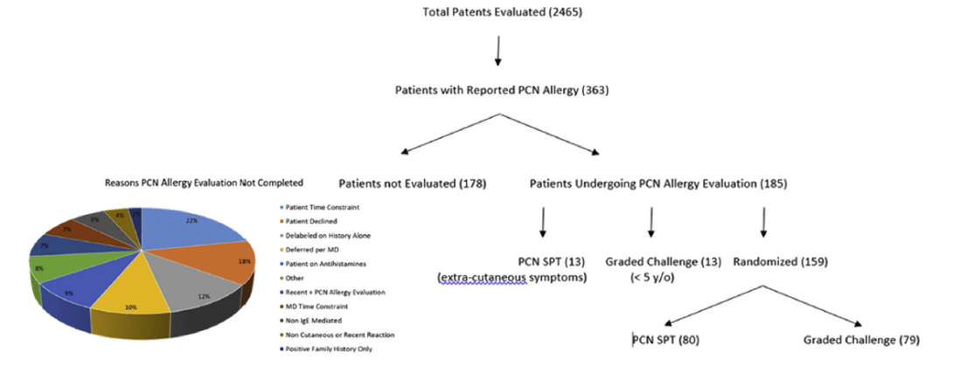
Outpatient Evaluations
J Allergy Clin Immunol Pract 2019;7:2163-70

Slide 22
Outpatient Evaluations
Outcome | Penicillin SPT | DC | Difference
Patients | 80 | 79 | —
PST Positive/DC fail, n (%) | 10 (12.5) | 3 (3.8) | 8.7% (P = .079)
PST Negative/DC pass | 70 (87.5) | 76 (96.2) | —
Time (min)
Mean ± SD | 72.7 ± 5.3 | 66.7 ± 4.8 | 6.0 (P < .001)
Median (IQR) | 73.5 (68.8–75.3) | 66.0 (62–70) | 7.5 (P < .001)
Cost
Each | $393.66 | $53.66 | $340.00
Total | $29,092.80 | $4,239.14 | $24,853.66
J Allergy Clin Immunol Pract 2019;7:2163-70

Slide 23
Outpatient Evaluations: PEN-FAST
Multicenter, prospective cohort
  Internal validation cohort: 622 patients
  External validation cohort: 945 patients
Features associated with positive penicillin skin test results = PEN-FAST
Negative predictive value
  96.3% (95% CI, 94.1% - 97.8%)
Only validated and supported in patients ≥16 years of age
PEN-FAST Calculator
PEN
Penicillin allergy reported
If yes, proceed
F
Five years or less since reaction
2 Points
A
Anaphylaxis or angioedema, OR
2 Points
S
Severe cutaneous adverse reactions
T
Treatment required for reactions
1 point
Total Points | Risk of Positive Penicillin Allergy Test
0 | Very low risk (<1%)
1-2 | Low risk (5%)
3 | Moderate risk (20%)
4-5 | High risk (50%)
Trubiano JA. JAMA Intern Med 2020;180:745.
Slide courtesy of M. Staicu, PharmD

Slide 24
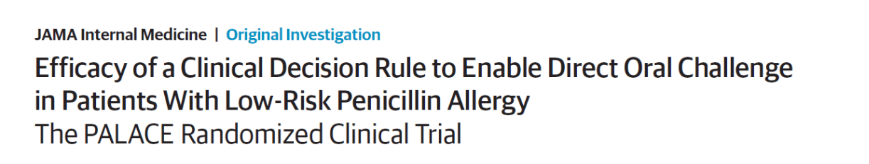
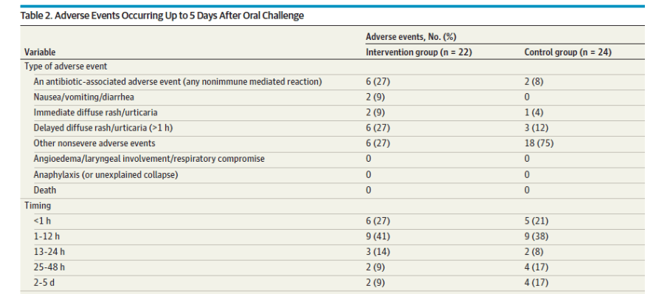
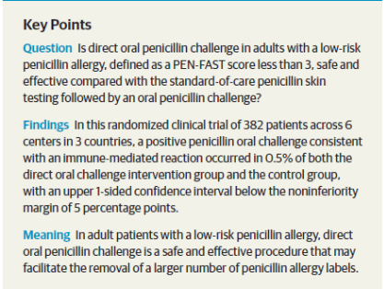
JAMA Intern Med. 2023 Sep 1;183(9):944-952.

Slide 25
Pediatrics

Slide 26



Penicillin Allergy Acquired
in Childhood
Individual Health Impact
Public Health Impact
Costs
Decreased cure/increased recurrence
Adverse effects from second line antibiotics
Mortality
Antimicrobial resistance
Clostridiodes difficile
Length of stay
Cost of hospitalization
J Allergy Clin Immunol. 2022 Dec;150(6):1333-1393

Slide 27
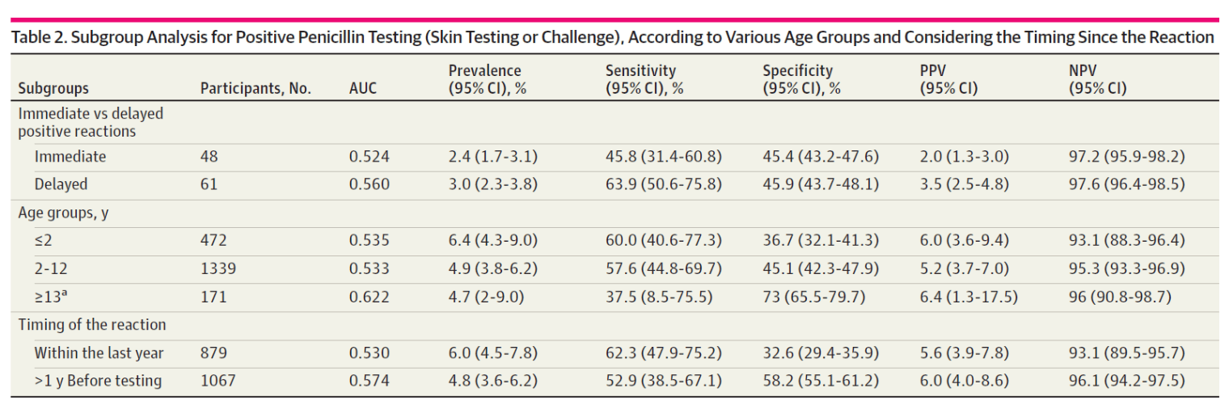
Pediatrics: PEN-FAST Doesn’t Work!
Poor predictive values in 2028 children
JAMA Network Open. 2022;5(9):e2233703.

Slide 28
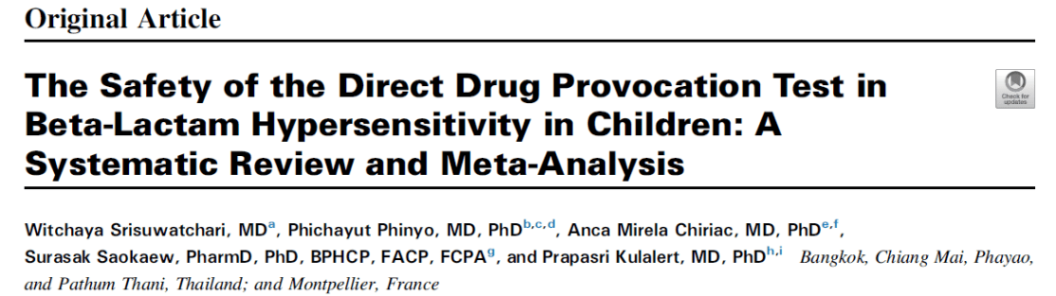
Pediatric Beta-lactam Challenge Meta-Analysis
8334 patients total, 28 studies
Type of reaction | % Reaction | Severe Reaction
Non-immediate | 5.23% | 2 (1 SSLR, 1 DILI)
Immediate | 0.08% | 1 (anaphylaxis)
***Severe reaction risk = 0.0004%***
J Allergy Clin Immunol Pract 2023;11:506-18

Slide 29
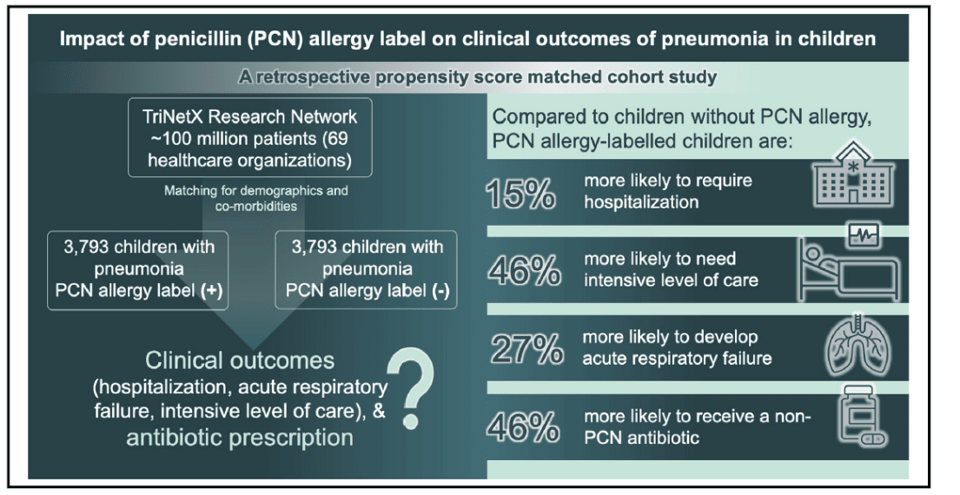
Pediatric Outcomes Data
J Allergy Clin Immunol Pract 2023;11:1899-906

Slide 30
Pediatric Challenges to Penicillin / Amoxicillin
We recommend against penicillin skin testing prior to direct amoxicillin challenge in pediatric patients with a history of benign cutaneous reaction (such as MDE and urticaria)
J Allergy Clin Immunol. 2022 Dec;150(6):1333-1393

Slide 31
Pregnancy

Slide 32
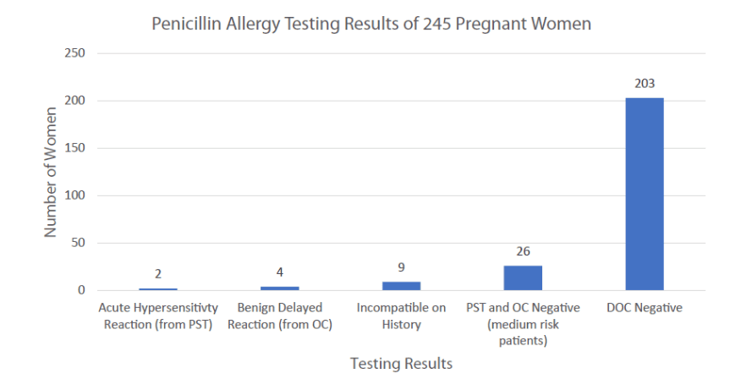
Direct Challenges in Pregnancy
Mak et al. J Allergy Clin Immunol Pract. 2022 Jul;10(7):1919-1921.e1

Slide 33
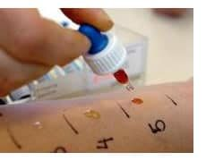
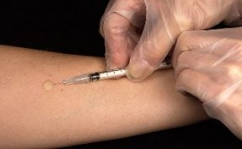
Obstetric Population
Graded Challenge
40 mg
amox
30 min
400 mg
Amox
30 min
DONE
Outcome | PST (n=73) | DC (n=71) | Difference | P
PST positive/DC fail | 5 (6.8) | 0 | 6.8%
PST negative/DC pass | 68 (93.8) | 70 (100) | -6.8% | 0.058
Time (median, IQR) | 75 (70-80) | 65 (65-70) | 5 | <0.0001
vs
15 min
400 mg
Amox
15 min
Penicillin Skin Testing
J Allergy Clin Immunol Pract. 2025. 13(9): 2405-2410

Slide 34
Telemedicine and Pregnancy
Remote obstetric office refers to A/I
Telemedicine visit by A/I for drug allergy history
Obstetric team conducts challenge at home office
A/I team available for support, follow up
A/I recommends challenge versus avoidance
*Process started summer 2024

Slide 35
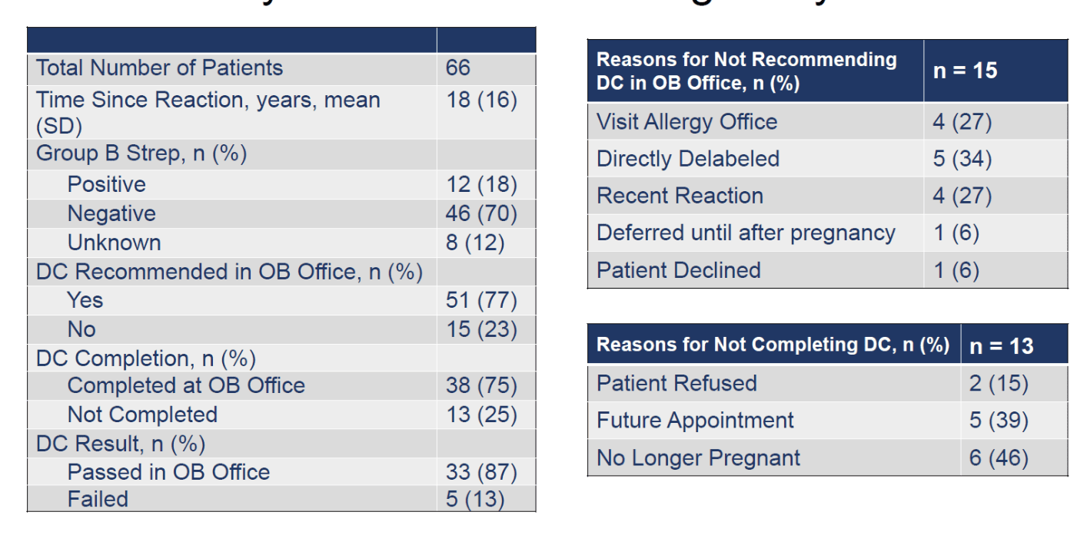
Preliminary Telemedicine in Pregnancy Results
Ramsey et al. Unpublished Data
Slide credit: Kylie Mariano
Notes:
Failed challenge reasons
Itching, rash
Chest pain
Fatigue, arm and leg numbness
Nausea and vomiting
Facial erythema and nausea

Slide 36
Immunocompromised Patients

Slide 37
Immunocompromised Patients
444 pts
156 oncologic malignancy 7 Stem cell transplant
26 solid organ transplant 84 other
Type of reaction
100 intermediate
Testing
185 spt + oral challenge
118 autoimmune disease 6 chronic prednisone
67 hematologic malignancy 6 HIV
200 delayed 60% PEN FAST <3
262 unknown
6 patch test + spt + oral challenge
253 direct oral challenge
Results
97.4% of patients remained delabled at median of 3.9 years
175 (~40%) of patients used penicillin based antibiotic after evaluation
5 with convincing reaction post delabeling
Rose et al. 2024. JACI IP. Epub ahead of print.

Slide 38
Primary Care Evaluations

Slide 39
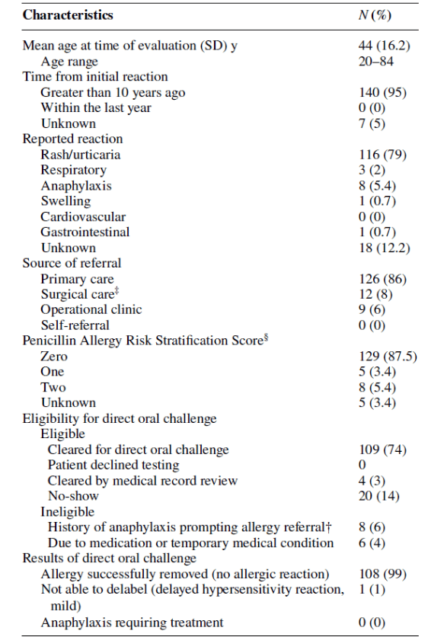
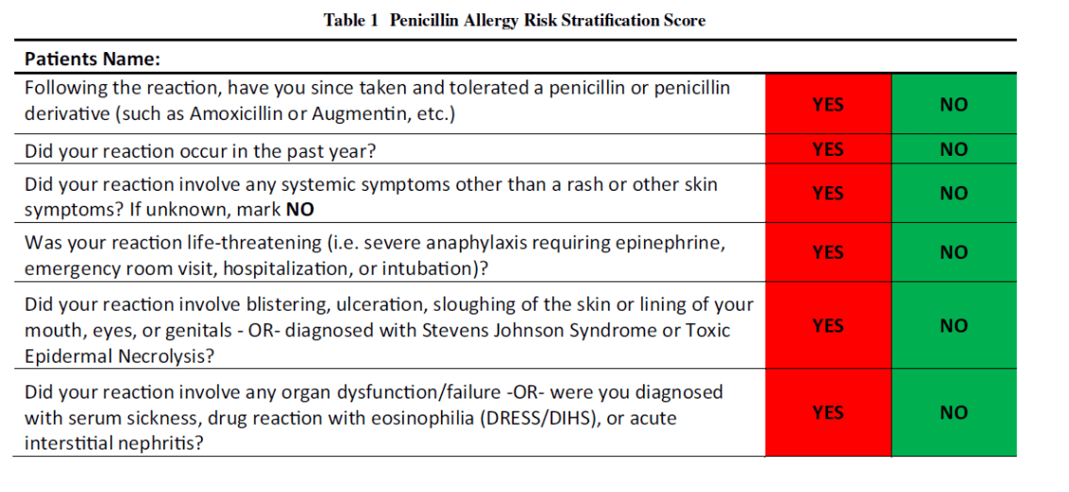
Adult Primary Care Challenges
J Gen Intern Med. 2023. 38(16):3651-3.

Slide 40
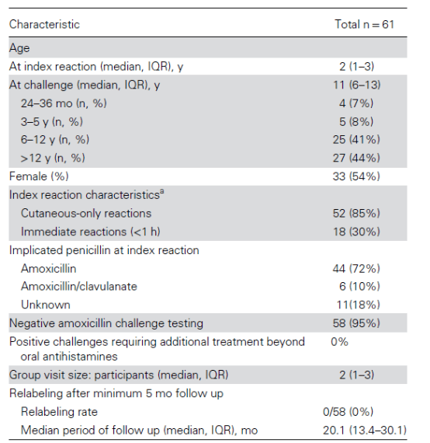
Pediatric Primary Care Challenges
Open Forum Infect Dis.
2025 Apr 24;12(5):ofaf236

Slide 41
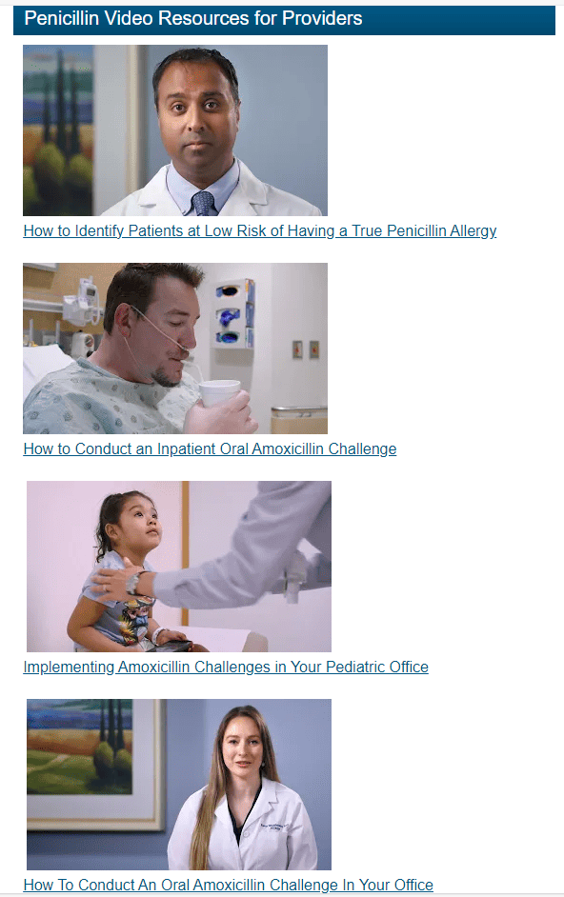
AAAAI penicillin allergy videos
  2 patient videos
  Healthcare professional videos
  https://education.aaaai.org/penicillin-allergy-center/penicillin

Slide 42
Preoperative Evaluations

Slide 43
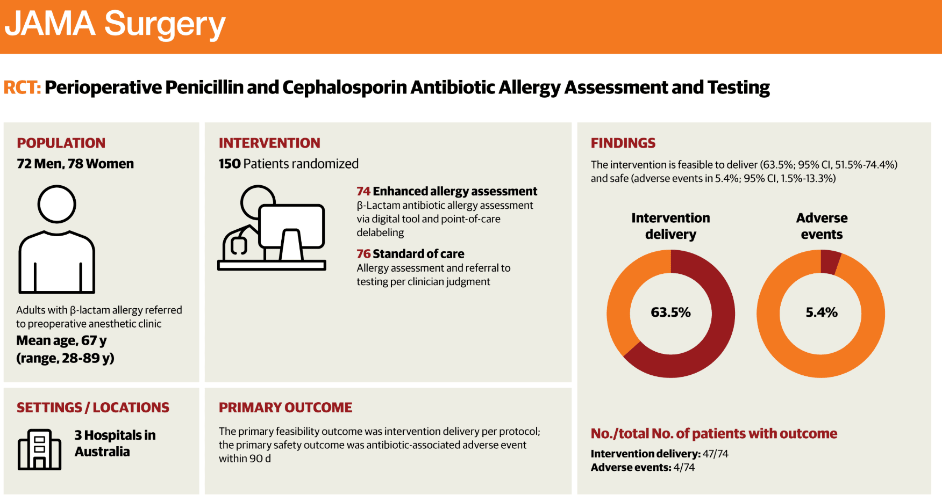
Preoperative Evaluations
JAMA Surg. 2025 May 1;160(5):518-525

Slide 44
Using cefazolin in penicillin allergic patient
History of penicillin allergy
Can use cefazolin,
even with a history of anaphylaxis to penicillin
Cefazolin has a unique side chain with very low cross-reactivity with penicillins
No testing needed
J Allergy Clin Immunol. 2022 Dec;150(6):1333-1393.

Slide 45
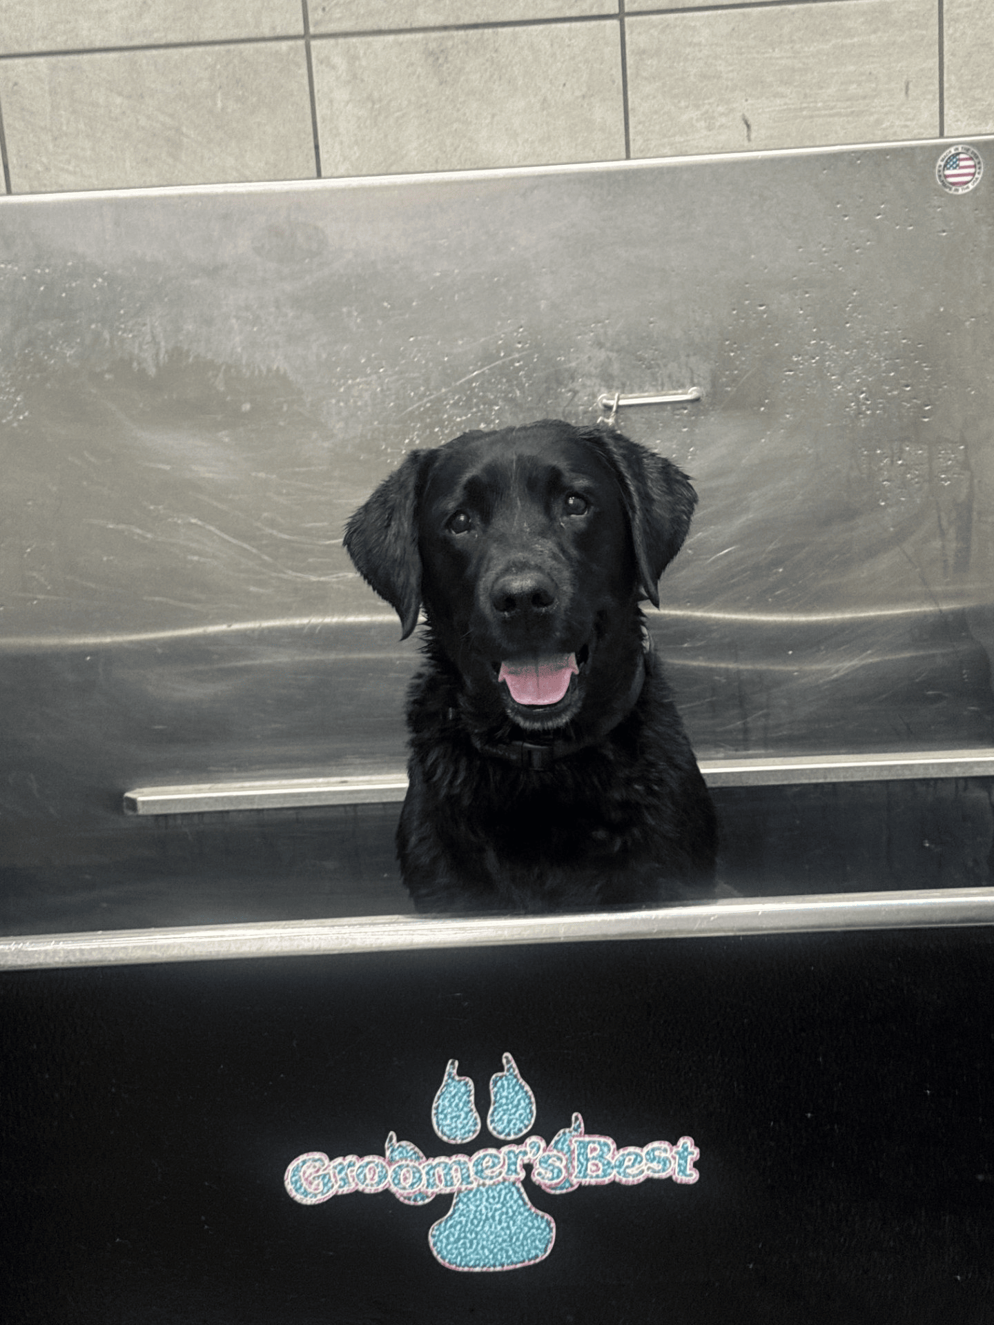


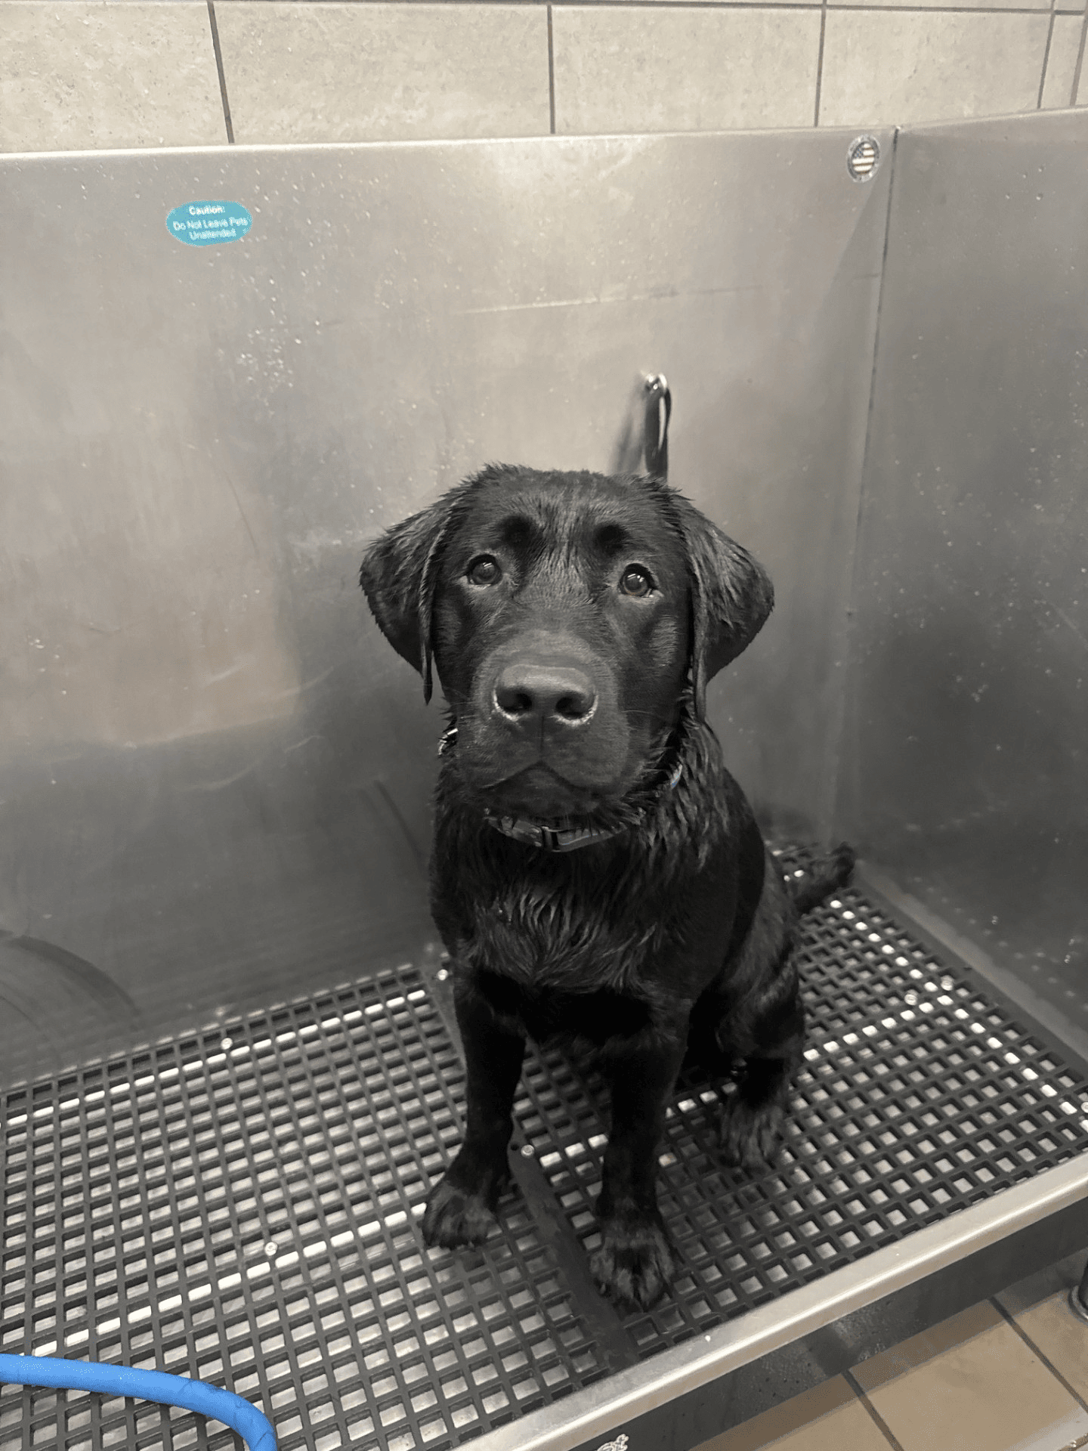
Thank you!
allison.ramsey@rochesterregional.org

